Slide 1

Chapter 5
Analytic Trigonometry
5.5 Trigonometric Equations

Slide 2
Objectives
Find all solutions of a trigonometric equation.
Solve equations with multiple angles.
Solve trigonometric equations quadratic in form.
Use factoring to separate different functions in trigonometric equations.
Use identities to solve trigonometric equations.
Use a calculator to solve trigonometric equations.
Solve equations with trigonometric and exponential or logarithmic functions.

Slide 3
Trigonometric Equations and Their Solutions
A trigonometric equation is an equation that contains a trigonometric expression with a variable, such as sin x.
The values that satisfy such an equation are its solutions. (There are trigonometric equations that have no solution.)
When an equation includes multiple angles, the period of the function plays an important role in ensuring that we do not leave out any solutions.

Slide 4
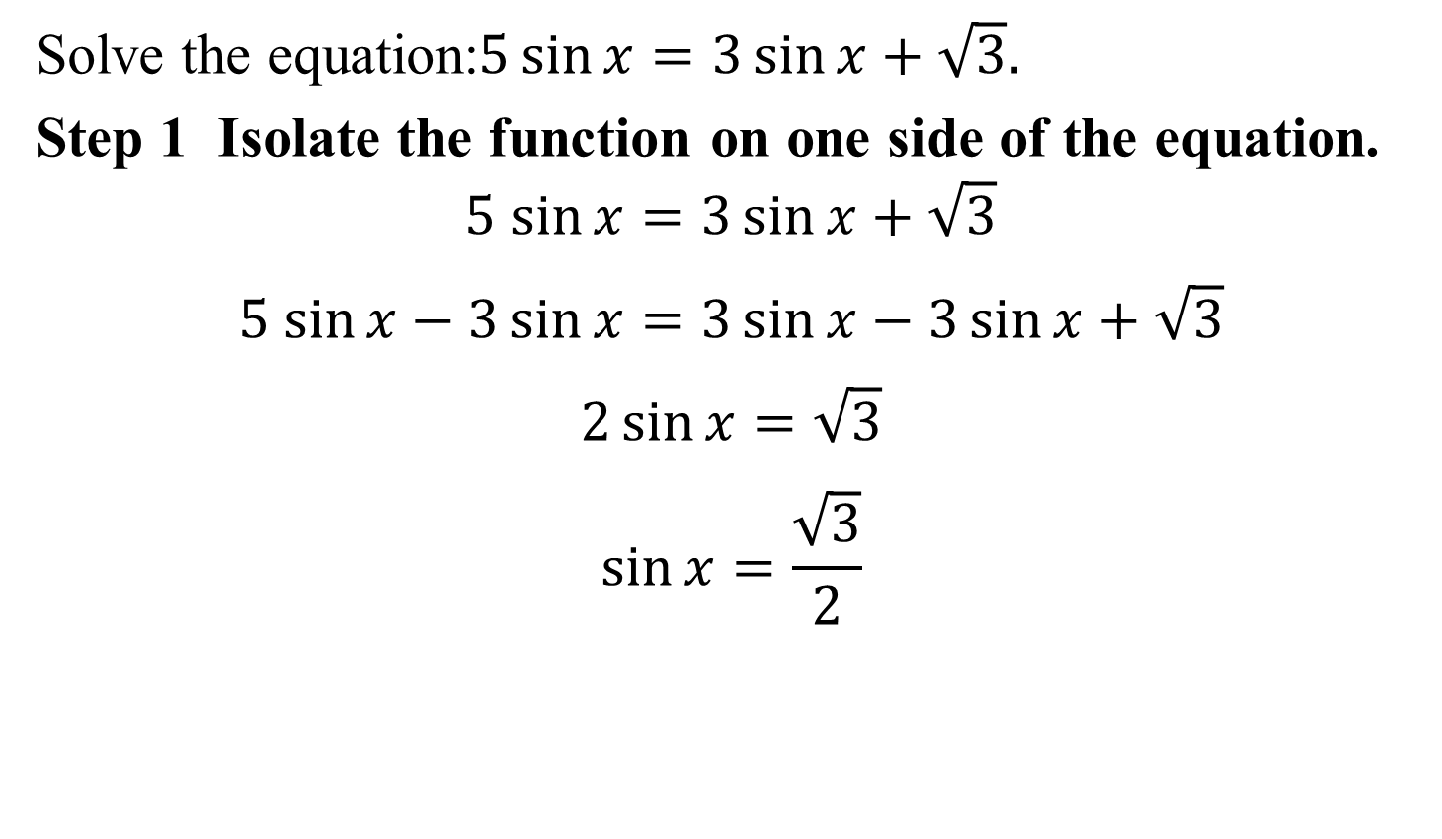
Example 1: Finding all Solutions of a Trigonometric Equation
Solve the equation:$5\sin{x=3\sin{x+\sqrt{3}.}}$
Step 1 Isolate the function on one side of the equation.
$$5 sin{x=3\sin{x+\sqrt{3}}}$$
$$5 sin{x−3\sin{x}=3\sin{x−3\sin{x}+\sqrt{3}}}$$
$$2\sin{x}=\sqrt{3}$$
$$\sin{x}=\frac{\sqrt{3}}{2}$$

Slide 5
Example 1: Finding all Solutions of a Trigonometric Equation (continued)
Step 2 Solve for the variable.
$$\sin{x}=\frac{\sqrt{3}}{2}$$
Solutions for this equation in $[0, 2π)$ are: $\frac{π}{3},\frac{2π}{3}.$
The solutions for this equation are:
$$\frac{π}{3}+2nπ,\frac{2π}{3}+2nπ$$

Slide 6
Example 2: Solving an Equation with a Multiple Angle
Solve the equation: $\tan{2x=\sqrt{3}}, 0≤x<2π.$
Because the period is π all solutions for this equation are given by
$$tan\frac{π}{3}=\sqrt{3}$$
$$x=\frac{π}{6}+\frac{0π}{2}=\frac{π}{6}$$
$$2x=\frac{π}{3}+nπ$$
$$n=0$$
$$x=\frac{π}{6}+\frac{nπ}{2}$$
$$n=1$$
$$x=\frac{π}{6}+\frac{π}{2}=\frac{π}{6}+\frac{3π}{6}=\frac{4π}{6}=\frac{2π}{3}$$

Slide 7
Example 2: Solving an Equation with a Multiple Angle
(continued)
n = 2
n = 3
In the interval $[0, 2π)$ the solutions are: $\frac{π}{6},\frac{2π}{3}, \frac{7π}{6} and \frac{5π}{3}.$
$$x=\frac{π}{6}+\frac{2π}{2}=\frac{π}{6}+\frac{6π}{6}=\frac{7π}{6}$$
$$x=\frac{π}{6}+\frac{3π}{2}=\frac{π}{6}+\frac{9π}{6}=\frac{10π}{6}=\frac{5π}{3}$$

Slide 8
Example 5: Solving a Trigonometric Equation Quadratic in Form
Solve the equation: $4\cos^{2}x−3=0, 0≤x<2π.$
$$4\cos^{2}x−3=0$$
$$4\cos^{2}x= 3$$
$$\cos^{2}x=\frac{3}{4}$$
$$\cos{x=±\sqrt{\frac{3}{4}}}=±\frac{\sqrt{3}}{2}$$
The solutions in the interval $\left[0, 2π\right)$are: $\frac{π}{6},\frac{5π}{6}, \frac{7π}{6} and \frac{11π}{6}.$

Slide 9
Example 6: Using Factoring to Separate Different Functions
Solve the equation: $\sin{x}\tan{x}=\sin{x},0≤x<2π.$
$$\sin{x}\tan{x}=\sin{x}$$
$$\sin{x}\tan{x}−\sin{x}=0$$
$$\sin{x}(tan{x}−1)=0$$
The solutions in the interval $\left[0, 2π\right)$are: 0, $\frac{π}{4},π, and \frac{5π}{4}.$
$$tanx−1=0$$
$$sinx=0$$
$$tanx=1$$
$$x=0, x=π$$
$$x=\frac{π}{4}, \frac{5π}{4}$$

Slide 10
Example 8: Using an Identity to Solve a Trigonometric Equation
Solve the equation: $\cos{2x+\sin{x=0, 0≤x<2π. }}$
$$\cos{2x+\sin{x=0 }}$$
$$1−2\sin^{2}x+sinx=0$$
$$2\sin^{2}x−sinx−1=0$$
$$\left(2sinx+1)(sinx−1)=0\right.$$
$$2sinx+1=0$$
$$sinx−1=0$$
$$2sinx=−1$$
$$sinx=1$$
$$sinx=−\frac{1}{2}$$
$$x=\frac{π}{2}$$
$x=\frac{7π}{6}, \frac{11π}{6}$

Slide 11
Example 11a: Solving Trigonometric Equations with a Calculator
Solve the equation tan x = 3.1044 correct to four decimal places, for $0≤x<2π$.
tan x is positive in quadrants I and III
In quadrant I; x ≈ 1.2592
In quadrant III; x ≈ π + 1.2592 about 4.4008
The solutions for this equation are 1.2592 and 4.4008.
$$\left.x=\tan^{−1}(3.1044\right)$$
$$x≈1.2592$$

Slide 12
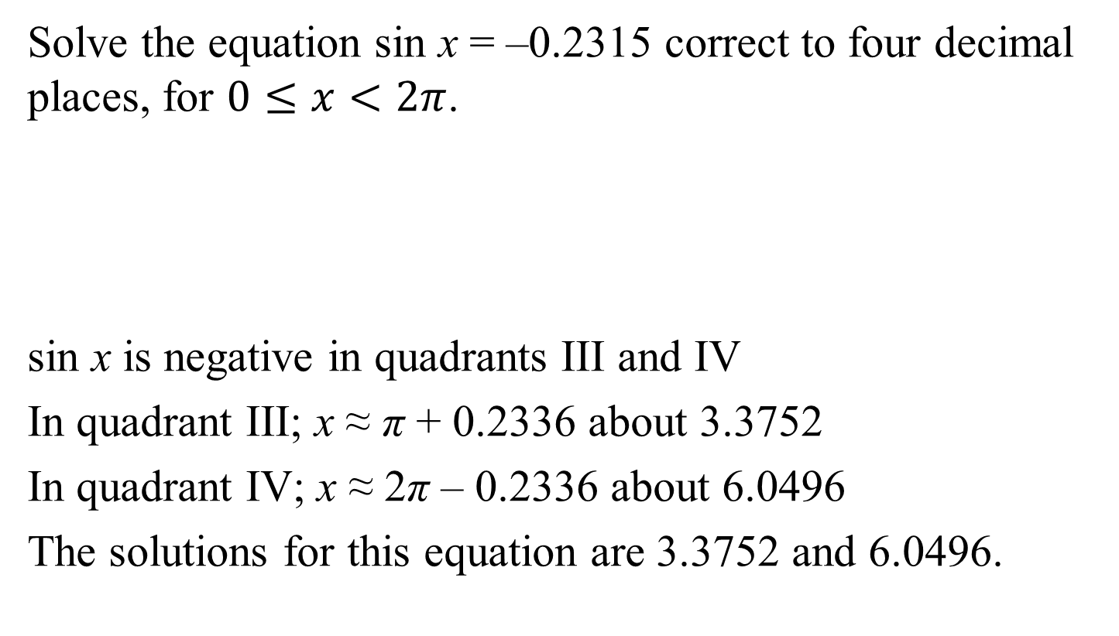

Example 11b: Solving Trigonometric Equations with a Calculator
Solve the equation sin x = –0.2315 correct to four decimal places, for $0≤x<2π$.
sin x is negative in quadrants III and IV
In quadrant III; x ≈ π + 0.2336 about 3.3752
In quadrant IV; x ≈ 2π – 0.2336 about 6.0496
The solutions for this equation are 3.3752 and 6.0496.
$$\left.x=\sin^{−1}(−0.2315\right)$$
$$x≈−0.2336$$

Slide 13
Example 13a: Solving Equations with Both Trigonometric and Exponential or Logarithmic Functions
Solve the equation for $0≤x<2π$. If exact solutions are not possible, express the solutions correct to four decimal places.
$$e^{\sin{x}}=1$$
$${lne}^{\sin{x}}=ln 1$$
$$\sin{x}=0$$
$$x=0, x=π$$

Slide 14
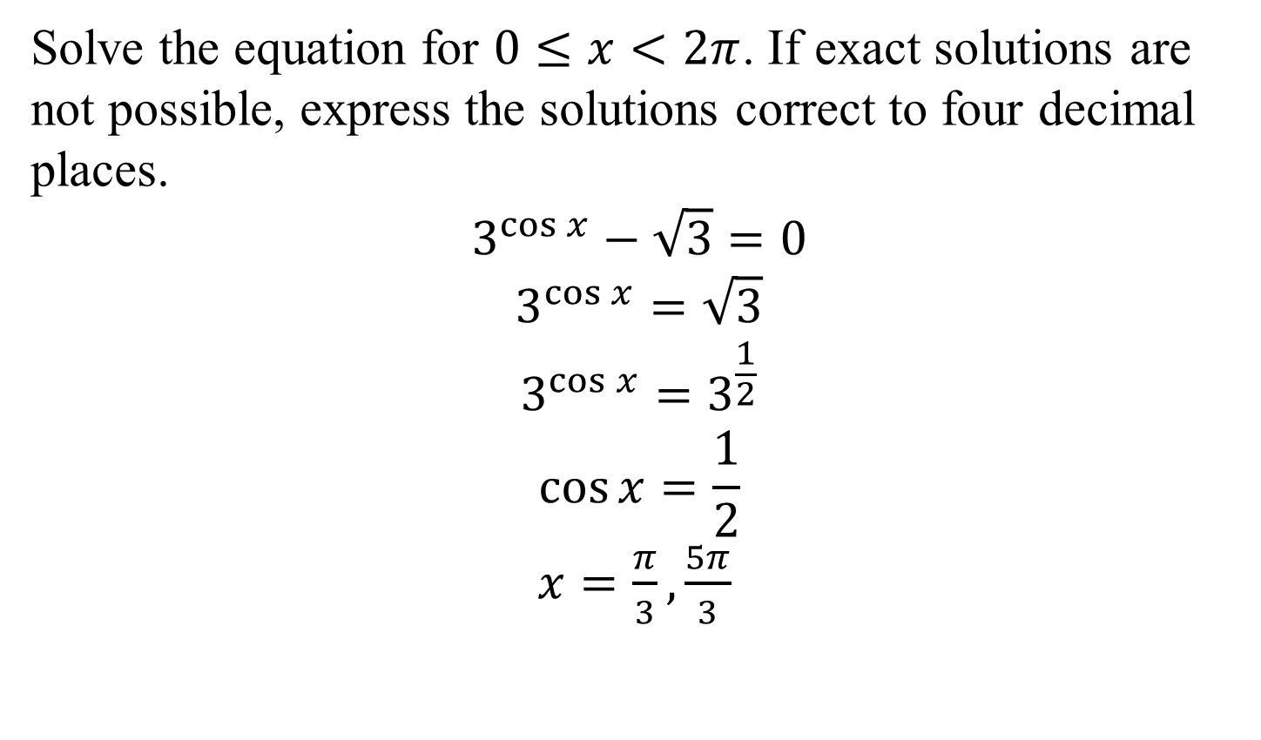
Example 13c: Solving Equations with Both Trigonometric and Exponential or Logarithmic Functions
Solve the equation for $0≤x<2π$. If exact solutions are not possible, express the solutions correct to four decimal places.
$$3^{\cos{x}}−\sqrt{3}=0$$
$$3^{\cos{x}}=\sqrt{3}$$
$$3^{\cos{x}}=3^{\frac{1}{2}}$$
$$\cos{x=\frac{1}{2}}$$
$x=\frac{π}{3}, \frac{5π}{3}$

