Slide 1

Chapter 5
Analytic Trigonometry
5.2 Sum and Difference Formulas

Slide 2
Objectives
Use the formula for the cosine of the difference of two angles.
Use sum and difference formulas for cosines and sines.
Use sum and difference formulas for tangents.

Slide 3
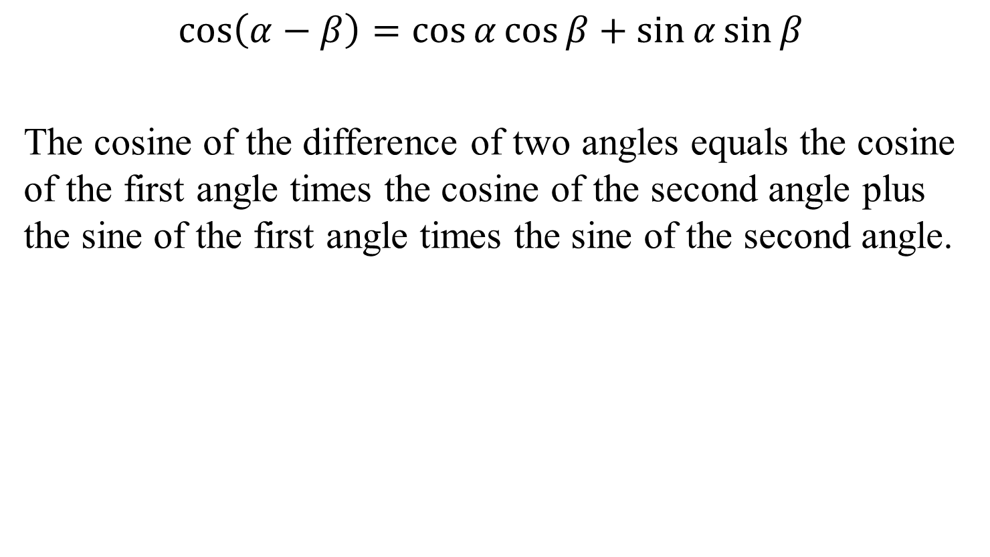
The Cosine of the Difference of Two Angles
$$\cos\left(α−β\right)=\cos{α}\cos{β}+\sin{α}\sin{β}$$
The cosine of the difference of two angles equals the cosine of the first angle times the cosine of the second angle plus the sine of the first angle times the sine of the second angle.

Slide 4
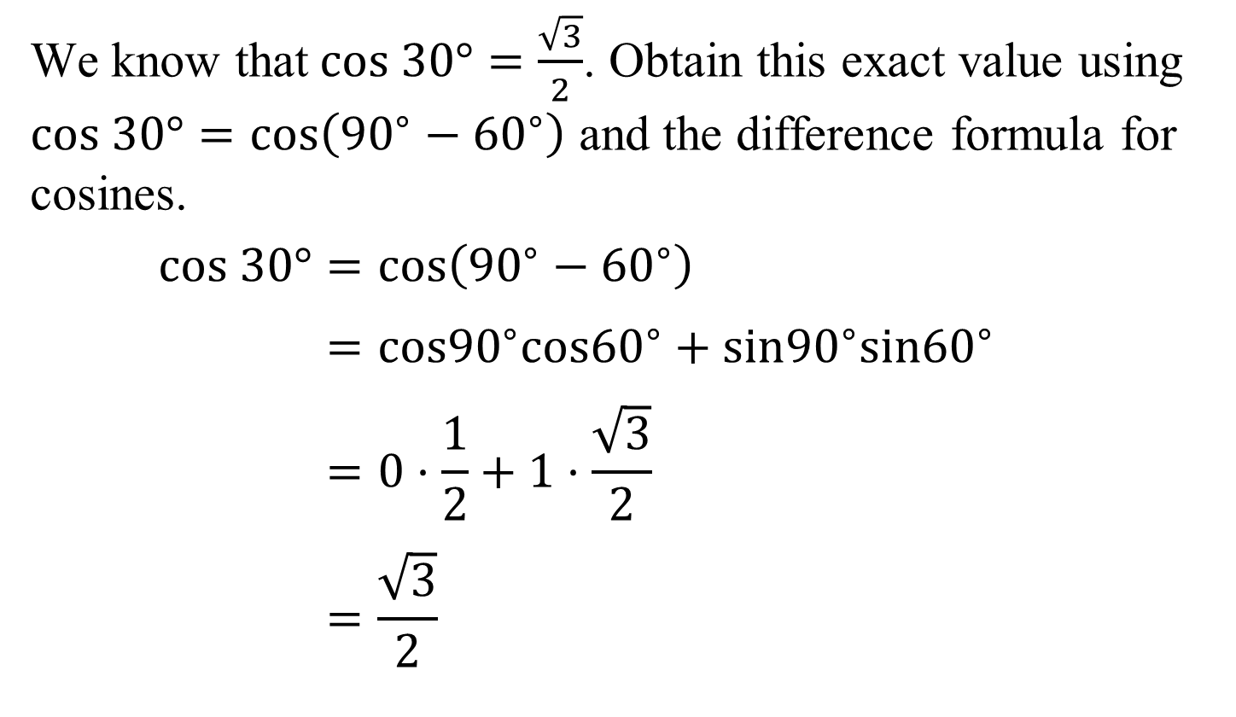
Example 1: Using the Difference Formula for Cosines to Find an Exact Value
We know that$cos 30°=\frac{\sqrt{3}}{2}$. Obtain this exact value using $cos 30°=cos\left({90}^{∘}−{60}^{∘}\right)$ and the difference formula for cosines.
$cos 30°=cos\left({90}^{∘}−{60}^{∘}\right)$
$$=cos{90}^{∘}cos{60}^{∘}+sin{90}^{∘}sin{60}^{∘}$$
$$=0·\frac{1}{2}+1·\frac{\sqrt{3}}{2}$$
$$=\frac{\sqrt{3}}{2}$$

Slide 5

Example 2: Using the Difference Formula for Cosines to Find an Exact Value
Find the exact value of $cos70°cos40°+sin70°sin40°.$
$$cos70°cos40°+sin70°sin40°=cos\left({70}^{°}−{40}^{°}\right)$$
$$=\cos{{30}^{°}}$$
$$=\frac{\sqrt{3}}{2}$$

Slide 6

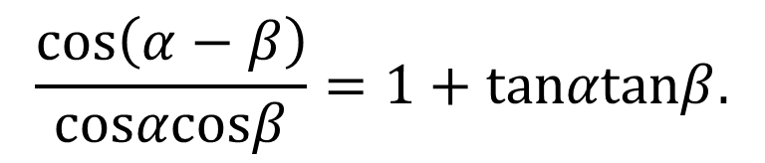
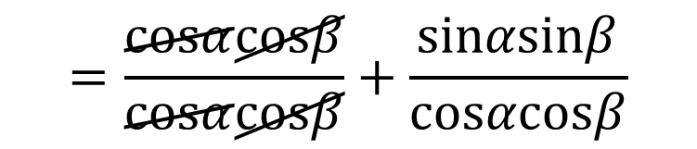
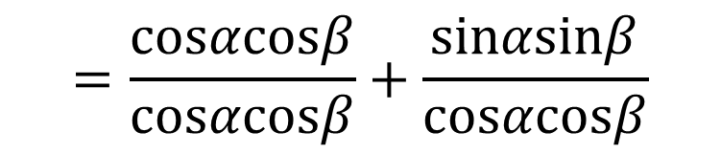
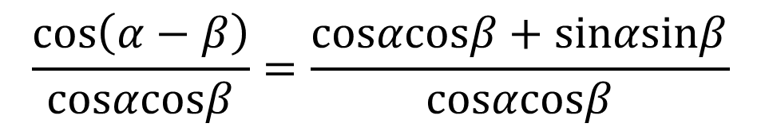
Example 3: Verifying an Identity
$$\frac{\left.cos ( α−β\right)}{cosαcosβ}=1+tanαtanβ.$$
Verify the identity:
$$\cos\left(α−β\right)=\cos{α}\cos{β}+\sin{α}\sin{β}$$
$$\frac{\left.cos ( α−β\right)}{cosαcosβ}=\frac{cosαcosβ+sinαsinβ}{cosαcosβ}$$
$$=\frac{cosαcosβ}{cosαcosβ}+\frac{sinαsinβ}{cosαcosβ}$$
$$=\frac{cosαcosβ}{cosαcosβ}+\frac{sinαsinβ}{cosαcosβ}$$
Divide by cos α cos β.

Slide 7
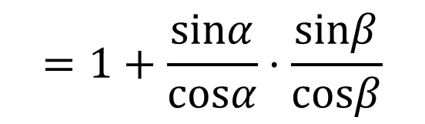

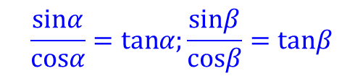

Example 3: Verifying an Identity (continued)
$$=\frac{cosαcosβ}{cosαcosβ}+\frac{sinαsinβ}{cosαcosβ}$$
The identity is verified.
$$=1+\frac{sinα}{cosα}·\frac{sinβ}{cosβ}$$
We have divided by cos α cos β and simplified.
$$=1+tanαtanβ$$
$$\frac{sinα}{cosα}=tanα;\frac{sinβ}{cosβ}=tanβ$$

Slide 8
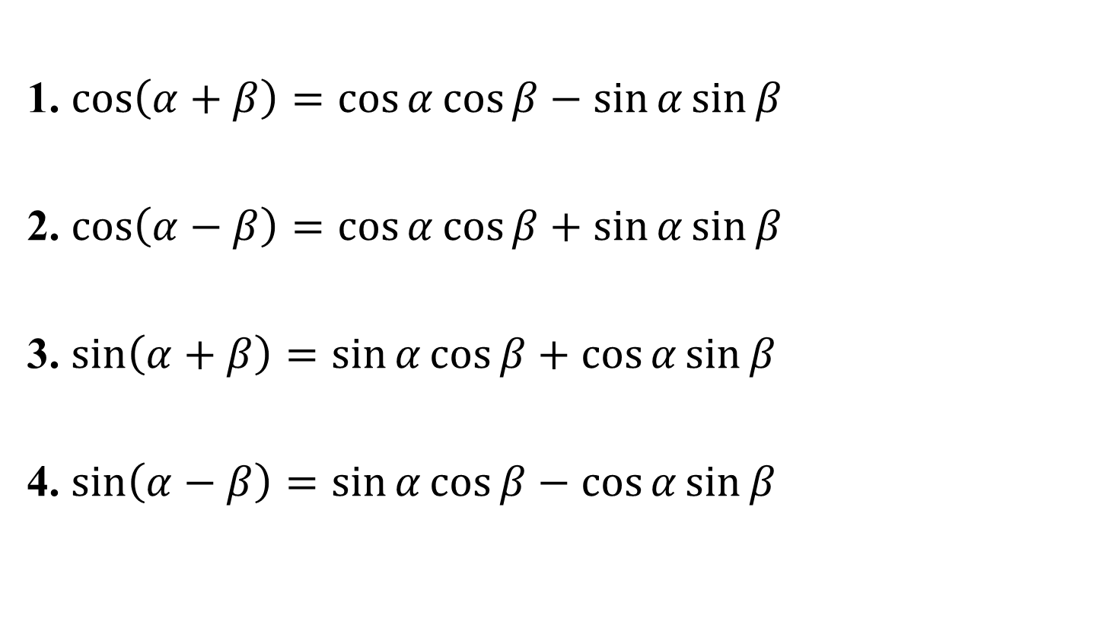
Sum and Difference Formulas for Cosines and Sines
1. $\cos\left(α+β\right)=\cos{α}\cos{β}−\sin{α}\sin{β}$
2. $\cos\left(α−β\right)=\cos{α}\cos{β}+\sin{α}\sin{β}$
3. $\sin\left(α+β\right)=\sin{α}\cos{β}+\cos{α}\sin{β}$
4. $\sin\left(α−β\right)=\sin{α}\cos{β}−\cos{α}\sin{β}$

Slide 9
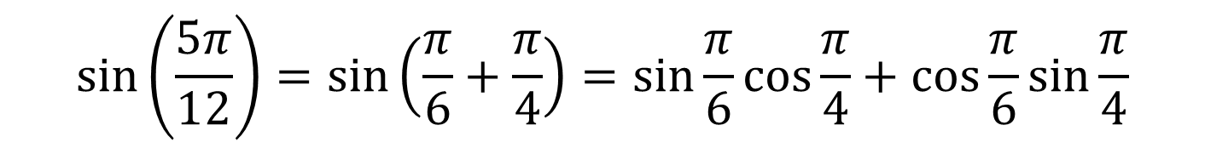


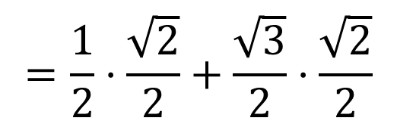
Example 4: Using the Sine of a Sum to Find an Exact Value
Find the exact value of $\sin{\frac{5π}{12}}$ using the fact that
$\frac{5π}{12}=\frac{π}{6}+\frac{π}{4}$.
$$\sin\left(α+β\right)=\sin{α}\cos{β}+\cos{α}\sin{β}$$
$$sin\left(\frac{5π}{12}\right)=sin\left(\frac{π}{6}+\frac{π}{4}\right)=sin\frac{π}{6}cos\frac{π}{4}+cos\frac{π}{6}sin\frac{π}{4}$$
$$=\frac{1}{2}·\frac{\sqrt{2}}{2}+\frac{\sqrt{3}}{2}·\frac{\sqrt{2}}{2}$$
$$=\frac{\sqrt{2}+\sqrt{6}}{4}$$

Slide 10









Example 5a: Finding Exact Values
Suppose that $\sin{α=\frac{4}{5}}$ for a quadrant II angle $α$ and $\sin{β=\frac{1}{2}}$ for a quadrant I angle $β$. Find the exact value of $\cos{α}$.
$$x^{2}+y^{2}=r^{2}$$
$$x^{2}+4^{2}=5^{2}$$
$$sinα=\frac{y}{r}=\frac{4}{5}$$
$$x^{2}+16=25$$
$$x^{2}=9$$
$$x=−3$$
$$cosα=\frac{x}{r}$$
$$=\frac{−3}{5}=−\frac{3}{5}$$

Slide 11









Example 5b: Finding Exact Values (continued)
Suppose that $\sin{α=\frac{4}{5}}$ for a quadrant II angle $α$ and $\sin{β=\frac{1}{2}}$ for a quadrant I angle $β$. Find the exact value of $\cos{β}$.
$$x^{2}+y^{2}=r^{2}$$
$$sinβ=\frac{y}{r}=\frac{1}{2}$$
$$x^{2}+1^{2}=2^{2}$$
$$x^{2}+1=4$$
$$x^{2}=3$$
$$x=\sqrt{3}$$
$$=\frac{\sqrt{3}}{2}$$
$$cosβ=\frac{x}{r}$$

Slide 12








Example 5c: Finding Exact Values (continued)
Suppose that $\sin{α=\frac{4}{5}}$ for a quadrant II angle $α$ and $\sin{β=\frac{1}{2}}$ for a quadrant I angle $β$. Find the exact value of $cos(α+{β)}$.
From our
previous work:
$$\cos\left(α+β\right)=\cos{α}\cos{β}−\sin{α}\sin{β}$$
$$=\left(−\frac{3}{5}\right)·\frac{\sqrt{3}}{2}−\frac{4}{5}·\frac{1}{2}$$
$$\sin{α=\frac{4}{5}}$$
$$\cos{α=−\frac{3}{5}}$$
$$=−\frac{3\sqrt{3}}{10}−\frac{4}{10}$$
$$\sin{β=\frac{1}{2}}$$
$$cos β=\frac{\sqrt{3}}{2}$$
$$=\frac{−3\sqrt{3}−4}{10}$$

Slide 13
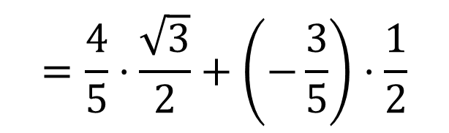







Example 5d: Finding Exact Values (continued)
Suppose that $\sin{α=\frac{4}{5}}$ for a quadrant II angle $α$ and $\sin{β=\frac{1}{2}}$ for a quadrant I angle $β$. Find the exact value of $sin(α+{β)}$.
From our
previous work:
$$\sin\left(α+β\right)=\sin{α}\cos{β}+\cos{α}\sin{β}$$
$$=\frac{4}{5}·\frac{\sqrt{3}}{2}+\left(−\frac{3}{5}\right)·\frac{1}{2}$$
$$\sin{α=\frac{4}{5}}$$
$$\cos{α=−\frac{3}{5}}$$
$$=\frac{4\sqrt{3}}{10}−\frac{3}{10}$$
$$\sin{β=\frac{1}{2}}$$
$$cos β=\frac{\sqrt{3}}{2}$$
$$=\frac{4\sqrt{3}−3}{10}$$

Slide 14
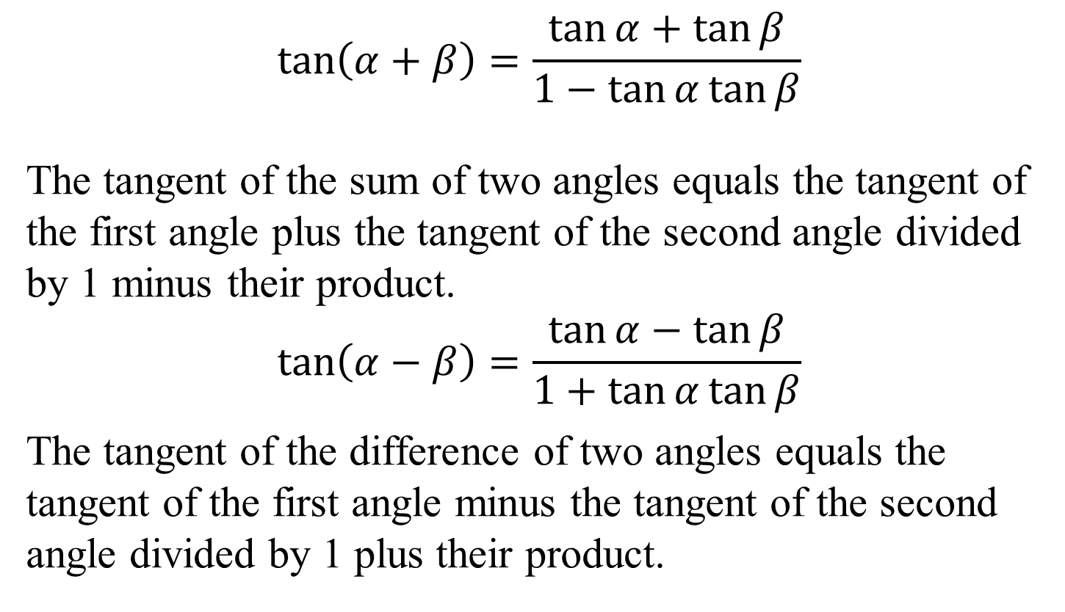
Sum and Difference Formulas for Tangents
$$\tan\left(α+β\right)=\frac{\tan{α}+\tan{β}}{1−\tan{α}\tan{β}}$$
The tangent of the sum of two angles equals the tangent of the first angle plus the tangent of the second angle divided by 1 minus their product.
$$\tan\left(α−β\right)=\frac{\tan{α}−\tan{β}}{1+\tan{α}\tan{β}}$$
The tangent of the difference of two angles equals the tangent of the first angle minus the tangent of the second angle divided by 1 plus their product.

Slide 15
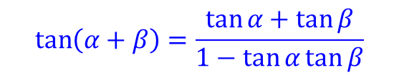

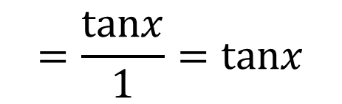


Example 7: Verifying an Identity
Verify the identity: $\tan\left(x+π\right)=\tan{x}$.
$$\tan\left(x+π\right)=\frac{\tan{x}+\tan{π}}{1−\tan{x}\tan{π}}$$
The identify is verified.
$$\tan\left(α+β\right)=\frac{\tan{α}+\tan{β}}{1−\tan{α}\tan{β}}$$
$$=\frac{tanx+0}{1−tanx·0}$$
$$tanπ=0$$
$$=\frac{tanx}{1}=tanx$$

