Slide 1

Chapter 5
Analytic Trigonometry
5.1 Verifying Trigonometric Identities

Slide 2
Objectives
Use the fundamental trigonometric identities to verify identities.
Show the equivalence of expressions containing both logarithmic and trigonometric functions.

Slide 3
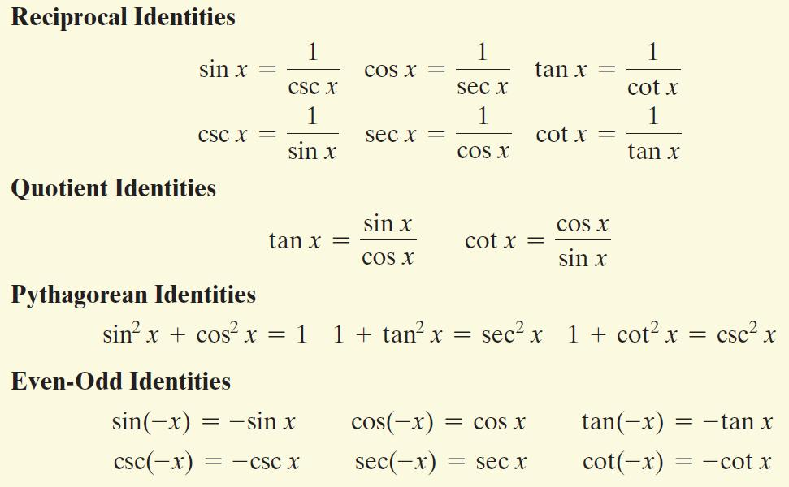
The Fundamental Identities

Slide 4
Using Fundamental Identities to Verify Other Identities
To verify an identity, we show that one side of the identity can be simplified so that it is identical to the other side. Each side of the equation is manipulated independently of the other side of the equation. Start with the side containing the more complicated expression. If you substitute one or more of the fundamental identities on the more complicated side, you will often be able to rewrite it in a form identical to that of the other side.

Slide 5
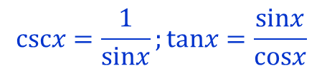

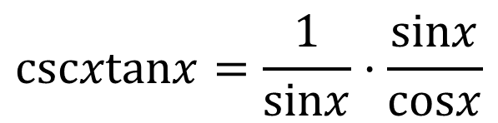



Example 1: Changing to Sines and Cosines to Verify an Identity
Verify the identity: cscx tanx = sec x
$$cscxtanx=\frac{1}{sinx}·\frac{sinx}{cosx}$$
$$cscx=\frac{1}{sinx};tanx=\frac{sinx}{cosx}$$
$$=\frac{1}{sinx}·\frac{sinx}{cosx}$$
Divide the numerator and the
denominator by the common factor.
$$=\frac{1}{cosx}$$
Multiply the remaining factors in
the numerator and denominator.
$$\frac{1}{cosx}=secx$$
$$=secx$$

Slide 6


Example 3: Using Factoring to Verify an Identity
Verify the identity: $\sin{x−\sin{x\cos^{2}x=\sin^{3}x}}$
$$\sin{x−\sin{x\cos^{2}x=\sin{x(1−\cos^{2}x)}}}$$
$$=\sin{x(\sin^{2}x)}$$
$$=\sin^{3}x$$
Factor sin x from the two terms.
$$\begin{matrix}\sin^{2}x+\cos^{2}x=1 \\ \sin^{2}x=1−\cos^{2}x\end{matrix}$$
Multiply.
The identity is verified.

Slide 7
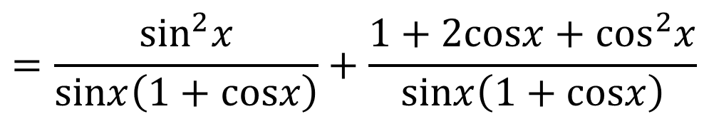
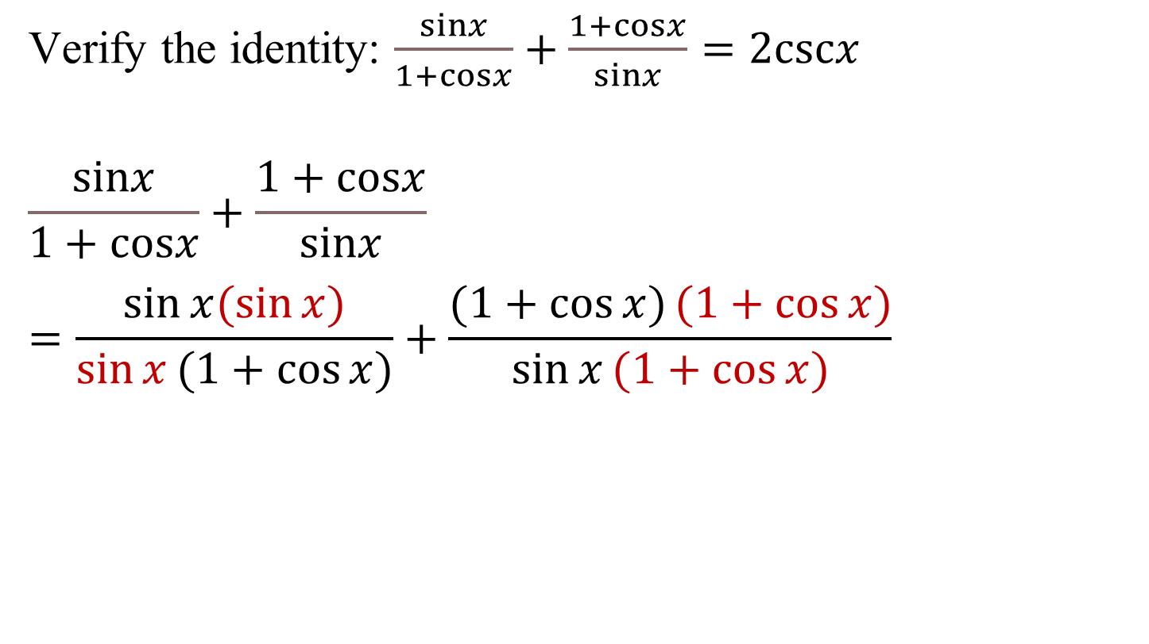
Example 5: Combining Fractional Expressions to Verify an Identity
Verify the identity: $\frac{sinx}{1+cosx}+\frac{1+cosx}{sinx}=2cscx$
$$\frac{sinx}{1+cosx}+\frac{1+cosx}{sinx}$$
$$=\frac{\sin{x(\sin{x})}}{\sin{x}(1+\cos{x)}}+\frac{(1+\cos{x)}(1+\cos{x)}}{\sin{x}(1+\cos{x)}}$$
The least common denominator is sin x(1 + cos x).
$$=\frac{\sin^{2}x}{\left.sinx ( 1+cosx\right)}+\frac{1+2cosx+\cos^{2}x}{\left.sinx ( 1+cosx\right)}$$
Use FOIL to multiply
(1 + cos x)(1 + cos x).

Slide 8
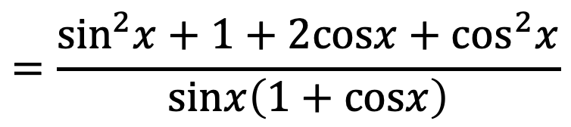
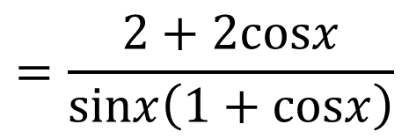
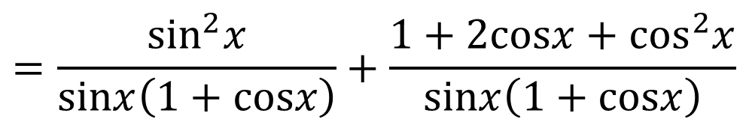
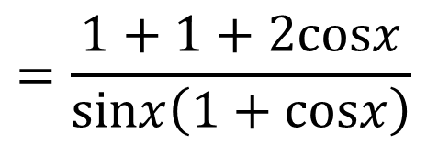
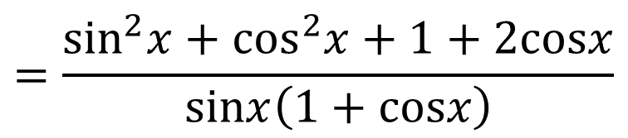

Example 5: Combining Fractional Expressions to Verify an Identity (continued)
$$=\frac{\sin^{2}x}{\left.sinx ( 1+cosx\right)}+\frac{1+2cosx+\cos^{2}x}{\left.sinx ( 1+cosx\right)}$$
$$=\frac{\sin^{2}x+1+2cosx+\cos^{2}x}{\left.sinx ( 1+cosx\right)}$$
Add the numerators. Put this
sum over the LCD.
$$=\frac{\sin^{2}x+\cos^{2}x+1+2cosx}{\left.sinx ( 1+cosx\right)}$$
Regroup terms in the numerator.
$$=\frac{1+1+2cosx}{\left.sinx ( 1+cosx\right)}$$
$$\sin^{2}x+\cos^{2}x=1$$
$$=\frac{2+2cosx}{\left.sinx ( 1+cosx\right)}$$
Add constant terms in the numerator.

Slide 9






Example 5: Combining Fractional Expressions to Verify an Identity (continued)
$$=\frac{2+2cosx}{\left.sinx ( 1+cosx\right)}$$
From previous slide.
$$=\frac{2(1+cosx)}{\left.sinx ( 1+cosx\right)}$$
Factor and simplify.
$$=\frac{2}{sinx}$$
Factor out the constant term.
$$=2·\frac{1}{sinx}$$
$$cscx=\frac{1}{sinx}$$
$$=2cscx$$
The identity is verified.

Slide 10


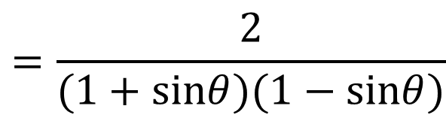
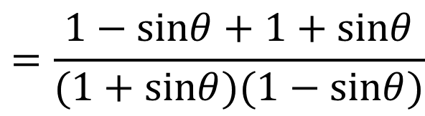
Example 8: Working with Both Sides Separately to Verify an Identity
Verify the identity: $\frac{1}{1+sinθ}+\frac{1}{1−sinθ}=2+2\tan^{2}θ$
We begin by working with the left side.
Rewrite each side
with the LCD.
$$\frac{1}{1+sinθ}+\frac{1}{1−sinθ}=\frac{\left.1 ( 1−sinθ\right)}{(1+sinθ)(1−sinθ)}+\frac{\left.1 ( 1+sinθ\right)}{(1+sinθ)(1−sinθ)}$$
$$=\frac{1−sinθ+1+sinθ}{(1+sinθ)(1−sinθ)}$$
Add numerators. Put this sum over the LCD.
$$=\frac{2}{(1+sinθ)(1−sinθ)}$$
Simplify the numerator.
$$=\frac{2}{1−\sin^{2}θ}$$
Multiply the factors in the denominator.

Slide 11
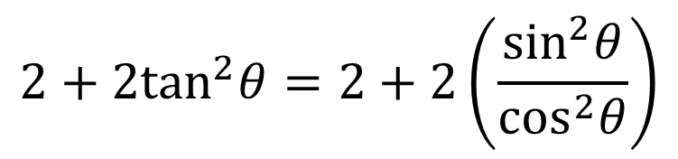
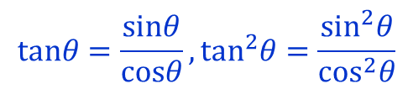
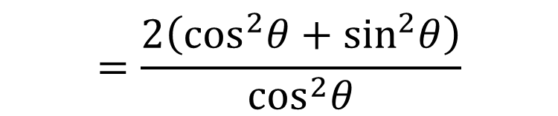
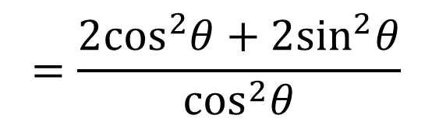
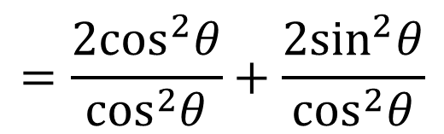
Example 8: Working with Both Sides Separately to Verify an Identity (continued)
We work with the right side.
$$2+2\tan^{2}θ=2+2\left(\frac{\sin^{2}θ}{\cos^{2}θ}\right)$$
$$tanθ=\frac{sinθ}{cosθ},\tan^{2}θ=\frac{\sin^{2}θ}{\cos^{2}θ}$$
$$=\frac{2\cos^{2}θ}{\cos^{2}θ}+\frac{2\sin^{2}θ}{\cos^{2}θ}$$
Rewrite each numerator with the LCD.
$$=\frac{2\cos^{2}θ+2\sin^{2}θ}{\cos^{2}θ}$$
Add numerators. Put this sum over the LCD.
$$=\frac{\left.2 ( \cos^{2}θ+\sin^{2}θ\right)}{\cos^{2}θ}$$
Factor out the constant term, 2.

Slide 12

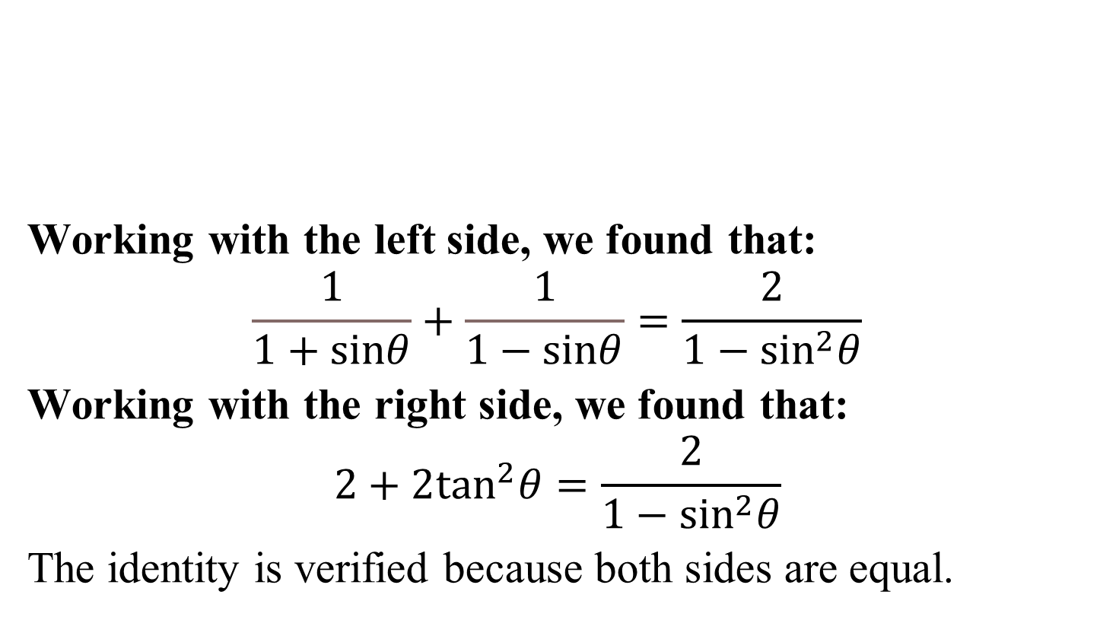

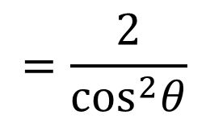
Example 8: Working with Both Sides Separately to Verify an Identity (continued)
$$=\frac{2}{\cos^{2}θ}$$
Working with the left side, we found that:
$$\frac{1}{1+sinθ}+\frac{1}{1−sinθ}=\frac{2}{1−\sin^{2}θ}$$
Working with the right side, we found that:
$$2+2\tan^{2}θ=\frac{2}{1−\sin^{2}θ}$$
The identity is verified because both sides are equal.
$$\sin^{2}θ+\cos^{2}θ=1$$
$$=\frac{2}{1−\sin^{2}θ}$$
$$\sin^{2}θ+\cos^{2}θ=1;\cos^{2}θ=1−\sin^{2}θ$$

Slide 13
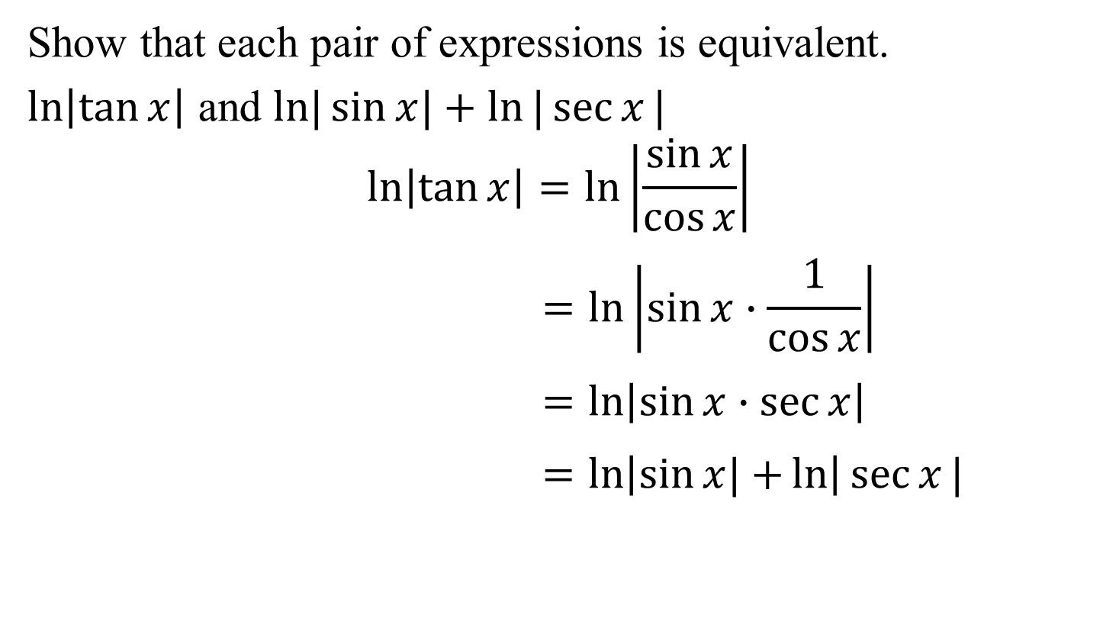
Example 9a: Verifying Two Expressions Are Equivalent
Show that each pair of expressions is equivalent.
$\ln\left|\tan{x}\right|$ and $ln|\sin{x|+ln⁡|\sec{x}}|$
$$\ln\left|\tan{x}\right|=ln\left|\frac{\sin{x}}{\cos{x}}\right|$$
$$=ln\left|\sin{x}∙\frac{1}{\cos{x}}\right|$$
$$=ln\left|\sin{x}∙\sec{x}\right|$$
$$=ln\left|\sin{x|+}ln\right|\sec{x}|$$

Slide 14
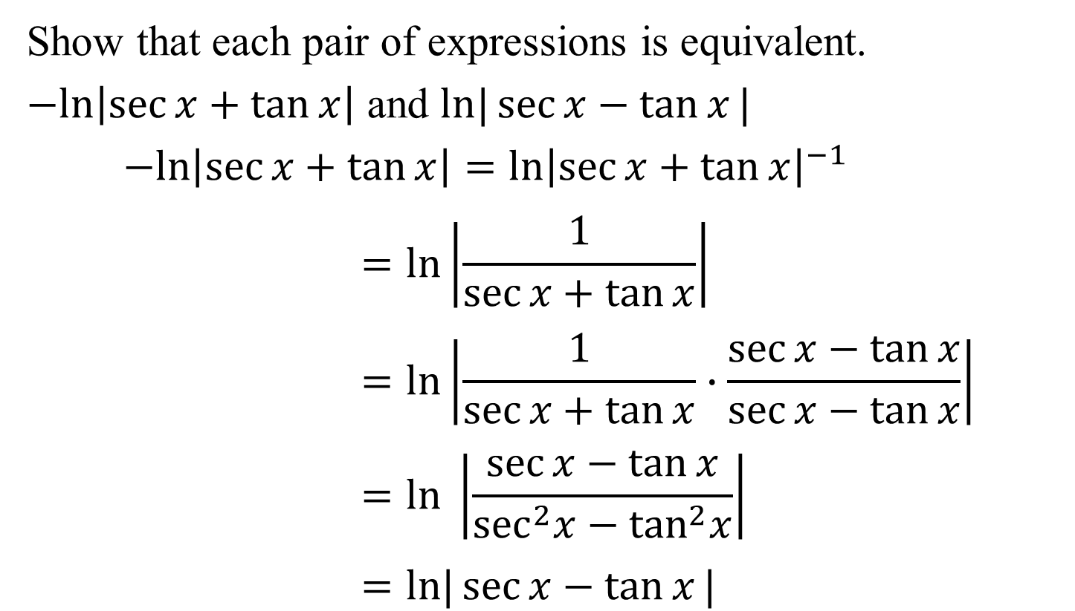
Example 9b: Verifying Two Expressions Are Equivalent
Show that each pair of expressions is equivalent.
$−ln\left|\sec{x}+\tan{x}\right|$ and $ln|\sec{x−\tan{x}|}$
$−ln\left|\sec{x}+\tan{x}\right|=ln{\left|\sec{x+\tan{x}}\right|}^{−1}$
$$=ln\left|\frac{1}{\sec{x+\tan{x}}}\right|$$
$$=ln\left|\frac{1}{\sec{x+\tan{x}}}∙\frac{\sec{x−\tan{x}}}{\sec{x−\tan{x}}}\right|$$
$$=ln \left|\frac{\sec{x−\tan{x}}}{\sec^{2}x−\tan^{2}x}\right|$$
$$=ln|\sec{x−\tan{x}|}$$

Slide 15
Guidelines for Verifying Trigonometric Identities
Work with each side of the equation independently of the other side. Start with the more complicated side and transform it in a step-by-step fashion until it looks exactly like the other side.
• Analyze the identity and look for opportunities to apply the fundamental identities.
• Try using one or more of the following techniques:
1. Rewrite the more complicated side in terms of sines and cosines.
2. Factor out the greatest common factor.

Slide 16
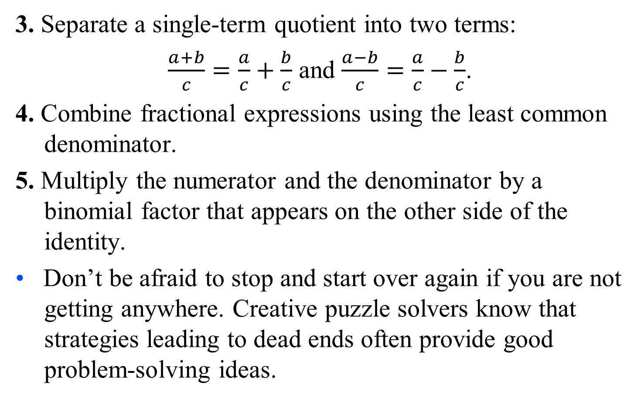
Guidelines for Verifying Trigonometric Identities (cont)
3. Separate a single-term quotient into two terms:
$\frac{a+b}{c}=\frac{a}{c}+\frac{b}{c}$ and $\frac{a−b}{c}=\frac{a}{c}−\frac{b}{c}$.
4. Combine fractional expressions using the least common denominator.
5. Multiply the numerator and the denominator by a binomial factor that appears on the other side of the identity.
• Don’t be afraid to stop and start over again if you are not getting anywhere. Creative puzzle solvers know that strategies leading to dead ends often provide good problem-solving ideas.

