Slide 1

Chapter 4
Trigonometric Functions
4.7 Inverse Trigonometric Functions

Slide 2
Objectives
Understand and use the inverse sine function.
Understand and use the inverse cosine function.
Understand and use the inverse tangent function.
Understand and use the inverse cotangent, cosecant, and secant functions.
Use a calculator to evaluate inverse trigonometric functions.
Find exact values of composite functions with inverse trigonometric functions.

Slide 3
Inverse Functions
Here are some helpful things to remember from our earlier discussion of inverse functions:
If no horizontal line intersects the graph of a function more than once, the function is one-to-one and has an inverse function.
If the point (a, b) is on the graph of f, then the point (b, a) is on the graph of the inverse function, denoted
f ^{–1}. The graph of f ^{–1} is a reflection of the graph of
f about the line y = x.

Slide 4
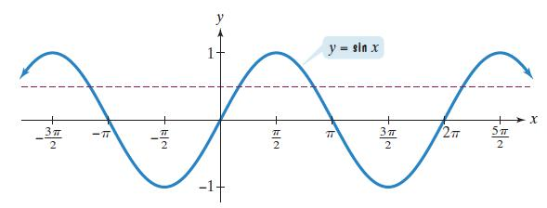
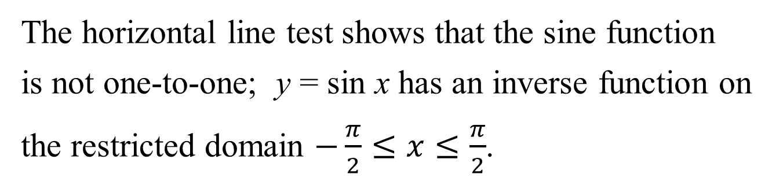
The Inverse Sine Function
The horizontal line test shows that the sine function
is not one-to-one; y = sin x has an inverse function on
the restricted domain $−\frac{π}{2}≤x≤\frac{π}{2}$.

Slide 5
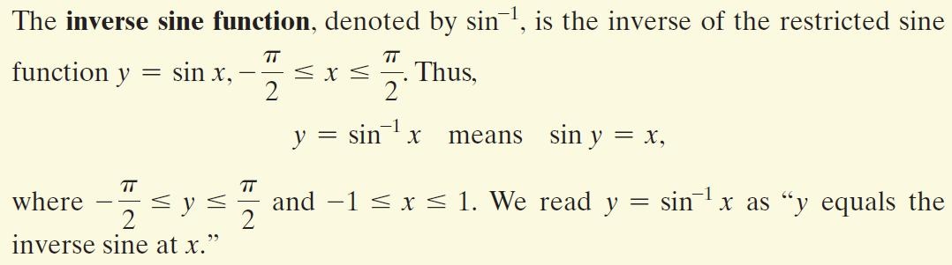
The Inverse Sine Function (continued)

Slide 6
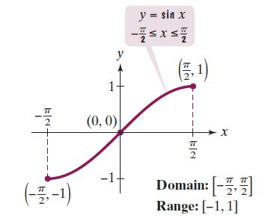
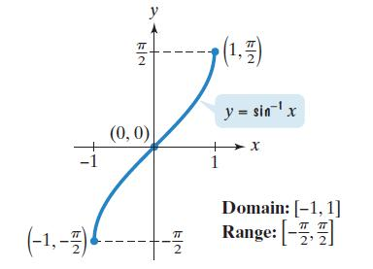
Graphing the Inverse Sine Function
One way to graph y = sin^{–1} x is to take points on the graph of the restricted sine function and reverse the order of the coordinates.

Slide 7
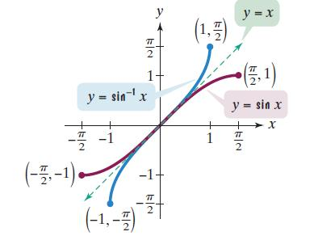
Graphing the Inverse Sine Function (continued)
Another way to obtain the graph of y = sin^{–1} x is to reflect the graph of the restricted sine function about the line y = x.

Slide 8
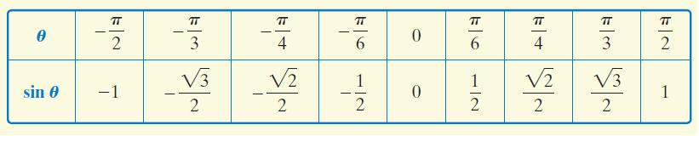
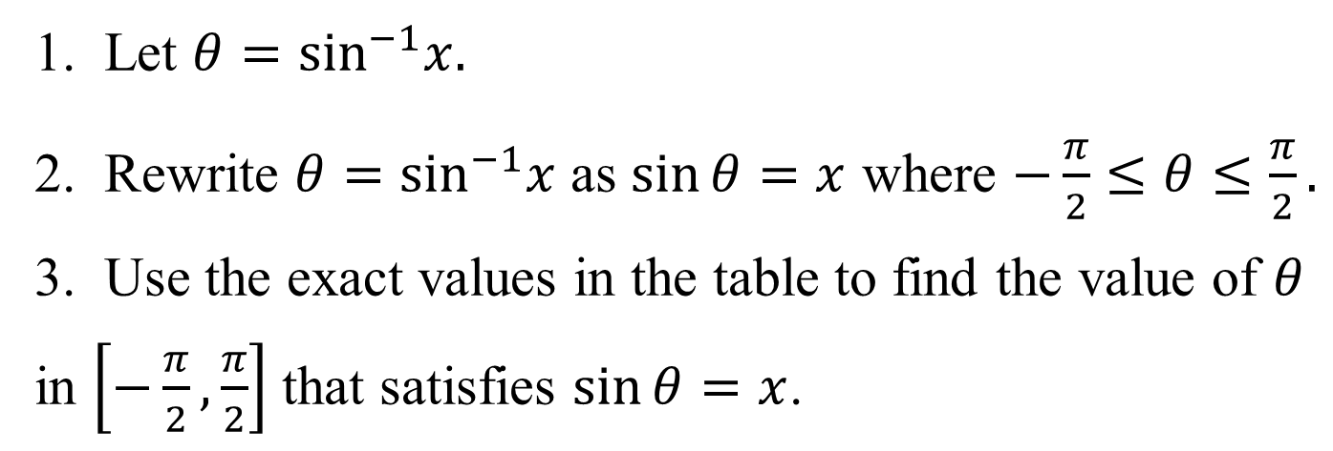
Finding Exact Values of sin^{–1}x
1. Let $θ=\sin^{−1}x.$
2. Rewrite $θ=\sin^{−1}x$ as $\sin{θ=x}$ where $−\frac{π}{2}≤θ≤\frac{π}{2}.$
3. Use the exact values in the table to find the value of $θ$ in $\left[−\frac{π}{2},\frac{π}{2}\right]$ that satisfies $\sin{θ=x}$.

Slide 9
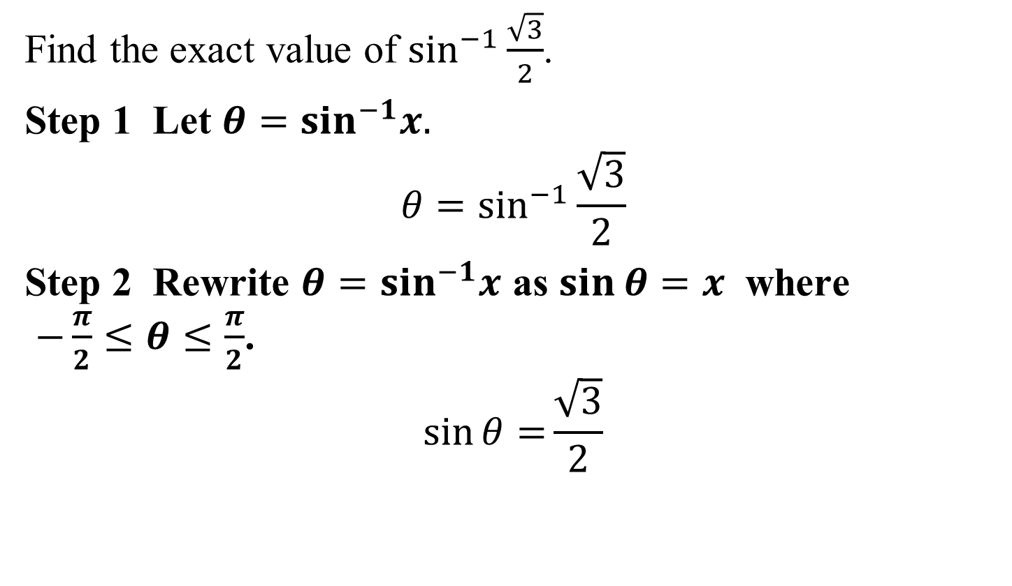
Example 1: Finding the Exact Value of an Inverse Sine Function
Find the exact value of $\sin^{−1}{\frac{\sqrt{3}}{2}}$.
Step 1 Let $θ=\sin^{−1}x.$
$${θ=sin}^{−1}{\frac{\sqrt{3}}{2}}$$
Step 2 Rewrite $θ=\sin^{−1}x$ as $\sin{θ=x}$ where
$−\frac{π}{2}≤θ≤\frac{π}{2}$.
$$\sin{θ=}{\frac{\sqrt{3}}{2}}$$

Slide 10
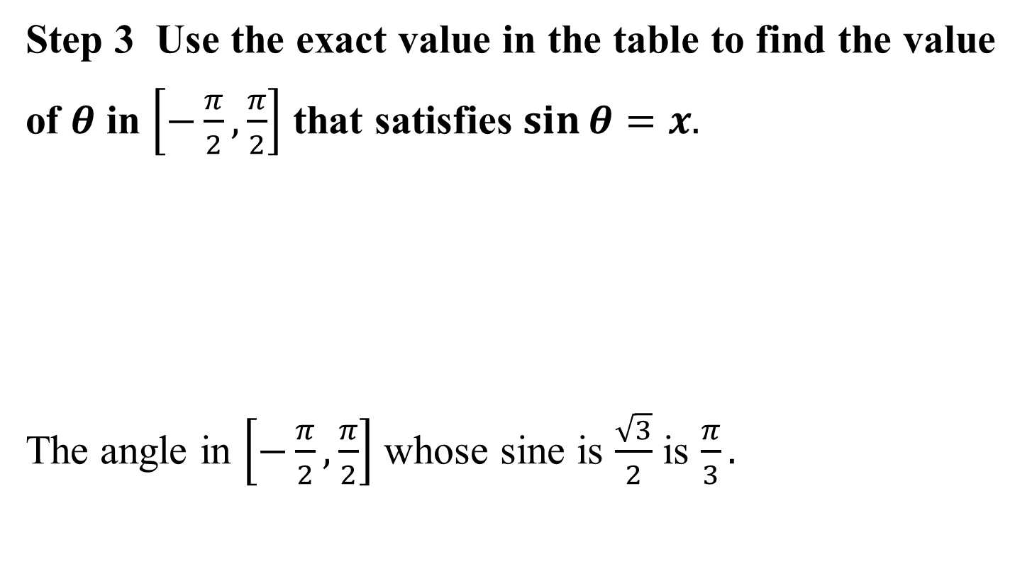
Example 1: Finding the Exact Value of an Inverse Sine Function (continued)
Step 3 Use the exact value in the table to find the value of $θ$ in $\left[−\frac{π}{2},\frac{π}{2}\right]$ that satisfies $\sin{θ=x.}$
The angle in $\left[−\frac{π}{2},\frac{π}{2}\right]$ whose sine is $\frac{\sqrt{3}}{2}$ is $\frac{π}{3}.$

Slide 11
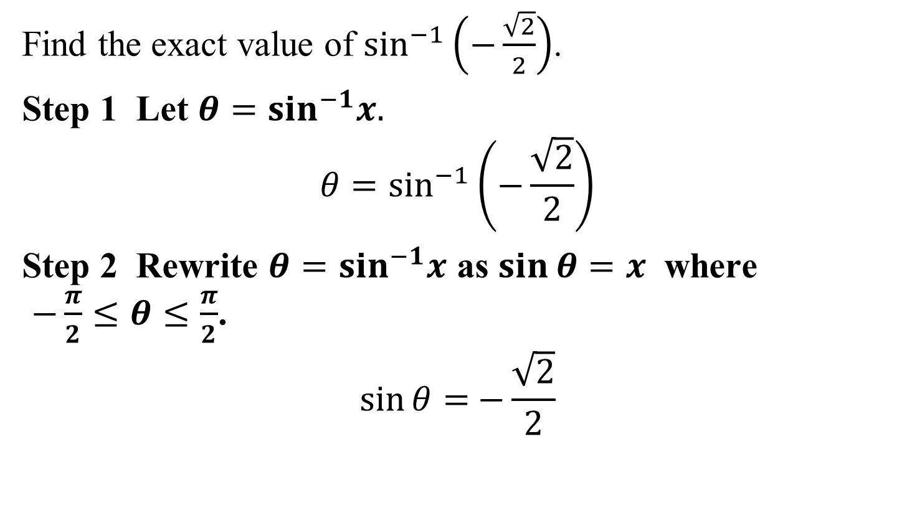
Example 2: Finding the Exact Value of an Inverse Sine Function
Find the exact value of $\sin^{−1}\left(−\frac{\sqrt{2}}{2}\right)$.
Step 1 Let $θ=\sin^{−1}x.$
$${θ=sin}^{−1}\left(−\frac{\sqrt{2}}{2}\right)$$
Step 2 Rewrite $θ=\sin^{−1}x$ as $\sin{θ=x}$ where
$−\frac{π}{2}≤θ≤\frac{π}{2}$.
$$\sin{θ=}−{\frac{\sqrt{2}}{2}}$$

Slide 12
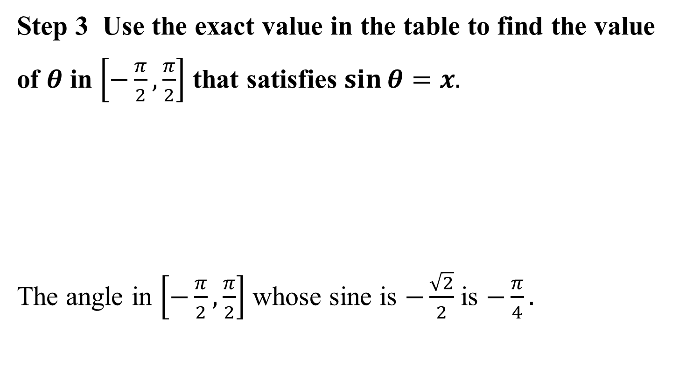
Example 2: Finding the Exact Value of an Inverse Sine Function (continued)
Step 3 Use the exact value in the table to find the value of $θ$ in $\left[−\frac{π}{2},\frac{π}{2}\right]$ that satisfies $\sin{θ=x.}$
The angle in $\left[−\frac{π}{2},\frac{π}{2}\right]$ whose sine is $−\frac{\sqrt{2}}{2}$ is $−\frac{π}{4}.$

Slide 13
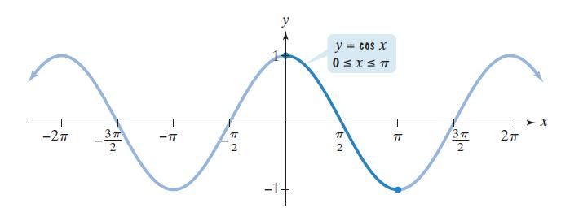
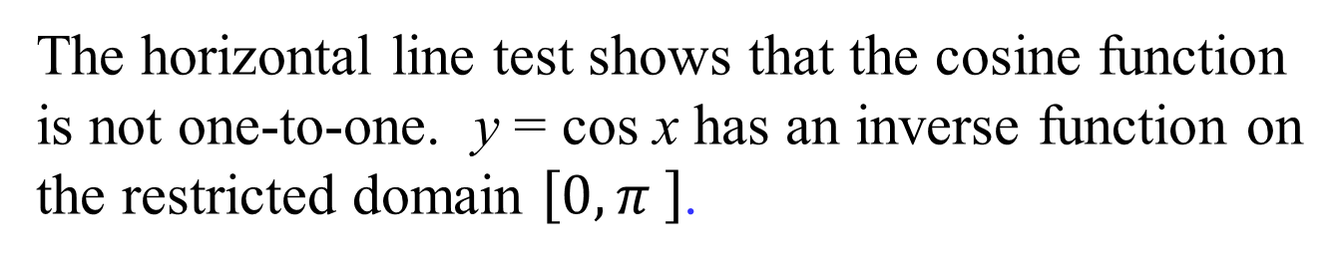
The Inverse Cosine Function
The horizontal line test shows that the cosine function
is not one-to-one. y = cos x has an inverse function on
the restricted domain $\left[0,π \right]$.

Slide 14
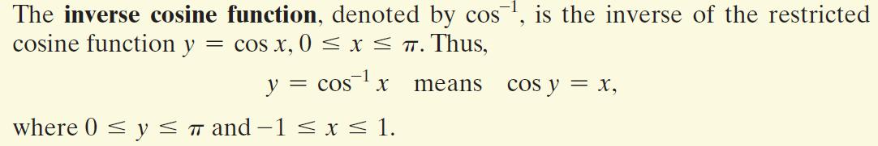
The Inverse Cosine Function (continued)

Slide 15
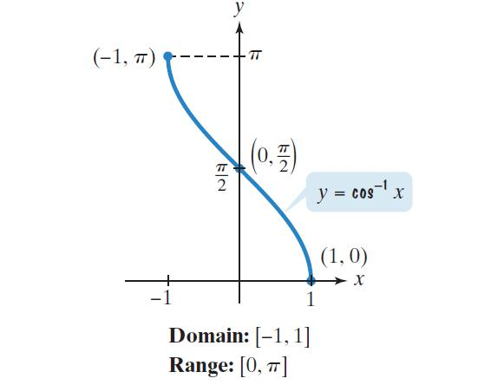
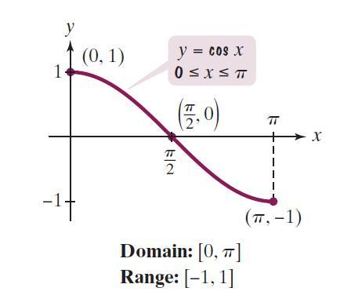
Graphing the Inverse Cosine Function
One way to graph y = cos^{–1} x is to take points on the graph of the restricted cosine function and reverse the order of the coordinates.

Slide 16
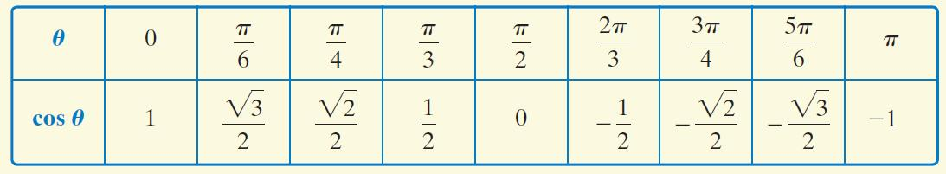
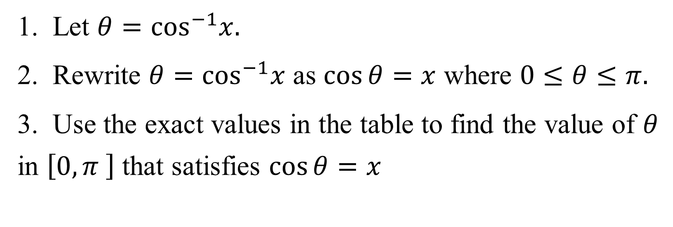
Finding Exact Values of cos^{–1} x
1. Let $θ=\cos^{−1}x.$
2. Rewrite $θ=\cos^{−1}x$ as $\cos{θ=x}$ where $0≤θ≤π.$
3. Use the exact values in the table to find the value of $θ$ in $\left[0,π \right]$ that satisfies $\cos{θ=x}$

Slide 17
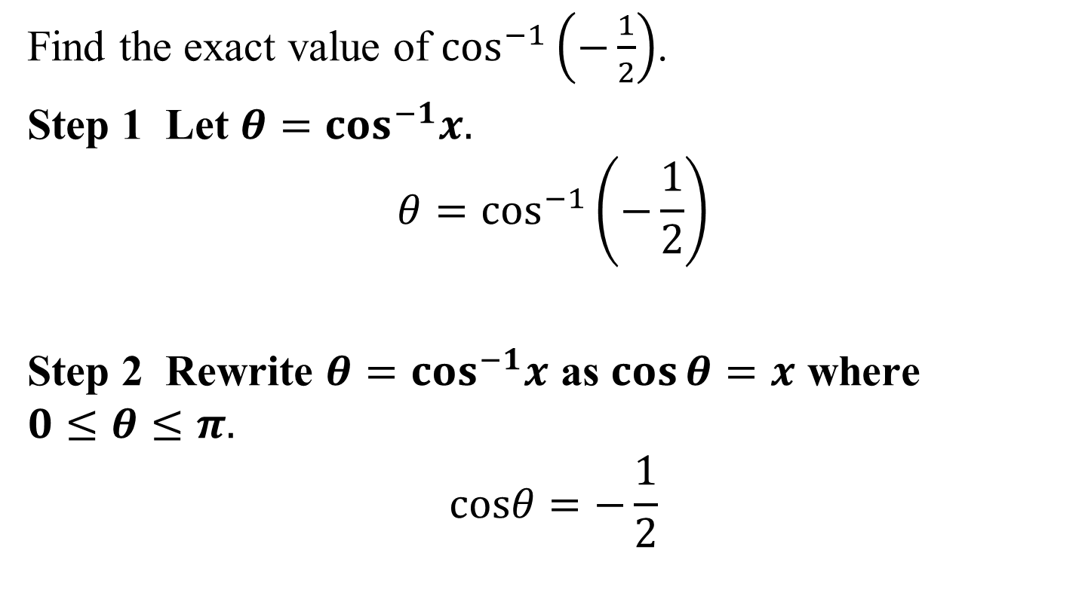
Example 3: Finding the Exact Value of an Inverse Cosine Function
Find the exact value of $\cos^{−1}\left(−\frac{1}{2}\right)$.
Step 1 Let $θ=\cos^{−1}x.$
$${θ=cos}^{−1}\left(−\frac{1}{2}\right)$$
Step 2 Rewrite $θ=\cos^{−1}x$ as $\cos{θ=x}$ where
$0≤θ≤π.$
$$cosθ=−\frac{1}{2}$$

Slide 18
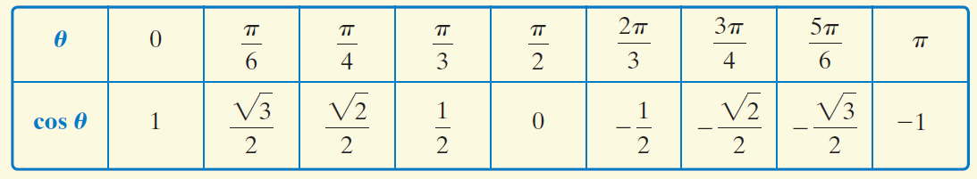
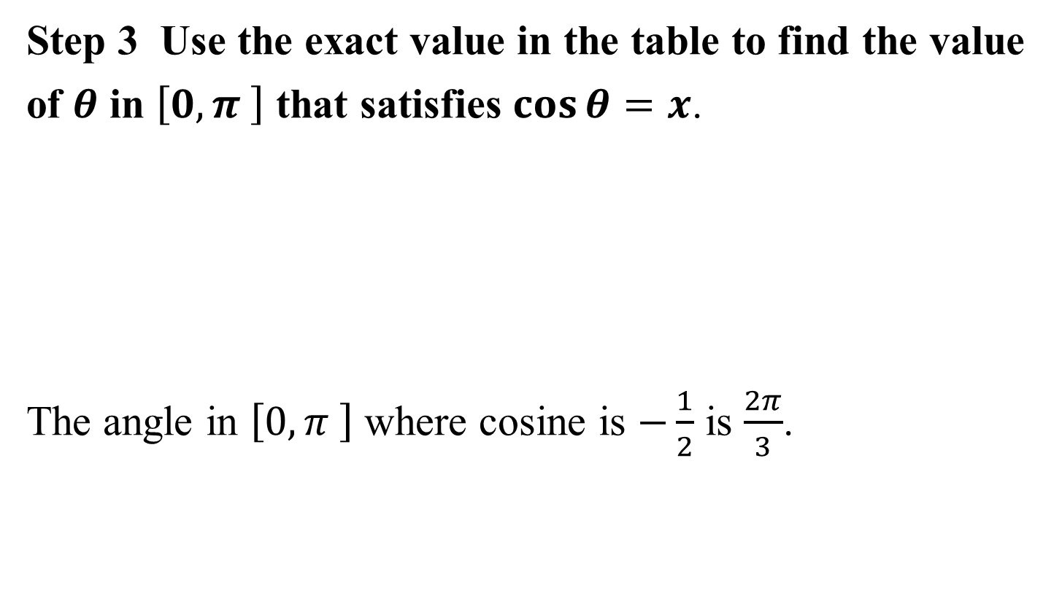
Example 3: Finding the Exact Value of an Inverse Cosine Function (continued)
Step 3 Use the exact value in the table to find the value of $θ$ in $\left[0,π \right]$ that satisfies $\cos{θ=x}$.
The angle in $\left[0,π \right]$ where cosine is $−\frac{1}{2}$ is $\frac{2π}{3}$.

Slide 19
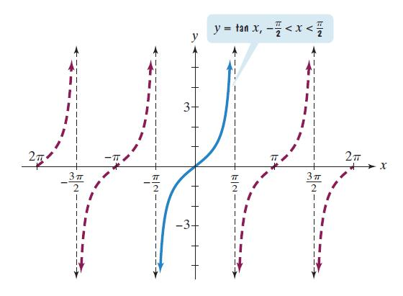
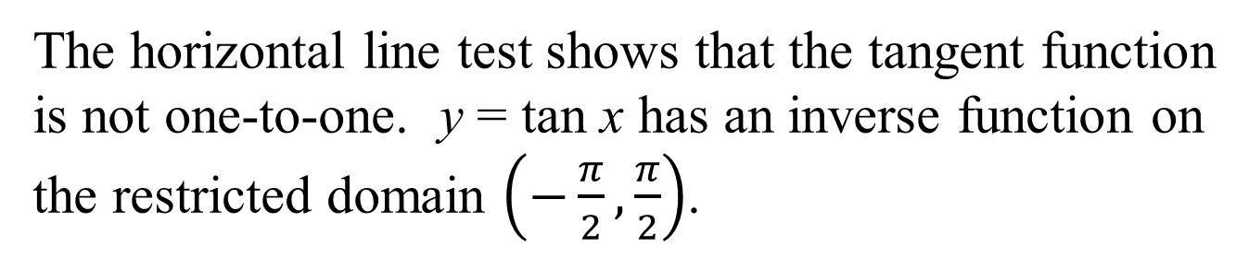
The Inverse Tangent Function
The horizontal line test shows that the tangent function
is not one-to-one. y = tan x has an inverse function on
the restricted domain $\left(−\frac{π}{2},\frac{π}{2}\right)$.

Slide 20
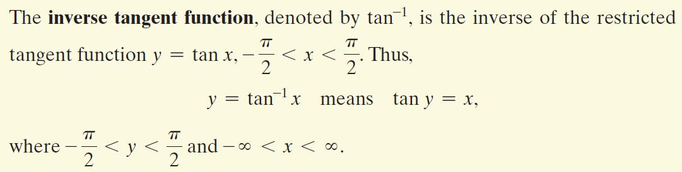
The Inverse Tangent Function (continued)

Slide 21
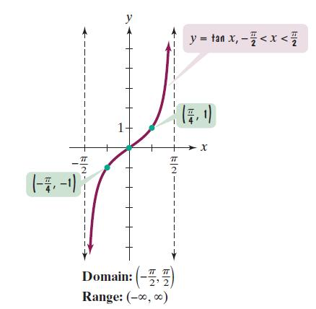
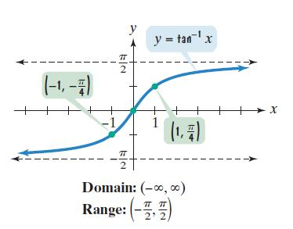
Graphing the Inverse Tangent Function
One way to graph y = tan^{–1} x is to take points on the graph of the restricted tangent function and reverse the order of the coordinates.

Slide 22
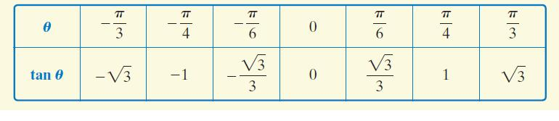
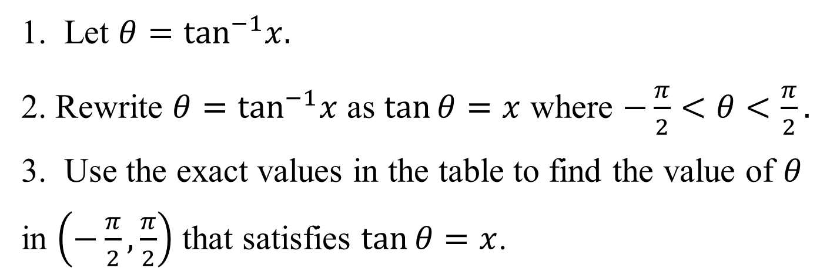
Finding Exact Values of tan^{–1} x
1. Let $θ=\tan^{−1}x.$
2. Rewrite $θ=\tan^{−1}x$ as $\tan{θ=x}$ where $−\frac{π}{2}<θ<\frac{π}{2}.$
3. Use the exact values in the table to find the value of $θ$ in $\left(−\frac{π}{2},\frac{π}{2}\right)$ that satisfies $\tan{θ=x}$.

Slide 23
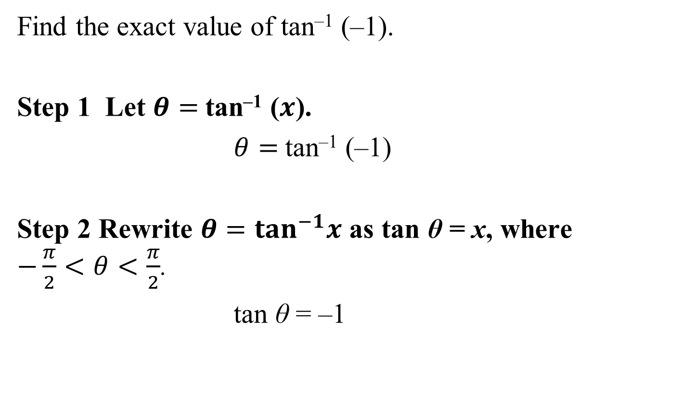
Example 4: Finding the Exact Value of an Inverse Tangent Function
Find the exact value of tan^{–1} (–1).
Step 1 Let $θ=$tan^{–1} ($x$).
$θ=$tan^{–1} (–1)
Step 2 Rewrite $θ=\tan^{−1}x$ as tan θ = x, where
$−\frac{π}{2}<θ<\frac{π}{2}$.
tan θ = –1

Slide 24
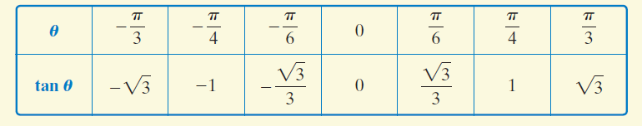
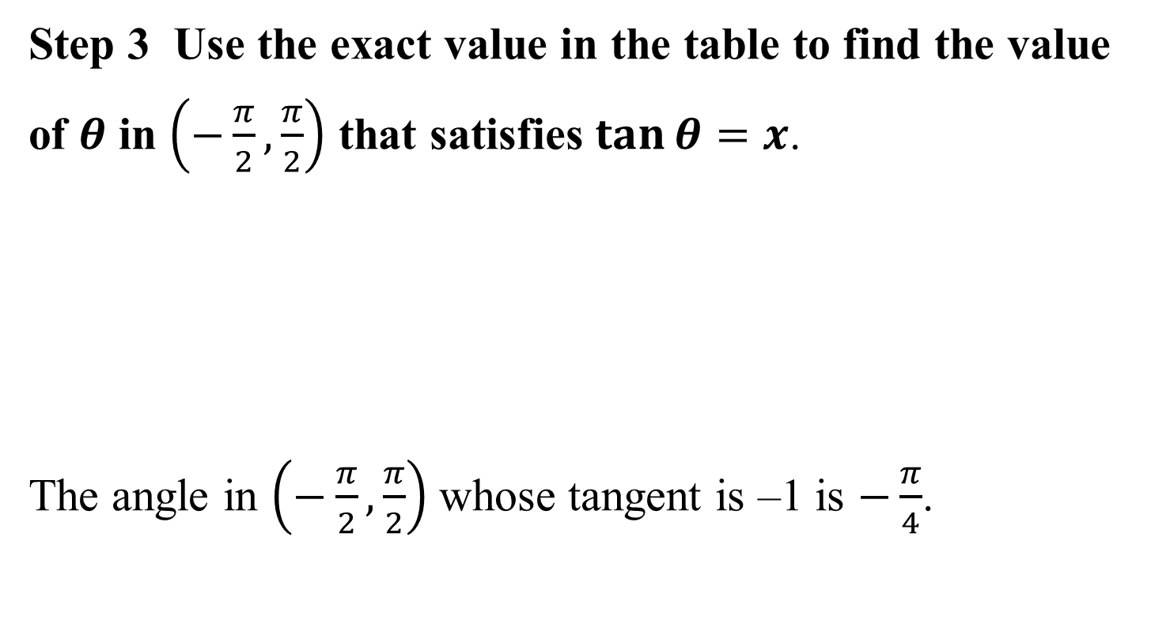
Example 4: Finding the Exact Value of an Inverse Tangent Function (continued)
Step 3 Use the exact value in the table to find the value of $θ$ in $\left(−\frac{π}{2},\frac{π}{2}\right)$ that satisfies $\tan{θ=x}$.
The angle in $\left(−\frac{π}{2},\frac{π}{2}\right)$whose tangent is –1 is $−\frac{π}{4}$.

Slide 25
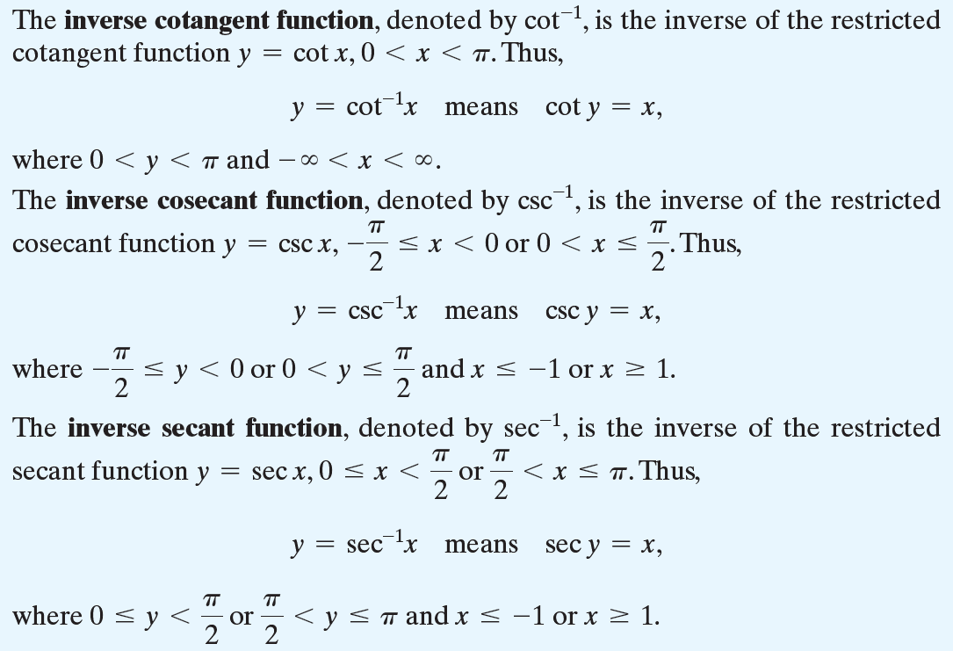
The Inverse Cotangent, Cosecant, and Secant Functions

Slide 26




Example 5: Finding the Exact values of Inverse Trigonometric Functions
Find the exact value of
a. $\cot^{−1}{0}$
b. $\csc^{−1}{(−1)}$
c. $\sec^{−1}{(−2)}$
$$=\frac{π}{2}$$
$$=−\frac{π}{2}$$
$$=\frac{2π}{3}$$

Slide 27
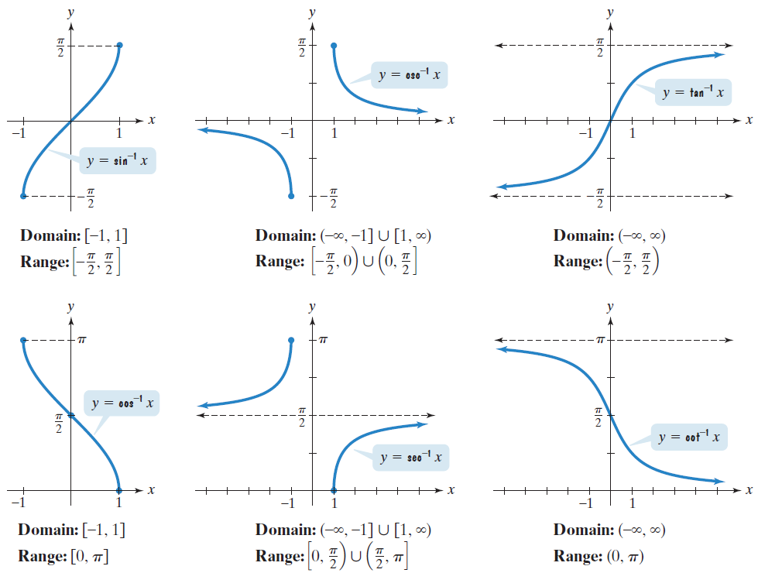
Graphs of the Inverse Trigonometric Functions

Slide 28

Example 6: Calculators and Inverse Trigonometric Functions
Use a calculator to find the value to four decimal places of each function:
a. $\cos^{−1}{\frac{1}{3}}$
b. tan^{–1} (–35.85)
= 1.2310
= –1.5429

Slide 29
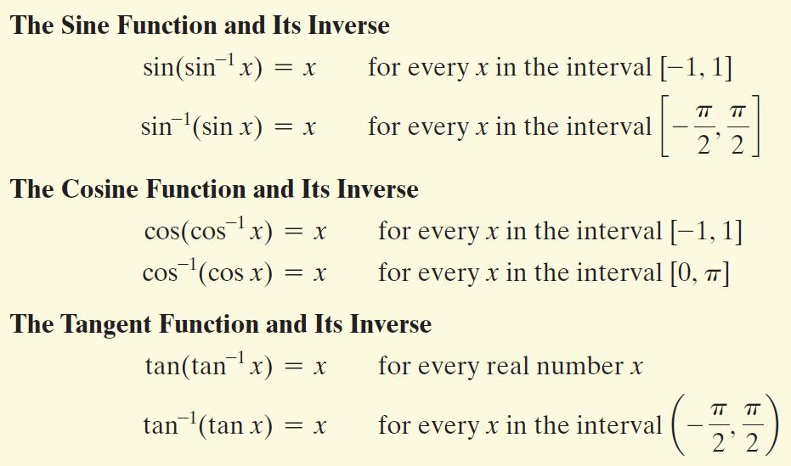
Inverse Properties

Slide 30
Example 7: Evaluating Compositions of Functions and Their Inverses
Find the exact value, if possible:
a. cos(cos^{–1} 0.7)
b. sin ^{–1}(sin π)
c. cos[cos^{–1} (–1.2)]
–1.2 is not included in the domain of the inverse cosine function. The expression is not defined.
= 0.7
= 0

