Slide 1

Chapter 4
Trigonometric Functions
4.6 Graphs of Other Trigonometric Functions

Slide 2
Objectives
Understand the graph of y = tan x.
Graph variations of y = tan x.
Understand the graph of y = cot x.
Graph variations of y = cot x.
Understand the graphs of y = csc x and y = sec x.
Graph variations of y = csc x and y = sec x.

Slide 3
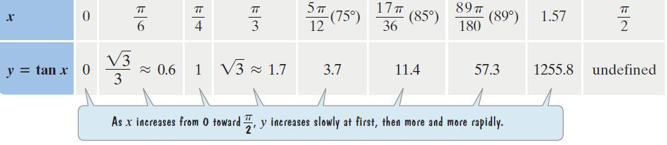
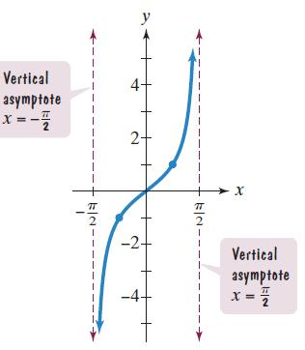
The Graph of y = tan x
Period: $π$
The tangent function is an odd function:
tan(–x) = –tan x.
The tangent function is undefined at $x=\frac{π}{2}.$

Slide 4
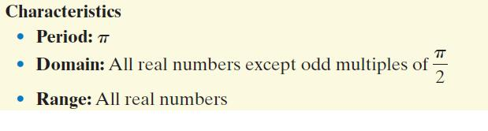
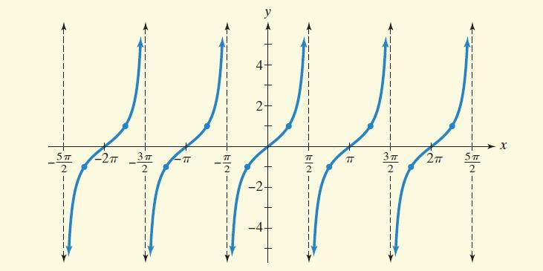
The Tangent Curve: The Graph of y = tan x and Its Characteristics

Slide 5
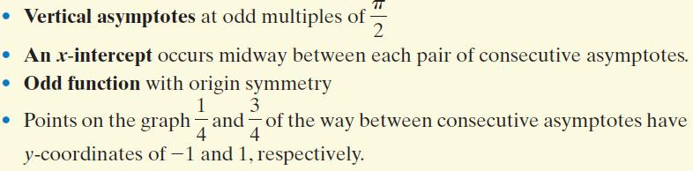
The Tangent Curve: The Graph of y = tan x and Its Characteristics (continued)

Slide 6
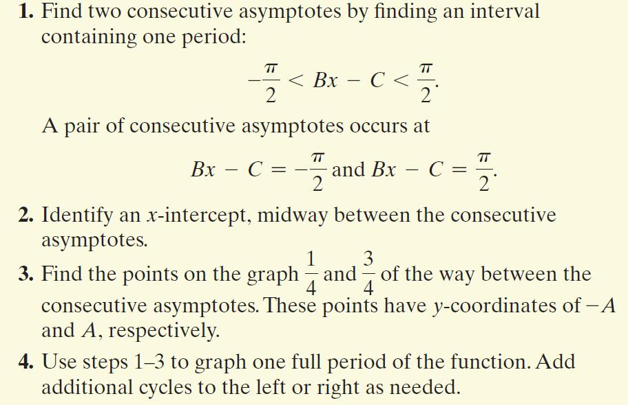
Graphing Variations of y = tan x

Slide 7
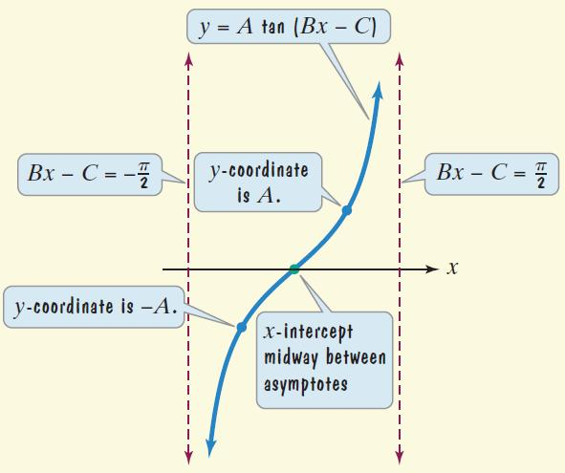
Graphing Variations of y = tan x (continued)

Slide 8
Example 1: Graphing a Tangent Function
Graph y = 3 tan 2x for $−\frac{π}{4}<x<\frac{3π}{4}$.
A = 3, B = 2, C = 0
Step 1 Find two consecutive asymptotes.
An interval containing one period is $\left(−\frac{π}{4},\frac{π}{4}\right)$.
Thus, two consecutive asymptotes occur at $x=−\frac{π}{4}$ and $\frac{π}{4}.$
Step 2 Identify an x-intercept, midway between the consecutive asymptotes. x = 0 is midway between $−\frac{π}{4}$ and $\frac{π}{4}.$ The graph passes through (0, 0).
$$−\frac{π}{2}<Bx−C<\frac{π}{2}$$
$$−\frac{π}{2}<2x<\frac{π}{2}$$
$$−\frac{π}{4}<x<\frac{π}{4}$$

Slide 9
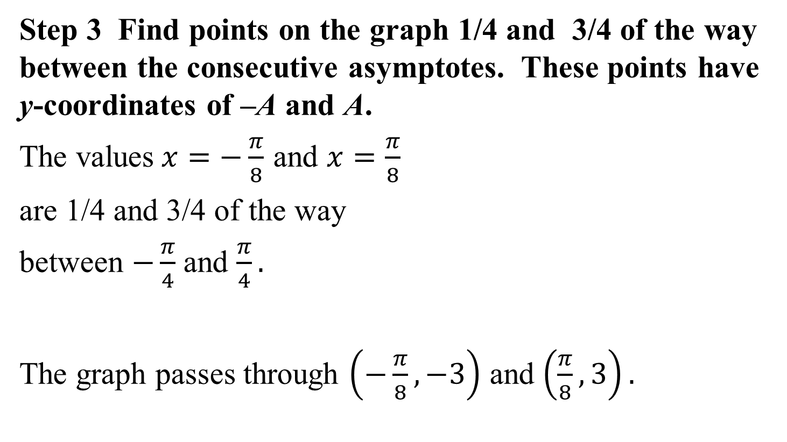
Example 1: Graphing a Tangent Function (continued)
Step 3 Find points on the graph 1/4 and 3/4 of the way between the consecutive asymptotes. These points have y-coordinates of –A and A.
The values$x=−\frac{π}{8}$ and $x=\frac{π}{8}$
are 1/4 and 3/4 of the way
between $−\frac{π}{4}$ and $\frac{π}{4}.$
The graph passes through $\left(−\frac{π}{8}, −3\right)$ and $\left(\frac{π}{8}, 3\right).$

Slide 10
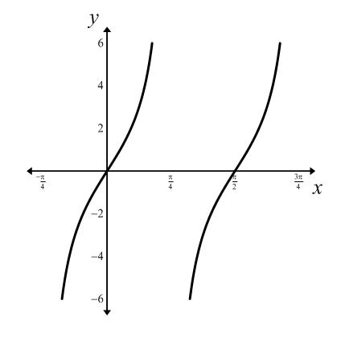
Example 1: Graphing a Tangent Function (continued)
Step 4 Use steps 1-3 to graph one full period of the function.

Slide 11
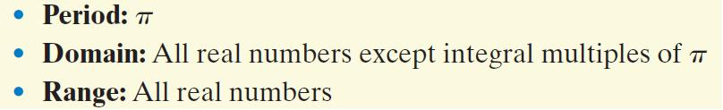
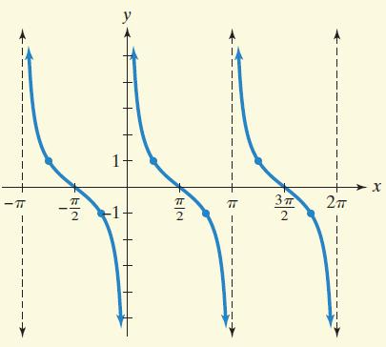
The Cotangent Curve: The Graph of y = cot x and Its Characteristics

Slide 12
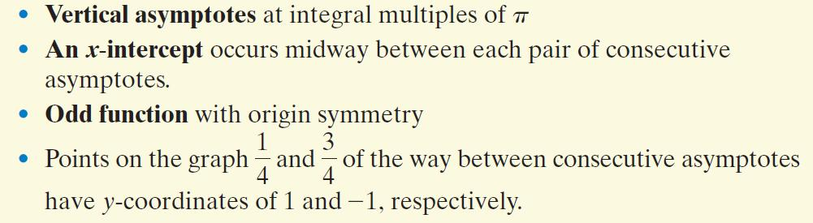
The Cotangent Curve: The Graph of y = cot x and Its Characteristics (continued)

Slide 13
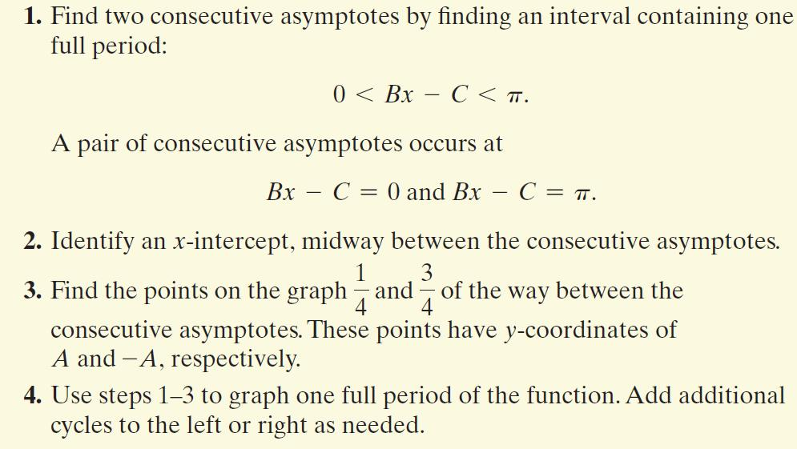
Graphing Variations of y = cot x

Slide 14
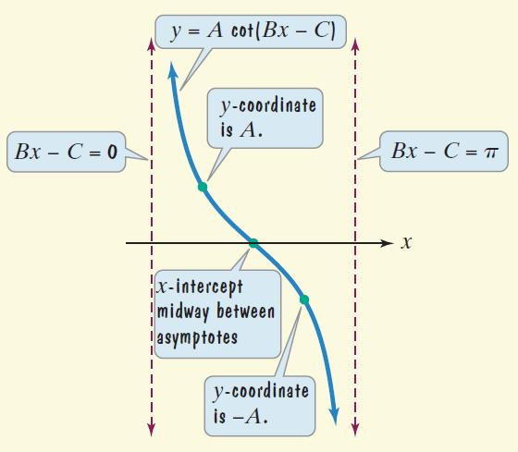
Graphing Variations of y = cot x (continued)

Slide 15
Example 3: Graphing a Cotangent Function
Graph $\frac{1}{2}\cot{\frac{π}{2}x}$.
Step 1 Find two consecutive asymptotes.
An interval containing one period is (0, 2). Thus, two consecutive asymptotes occur at x = 0 and x = 2.
Step 2 Identify an x-intercept midway between the consecutive asymptotes.
x = 1 is midway between x = 0 and x = 2.
The graph passes through (1, 0).
$$A=\frac{1}{2},B=\frac{π}{2},C=0$$
$$0<Bx−C<π$$
$$0<\frac{π}{2}x<π$$
$$0<x<2$$

Slide 16
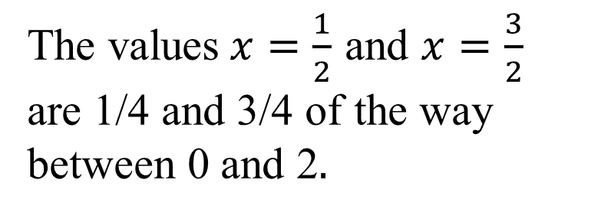

Example 3: Graphing a Cotangent Function (continued)
Step 3 Find points on the graph 1/4 and 3/4 of the way between consecutive asymptotes. These points have y-coordinates of A and –A.
The graph passes through $\left(\frac{1}{2},\frac{1}{2}\right)$and $\left(\frac{3}{2},−\frac{1}{2}\right).$
The values$x=\frac{1}{2}$ and $x=\frac{3}{2}$
are 1/4 and 3/4 of the way
between 0 and 2$.$

Slide 17
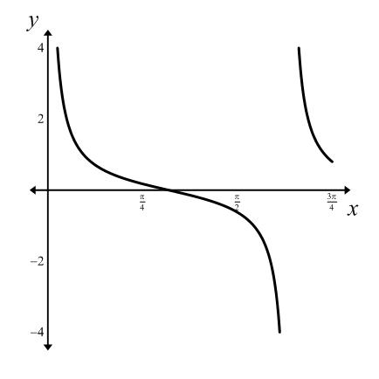
Example 3: Graphing a Cotangent Function (continued)
Step 4 Use steps 1-3 to graph one full period of the function.

Slide 18
The Graphs of y = csc x and y = sec x
We obtain the graphs of the cosecant and the secant curves by using the reciprocal identities
$\csc{x}=\frac{1}{\sin{x}}$ and $\sec{x}=\frac{1}{\cos{x}}$.
We obtain the graph of y = csc x by taking reciprocals of the y-values in the graph of y = sin x. Vertical asymptotes of y = csc x occur at the x-intercepts of y = sin x.
We obtain the graph of y = sec x by taking reciprocals of the y-values in the graph of y = cos x. Vertical asymptotes of
y = sec x occur at the x-intercepts of y = cos x.

Slide 19
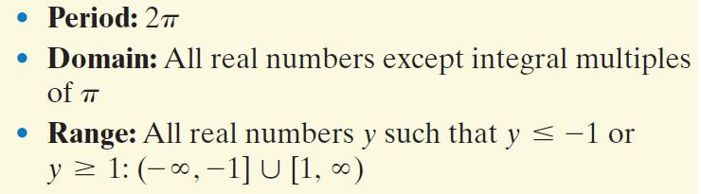
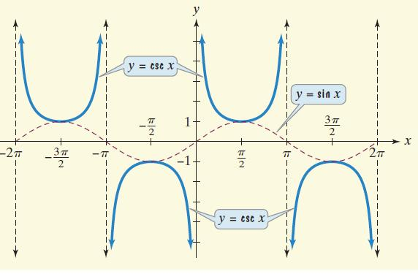
The Cosecant Curve: The Graph of y = csc x and Its Characteristics

Slide 20

The Cosecant Curve: The Graph of y = csc x and Its Characteristics (continued)

Slide 21
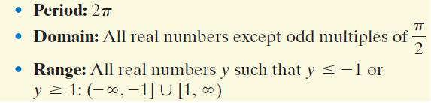
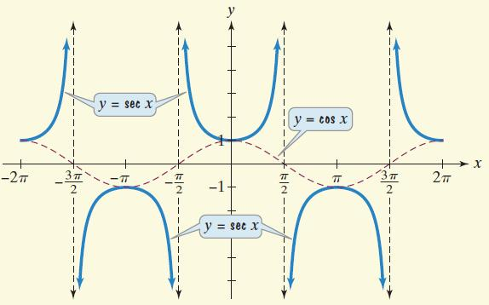
The Secant Curve: The Graph of y = sec x and Its Characteristics

Slide 22

The Secant Curve: The Graph of y = sec x and Its Characteristics (continued)

Slide 23
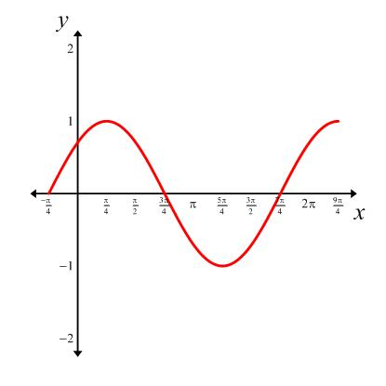
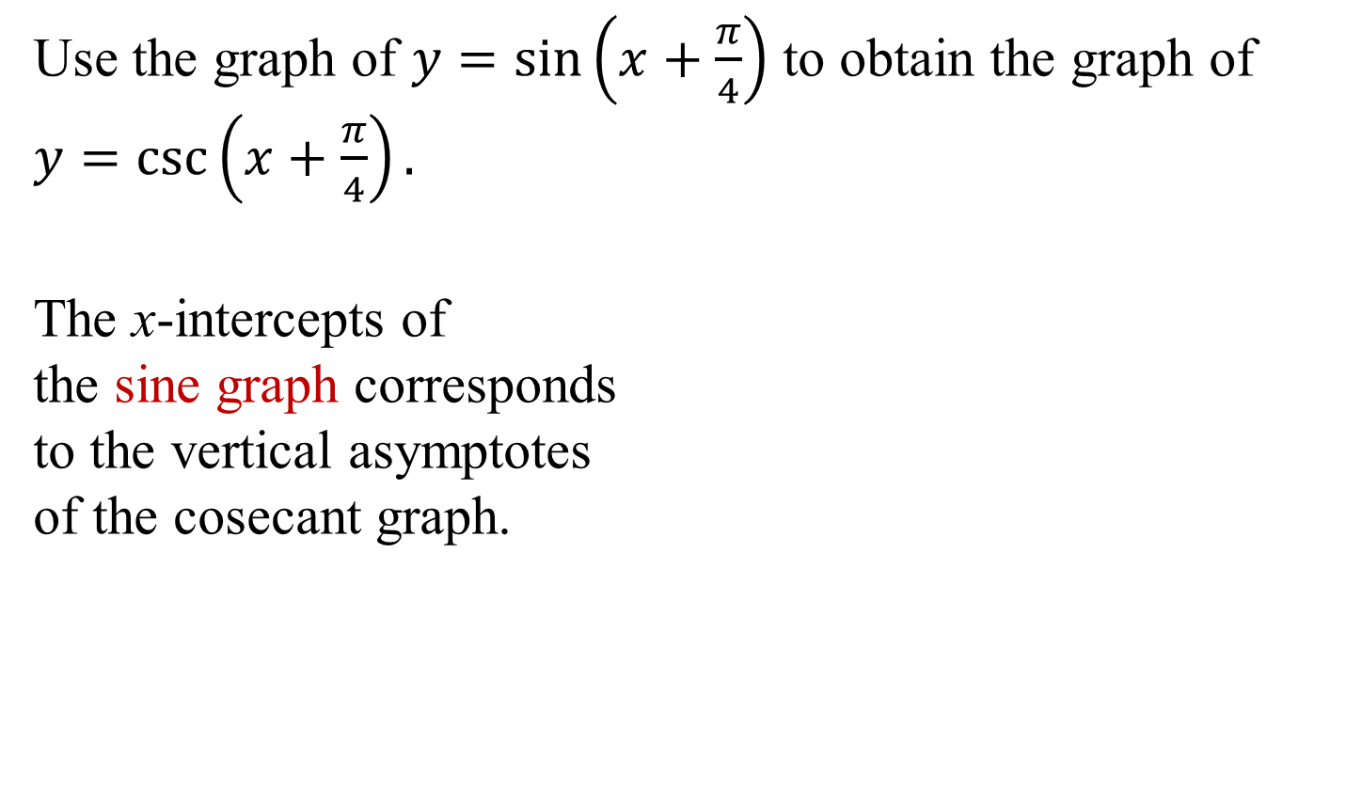
Example 4: Using a Sine Curve to Obtain a Cosecant Curve
Use the graph of $y=\sin\left(x+\frac{π}{4}\right)$ to obtain the graph of $y=\csc\left(x+\frac{π}{4}\right).$
The x-intercepts of
the sine graph corresponds
to the vertical asymptotes
of the cosecant graph.

Slide 24
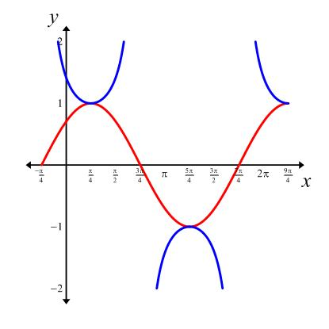
Example 4: Using a Sine Curve to Obtain a Cosecant Curve (continued)
Using the asymptotes as guides, we sketch the graph of $y=\csc\left(x+\frac{π}{4}\right).$
$$y=csc\left(x+\frac{π}{4}\right)$$
$$y=sin\left(x+\frac{π}{4}\right)$$

Slide 25
Example 5: Graphing a Secant Function
Graph y = 2 sec 2x for $−\frac{3π}{4}<x<\frac{3π}{4}.$
We begin by graphing the reciprocal function, y = 2 cos 2x. This equation is of the form y = A cos Bx, with A = 2 and
B = 2.
amplitude: |A| = |2| = 2
period: $\frac{2π}{B}=\frac{2π}{2}=π$
We will use quarter-periods to find x-values for the five key points.

Slide 26
Example 5: Graphing a Secant Function (continued)
The x-values for the five key points are: $0, \frac{π}{4}, \frac{π}{2},\frac{3π}{4} and π.$
Evaluating the function y = 2 cos 2x at each of these values of x, the key points are:
$$\left(0, 2\right), \left(\frac{π}{4}, 0\right),\left(\frac{π}{2},−2\right),\left(\frac{3π}{4},0\right),\left(π,2\right)$$

Slide 27
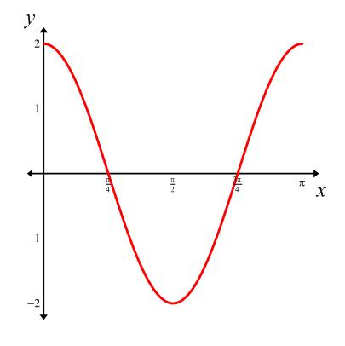
Example 5: Graphing a Secant Function (continued)
The key points for our graph of y = 2 cos 2x are:
$\left(0, 2\right), \left(\frac{π}{4}, 0\right),\left(\frac{π}{2},−2\right),\left(\frac{3π}{4},0\right),\left(π,2\right)$.
We draw vertical asymptotes
through the x-intercepts to use
as guides for the graph of
y = 2 sec 2x.

Slide 28
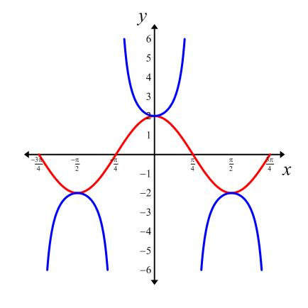
Example 5: Graphing a Secant Function (continued)
Graph y = 2 sec 2x for $−\frac{3π}{4}<x<\frac{3π}{4}.$
$$y=2sec2x$$
$$y=2cos2x$$

Slide 29
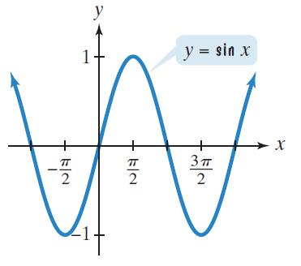
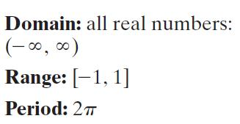
The Six Curves of Trigonometry

Slide 30
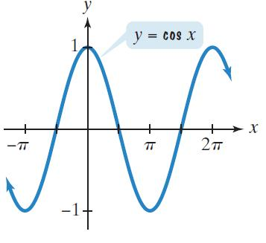
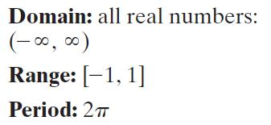
The Six Curves of Trigonometry (continued)

Slide 31
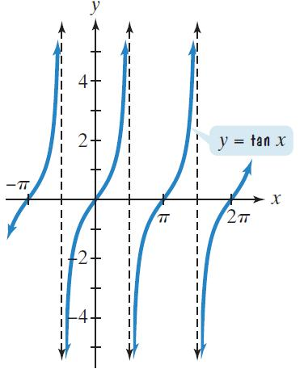
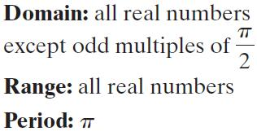
The Six Curves of Trigonometry (continued)

Slide 32
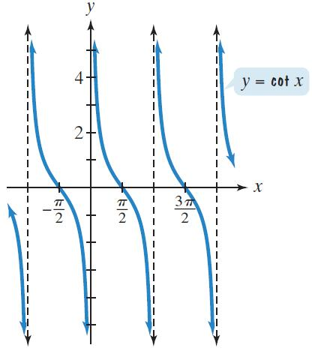
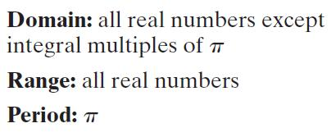
The Six Curves of Trigonometry (continued)

Slide 33
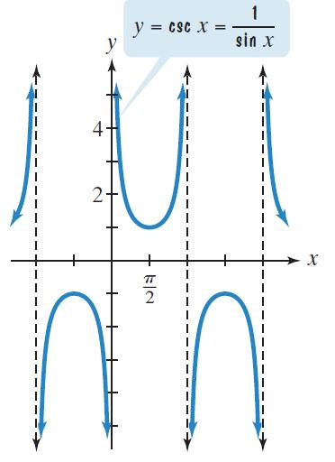
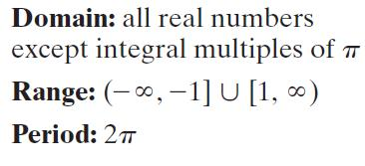
The Six Curves of Trigonometry (continued)

Slide 34
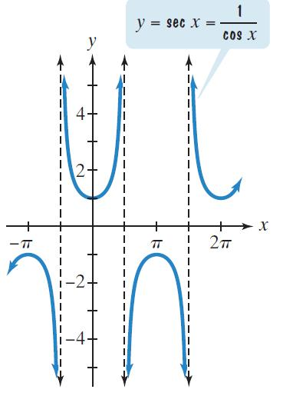
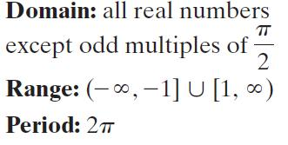
The Six Curves of Trigonometry (continued)

