Slide 1

Chapter 4
Trigonometric Functions
4.5 Graphs of Sine and Cosine Functions

Slide 2
Objectives
Understand the graph of y = sin x.
Graph variations of y = sin x.
Understand the graph of y = cos x.
Graph variations of y = cos x.
Use vertical shifts of sine and cosine curves.
Model periodic behavior.

Slide 3
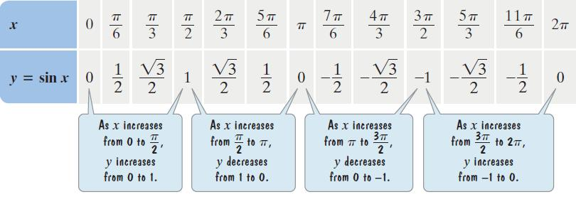
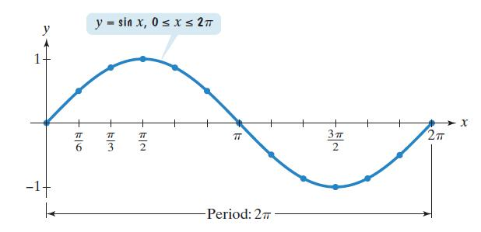
The Graph of y = sinx

Slide 4
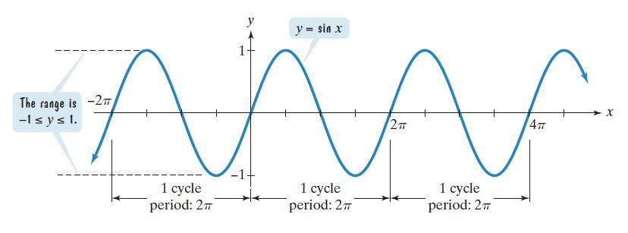

Some Properties of the Graph of y = sinx
The domain is $\left(−∞, ∞\right)$.
The range is [ –1, 1].
The period is 2π.
The function is an odd function: sin(– x) = –sin x.

Slide 5
Graphing Variations of y = sinx
1. Identify the amplitude and the period.
2. Find the values of x for the five key points—the three x-intercepts, the maximum point, and the minimum point. Start with the value of x where the cycle begins and add quarter-periods—that is, period/4—to find successive values of x.
3. Find the values of y for the five key points by evaluating the function at each value of x from step 2.
4. Connect the five key points with a smooth curve and graph one complete cycle of the given function.
5. Extend the graph in step 4 to the left or right as desired.

Slide 6
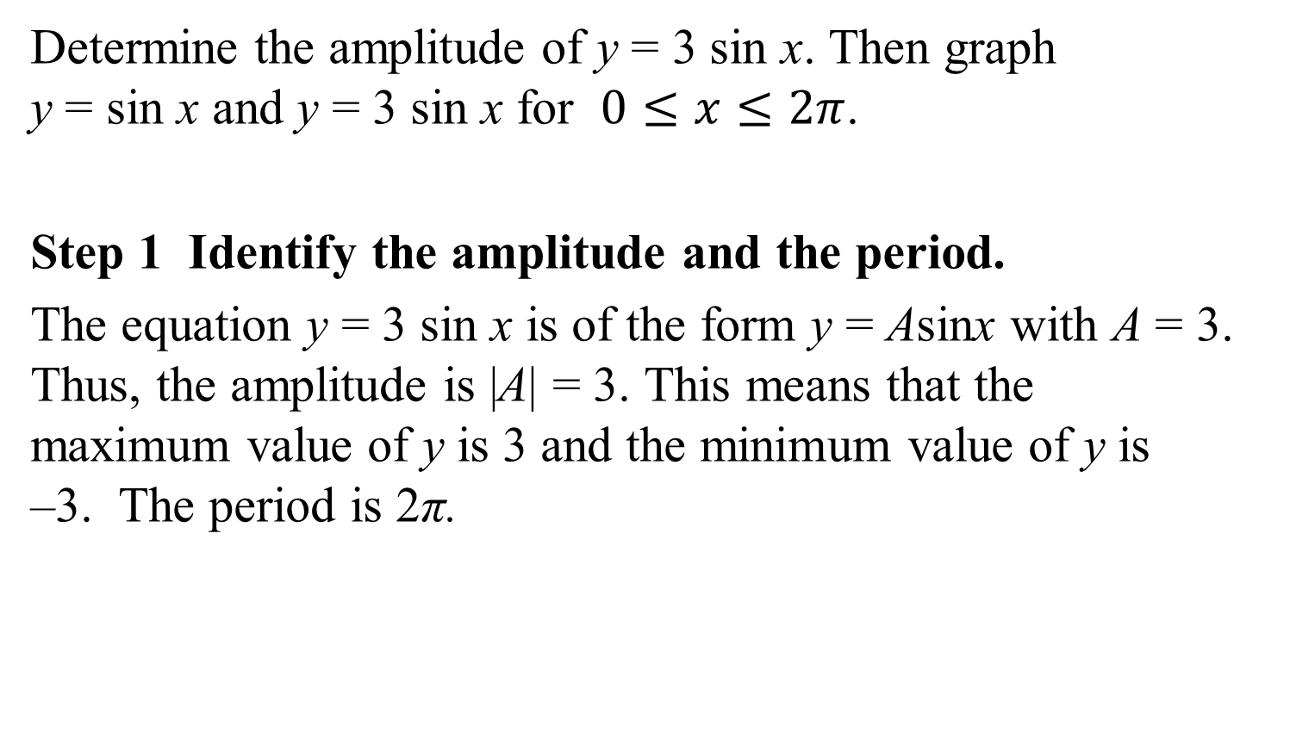
Example 1: Graphing a Variation of y = sinx
Determine the amplitude of y = 3 sin x. Then graph
y = sin x and y = 3 sin x for $0≤x≤2π$.
Step 1 Identify the amplitude and the period.
The equation y = 3 sin x is of the form y = Asinx with A = 3. Thus, the amplitude is |A| = 3. This means that the maximum value of y is 3 and the minimum value of y is
–3. The period is 2π.

Slide 7



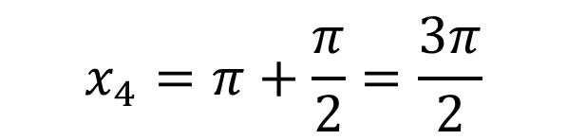
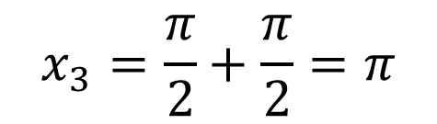
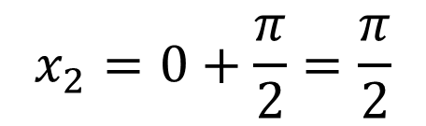
Example 1: Graphing a Variation of y = sinx
(continued)
Step 2 Find the values of x for the five key points. To generate x-values for each of the five key points, we begin by dividing the period, 2π by 4. The cycle begins at x₁ = 0. We add quarter periods to generate x-values for each of the key points.
$$\frac{2π}{4}=\frac{π}{2}$$
$$x_{2}=0+\frac{π}{2}=\frac{π}{2}$$
$$x_{3}=\frac{π}{2}+\frac{π}{2}=π$$
$$x_{1}=0$$
$$x_{4}=π+\frac{π}{2}=\frac{3π}{2}$$
$$x_{5}=\frac{3π}{2}+\frac{π}{2}=2π$$

Slide 8



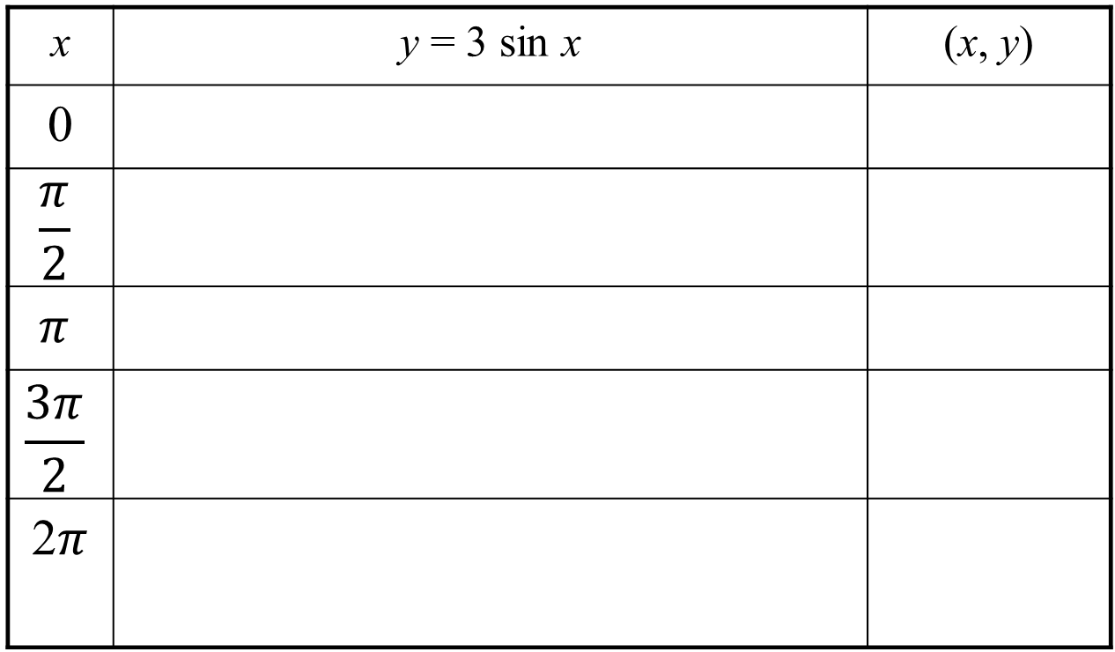
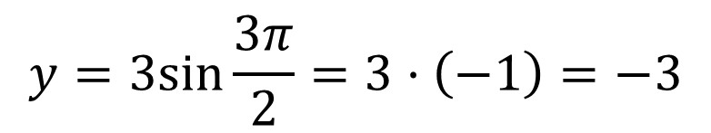


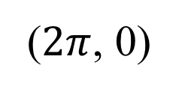
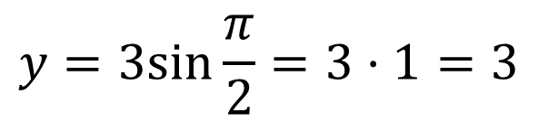
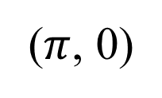
Example 1: Graphing a Variation of y = sinx
(continued)
Step 3 Find the values of y for the five key points.
x | y = 3 sin x | (x, y)
0
$$\frac{π}{2}$$
$$π$$
$$\frac{3π}{2}$$
2$π$
$$y=3sin0=3·0=0$$
(0, 0)
$$y=3sin\frac{π}{2}=3·1=3$$
$$\left(\frac{π}{2},3\right)$$
$$y=3sinπ=3·0=0$$
($π$, 0)
$$y=3sin\frac{3π}{2}=3·\left(−1\right)=−3$$
$$\left(\frac{3π}{2},−3\right)$$
$$y=3sin2π=3·0=0$$
($2π$, 0)

Slide 9
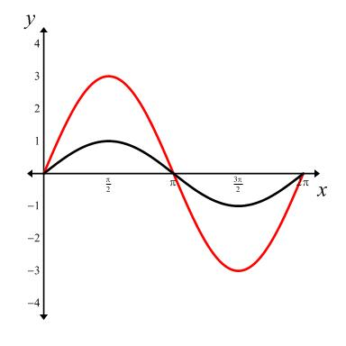
Example 1: Graphing a Variation of y = sinx
(continued)
Step 4 Connect the five key points with a smooth curve
and graph one complete cycle of the given function.
amplitude = 3
period

Slide 10
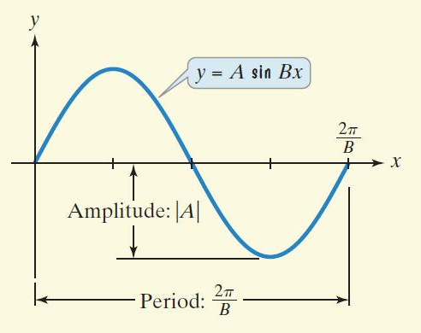

Amplitudes and Periods
The graph of y = A sin Bx, B > 0, has
amplitude = |A|
period = $\frac{2π}{B}$.

Slide 11
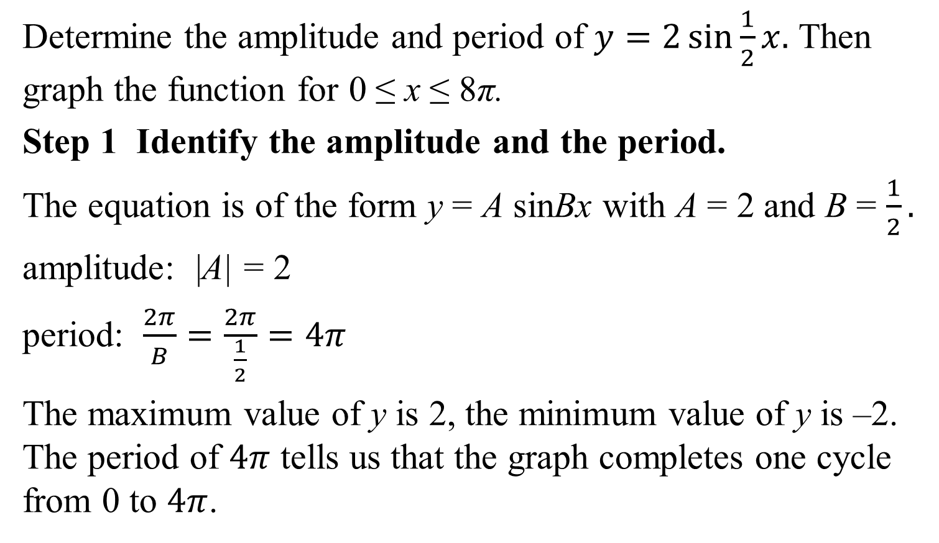
Example 3: Graphing a Function of the Form y = AsinBx
Determine the amplitude and period of $y=2\sin{\frac{1}{2}x.}$ Then graph the function for 0 ≤ x ≤ 8π.
Step 1 Identify the amplitude and the period.
The equation is of the form y = A sinBx with A = 2 and B = $\frac{1}{2}.$
amplitude: |A| = 2
period: $\frac{2π}{B}=\frac{2π}{\frac{1}{2}}=4π$
The maximum value of y is 2, the minimum value of y is –2. The period of $4π$ tells us that the graph completes one cycle from 0 to $4π$.

Slide 12

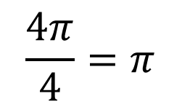





Example 3: Graphing a Function of the Form y = AsinBx (continued)
Step 2 Find the values of x for the five key points.
To generate x-values for each of the five key points, we begin by dividing the period, $4π$, by 4. The cycle begins at x₁ = 0. We add quarter periods to generate x-values for each of the key points.
$$\frac{4π}{4}=π$$
$$x_{1}=0$$
$$x_{2}=0+π=π$$
$$x_{3}=π+π=2π$$
$$x_{4}=2π+π=3π$$
$$x_{5}=3π+π=4π$$

Slide 13
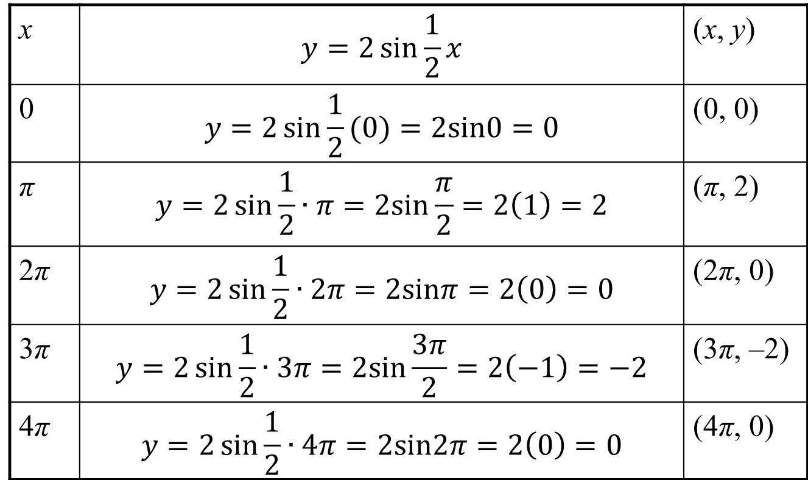
Example 3: Graphing a Function of the Form y = AsinBx (continued)
Step 3 Find the values of y for the five key points.
x | $$y=2\sin{\frac{1}{2}x}$$ | (x, y)
0 | $$y=2\sin{\frac{1}{2}(0)}=2sin0=0$$ | (0, 0)
π | $$y=2\sin{\frac{1}{2}∙π=2sin\frac{π}{2}=2\left(1\right)=2}$$ | (π, 2)
2π | $$y=2\sin{\frac{1}{2}∙2π=2sinπ=2\left(0\right)=0}$$ | (2π, 0)
3π | $$y=2\sin{\frac{1}{2}∙3π=2sin\frac{3π}{2}=2\left(−1\right)=−2}$$ | (3π, –2)
4π | $$y=2\sin{\frac{1}{2}∙4π=2sin2π=2\left(0\right)=0}$$ | (4π, 0)

Slide 14
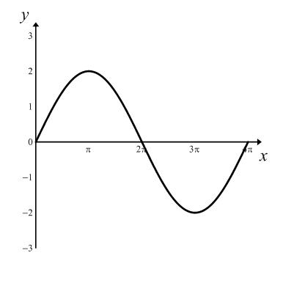
Example 3: Graphing a Function of the Form y = AsinBx (continued)
Step 4 Connect the five key points with a smooth curve and graph one complete cycle of the given function.
amplitude = 2
period

Slide 15
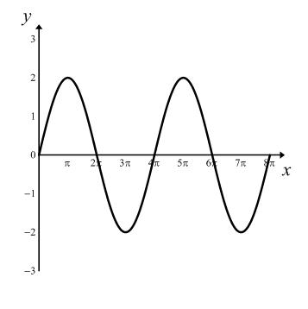
Example 3: Graphing a Function of the Form y = AsinBx (continued)
Step 5 Extend the graph in step 4 to the left or right as desired. We will extend the graph to include
the interval 0 ≤ x ≤ 8π.
amplitude = 2
period

Slide 16
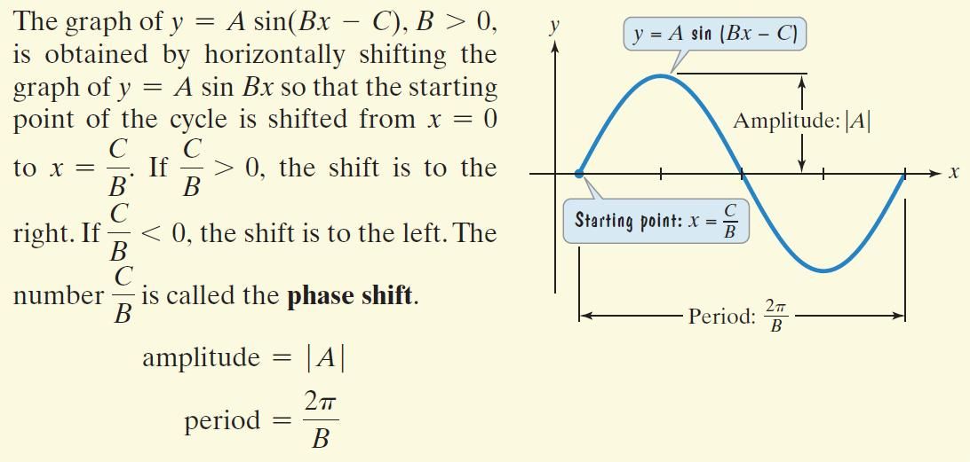
The Graph of y = Asin(Bx – C)

Slide 17

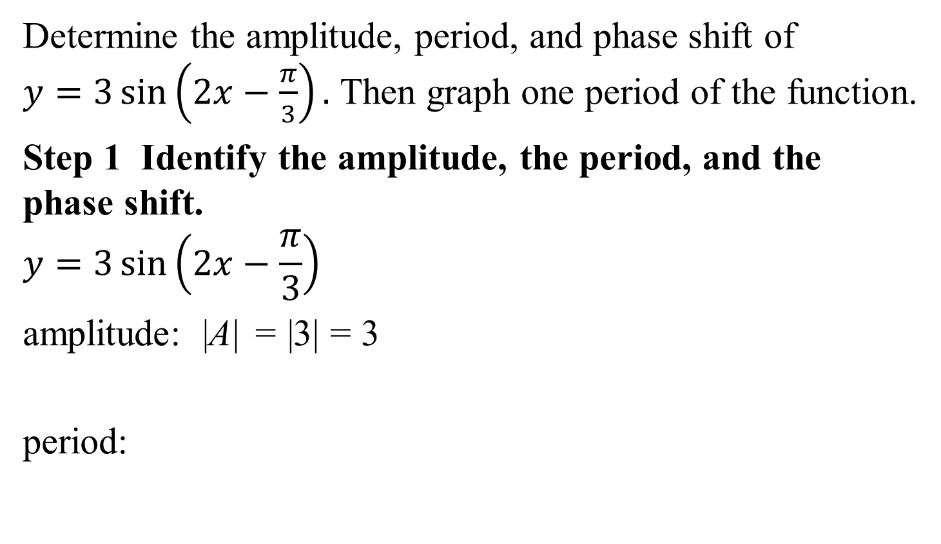
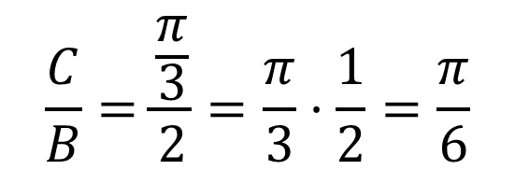
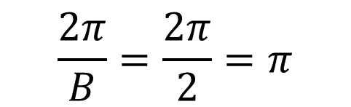
Example 4: Graphing a Function of the Form y = Asin(Bx – C)
Determine the amplitude, period, and phase shift of
$y=3\sin\left(2x−\frac{π}{3}\right).$ Then graph one period of the function.
Step 1 Identify the amplitude, the period, and the phase shift.
$$y=3\sin\left(2x−\frac{π}{3}\right)$$
amplitude: |A| = |3| = 3
period:
$$A=3,B=2,C=\frac{π}{3}$$
$$\frac{C}{B}=\frac{\frac{π}{3}}{2}=\frac{π}{3}·\frac{1}{2}=\frac{π}{6}$$
$$\frac{2π}{B}=\frac{2π}{2}=π$$
phase shift:

Slide 18

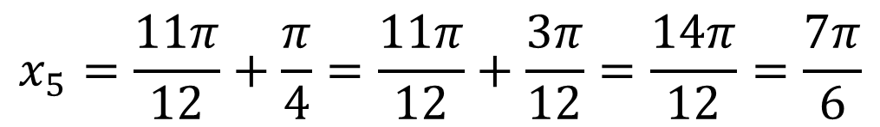

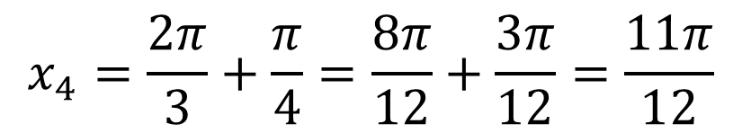
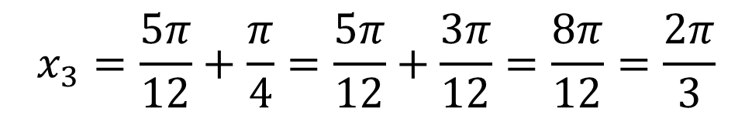
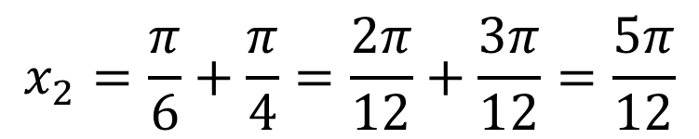
Example 4: Graphing a Function of the Form y = Asin(Bx – C) (continued)
Step 2 Find the values of x for the five key points.
$$\frac{period}{4}=\frac{π}{4}$$
$$x_{1}=\frac{π}{6}$$
$$x_{2}=\frac{π}{6}+\frac{π}{4}=\frac{2π}{12}+\frac{3π}{12}=\frac{5π}{12}$$
$$x_{3}=\frac{5π}{12}+\frac{π}{4}=\frac{5π}{12}+\frac{3π}{12}=\frac{8π}{12}=\frac{2π}{3}$$
$$x_{4}=\frac{2π}{3}+\frac{π}{4}=\frac{8π}{12}+\frac{3π}{12}=\frac{11π}{12}$$
$$x_{5}=\frac{11π}{12}+\frac{π}{4}=\frac{11π}{12}+\frac{3π}{12}=\frac{14π}{12}=\frac{7π}{6}$$

Slide 19
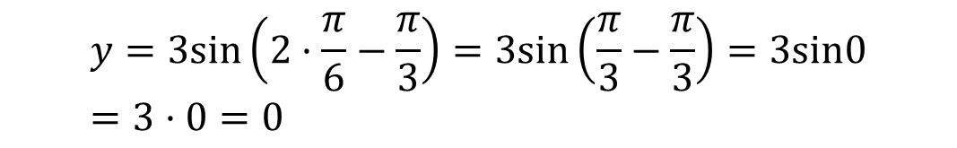
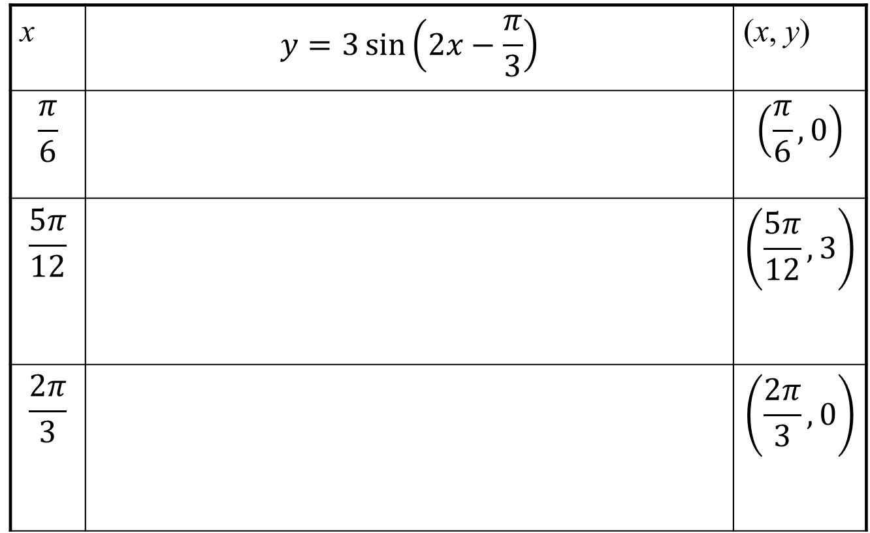
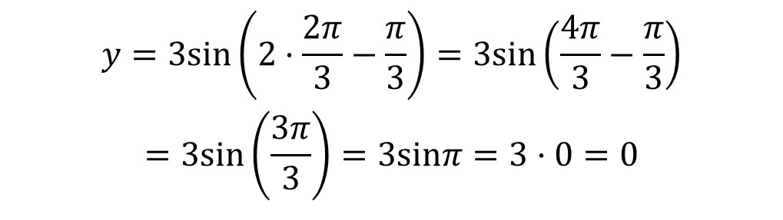
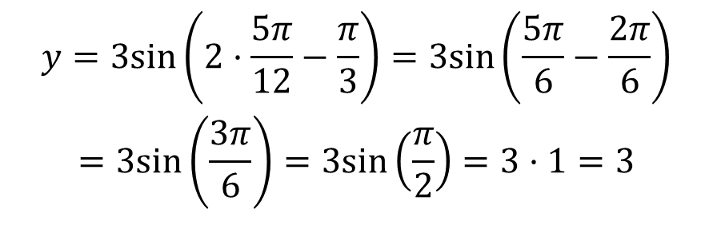
Example 4: Graphing a Function of the Form y = Asin(Bx – C) (continued)
Step 3 Find the values of y for the five key points.
x | $$y=3\sin\left(2x−\frac{π}{3}\right)$$ | (x, y)
$$\frac{π}{6}$$ |  | $$\left(\frac{π}{6}, 0\right)$$
$$\frac{5π}{12}$$ |  | $$\left(\frac{5π}{12}, 3\right)$$
$$\frac{2π}{3}$$ |  | $$\left(\frac{2π}{3}, 0\right)$$
$$y=3sin\left(2·\frac{π}{6}−\frac{π}{3}\right)=3sin\left(\frac{π}{3}−\frac{π}{3}\right)=3sin0 \\ =3·0=0$$
$$\begin{matrix}\begin{aligned}y=3sin\left(2·\frac{5π}{12}−\frac{π}{3}\right)=3sin\left(\frac{5π}{6}−\frac{2π}{6}\right) \\ =3sin\left(\frac{3π}{6}\right)=3sin\left(\frac{π}{2}\right)=3·1=3\end{aligned} \\ \end{matrix}$$
$$\begin{matrix}\begin{aligned}y=3sin\left(2·\frac{2π}{3}−\frac{π}{3}\right)=3sin\left(\frac{4π}{3}−\frac{π}{3}\right) \\ =3sin\left(\frac{3π}{3}\right)=3sinπ=3·0=0\end{aligned} \\ \end{matrix}$$

Slide 20
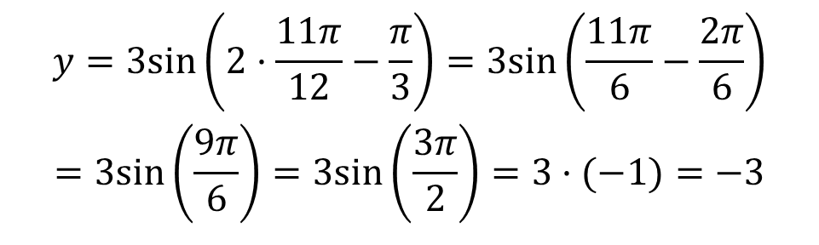
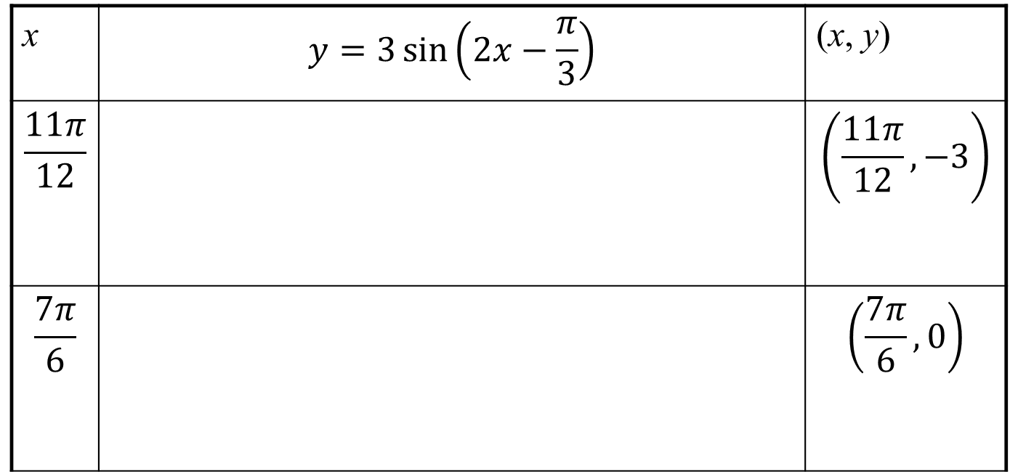
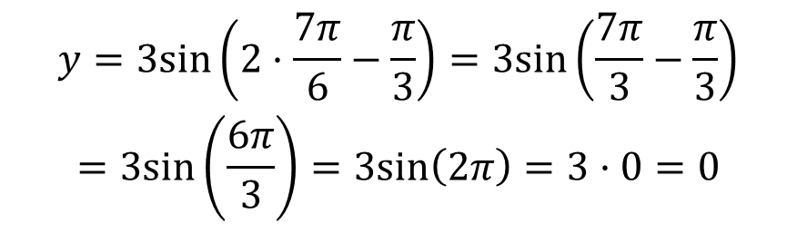
Example 4: Graphing a Function of the Form y = Asin(Bx – C) (continued)
Step 3 Find the values of y for the five key points.
x | $$y=3\sin\left(2x−\frac{π}{3}\right)$$ | (x, y)
$$\frac{11π}{12}$$ |  | $$\left(\frac{11π}{12}, −3\right)$$
$$\frac{7π}{6}$$ |  | $$\left(\frac{7π}{6}, 0\right)$$
$$\begin{matrix}\begin{aligned}y=3sin\left(2·\frac{11π}{12}−\frac{π}{3}\right)=3sin\left(\frac{11π}{6}−\frac{2π}{6}\right) \\ =3sin\left(\frac{9π}{6}\right)=3sin\left(\frac{3π}{2}\right)=3·(−1)=−3\end{aligned} \\ \end{matrix}$$
$$\begin{matrix}\begin{aligned}y=3sin\left(2·\frac{7π}{6}−\frac{π}{3}\right)=3sin\left(\frac{7π}{3}−\frac{π}{3}\right) \\ =3sin\left(\frac{6π}{3}\right)=3sin\left(2π\right)=3·0=0\end{aligned} \\ \end{matrix}$$

Slide 21
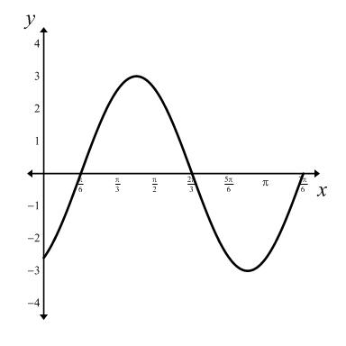

Example 4: Graphing a Function of the Form y = Asin(Bx – C) (continued)
Step 4 Connect the five key points with a smooth curve and graph one complete cycle of the function
$$y=3\sin\left(2x−\frac{π}{3}\right).$$
amplitude = 3
phase shift
period

Slide 22
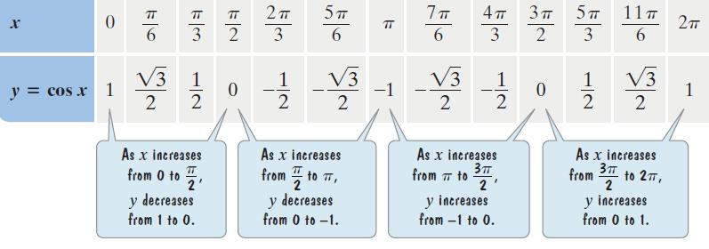
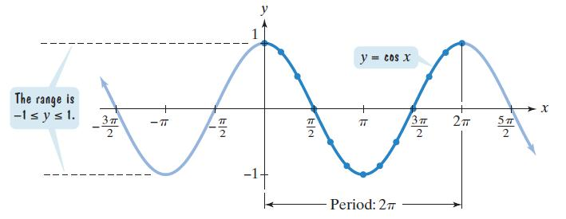
The graph of y = cosx

Slide 23

Some Properties of the Graph of y = cosx
The domain is $\left(−∞, ∞\right)$.
The range is [ –1, 1].
The period is 2π.
The function is an even function: cos(– x) = cos x.

Slide 24
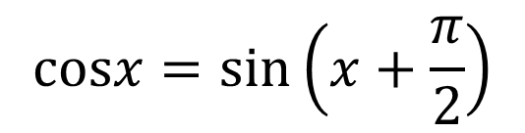
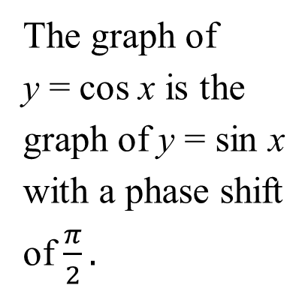
Sinusoidal Graphs
The graphs of sine
functions and cosine
functions are called
sinusoidal graphs.
The graph of
y = cos x is the
graph of y = sin x
with a phase shift
of $\frac{π}{2}.$
$$cosx=sin\left(x+\frac{π}{2}\right)$$

Slide 25
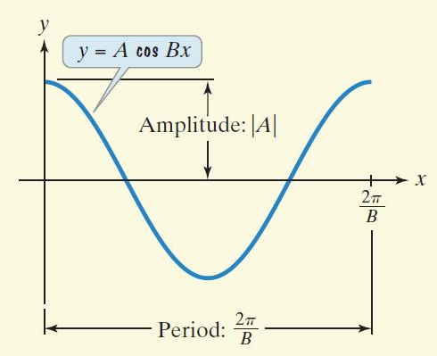

Graphing Variations of y = cosx
The graph of y = A cos Bx, B > 0, has
amplitude = |A|
period = $\frac{2π}{B}$.

Slide 26


Example 5: Graphing a Function of the Form y = AcosBx
Determine the amplitude and period of $y=−4\cos{πx.}$
Then graph the function for –2 ≤ x ≤ 2.
Step 1 Identify the amplitude and the period.
amplitude: |A| = |–4| = 4
period:
$$\frac{2π}{B}=\frac{2π}{π}=2$$

Slide 27






Example 5: Graphing a Function of the Form y = AcosBx (continued)
Step 2 Find the values of x for the five key points.
$$\frac{period}{4}=\frac{2}{4}=\frac{1}{2}$$
$$x_{2}=0+\frac{1}{2}=\frac{1}{2}$$
$$x_{1}=0$$
$$x_{3}=\frac{1}{2}+\frac{1}{2}=1$$
$$x_{4}=1+\frac{1}{2}=\frac{3}{2}$$
$$x_{5}=\frac{3}{2}+\frac{1}{2}=2$$

Slide 28

Example 5: Graphing a Function of the Form y = AcosBx (continued)
Step 3 Find the values of y for the five key points.
x | $$y=−4\cos{πx}$$ | (x, y)
0 | $$y=−4\cos\left(π∙0\right)=−4cos 0=−4\left(1\right)=−4$$ | $$\left(0,−4\right)$$
$$\frac{1}{2}$$ | $$y=−4\cos\left(π∙\frac{1}{2}\right)=−4cos \frac{π}{2}=−4\left(0\right)=0$$ | $$\left(\frac{1}{2}, 0\right)$$
1 | $$y=−4\cos\left(π∙1\right)=−4cos π=−4\left(−1\right)=4$$ | $$\left(1, 4\right)$$

Slide 29

Example 5: Graphing a Function of the Form y = AcosBx (continued)
Step 3 Find the values of y for the five key points.
x | $$y=−4\cos{πx}$$ | (x, y)
$$\frac{3}{2}$$ | $$y=−4\cos\left(π∙\frac{3}{2}\right)=−4cos \frac{3π}{2}=−4\left(0\right)=0$$ | $$\left(\frac{3}{2}, 0\right)$$
2 | $$y=−4\cos\left(π∙2\right)=−4cos 2π=−4\left(1\right)=−4$$ | $$\left(2, −4\right)$$

Slide 30
Example 5: Graphing a Function of the Form y = AcosBx (continued)
Step 4 Connect the five key points with a smooth curve
and graph one complete cycle of the given function.
amplitude = 4
period = 2

Slide 31
Example 5: Graphing a Function of the Form y = AcosBx (continued)
Step 5 Extend the graph to the left or right as desired.
amplitude = 4
period = 2

Slide 32

The Graph of y = Acos(Bx – C)

Slide 33



Example 6: Graphing a Function of the Form y = Acos(Bx – C)
Determine the amplitude, period, and phase shift of
$y=\frac{3}{2}\cos\left(2x+π\right)$. Then graph one period of the function.
Step 1 Identify the amplitude, the period, and the phase shift. $y=A\cos\left(Bx−C\right)= \frac{3}{2}\cos\left(2x+π\right)$.
amplitude: $\left|\frac{3}{2}\right|=\frac{3}{2}$
period:
$$\frac{2π}{B}=\frac{2π}{2}=π$$
$$\frac{C}{B}=\frac{−π}{2}=−\frac{π}{2}$$
phase shift:

Slide 34






Example 6: Graphing a Function of the Form y = Acos(Bx – C) (continued)
Step 2 Find the x-values for the five key points.
$$\frac{period}{4}=\frac{π}{4}$$
$$x_{1}=−\frac{π}{2}$$
$$x_{2}=−\frac{π}{2}+\frac{π}{4}=−\frac{π}{4}$$
$$x_{3}=−\frac{π}{4}+\frac{π}{4}=0$$
$$x_{4}=0+\frac{π}{4}=\frac{π}{4}$$
$$x_{5}=\frac{π}{4}+\frac{π}{4}=\frac{2π}{4}=\frac{π}{2}$$

Slide 35

Example 6: Graphing a Function of the Form y = Acos(Bx – C) (continued)
Step 3 Find the values of y for the five key points.
x | $$y=\frac{3}{2}\cos\left(2x+π\right)$$ | (x, y)
$$−\frac{π}{2}$$ | $$y=\frac{3}{2}\cos\left(2\left(−\frac{π}{2}\right)+π\right)=\frac{3}{2}\cos\left(−π+π\right)=\frac{3}{2}\cos{0=\frac{3}{2}∙1=\frac{3}{2}}$$ | $$\left(−\frac{π}{2},\frac{3}{2}\right)$$
$$−\frac{π}{4}$$ | $$y=\frac{3}{2}\cos\left(2\left(−\frac{π}{4}\right)+π\right)=\frac{3}{2}\cos\left(−\frac{π}{2}+π\right)=\frac{3}{2}\cos{\frac{π}{2}=\frac{3}{2}∙0=0}$$ | $$\left(−\frac{π}{4}, 0 \right)$$
0 | $$y=\frac{3}{2}\cos\left(2\left(0\right)+π\right)=\frac{3}{2}\cos\left(π\right)=\frac{3}{2}\left(−1\right)=−\frac{3}{2}$$ | $$\left(0, −\frac{3}{2}\right)$$

Slide 36

Example 6: Graphing a Function of the Form y = Acos(Bx – C) (continued)
Step 3 Find the values of y for the five key points.
x | $$y=\frac{3}{2}\cos\left(2x+π\right)$$ | (x, y)
$$\frac{π}{4}$$ | $$y=\frac{3}{2}\cos\left(2\left(\frac{π}{4}\right)+π\right)=\frac{3}{2}\cos\left(\frac{π}{2}+π\right)=\frac{3}{2}\cos{\frac{3π}{2}=\frac{3}{2}∙0=0}$$ | $$\left(\frac{π}{4}, 0\right)$$
$$\frac{π}{2}$$ | $$y=\frac{3}{2}\cos\left(2\left(\frac{π}{2}\right)+π\right)=\frac{3}{2}\cos\left(π+π\right)=\frac{3}{2}\cos{2π=\frac{3}{2}∙1=\frac{3}{2}}$$ | $$\left(\frac{π}{2},\frac{3}{2}\right)$$

Slide 37

Example 6: Graphing a Function of the Form y = Acos(Bx – C) (continued)
Step 4 Connect the five key points with a smooth curve
and graph one complete cycle of the given function.
amplitude
period

Slide 38

Vertical Shifts of Sinusoidal Graphs
For sinusoidal graphs of the form $y=A\sin\left(Bx−C\right)+D$
and $y=A\cos\left(Bx−C\right)+D.$ The constant D causes a vertical shift in the graph.
These vertical shifts result in sinusoidal graphs oscillating about the horizontal line y = D rather than about the x-axis.
The maximum value of y is D + |A|.
The minimum value of y is D – |A|.

Slide 39


Example 7: A Vertical Shift
Graph one period of the function $y=2\cos{x}+1.$
Step 1 Identify the amplitude, period, phase shift, and vertical shift.
$$y=A\cos\left(Bx−C\right)+D$$
amplitude: |A| = |2| = 2
phase shift: 0
$$\frac{2π}{B}=\frac{2π}{1}=2π$$
period:
vertical shift:
one unit upward

Slide 40






Example 7: A Vertical Shift (continued)
Step 2 Find the values of x for the five key points.
$$\frac{period}{4}=\frac{2π}{4}=\frac{π}{2}$$
$$x_{2}=0+\frac{π}{2}=\frac{π}{2}$$
$$x_{3}=\frac{π}{2}+\frac{π}{2}=π$$
$$x_{1}=0$$
$$x_{4}=π+\frac{π}{2}=\frac{3π}{2}$$
$$x_{5}=\frac{3π}{2}+\frac{π}{2}=2π$$

Slide 41






Example 7: A Vertical Shift (continued)
Step 3 Find the values of y for the five key points.
x | $$y=2\cos{x}+1$$ | (x, y)
0 | $$y=2cos0+1=2·1+1=3$$
$$\frac{π}{2}$$
$$π$$ | $$y=2cos\left(π\right)+1=2\left(−1\right)+1=−1$$
$$\frac{3π}{2}$$ | $$y=2cos\left(\frac{3π}{2}\right)+1=2·0+1=1$$
2$π$ | $$y=2cos\left(2π\right)+1=2·1+1=3$$
(0, 3)
$$y=2cos\left(\frac{π}{2}\right)+1=2·0+1=1$$
$$\left(\frac{π}{2},1\right)$$
($π$, $−1$)
$$\left(\frac{3π}{2},1\right)$$
($2π$, 3)

Slide 42

Example 7: A Vertical Shift (continued)
Step 4 Connect the five key points with a smooth curve
and graph one complete cycle of the given function.

Slide 43
Example 9: Modeling Periodic Behavior
A region that is 30° north of the Equator averages a minimum of 10 hours of daylight in December. Hours of daylight are at a maximum of 14 hours in June. Let x represent the month of the year, with 1 for January, 2 for February, 3 for March, and 12 for December. If y represents the number of hours of daylight in month x, use a sine function of the form y = Asin(Bx – C) + D to model the hours of daylight.
Because the hours of daylight range from a minimum of 10 to a maximum of 14, the curve oscillates about the middle value, 12 hours. Thus, D = 12.

Slide 44



Example 9: Modeling Periodic Behavior (continued)
The maximum number of hours of daylight is 14, which is 2 hours more than 12 hours. Thus, A, the amplitude, is 2; A = 2.
One complete cycle occurs over a period of 12 months.
$$12=\frac{2π}{B}$$
$$12B=2π$$
$$B=\frac{2π}{12}=\frac{π}{6}$$

Slide 45






Example 9: Modeling Periodic Behavior (continued)
The starting point of the cycle is March, x = 3.
The phase shift is $\frac{π}{2}.$
The equation that models the hours of daylight is
$$3=\frac{C}{B}$$
$$3=\frac{C}{\frac{π}{6}}$$
$$C=3·\frac{π}{6}=\frac{3π}{6}=\frac{π}{2}$$
$$A=2,B=\frac{π}{6},C=\frac{π}{2},D=12$$
$$y=2sin\left(\frac{π}{6}x−\frac{π}{2}\right)+12.$$

