Slide 1

Chapter 4
Trigonometric Functions
4.2 Trigonometric Functions: The Unit Circle

Slide 2
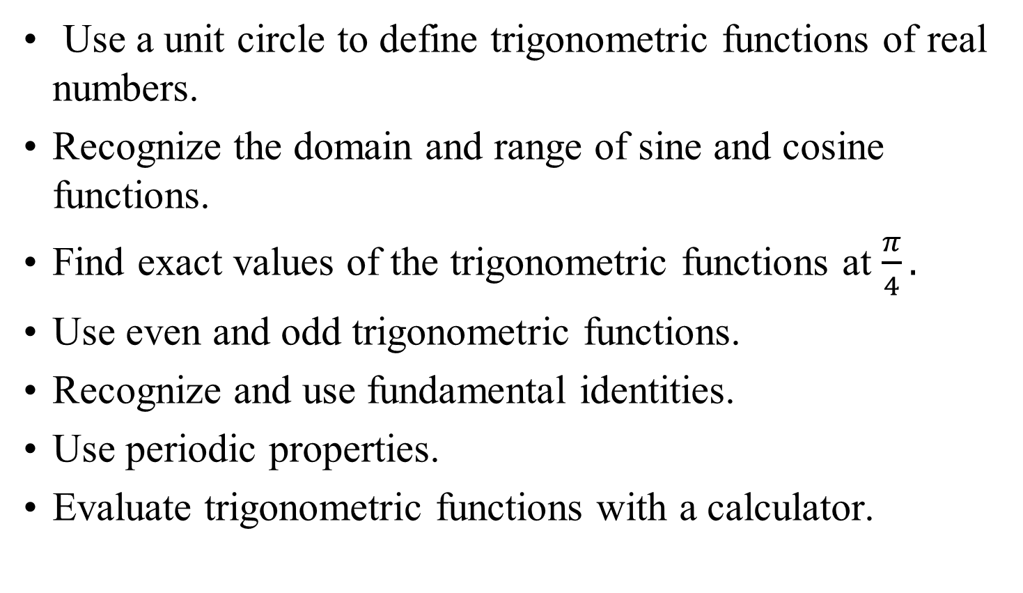
Objectives
Use a unit circle to define trigonometric functions of real numbers.
Recognize the domain and range of sine and cosine functions.
Find exact values of the trigonometric functions at $\frac{π}{4}.$
Use even and odd trigonometric functions.
Recognize and use fundamental identities.
Use periodic properties.
Evaluate trigonometric functions with a calculator.

Slide 3
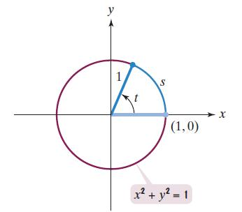
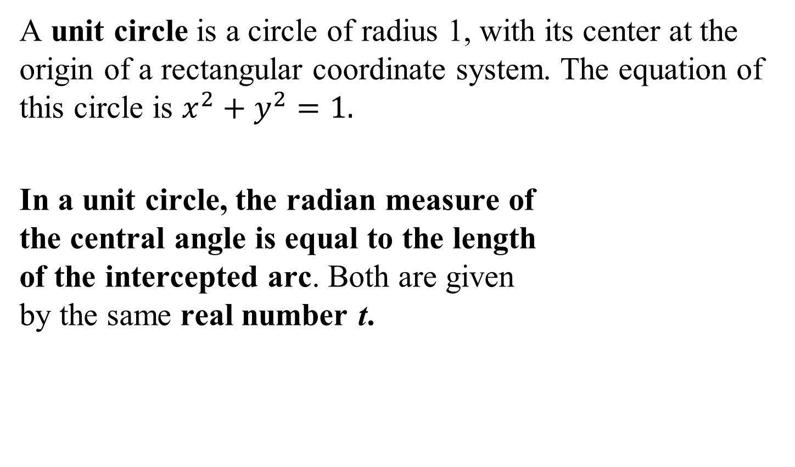
The Unit Circle
A unit circle is a circle of radius 1, with its center at the origin of a rectangular coordinate system. The equation of this circle is $x^{2}+y^{2}=1.$
In a unit circle, the radian measure of
the central angle is equal to the length
of the intercepted arc. Both are given
by the same real number t.

Slide 4
The Six Trigonometric Functions
Name | Abbreviation | Name | Abbreviation
sine | sin | cosecant | csc
cosine | cos | secant | sec
tangent | tan | cotangent | cot

Slide 5


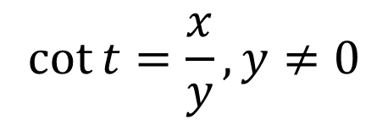
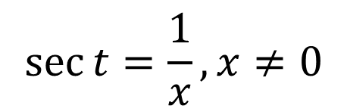
Definitions of the Trigonometric Functions in Terms of a Unit Circle
If t is a real number and P = (x, y) is the point on the unit circle that corresponds to t, then
$$\sin{t}=y$$
$$\cos{t}=x$$
$$\tan{t}=\frac{y}{x},x≠0$$
$$\csc{t}=\frac{1}{y},y≠0$$
$$\sec{t}=\frac{1}{x},x≠0$$
$$\cot{t}=\frac{x}{y},y≠0$$

Slide 6
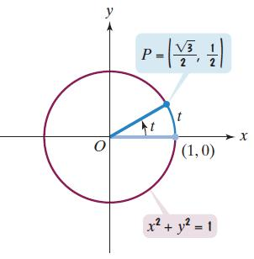







Example 1: Finding Values of the Trigonometric Functions
Use the figure to find the values of the trigonometric functions at t.
$$\sin{t}$$
$$\cos{t}$$
$$\tan{t}$$
$$=y=\frac{1}{2}$$
$$=x=\frac{\sqrt{3}}{2}$$
$$=\frac{\frac{1}{2}}{\frac{\sqrt{3}}{2}}$$
$$=\frac{y}{x}$$
$$=\frac{1}{\sqrt{3}}$$
$$=\frac{1}{\sqrt{3}}⋅\frac{\sqrt{3}}{\sqrt{3}}=\frac{\sqrt{3}}{3}$$

Slide 7








Example 1: Finding Values of the Trigonometric Functions (cont)
Use the figure to find the values of the trigonometric functions at t.
$$\csc{t}$$
$$\sec{t}$$
$$\cot{t}$$
$$=\frac{1}{y}=\frac{1}{2}$$
$$=\frac{1}{x}=\frac{1}{\frac{\sqrt{3}}{2}}$$
$$=\frac{2}{\sqrt{3}}$$
$$=\frac{2}{\sqrt{3}}⋅\frac{\sqrt{3}}{\sqrt{3}}=\frac{2\sqrt{3}}{3}$$
$$=\frac{\frac{\sqrt{3}}{2}}{\frac{1}{2}}$$
$$=\frac{x}{y}$$
$$=\sqrt{3}$$

Slide 8

The Domain and Range of the Sine and Cosine Functions
The domain of the sine function and the cosine function is $\left(−∞,∞\right),$ the set of all real numbers. The range of these functions is [–1, 1], the set of all real numbers from –1 to 1, inclusive.

Slide 9
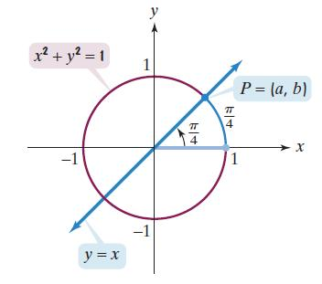
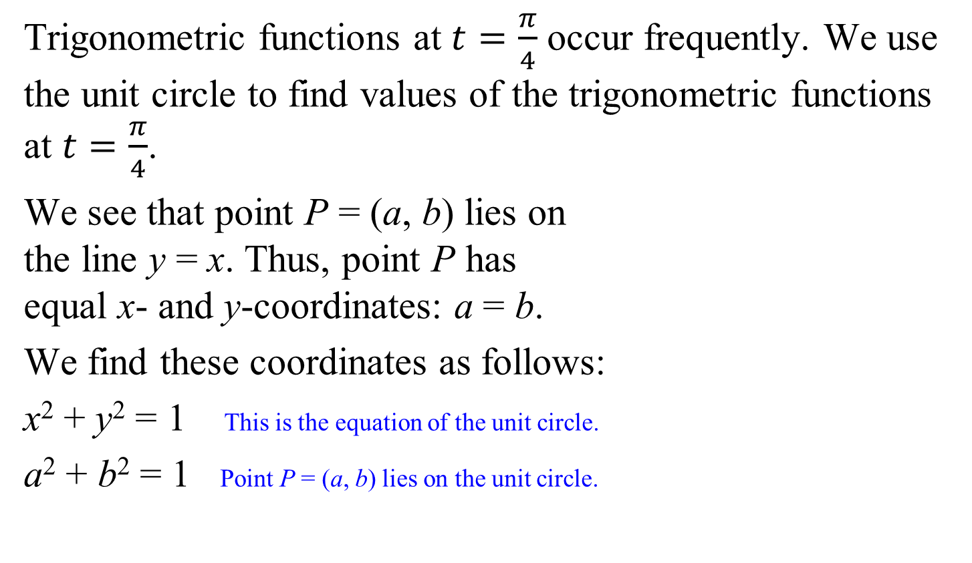
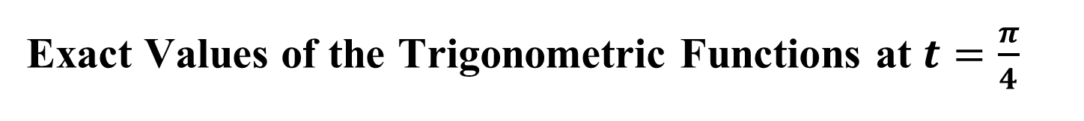
Exact Values of the Trigonometric Functions at $t=\frac{π}{4}$
Trigonometric functions at $t=\frac{π}{4}$ occur frequently. We use the unit circle to find values of the trigonometric functions at $t=\frac{π}{4}$.
We see that point P = (a, b) lies on
the line y = x. Thus, point P has
equal x- and y-coordinates: a = b.
We find these coordinates as follows:
x² + y² = 1 This is the equation of the unit circle.
a² + b² = 1 Point P = (a, b) lies on the unit circle.

Slide 10
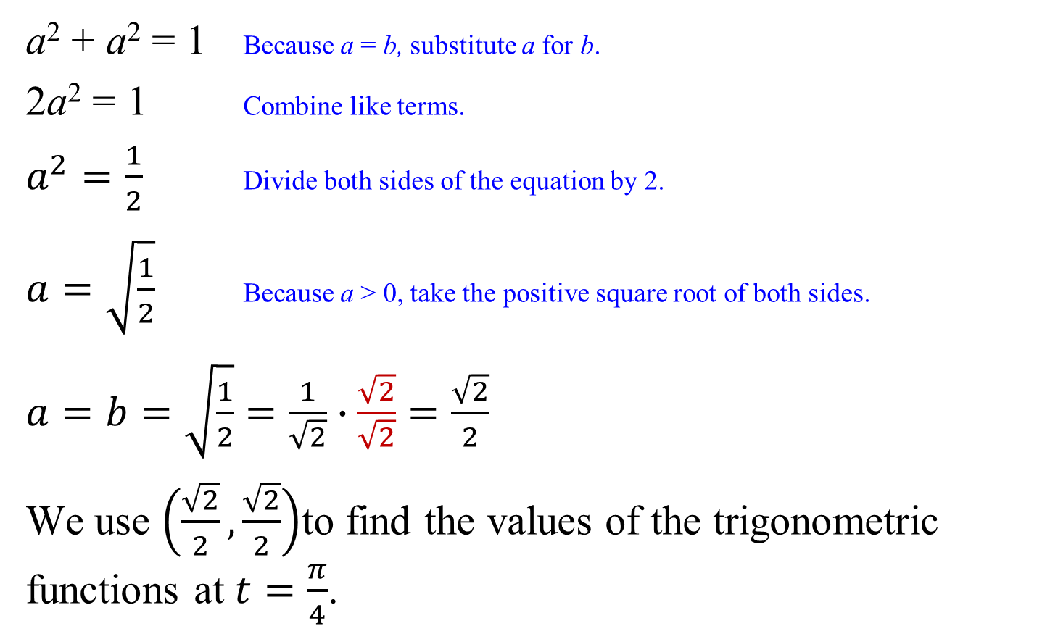
Exact Values of the Trigonometric Functions at $t=\frac{π}{4}$
a² + a² = 1 Because a = b, substitute a for b.
2a² = 1 Combine like terms.
$a^{2}=\frac{1}{2}$ Divide both sides of the equation by 2.
$a=\sqrt{\frac{1}{2}}$ Because a > 0, take the positive square root of both sides.
$a=b=\sqrt{\frac{1}{2}}=\frac{1}{\sqrt{2}}∙\frac{\sqrt{2}}{\sqrt{2}}=\frac{\sqrt{2}}{2}$
We use $\left(\frac{\sqrt{2}}{2},\frac{\sqrt{2}}{2}\right)$to find the values of the trigonometric functions at $t=\frac{π}{4}$.

Slide 11
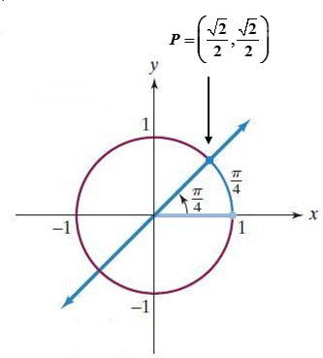




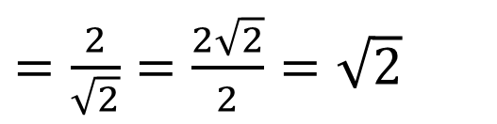

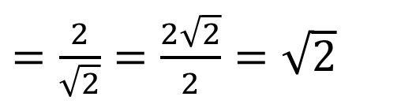
Example 3: Finding Values of the Trigonometric Functions at $t=\frac{π}{4}$
Find $\csc{\frac{π}{4}}$ , $\sec{\frac{π}{4}}$, $\cot{\frac{π}{4}}$.
We use $\left(\frac{\sqrt{2}}{2},\frac{\sqrt{2}}{2}\right)$ to find the values.
$$\csc{\frac{π}{4}}=\frac{1}{y}$$
$$\sec{\frac{π}{4}=}\frac{1}{x}$$
$$\cot{\frac{π}{4}}=\frac{x}{y}$$
$=\frac{2}{\sqrt{2}}=\frac{2\sqrt{2}}{2}=\sqrt{2}$
$=\frac{1}{\frac{\sqrt{2}}{2}}$
$=\frac{1}{\frac{\sqrt{2}}{2}}$
$=\frac{2}{\sqrt{2}}=\frac{2\sqrt{2}}{2}=\sqrt{2}$
$=\frac{\frac{\sqrt{2}}{2}}{\frac{\sqrt{2}}{2}}$
= 1

Slide 12





Trigonometric Functions at $\frac{π}{4}$
$$\sin{\frac{π}{4}}=\frac{\sqrt{2}}{2}$$
$$\cos{\frac{π}{4}}=\frac{\sqrt{2}}{2}$$
$$\tan{\frac{π}{4}}=1$$
$$\csc{\frac{π}{4}}=\sqrt{2}$$
$$\sec{\frac{π}{4}}=\sqrt{2}$$
$$\cot{\frac{π}{4}}=1$$

Slide 13
Even and Odd Trigonometric Functions
The cosine and secant function are even.
cos(–t) = cos t sec(–t) = sec t
The sine, cosecant, tangent, cotangent function are odd.
sin(–t) = –sin t csc(–t) = –csc t
tan(–t) = –tan t cot(–t) = –cot t

Slide 14
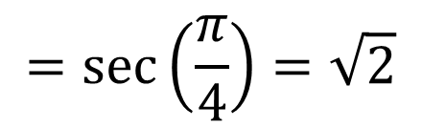

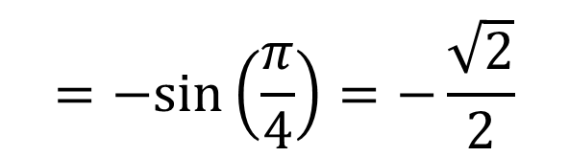
Example 4: Using Even and Odd Functions to Find Values of Trigonometric Functions
Find the value of each trigonometric function:
a. $sec\left(−\frac{π}{4}\right)$
b. $sin\left(−\frac{π}{4}\right)$
$$=sec\left(\frac{π}{4}\right)=\sqrt{2}$$
$$=−sin\left(\frac{π}{4}\right)=−\frac{\sqrt{2}}{2}$$

Slide 15





Fundamental Trigonometric Identities
Reciprocal Identities
$$\sin{t}=\frac{1}{\csc{t}}$$
$$\cos{t}=\frac{1}{\sec{t}}$$
$$\tan{t}=\frac{1}{\cot{t}}$$
Quotient Identities
$$\tan{t}=\frac{\sin{t}}{\cos{t}}$$
$$\csc{t}=\frac{1}{\sin{t}}$$
$$\sec{t}=\frac{1}{\cos{t}}$$
$$\cot{t}=\frac{1}{\tan{t}}$$
$$\cot{t}=\frac{\cos{t}}{\sin{t}}$$

Slide 16


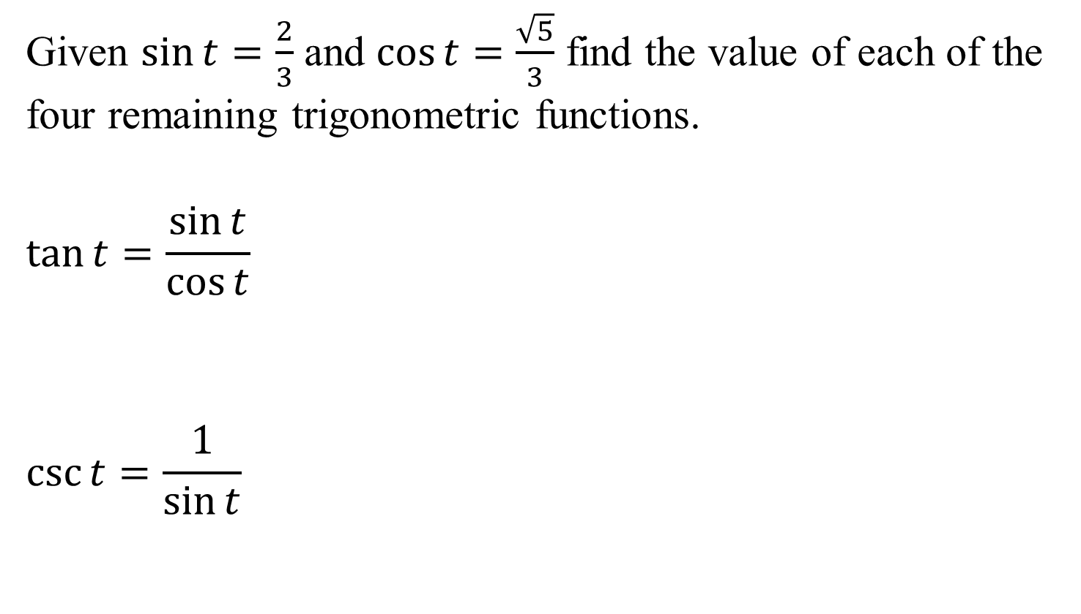

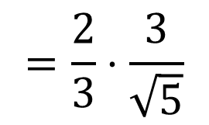

Example 5: Using Quotient and Reciprocal Identities
Given $\sin{t=\frac{2}{3}}$ and $\cos{t=\frac{\sqrt{5}}{3}}$ find the value of each of the four remaining trigonometric functions.
$$\tan{t}=\frac{\sin{t}}{\cos{t}}$$
$$\csc{t}=\frac{1}{\sin{t}}$$
$$=\frac{\frac{2}{3}}{\frac{\sqrt{5}}{3}}$$
$$=\frac{2}{3}⋅\frac{3}{\sqrt{5}}$$
$$=\frac{2}{\sqrt{5}}⋅\frac{\sqrt{5}}{\sqrt{5}}=\frac{2\sqrt{5}}{5}$$
$$=\frac{2}{\sqrt{5}}$$
$$=\frac{1}{\frac{2}{3}}=\frac{3}{2}$$

Slide 17







Example 5: Using Quotient and Reciprocal Identities (cont)
Given $\sin{t=\frac{2}{3}}$ and $\cos{t=\frac{\sqrt{5}}{3}}$ find the value of each of the four remaining trigonometric functions.
$$\sec{t}=\frac{1}{\cos{t}}$$
$$\cot{t}=\frac{1}{\tan{t}}$$
$$=\frac{1}{\frac{\sqrt{5}}{3}}$$
$$=\frac{3}{\sqrt{5}}⋅\frac{\sqrt{5}}{\sqrt{5}}=\frac{3\sqrt{5}}{5}$$
$$=\frac{3}{\sqrt{5}}$$
$$=\frac{1}{\frac{2\sqrt{5}}{5}}$$
$$=\frac{5}{2\sqrt{5}}$$
$$=\frac{5}{2\sqrt{5}}⋅\frac{\sqrt{5}}{\sqrt{5}}=\frac{5\sqrt{5}}{2⋅5}=\frac{\sqrt{5}}{2}$$

Slide 18
Pythagorean Identities
sin²t + cos²t = 1
1 + tan²t = sec²t
1 + cot²t = csc²t

Slide 19


Example 6: Using a Pythagorean Identity
Given that $\sin{t=\frac{1}{2}}$ and $0≤t<\frac{π}{2}$, find the value of cos t using a trigonometric identity.
sin²t + cos²t = 1
${\left(\frac{1}{2}\right)}^{2}+\cos^{2}t=1$
$\frac{1}{4}+\cos^{2}t=1$
$\cos^{2}t=1−\frac{1}{4}$
$\cos^{2}t= \frac{3}{4}$
$cost=\sqrt{\frac{3}{4}}=\frac{\sqrt{3}}{2}$

Slide 20
Definition of a Periodic Function
A function f is periodic if there exists a positive number p such that
            f (t + p) = f(t)
            for all t in the domain of f. The smallest positive number p for which f is periodic is called the period of f.

Slide 21

Periodic Properties of the Sine and Cosine Functions
$\sin\left(t+2π\right)=\sin{t}$ and $\cos\left(t+2π\right)=\cos{t}$
The sine and cosine functions are periodic functions and have period 2π.

Slide 22

Periodic Properties of the Tangent and Cotangent Functions
$\tan\left(t+π\right)=\tan{t}$ and $\cot\left(t+π\right)=\cot{t}$
The tangent and cotangent functions are periodic functions and have period π.

Slide 23






Example 7: Using Periodic Properties
Find the value of each trigonometric function:
a. $\cot{\frac{5π}{4}}$
b. $\cos\left(−\frac{9π}{4}\right)$
$$=\cot\left(\frac{π}{4}+π\right)$$
$$=\cot{\frac{π}{4}=1}$$
$$=\cos\left(\frac{9π}{4}\right)$$
$$=\cos{\frac{π}{4}=\frac{\sqrt{2}}{2}}$$
$$=\cos\left(\frac{π}{4}+2π\right)$$

Slide 24

Repetitive Behavior of the Sine, Cosine, and Tangent Functions
For any integer n and real number t,
$\sin\left(t+2πn\right)=\sin{t}$, $\cos\left(t+2πn\right)=\cos{t}$, and $\tan\left(t+πn\right)=\tan{t}$.

Slide 25
Using a Calculator to Evaluate Trigonometric Functions
The first step in using a calculator to evaluate trigonometric functions is to set the calculator to the correct mode, degrees or radians. The domains of the trigonometric functions in the unit circle are sets of real numbers. Therefore, we use the radian mode.
We will use the keys on a calculator that are marked SIN, COS, and TAN.
You may consult the manual for your calculator for specific directions for evaluating trigonometric functions.

Slide 26

Example 8: Evaluating Trigonometric Functions with a Calculator
Use a calculator to find the value to four decimal places:
a. $\sin{\frac{π}{4}}$
b. csc 1.5
≈ 0.7071
≈ 1.0025

