Slide 1

Chapter 4
Trigonometric Functions
4.3 Right Triangle Trigonometry

Slide 2
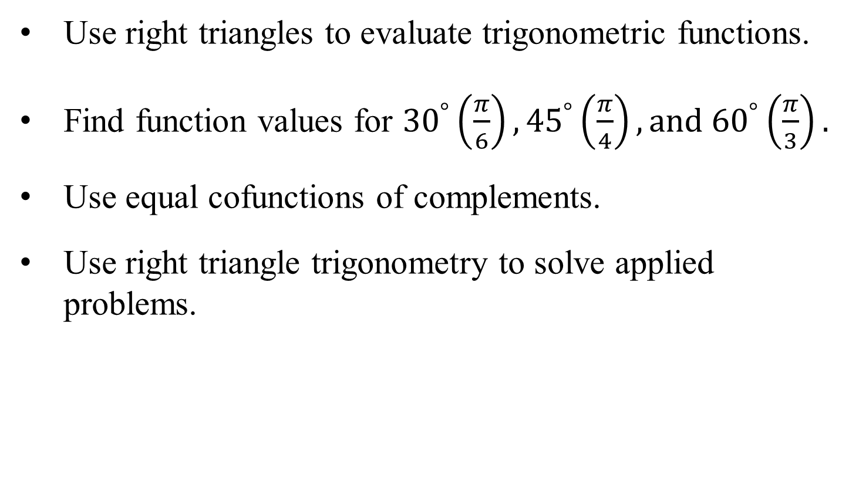
Objectives
Use right triangles to evaluate trigonometric functions.
Find function values for ${30}^{°}\left(\frac{π}{6}\right),{45}^{°}\left(\frac{π}{4}\right), and{ 60}^{°}\left(\frac{π}{3}\right).$
Use equal cofunctions of complements.
Use right triangle trigonometry to solve applied problems.

Slide 3
The Six Trigonometric Functions
The six trigonometric functions are:
Function Abbreviation
sine sin
cosine cos
tangent tan
cosecant csc
secant sec
cotangent cot

Slide 4
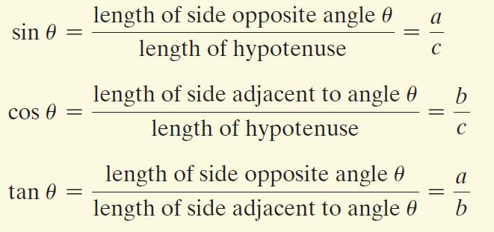
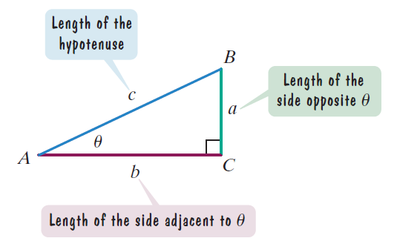
Right Triangle Definitions of Trigonometric Functions
In general, the trigonometric functions
of depend only on the size of angle
and not on the size of the triangle.

Slide 5
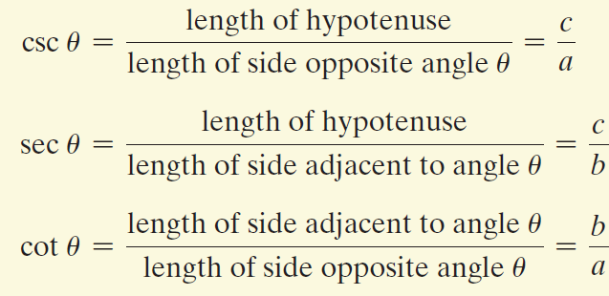
Right Triangle Definitions of Trigonometric Functions
(continued)
In general, the trigonometric functions
of depend only on the size of angle
and not on the size of the triangle.

Slide 6
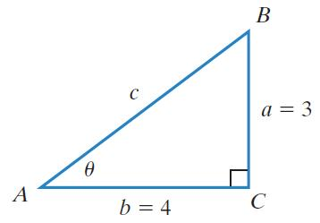

Example 1: Evaluating Trigonometric Functions
Find the value of the six trigonometric functions of θ in the figure.
We begin by finding c.
$$a^{2}+b^{2}=c^{2}$$
$$c^{2}=3^{2}+4^{2}=9+16=25$$
$$c=\sqrt{25}=5$$
$$sinθ=\frac{3}{5}$$
$$tanθ=\frac{3}{4}$$
$$secθ=\frac{5}{4}$$
$$cosθ=\frac{4}{5}$$
$$cscθ=\frac{5}{3}$$
$$cotθ=\frac{4}{3}$$

Slide 7
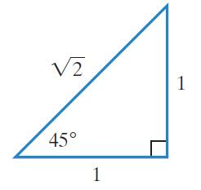
Function Values for Some Special Angles
A right triangle with a 45°, or $\frac{π}{4}$ radian, angle is isosceles – that is, it has two sides of equal length.

Slide 8
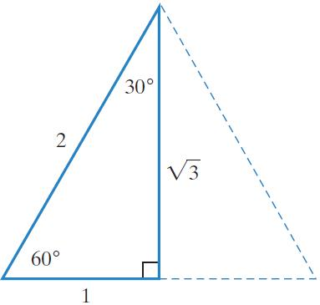
Function Values for Some Special Angles (continued)
A right triangle that has a 30°, or $\frac{π}{6}$ radian, angle also has a 60°, or $\frac{π}{3}$ radian angle. In a 30-60-90 triangle, the measure of the side opposite the 30° angle is one-half the measure of the hypotenuse.

Slide 9

Example 3: Evaluating Trigonometric Functions of 45°
Use the figure to find csc 45°, sec 45°, and cot 45°.
$$\csc{{45}^{°}}=\frac{length of hypotenuse}{length of side opposite 45}$$
$$\sec{{45}^{°}}=\frac{length of hypotenuse}{length of side adjacent 45}$$
$$\cot{{45}^{°}}=\frac{length of side adjacent 45}{length of side opposite 45}$$
$$=\frac{\sqrt{2}}{1}=\sqrt{2}$$
$$=\frac{\sqrt{2}}{1}=\sqrt{2}$$
$$=\frac{1}{1}=1$$

Slide 10
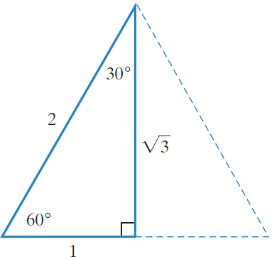
Example 4: Evaluating Trigonometric Functions of 30° and 60°
Use the figure to find tan 60° and tan 30°. If a radical appears in a denominator, rationalize the denominator.
$$\tan{{60}^{°}}=\frac{length of side opposite 60}{length of side adjacent 60}$$
$$\tan{{30}^{°}}=\frac{length of side opposite 30}{length of side adjacent 30}$$
$$=\frac{\sqrt{3}}{1}=\sqrt{3}$$
$$=\frac{1}{\sqrt{3}}=\frac{1}{\sqrt{3}}·\frac{\sqrt{3}}{\sqrt{3}}=\frac{\sqrt{3}}{3}$$

Slide 11
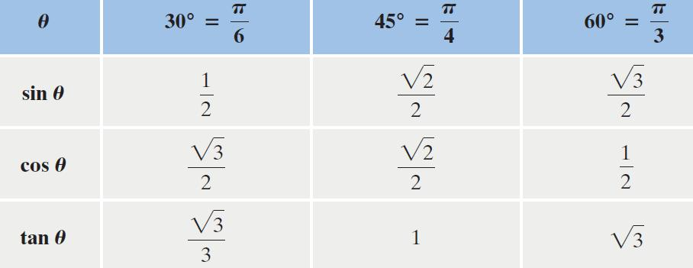
Trigonometric Functions of Special Angles

Slide 12
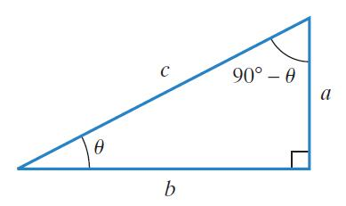
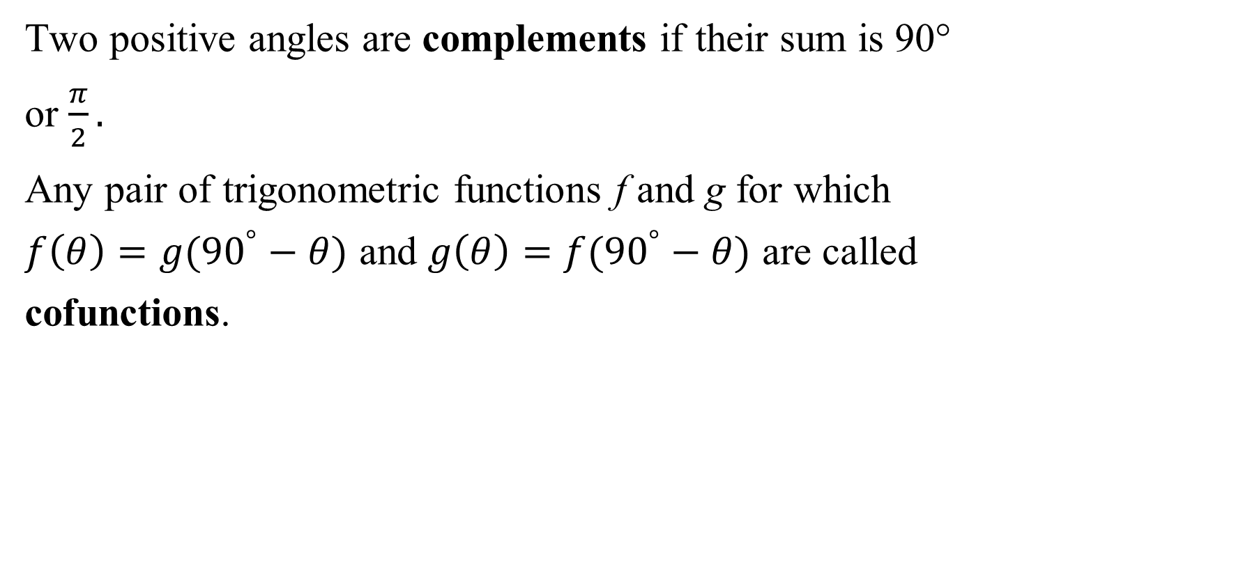
Trigonometric Functions and Complements
Two positive angles are complements if their sum is 90°
or $\frac{π}{2}.$
Any pair of trigonometric functions f and g for which $f\left(θ\right)=g({90}^{°}−θ)$ and $g\left(θ\right)=f({90}^{°}−θ)$ are called cofunctions.

Slide 13
Cofunction Identities
The value of a trigonometric function of $θ$ is equal to the cofunction of the complement of $θ$. Cofunctions of complementary angles are equal.
$\sin{θ}=cos({90}^{°}−θ)$ $\cos{θ}=sin({90}^{°}−θ)$
$\tan{θ}=cot({90}^{°}−θ)$ $\cot{θ}=tan({90}^{°}−θ)$
$\sec{θ}=csc({90}^{°}−θ)$ $\csc{θ}=sec\left({90}^{°}−θ\right)$
If $θ$ is in radians, replace 90° with $\frac{π}{2}$.

Slide 14
Example 5: Using Cofunction Identities
Find a cofunction with the same value as the given expression:
a. $\sin{{46}^{°}}$
b. $\cot{\frac{π}{12}}$
$$=cos({90}^{°}−{46}^{°})=\cos{{44}^{°}}$$
$$=tan\left(\frac{π}{2}−\frac{π}{12}\right)=tan\left(\frac{6π}{12}−\frac{π}{12}\right)=tan\frac{5π}{12}$$

Slide 15
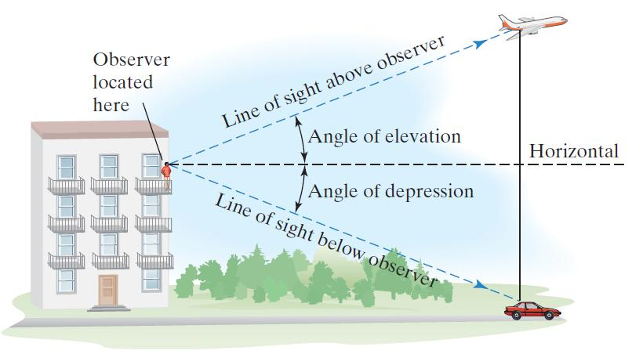
Applications: Angle of Elevation and Angle of Depression
An angle formed by a horizontal line and the line of sight to an object that is above the horizontal line is called the angle of elevation. The angle formed by the horizontal line and the line of sight to an object that is below the horizontal line is called the angle of depression.

Slide 16
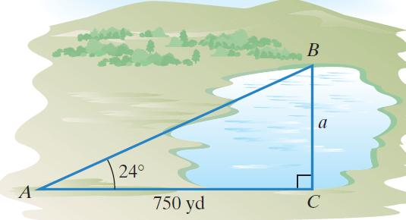
Example 6: Problem Solving Using an Angle of Elevation
The irregular blue shape in the figure represents a lake. The distance across the lake, a, is unknown. To find this distance, a surveyor took the measurements shown in the figure. What is the distance across the lake?
$$\tan{{24}^{°}}=\frac{a}{750}$$
$$a=750\tan{{24}^{°}}$$
$$a≈333.9$$
The distance across the lake is approximately 333.9 yards.

