Slide 1

Chapter 3
Exponential and Logarithmic Functions
3.5 Exponential Growth and Decay; Modeling Data

Slide 2
Objectives
Model exponential growth and decay.
Use logistic growth models.
Use Newton’s Law of Cooling.
Choose an appropriate model for data.
Express an exponential model in base e.

Slide 3
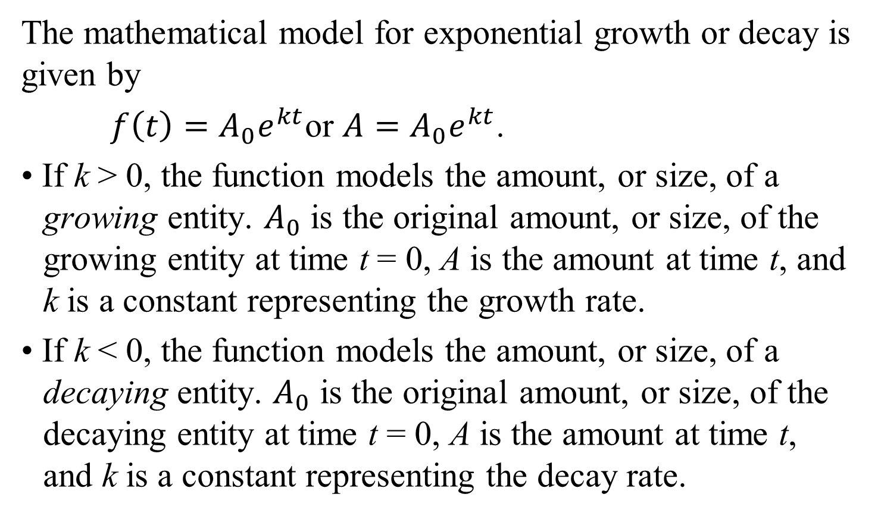
Exponential Growth and Decay Models
The mathematical model for exponential growth or decay is given by
$f\left(t\right)=A_{0}e^{kt}$or $A=A_{0}e^{kt}$.
• If k > 0, the function models the amount, or size, of a growing entity. $A_{0}$ is the original amount, or size, of the growing entity at time t = 0, A is the amount at time t, and k is a constant representing the growth rate.
• If k < 0, the function models the amount, or size, of a decaying entity. $A_{0}$ is the original amount, or size, of the decaying entity at time t = 0, A is the amount at time t, and k is a constant representing the decay rate.

Slide 4
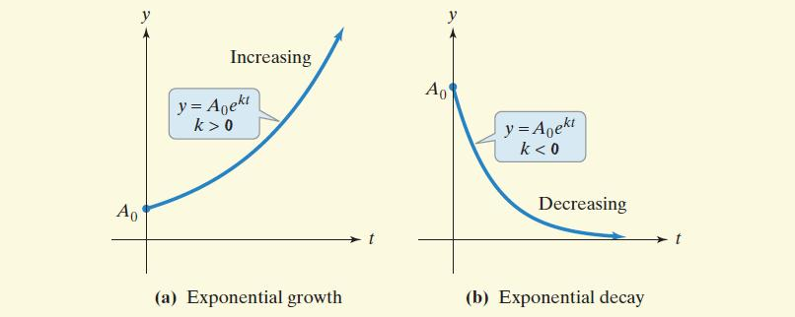
Exponential Growth and Decay Models (continued)

Slide 5
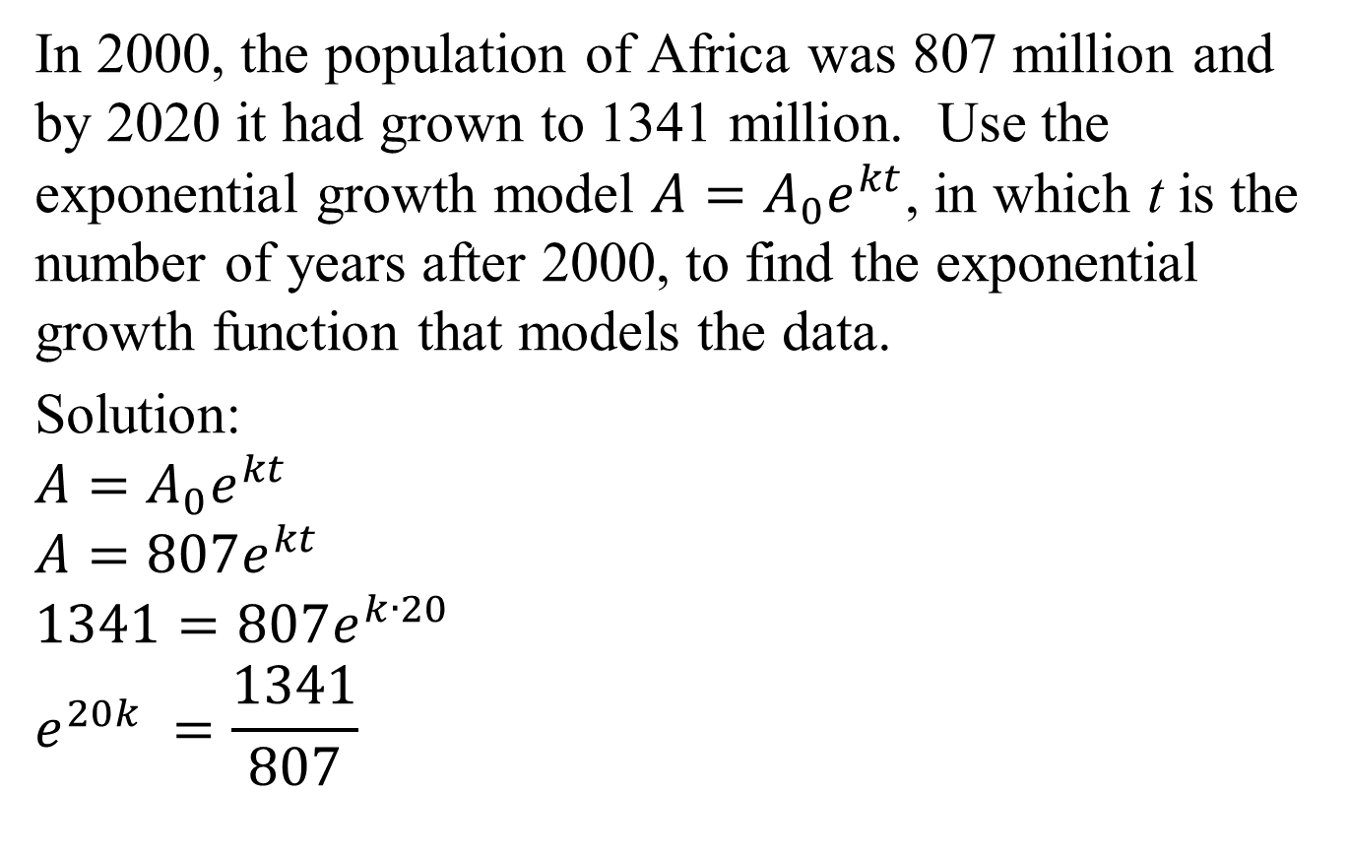


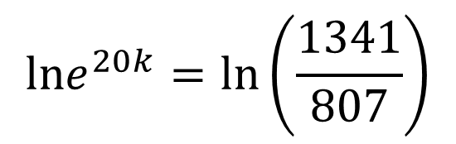
Example 1a: Application
In 2000, the population of Africa was 807 million and by 2020 it had grown to 1341 million. Use the exponential growth model $A=A_{0}e^{kt}$, in which t is the number of years after 2000, to find the exponential growth function that models the data.
Solution:
$$A=A_{0}e^{kt}$$
$$A=807e^{kt}$$
$$1341=807e^{k∙20}$$
$$e^{20k} =\frac{1341}{807}$$
$$lne^{20k}=ln\left(\frac{1341}{807}\right)$$
$$20k=ln\left(\frac{1341}{807}\right)$$
$$k=\frac{ln\left(\frac{1341}{807}\right)}{20}$$
$$≈0.025$$
The model is$A=807e^{0.025t}$.

Slide 6
Example 1b: Application (continued)
By which year will Africa’s population reach 2000 million, or two billion?
$A=807e^{0.025t}$
$2000=807e^{0.025t}$
$$e^{0.025t}=\frac{2000}{807}$$
$$ln e^{0.025t}=ln\left(\frac{2000}{807}\right)$$
By the year 2036, Africa’s population will reach 2000 million, or two billion.
$0.025t=$ $ln\left(\frac{2000}{807}\right)$
$$t=\frac{ln \left(\frac{2000}{807}\right)}{0.025}$$
$$t≈36$$

Slide 7
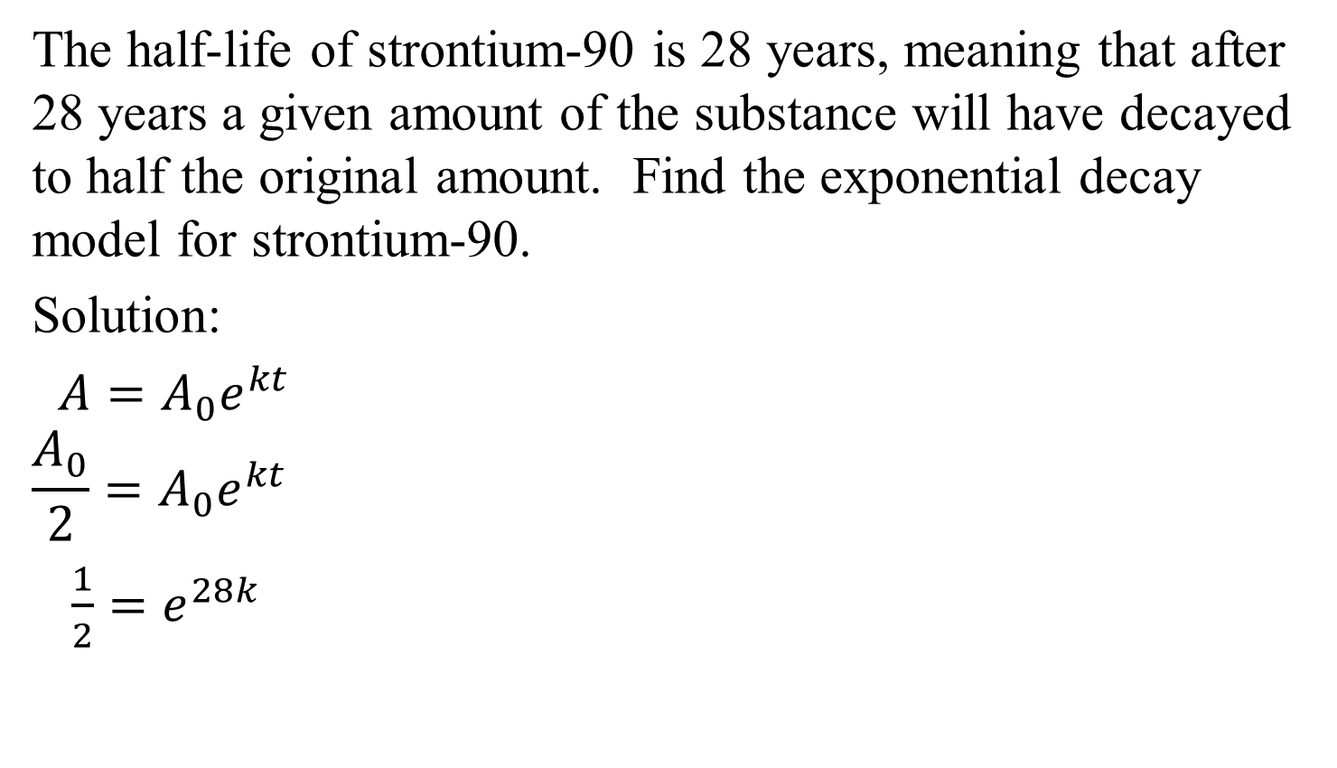
Example 2a: Application (Strontium)
The half-life of strontium-90 is 28 years, meaning that after 28 years a given amount of the substance will have decayed to half the original amount. Find the exponential decay model for strontium-90.
Solution:
$A=A_{0}e^{kt}$
$$\frac{A_{0}}{2}={A_{0}e}^{kt}$$
$\frac{1}{2}=e^{28k}$
$$ln\left(\frac{1}{2}\right)=28k$$
$$k=\frac{ln\left(\frac{1}{2}\right)}{28}$$
$$≈−0.0248$$
$$ln\left(\frac{1}{2}\right)=ln{ e}^{28k}$$
The model is $A=A_{0}e^{−0.0248t}$.

Slide 8
Example 2b: Application (Strontium)
We found the exponential decay model to be
$A=A_{0}e^{−0.0248t}$. If there are originally 60 grams, how long will it take for strontium-90 to decay to a level of 10 grams?
$$A=A_{0}e^{−0.0248t}$$
$$−0.0248t=ln\left(\frac{1}{6}\right)$$
$$10=60e^{−0.0248t}$$
$$t=\frac{ln\left(\frac{1}{6}\right)}{−0.0248}$$
$$\left(\frac{1}{6}\right)=e^{−0.0248t}$$
$$≈72$$
$$ln\left(\frac{1}{6}\right)=lne^{−0.0248t}$$
It will take about 72 years for 60 grams of strontium-90 to decay to a level of 10 grams.

Slide 9
Logistic Growth Model
The mathematical model for limited logistic growth is given by
$$f\left(t\right)=\frac{c}{1+ae^{−bt}} or A=\frac{c}{1+ae^{−bt}},$$
where a, b, and c are constants, with c > 0 and b > 0.

Slide 10
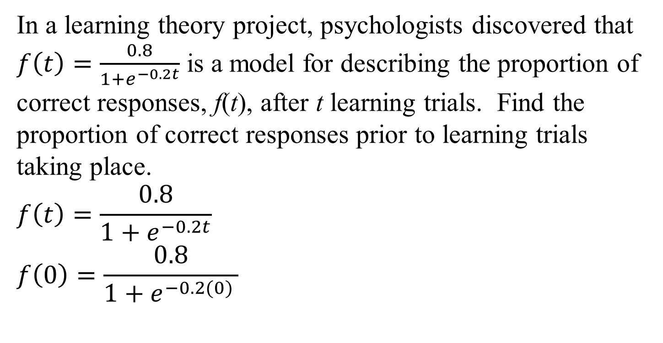
Example 3a: Application (Learning Theory)
In a learning theory project, psychologists discovered that $f\left(t\right)=\frac{0.8}{1+e^{−0.2t}}$ is a model for describing the proportion of correct responses, f(t), after t learning trials. Find the proportion of correct responses prior to learning trials taking place.
$$f\left(t\right)=\frac{0.8}{1+e^{−0.2t}}$$
$$f\left(0\right)=\frac{0.8}{1+e^{−0.2(0) }}$$
Prior to learning trials
taking place, the proportion
of correct responses was 0.4.
$$=\frac{0.8}{1+1}$$
$$=\frac{0.8}{2}$$
$$=0.4$$

Slide 11
Example 3b and c: Application (continued)
b. Find the proportion of correct responses after 10 learning trials. $f\left(t\right)=\frac{0.8}{1+e^{−0.2t}}$
$f\left(10\right)=\frac{0.8}{1+e^{−0.2(10)}}$
$≈0.7$
After 10 learning trials, the proportion of correct responses was 0.7.
c. What is the limiting size of f(t), the proportion of correct responses, as continued learning trials take place?
The limiting size of f(t) is 0.8.

Slide 12
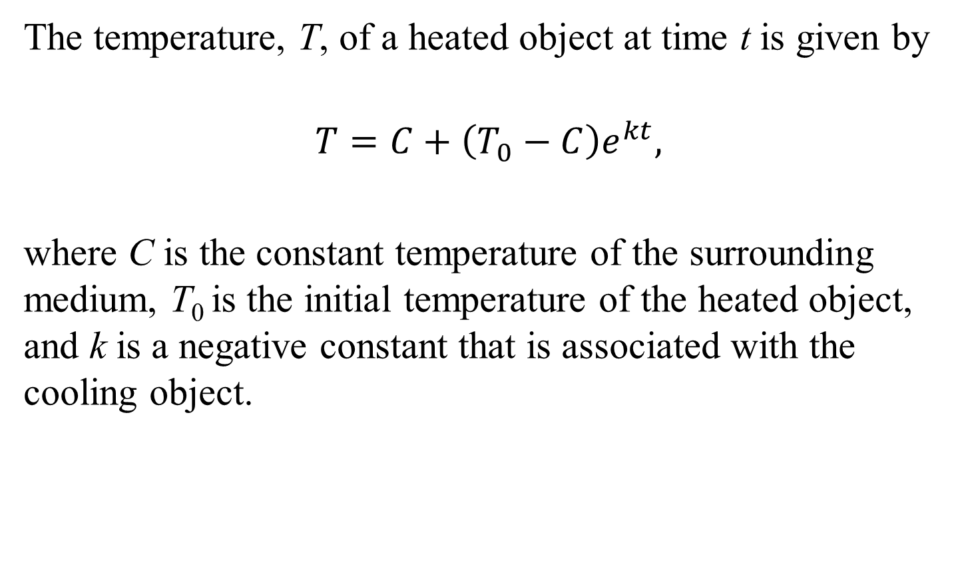
Newton’s Law of Cooling
The temperature, T, of a heated object at time t is given by
$$T=C+\left(T_{0}−C\right)e^{kt},$$
where C is the constant temperature of the surrounding medium, T₀ is the initial temperature of the heated object, and k is a negative constant that is associated with the cooling object.

Slide 13
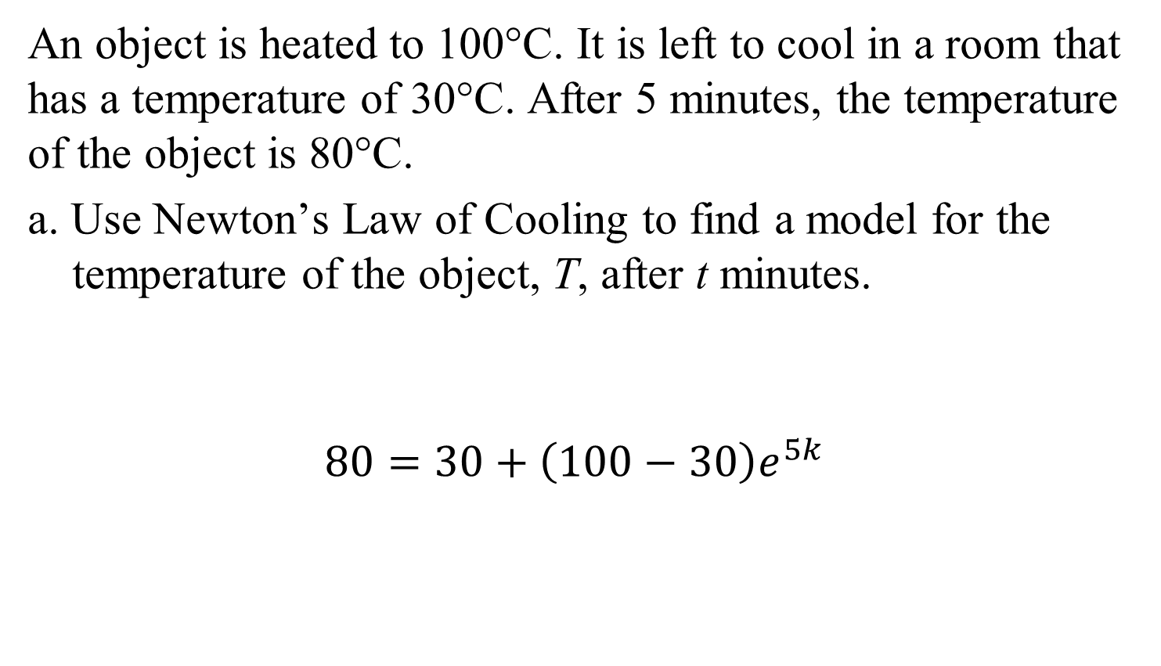
Example 4a: Using Newton’s Law of Cooling
An object is heated to 100°C. It is left to cool in a room that has a temperature of 30°C. After 5 minutes, the temperature of the object is 80°C.
a. Use Newton’s Law of Cooling to find a model for the temperature of the object, T, after t minutes.
$$80=30+\left(100−30\right)e^{5k}$$
initial temperature
time = 5 min
temperature after 5 minutes
constant temperature of the room

Slide 14


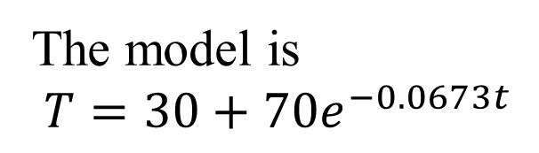
Example 4a: Using Newton’s Law of Cooling (continued)
$80=30+\left(100−30\right)e^{5k}$
$80=30+70$ $e^{5k}$
$50=70$ $e^{5k}$
$e^{5k}=\frac{50}{70}$
$lne^{5k}=ln\frac{5}{7}$
$5k=ln\frac{5}{7}$
$k=\frac{ln\left(\frac{5}{7}\right)}{5}$
$$≈−0.0673$$
The model is
$$T=30+70e^{−0.0673t}$$

Slide 15
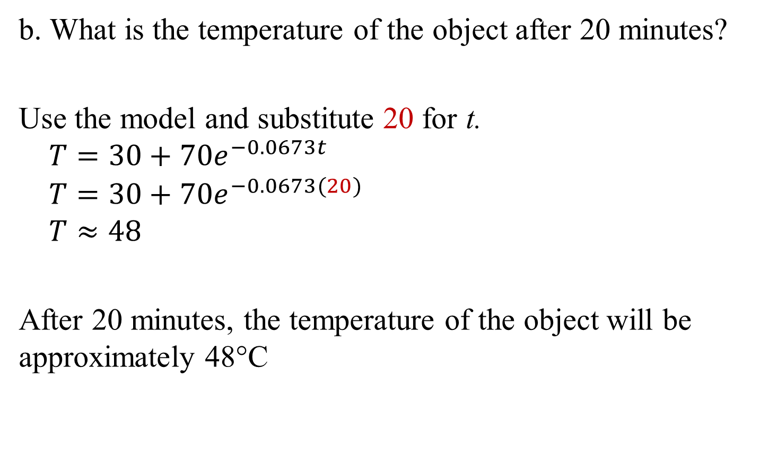
Example 4b: Using Newton’s Law of Cooling
b. What is the temperature of the object after 20 minutes?
Use the model and substitute 20 for t.
$$T=30+70e^{−0.0673t}$$
$$T=30+70e^{−0.0673(20)}$$
$$T≈48$$
After 20 minutes, the temperature of the object will be approximately 48°C

Slide 16

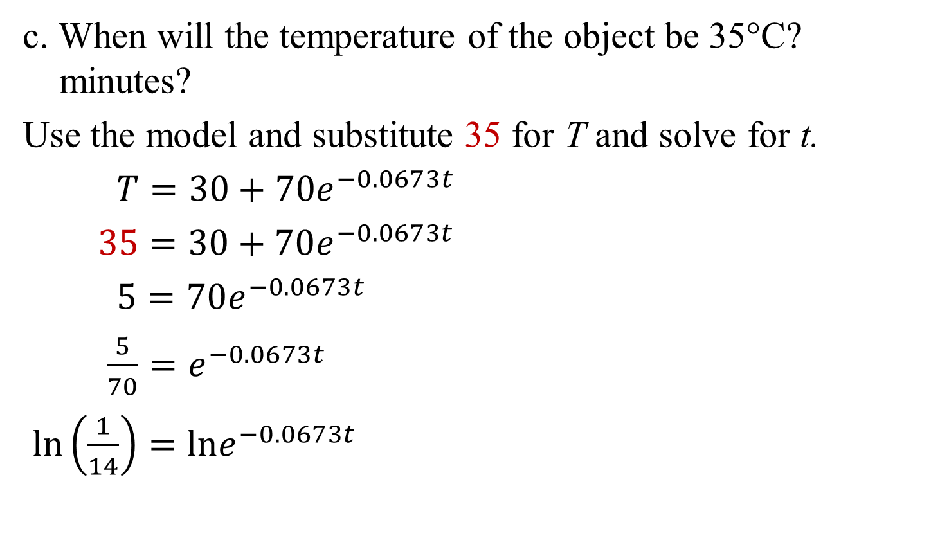

Example 4c: Using Newton’s Law of Cooling
c. When will the temperature of the object be 35°C? minutes?
Use the model and substitute 35 for T and solve for t.
$T=30+70e^{−0.0673t}$
$35=30+70e^{−0.0673t}$
$5=70e^{−0.0673t}$
$\frac{5}{70}=e^{−0.0673t}$
$ln\left(\frac{1}{14}\right)=lne^{−0.0673t}$
$$t ≈\frac{ln\left(\frac{1}{14}\right)}{−0.0673}$$
$$t ≈39$$
The temperature of the object will be 35°C in approximately 39 minutes.

Slide 17
Example 5: Choosing a Model for Data
Table 4.7 shows the populations of various cities, in
thousands, and the average walking speed, in feet per
second, of a person living in the city. Create a scatter plot
for the data.
Population (thousands) | Walking Speed (feet per second)
5.5 | 0.6
14 | 1.0
71 | 1.6
138 | 1.9
342 | 2.2

Slide 18
Example 5: Choosing a Model for Data (continued)
Based on the scatter plot, what type of function would be a good choice for modeling the data?
Solution:
The shape suggests that a
logarithmic function is a
good choice for modeling
the data.

Slide 19
Expressing y = ab^{x} in Base e
$y=ab^{x}$ is equivalent to $y=ae^{(ln b)∙x}.$

Slide 20
Example 8: Rewriting a Model
Rewrite y = 4(7.8)^{x} in terms of base e. Express the answer in terms of a natural logarithm and then round to three decimal places.
Solution:
$y=4{(7.8)}^{x}$
$y=4e^{\left(ln 7.8\right)x}$
$y≈4e^{2.054x}$

