Slide 1

Chapter 3
Exponential and Logarithmic Functions
3.3 Properties of Logarithms

Slide 2
Objectives
Use the product rule.
Use the quotient rule.
Use the power rule.
Expand logarithmic expressions.
Condense logarithmic expressions.
Use the change-of-base property.

Slide 3
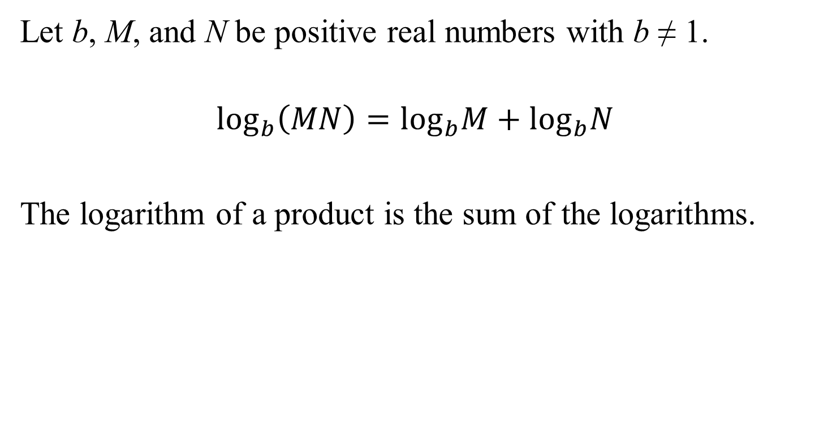
The Product Rule
Let b, M, and N be positive real numbers with b ≠ 1.
$$\log_{b}\left(MN\right)=\log_{b}M+\log_{b}N$$
The logarithm of a product is the sum of the logarithms.

Slide 4
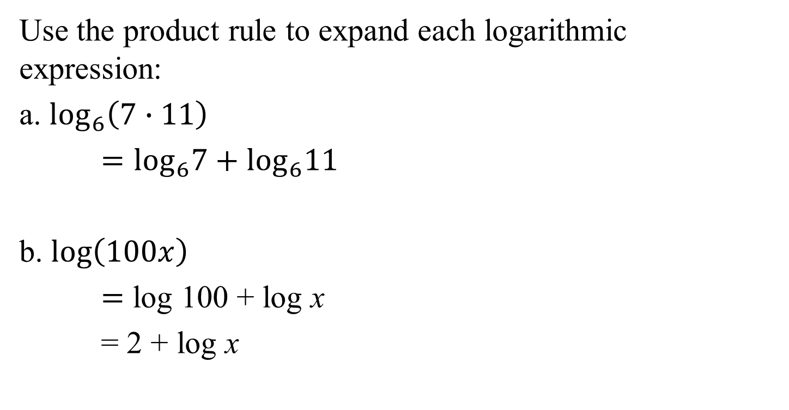
Example 1: Using the Product Rule
Use the product rule to expand each logarithmic expression:
a. $\log_{6}\left(7∙11\right)$
$=\log_{6}7+\log_{6}11$
b. $log\left(100x\right)$
$=$ log 100 + log x
= 2 + log x

Slide 5
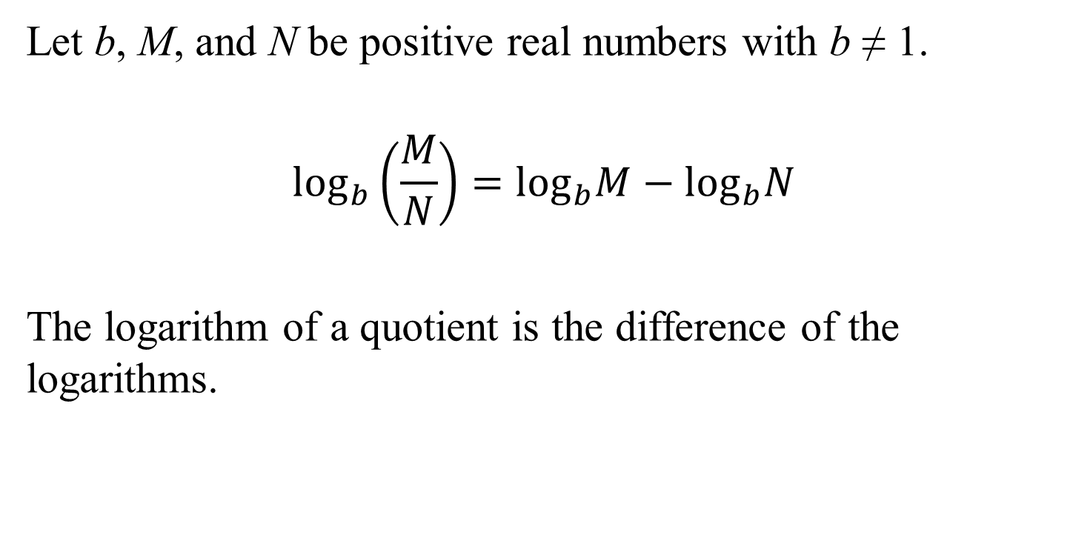
The Quotient Rule
Let b, M, and N be positive real numbers with b ≠ 1.
$$\log_{b}\left(\frac{M}{N}\right)=\log_{b}M−\log_{b}N$$
The logarithm of a quotient is the difference of the logarithms.

Slide 6

Example 2: Using the Quotient Rule
Use the quotient rule to expand each logarithmic expression:
a. $\log_{8}\left(\frac{23}{x}\right)$
= $\log_{8}23−\log_{8}x$
b. $ln\left(\frac{e^{5}}{11}\right)$
$=lne^{5}−ln11$
$=5−ln11$

Slide 7
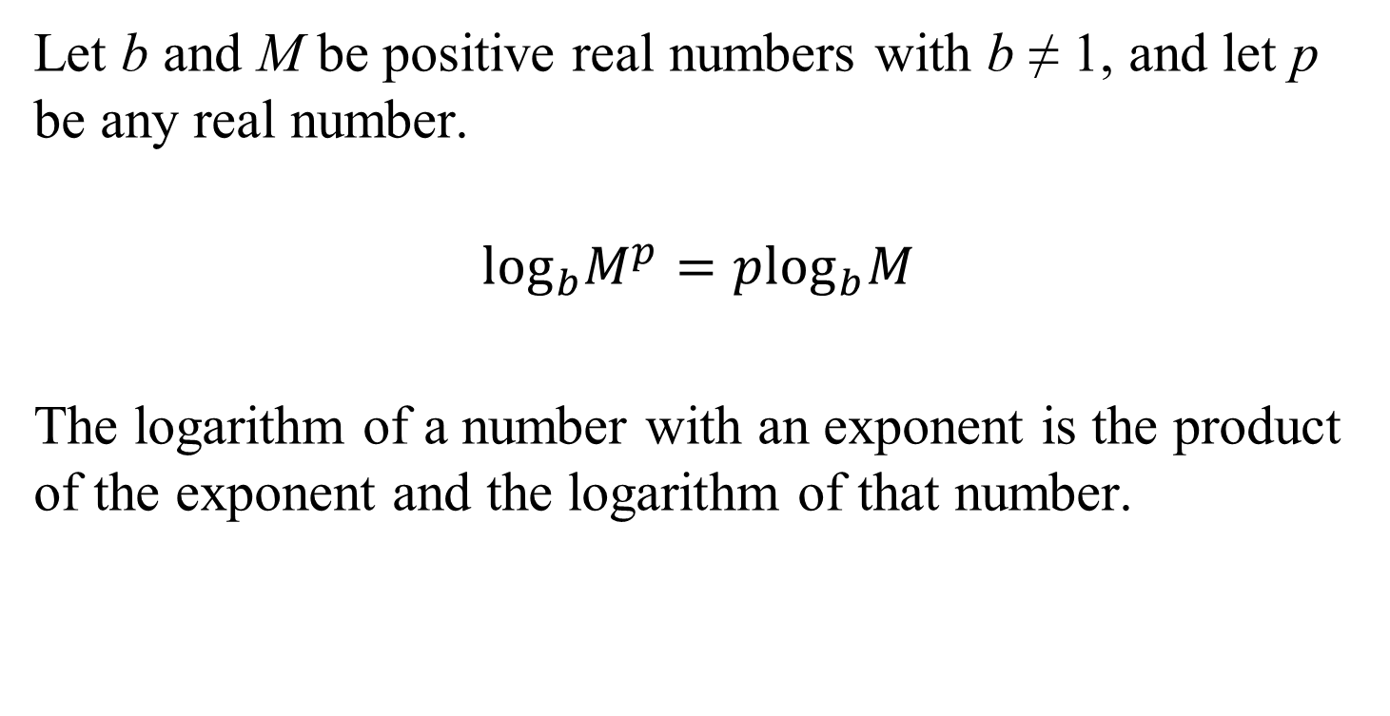
The Power Rule
Let b and M be positive real numbers with b ≠ 1, and let p be any real number.
$$\log_{b}M^{p}=p\log_{b}M$$
The logarithm of a number with an exponent is the product of the exponent and the logarithm of that number.

Slide 8
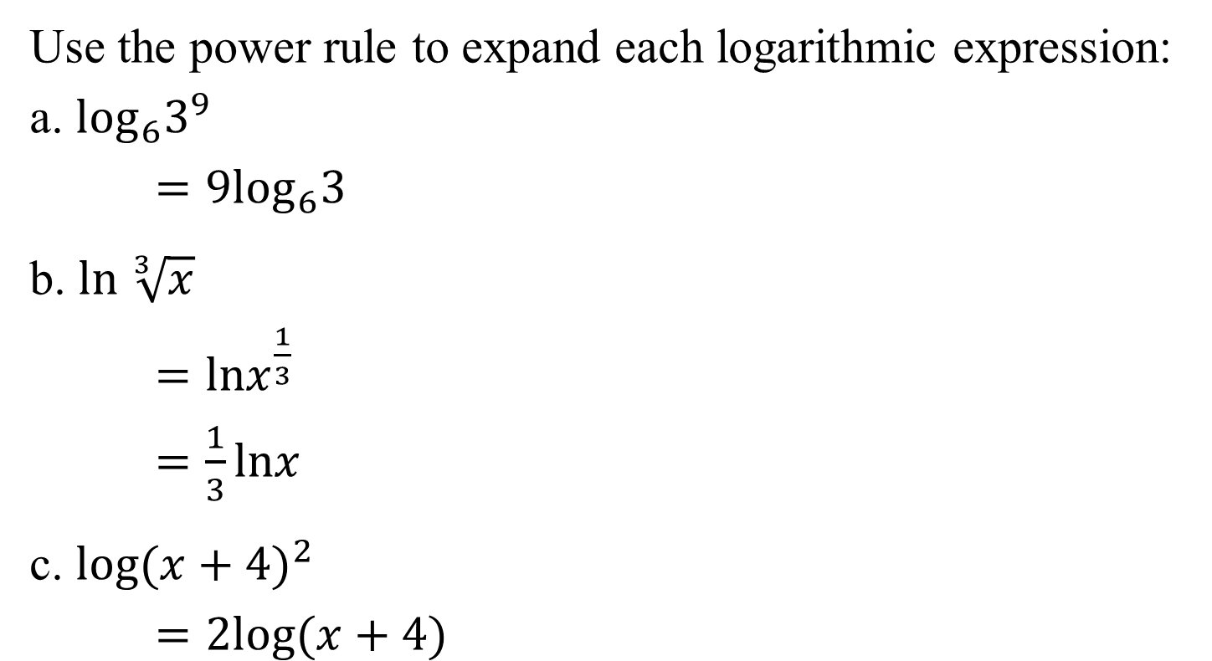
Example 3: Using the Power Rule
Use the power rule to expand each logarithmic expression:
a. $\log_{6}3^{9}$
$=9\log_{6}3$
b. $ln \sqrt[3]{x}$
$=lnx^{\frac{1}{3}}$
$=\frac{1}{3}lnx$
c. $log{(x+4)}^{2}$
$=2log⁡(x+4)$

Slide 9
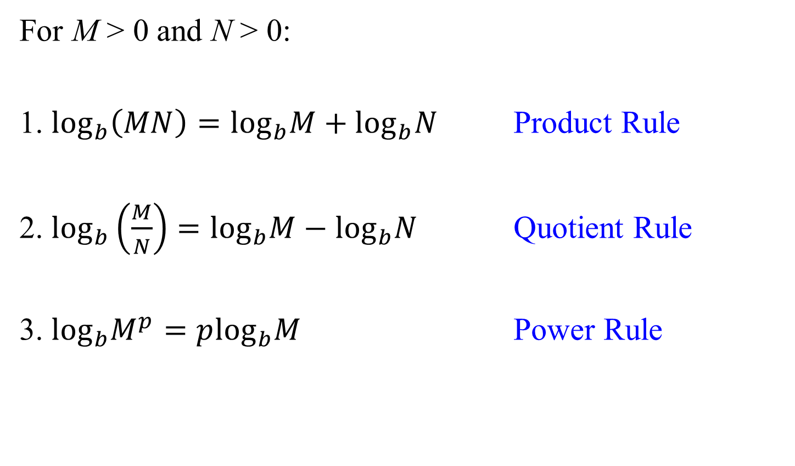
Properties for Expanding Logarithmic Expressions
For M > 0 and N > 0:
1. $\log_{b}\left(MN\right)=\log_{b}M+\log_{b}N$ Product Rule
2. $\log_{b}\left(\frac{M}{N}\right)=\log_{b}M−\log_{b}N$ Quotient Rule
3. $\log_{b}M^{p}=p\log_{b}M$ Power Rule

Slide 10
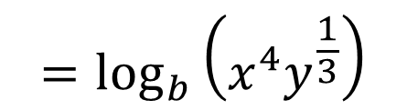
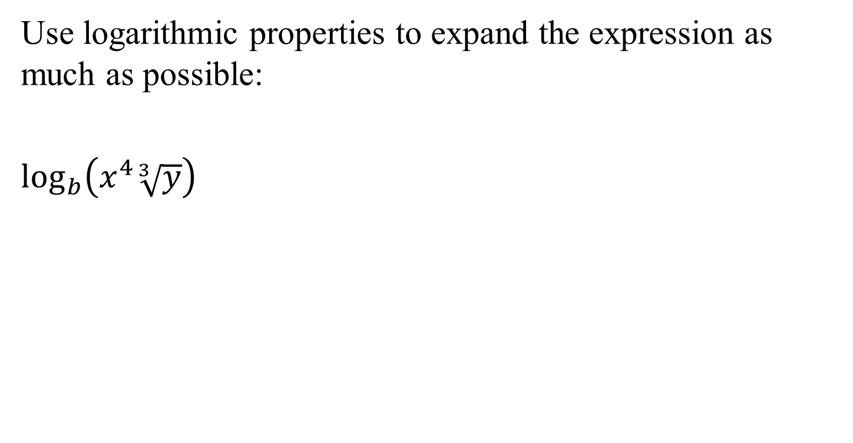
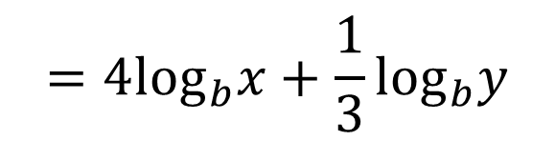
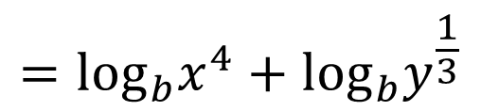
Example 4a: Expanding Logarithmic Expressions
Use logarithmic properties to expand the expression as much as possible:
$\log_{b}\left(x^{4}\sqrt[3]{y}\right)$
$$=\log_{b}\left(x^{4}y^{\frac{1}{3}}\right)$$
$$=\log_{b}x^{4}+\log_{b}y^{\frac{1}{3}}$$
$$=4\log_{b}x+\frac{1}{3}\log_{b}y$$

Slide 11
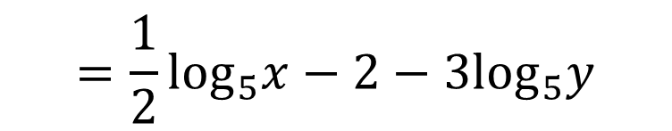

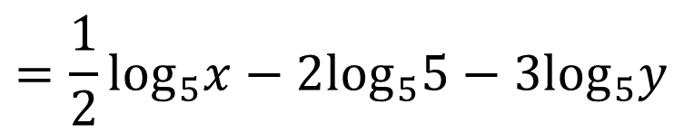
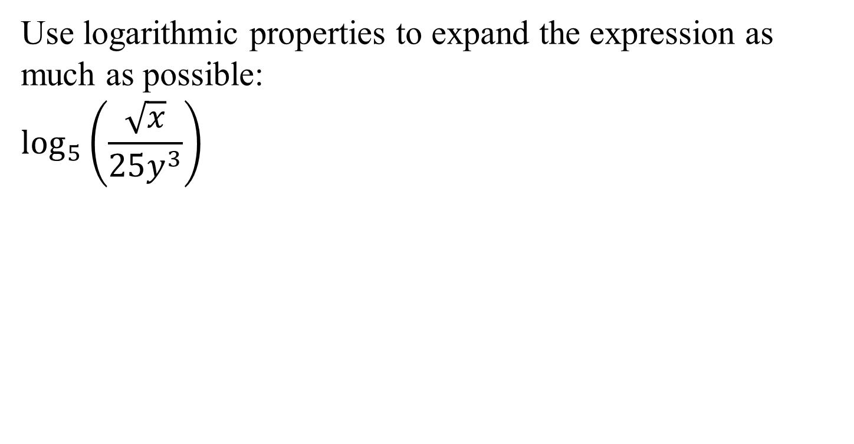
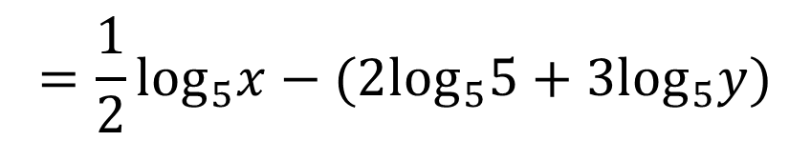
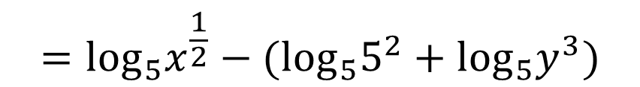
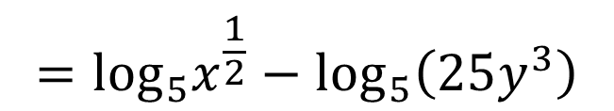
Example 4b: Expanding Logarithmic Expressions
Use logarithmic properties to expand the expression as much as possible:
$$\log_{5}\left(\frac{\sqrt{x}}{25y^{3}}\right)$$
$$=\log_{5}\left(\frac{x^{\frac{1}{2}}}{25y^{3}}\right)$$
$$=\log_{5}x^{\frac{1}{2}}−\log_{5}\left(25y^{3}\right)$$
$$=\log_{5}x^{\frac{1}{2}}−(\log_{5}5^{2}+\log_{5}y^{3})$$
$$=\frac{1}{2}\log_{5}x−(2\log_{5}5+{3log}_{5}y)$$
$$=\frac{1}{2}\log_{5}x−2\log_{5}5−3\log_{5}y$$
$$=\frac{1}{2}\log_{5}x−2−3\log_{5}y$$

Slide 12

Properties for Condensing Logarithmic Expressions
For M > 0 and N > 0:
1. $\log_{b}M+\log_{b}N=\log_{b}\left(MN\right)$ Product Rule
2. $\log_{b}M−\log_{b}N=\log_{b}\left(\frac{M}{N}\right)$ Quotient Rule
3. $p\log_{b}M=\log_{b}M^{p}$ Power Rule

Slide 13

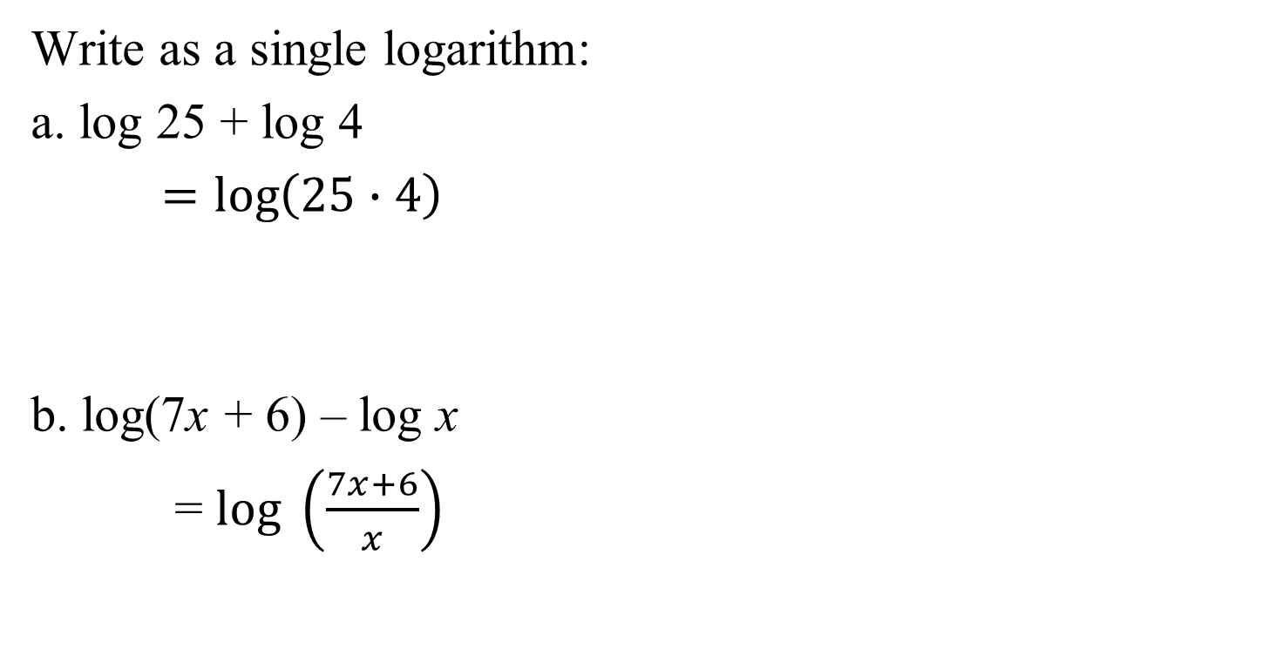

Example 5: Condensing Logarithmic Expressions
Write as a single logarithm:
a. log 25 + log 4
$=log\left(25∙4\right)$
b. log(7x + 6) – log x
= $log \left(\frac{7x+6}{x}\right)$
$$=log 100$$
$$=2$$

Slide 14

Example 6a: Condensing Logarithmic Expressions
Write as a single logarithm:
$$2lnx+\frac{1}{3}ln(x+5)$$
$=lnx^{2}+ln{\left(x+5\right)}^{\frac{1}{3}}$
$=ln\left[x^{2}{\left(x+5\right)}^{\frac{1}{3}}\right]$
$=ln\left(x^{2}\sqrt[3]{x+5}\right)$

Slide 15
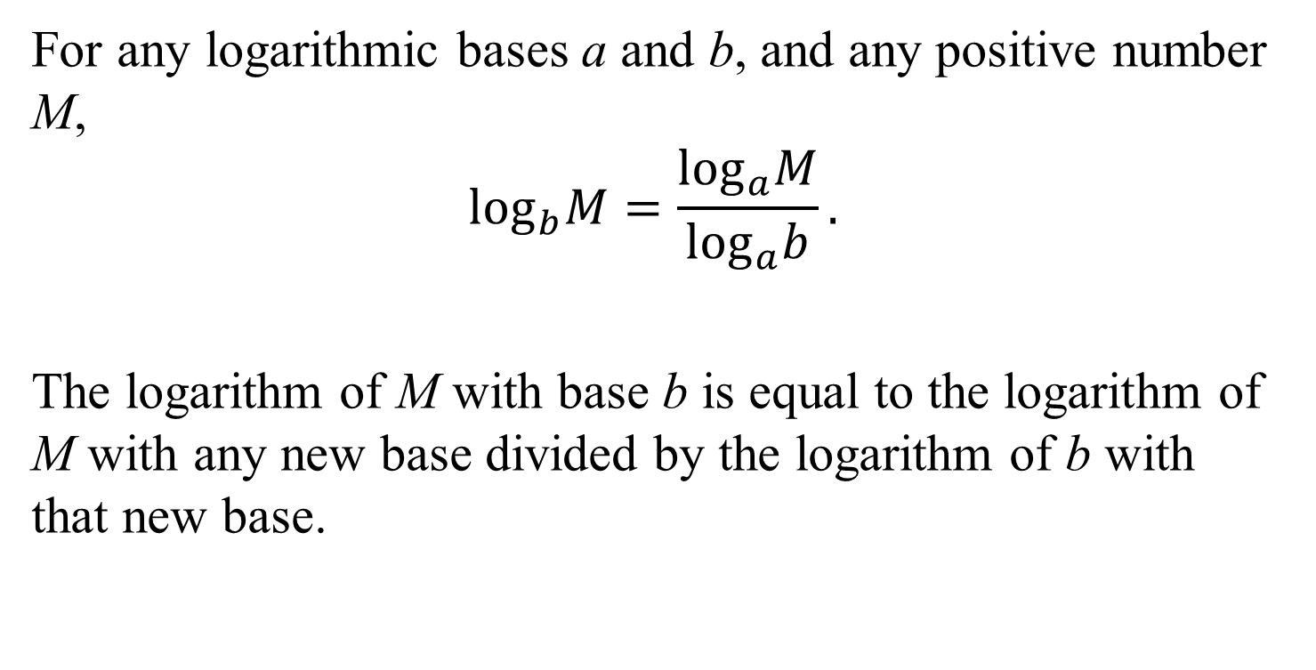
The Change-of-Base Property
For any logarithmic bases a and b, and any positive number M,
$$\log_{b}M=\frac{\log_{a}M}{\log_{a}b}.$$
The logarithm of M with base b is equal to the logarithm of M with any new base divided by the logarithm of b with that new base.

Slide 16
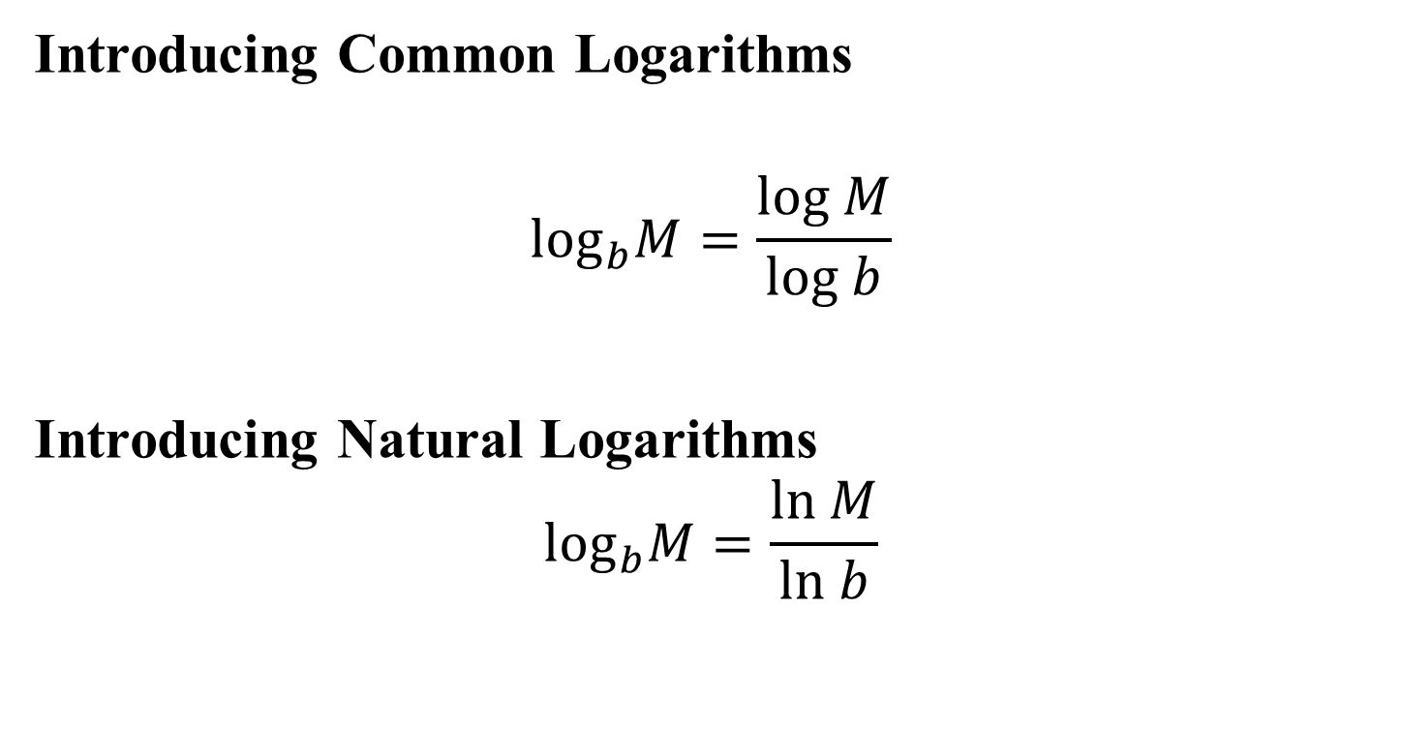
The Change-of-Base Property: Introducing Common and Natural Logarithms
Introducing Common Logarithms
$$\log_{b}M=\frac{log M}{log b}$$
Introducing Natural Logarithms
$$\log_{b}M=\frac{ln M}{ln b}$$

Slide 17
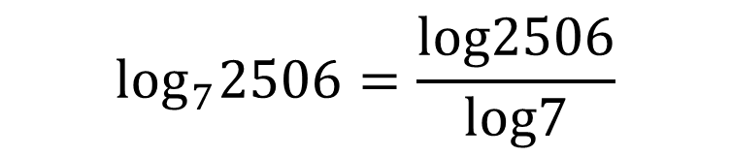
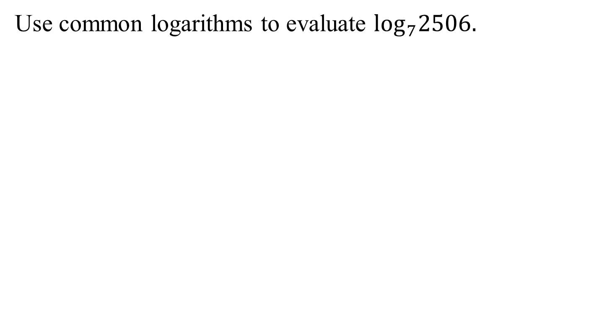

Example 7: Changing Base to Common Logarithms
Use common logarithms to evaluate $\log_{7}2506.$
$$\log_{7}2506=\frac{log2506}{log7}$$
$$≈4.02$$

Slide 18
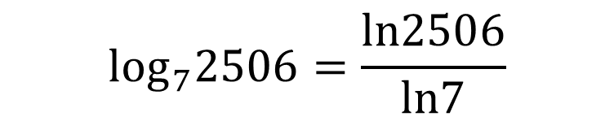
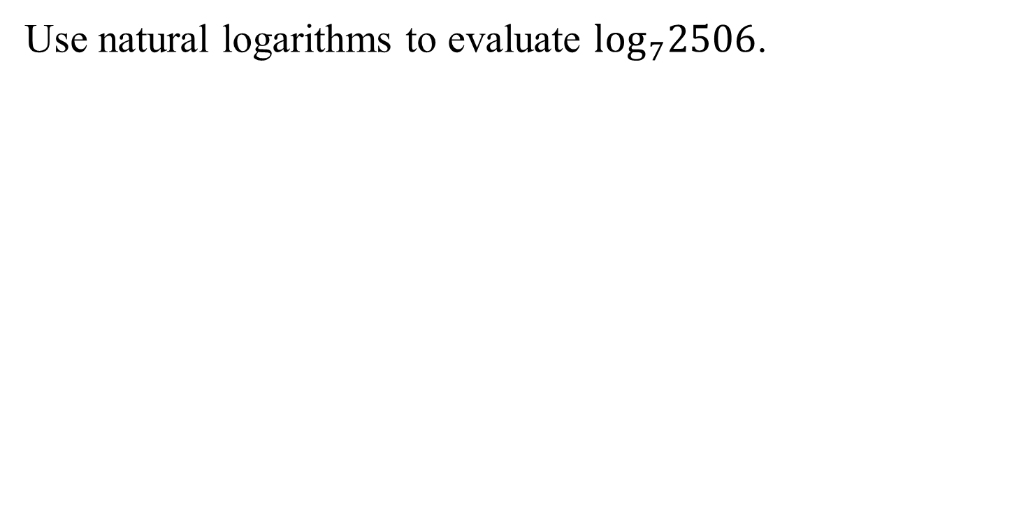

Example 8: Changing Base to Natural Logarithms
Use natural logarithms to evaluate $\log_{7}2506$.
$$\log_{7}2506=\frac{ln2506}{ln7}$$
$$≈4.02$$

