Slide 1

Chapter 2
Polynomial and Rational Functions
2.6 Rational Functions and Their Graphs

Slide 2
Objectives
Find the domains of rational functions.
Use arrow notation.
Identify vertical asymptotes.
Identify horizontal asymptotes.
Use transformations to graph rational functions.
Graph rational functions.
Identify slant asymptotes.
Solve applied problems involving rational functions.

Slide 3
Rational Functions
Rational functions are quotients of polynomial functions. This means that rational functions can be expressed as
$$f\left(x\right)=\frac{p(x)}{q(x)},$$
where p and q are polynomial functions and $q\left(x\right)≠0.$
The domain of a rational function is the set of all real numbers except the x-values that make the denominator zero.

Slide 4
Example 1a: Finding the Domain of a Rational Function
Find the domain of the rational function: $f\left(x\right)=\frac{x^{2}−25}{x−5}$. Solution:
Rational functions contain division. Because division by 0 is undefined, we must exclude from the domain of each function values of x that cause the polynomial function in the denominator to be 0. x – 5 = 0
x = 5
The domain of f consists of all real numbers except 5.
Set builder notation: $\{x|x≠5\}$
Interval notation: $\left(−∞,5\right)∪\left(5,∞\right)$

Slide 5
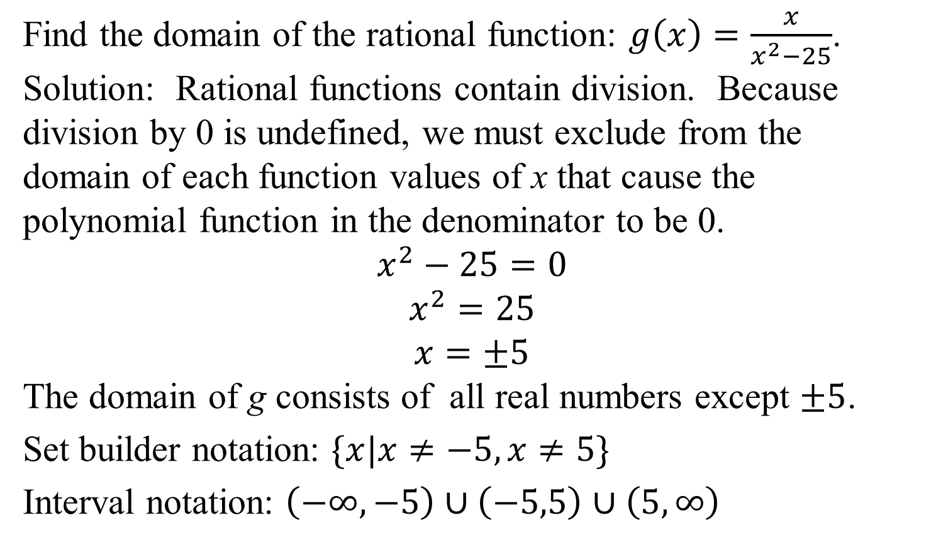
Example 1b: Finding the Domain of a Rational Function
Find the domain of the rational function: $g\left(x\right)=\frac{x}{x^{2}−25}$. Solution: Rational functions contain division. Because division by 0 is undefined, we must exclude from the domain of each function values of x that cause the polynomial function in the denominator to be 0.
$$x^{2}−25=0$$
$$x^{2}=25$$
$$x=±5$$
The domain of g consists of all real numbers except $±5$.
Set builder notation: $\{x|x≠−5,x≠5\}$
Interval notation: $\left(−∞,−5\right)∪\left(−5,5\right)$ $∪\left(5, ∞\right)$

Slide 6
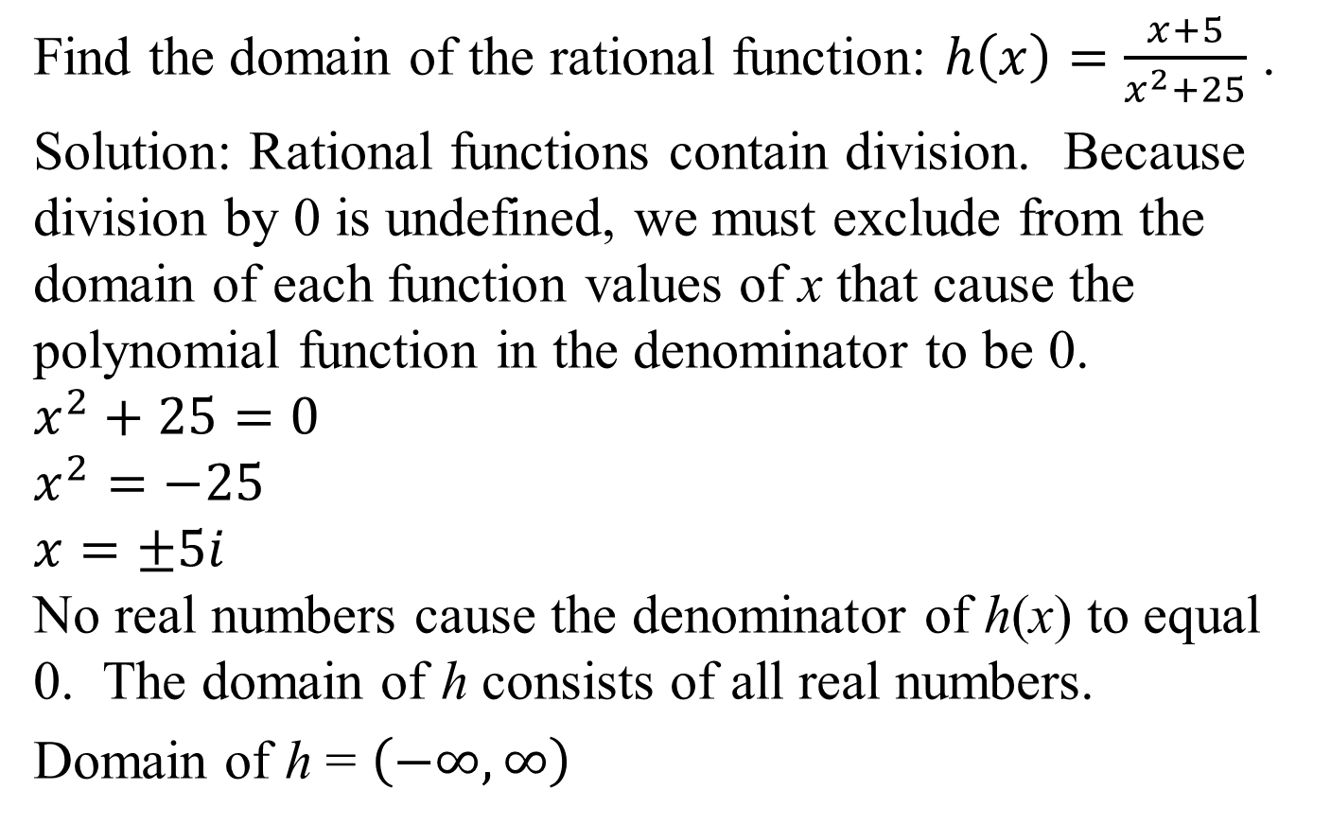
Example 1c: Finding the Domain of a Rational Function
Find the domain of the rational function: $h\left(x\right)=\frac{x+5}{x^{2}+25}$ .
Solution: Rational functions contain division. Because division by 0 is undefined, we must exclude from the domain of each function values of x that cause the polynomial function in the denominator to be 0.
$$x^{2}+25=0$$
$$x^{2}=−25$$
$$x=±5i$$
No real numbers cause the denominator of h(x) to equal 0. The domain of h consists of all real numbers.
Domain of h = $\left(−∞, ∞\right)$

Slide 7
Arrow Notation
We use arrow notation to describe the behavior of some functions.
Symbol | Meaning
$$x→a^{+}$$ | x approaches a from the right.
$$x→a^{−}$$ | x approaches a from the left.
$$x→∞$$ | x approaches infinity; that is, x increases without bound.
$$x→−∞$$ | x approaches negative infinity; that is, x decreases without bound.

Slide 8
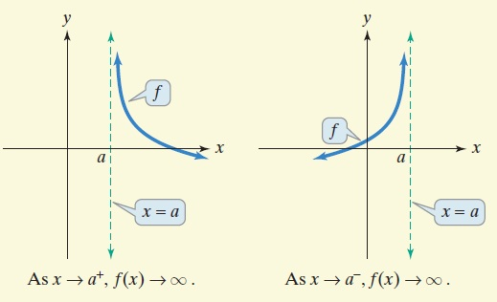
Definition of a Vertical Asymptote
The line x = a is a vertical asymptote of the graph of a function f if f(x) increases without bound as x approaches a.

Slide 9
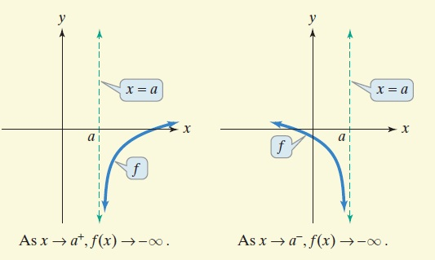
Definition of a Vertical Asymptote (continued)
The line x = a is a vertical asymptote of the graph of a function f if f(x) decreases without bound as x approaches a.

Slide 10
Locating Vertical Asymptotes
If $f\left(x\right)=\frac{p(x)}{q(x)}$ is a rational function in which p(x) and q(x) have no common factors and a is a zero of q(x), the denominator, then x = a is a vertical asymptote of the graph of f.

Slide 11
Example 2a: Finding the Vertical Asymptotes of a Rational Function
Find the vertical asymptotes, if any, of the graph of the rational function:
$$f\left(x\right)=\frac{x}{x^{2}−1}$$
Solution:
There are no common factors in the numerator and the denominator.
The zeros of the denominator are –1 and 1. Thus, the lines x = –1 and x = 1 are the vertical asymptotes for the graph of f.
$$=\frac{x}{(x−1)(x+1)}$$

Slide 12
Example 2a: Finding the Vertical Asymptotes of a Rational Function (continued)
Find the vertical asymptotes, if any, of the graph of the rational function: $f\left(x\right)=\frac{x}{x^{2}−1}$.
The zeros of the denominator are
–1 and 1. Thus, the lines
x = –1 and x = 1
are the vertical
asymptotes for the graph of f.

Slide 13
Example 2c: Finding the Vertical Asymptotes of a Rational Function
Find the vertical asymptotes, if any, of the graph of the rational function: $h\left(x\right)=\frac{x−1}{x^{2}+1}$
Solution: We cannot factor the
denominator of h(x) over
the real numbers. The
denominator has no real
zeros. Thus, the graph of h
has no vertical asymptotes.

Slide 14
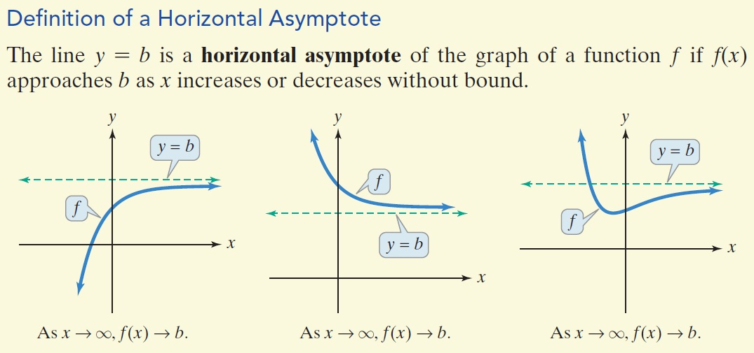
Definition of a Horizontal Asymptote

Slide 15
Locating Horizontal Asymptotes
Let f be the rational function given by
$f\left(x\right)=\frac{a_{n}x^{n}+a_{n−1}x^{n−1}+…+a_{1}x+a_{0}}{b_{m}x^{m}+b_{m−1}x^{m−1}+…+b_{1}x+b_{0}}$, $a_{n}≠0, b_{m}≠0.$
The degree of the numerator is n. The degree of the denominator is m.
1. If n < m, the x-axis, or y = 0, is the horizontal asymptote of the graph of f.
2. If n = m, the line $y=\frac{a_{n}}{b_{m}}$ is the horizontal asymptote of the graph of f.
3. If n > m, the graph of f has no horizontal asymptote.

Slide 16
Example 3a: Finding the Horizontal Asymptote of a Rational Function
Find the horizontal asymptote, if any, of the graph of the rational function:
$$f\left(x\right)=\frac{9x^{2}}{3x^{2}+1}$$
Solution:
The degree of the numerator, 2, is equal to the degree of the denominator, 2. The leading coefficients of the numerator and the denominator, 9 and 3, are used to obtain the equation of the horizontal asymptote.
The equation of the horizontal asymptote is $y=\frac{9}{3}$ or
y = 3.

Slide 17
Example 3a: Finding the Horizontal Asymptote of a Rational Function (continued)
Solution (continued):
The equation of the horizontal asymptote is y = 3.

Slide 18
Example 3b: Finding the Horizontal Asymptote of a Rational Function
Find the horizontal asymptote, if any, of the graph of the rational function:
$$g\left(x\right)=\frac{9x}{3x^{2}+1}$$
Solution:
The degree of the numerator, 1, is less than the degree of the denominator, 2. Thus, the graph of g has the x-axis as a horizontal asymptote.
The equation of the horizontal asymptote is y = 0.

Slide 19
Example 3b: Finding the Horizontal Asymptote of a Rational Function (continued)
Solution (continued):
The equation of the horizontal asymptote is y = 0.

Slide 20
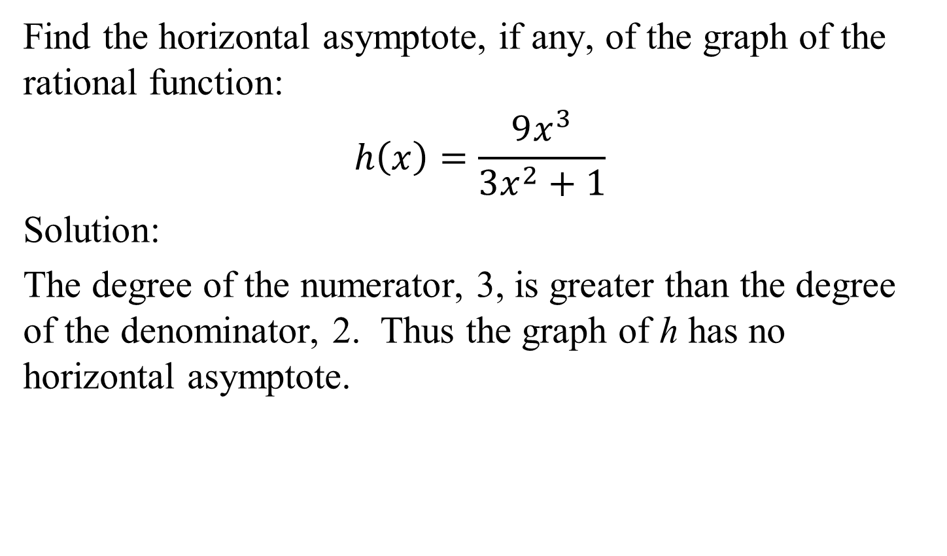
Example 3c: Finding the Horizontal Asymptote of a Rational Function
Find the horizontal asymptote, if any, of the graph of the rational function:
$$h\left(x\right)=\frac{9x^{3}}{3x^{2}+1}$$
Solution:
The degree of the numerator, 3, is greater than the degree of the denominator, 2. Thus the graph of h has no horizontal asymptote.

Slide 21
Example 3c: Finding the Horizontal Asymptote of a Rational Function (continued)
Solution (continued):
The graph has no horizontal asymptote.

Slide 22
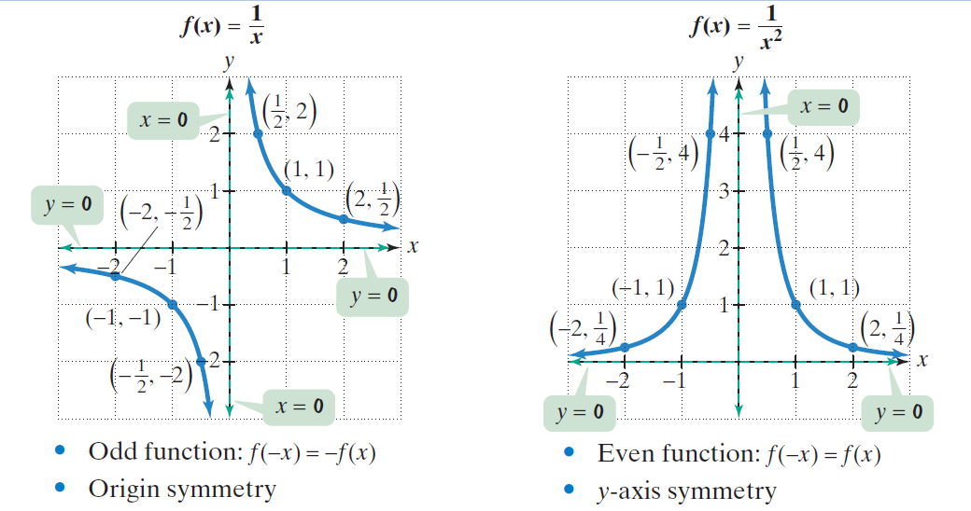
Basic Rational Functions

Slide 23
Example 4: Using Transformations to Graph a Rational Function
Use the graph of $f\left(x\right)=\frac{1}{x}$ to graph $g\left(x\right)=\frac{1}{x+2}−1$
Solution:
Begin with $f\left(x\right)=\frac{1}{x}$
We’ve identified two
points and the
asymptotes.
Vertical
asymptote
x = 0
Horizontal
asymptote
y = 0

Slide 24
Example 4: Using Transformations to Graph a Rational Function (continued)
Solution (continued):
The graph will shift
2 units to the left.
Subtract 2 from each
x-coordinate. The
vertical asymptote
is now x = –2.
Vertical
asymptote
x = –2
Horizontal
asymptote
y = 0

Slide 25
Example 4: Using Transformations to Graph a Rational Function (continued)
Solution (continued):
The graph will shift
1 unit down.
Subtract 1 from each
y-coordinate. The
horizontal asymptote
is now y = –1.
Vertical
asymptote
x = –2
Horizontal
asymptote
y = –1

Slide 26
Strategy for Graphing a Rational Function
The following strategy can be used to graph
$$f\left(x\right)=\frac{p(x)}{q(x)},$$
where p and q are polynomial functions with no common factors.
1. Determine whether the graph of f has symmetry.
$f\left(−x\right)=f\left(x\right):$ y-axis symmetry
$f\left(−x\right)=−f\left(x\right):$ origin symmetry
2. Find the y-intercept (if there is one) by evaluating
f(0).

Slide 27
Strategy for Graphing a Rational Function (continued)
3. Find the x-intercepts (if there are any) by solving the equation p(x) = 0.
Find any vertical asymptote(s) by solving the equation q(x) = 0.
Find the horizontal asymptote (if there is one) using
the rule for determining the horizontal asymptote of
a rational function.
Plot at least one point between and beyond each
x-intercept and vertical asymptote.
7. Use the information obtained previously to graph the function between and beyond the vertical asymptotes.

Slide 28
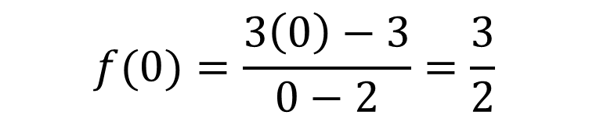
Example 5: Graphing a Rational Function
Graph: $f\left(x\right)=\frac{3x−3}{x−2}$
Solution:
Step 1 Determine symmetry.
$$f\left(−x\right)=\frac{3(−x)−3}{(−x)−2}$$
Because f(–x) does not equal either f(x) or –f(x), the graph has neither y-axis symmetry nor origin symmetry.
Step 2 Find the y-intercept. Evaluate f(0).
$$=\frac{−3x−3}{−x−2}$$
$$f(0)=\frac{\left.3 ( 0\right)−3}{0−2}=\frac{3}{2}$$

Slide 29
Example 5: Graphing a Rational Function (continued)
Step 3 Find x-intercept(s).
3x – 3 = 0
3x = 3
x = 1
Step 4 Find the vertical asymptote(s).
x – 2 = 0
x = 2
Step 5 Find the horizontal asymptote.
The numerator and denominator of f have the same degree, 1. The horizontal asymptote is $y=\frac{3}{1}=3.$

Slide 30
Example 5: Graphing a Rational Function (continued)
Step 6 Plot points between and beyond each
x-intercept and vertical asymptotes.
The x-intercept is 1. The graph
passes through the point (1,0).
The y-intercept is 3/2. The
graph passes through the
point (0, 3/2).
We evaluate f(x) at x = −1,
x = 1/2, x = 3/2, x = 5/2, and x = 3.
vertical
asymptote
x = 2

Slide 31
Example 5: Graphing a Rational Function (continued)
Step 6 (continued)
We evaluate f at the selected points.
x | –1 | $$\frac{1}{2}$$ | $$\frac{3}{2}$$ | $$\frac{5}{2}$$ | 3
$$f\left(x\right)=\frac{3x−3}{x−2}$$ | 2 | 1 | –3 | 9 | 6

Slide 32
Example 5: Graphing a Rational Function (continued)
Step 7 Graph the function.
vertical
asymptote
x = 2
horizontal
asymptote
y = 3

Slide 33
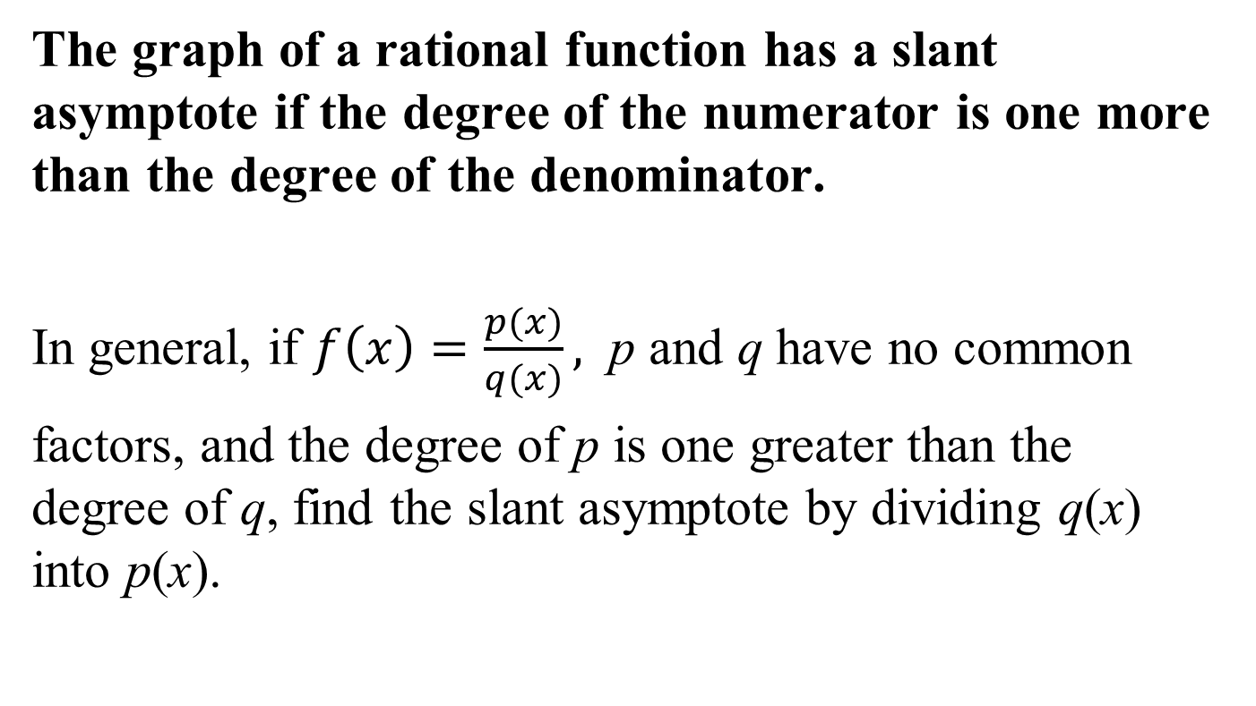
Slant Asymptotes
The graph of a rational function has a slant asymptote if the degree of the numerator is one more than the degree of the denominator.
In general, if $f\left(x\right)=\frac{p(x)}{q(x)},$ p and q have no common
factors, and the degree of p is one greater than the degree of q, find the slant asymptote by dividing q(x) into p(x).

Slide 34
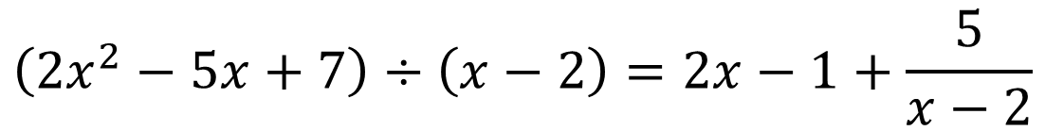
Example 8: Finding the Slant Asymptote of a Rational Function
Find the slant asymptote of $f\left(x\right)=\frac{2x^{2}−5x+7}{x−2}$.
Solution: The degree of the numerator, 2, is exactly one more than the degree of the denominator, 1.
To find the equation of the slant asymptote, divide the numerator by the denominator.
2 | 2 | –5 | 7
 |  | 4 | –2
 | 2 | –1 | 5
$$\left(2x^{2}−5x+7\right)÷\left(x−2\right)=2x−1+\frac{5}{x−2}$$

Slide 35
Example 8: Finding the Slant Asymptote of a Rational Function (continued)
The equation of the slant asymptote is y = 2x – 1.
The graph of f(x) is shown.
vertical
asymptote
x = 2
slant asymptote
y = 2x – 1

Slide 36
Example 9a: Application
A company is planning to manufacture wheelchairs that are light, fast, and beautiful. The fixed monthly cost will be $500,000 and it will cost $400 to produce each radically innovative chair.
Write the cost function, C, of producing x wheelchairs.
Solution:
C(x) = 500,000 + 400x

Slide 37
Example 9b: Application (continued)
A company is planning to manufacture wheelchairs that are light, fast, and beautiful. The fixed monthly cost will be $500,000 and it will cost $400 to produce each radically innovative chair.
Write the average cost function, $\overline{C}$, of producing x wheelchairs.
Solution:
$$\overline{C}\left(x\right)=\frac{500,000+400x}{x}$$

Slide 38
Example 9c: Application
Find and interpret $\overline{C}\left(1000\right),\overline{C}\left(10,000\right), and \overline{C}\left(100,000\right)$.
Solution:
$$\overline{C}\left(x\right)=\frac{500,000+400x}{x}$$
$$\overline{C}\left(1000\right)=\frac{500,000+400(1000)}{1000}$$
= 900
The average cost per wheelchair of producing 1000 wheelchairs per month is $900.

Slide 39
Example 9c: Application (continued)
Find and interpret $\overline{C}\left(1000\right),\overline{C}\left(10,000\right), and \overline{C}\left(100,000\right)$.
Solution:
$$\overline{C}\left(x\right)=\frac{500,000+400x}{x}$$
$$\overline{C}\left(10,000\right)=\frac{500,000+400(10,000)}{10,000}$$
= 450
The average cost per wheelchair of producing 10,000 wheelchairs per month is $450.

Slide 40
Example 9c: Application (continued)
Find and interpret $\overline{C}\left(1000\right),\overline{C}\left(10,000\right), and \overline{C}\left(100,000\right)$.
Solution:
$$\overline{C}\left(x\right)=\frac{500,000+400x}{x}$$
$$\overline{C}\left(100,000\right)=\frac{500,000+400(100,000)}{100,000}$$
= 405
The average cost per wheelchair of producing 10,000 wheelchairs per month is $405.

Slide 41
Example 9d: Application (continued)
Find the horizontal asymptote for the average cost function, and describe what this means for the company.
Solution:
$$\overline{C}\left(x\right)=\frac{500,000+400x}{x}$$
$$\overline{C}\left(x\right)=\frac{400x+500,000}{x}$$
The horizontal asymptote is y = 400.
The cost per wheelchair approaches $400 as more wheelchairs are produced.

