Slide 1

Chapter 1
Functions and Graphs
1.8 Inverse Functions

Slide 2
Objectives
Verify inverse functions.
Find the inverse of a function.
Use the horizontal line test to determine if a function has an inverse function.
Use the graph of a one-to-one function to graph its inverse function.
Find the inverse of a function and graph both functions on the same axes.

Slide 3
Definition of the Inverse of a Function
Let $f$ and $g$ be two functions such that
$f\left(g\left(x\right)\right)=x$ for every x in the domain of g
and
$g\left(f\left(x\right)\right)=x$ for every x in the domain of f.
The function g is the inverse of the function f and is denoted $f^{−1}$ (read “f-inverse”). Thus, $f\left(f^{−1}(x)\right)=x$ and
$f^{−1}\left(f(x)\right)=x$. The domain of f is equal to the range of
$f^{−1}$, and vice versa.

Slide 4
Example 1: Verifying Inverse Functions
Show that each function is the inverse of the other:
$$f\left(x\right)=4x−7 and g\left(x\right)=\frac{x+7}{4}.$$
Solution:
$$f\left(g\left(x\right)\right)=f\left(\frac{x+7}{4}\right)$$
$$g\left(f(x)\right)=g(4x−7)$$
$f\left(g\left(x\right)\right)=g\left(f\left(x\right)\right)=x$ verifies that $f$and $g$ are inverse functions.
$$=4\left(\frac{x+7}{4}\right)−7$$
$$=x+7−7$$
$$=x$$
$$=\frac{4x−7+7}{4}$$
$$=\frac{4x}{4}$$
$$=x$$

Slide 5
Finding the Inverse of a Function
The equation for the inverse of a function f can be found as follows:
1. Replace f(x) with y in the equation for f(x).
2. Interchange x and y.
3. Solve for y. If this equation does not define y as a function of x, the function f does not have an inverse function and this procedure ends. If this equation does define y as a function of x, the function f has an inverse function.
4. If f has an inverse function, replace y in step 3 by f ^{–1}(x). We can verify our result by showing that f(f ^{–1} (x)) = x and f ^{–1} (f(x)) = x.

Slide 6
Example 2: Finding the Inverse of a Function
Find the inverse of $f\left(x\right)=2x+7$.
Solution:
Step 1 Replace f(x) with y: $y=2x+7$
Step 2 Interchange x and y: $x=2y+7$
Step 3 Solve for y: $x=2y+7$
$$x−7=2y$$
$$y=\frac{x−7}{2}$$
Step 4 Replace y with f ^{–1} (x): $f^{−1}\left(x\right)=\frac{x−7}{2}$

Slide 7
The Horizontal Line Test for Inverse Functions
A function f has an inverse that is a function, f ^{–1}, if there is no horizontal line that intersects the graph of the function f at more than one point.

Slide 8
Example 5: Applying the Horizontal Line Test
Which of the following graphs represent functions that have inverse functions?
a. c.
Solution: Graph c represents a function that has an inverse.

Slide 9
Graphs of f and f ^{– 1}
The graph of f ^{–1} is a reflection of the graph of f about the line y = x.

Slide 10
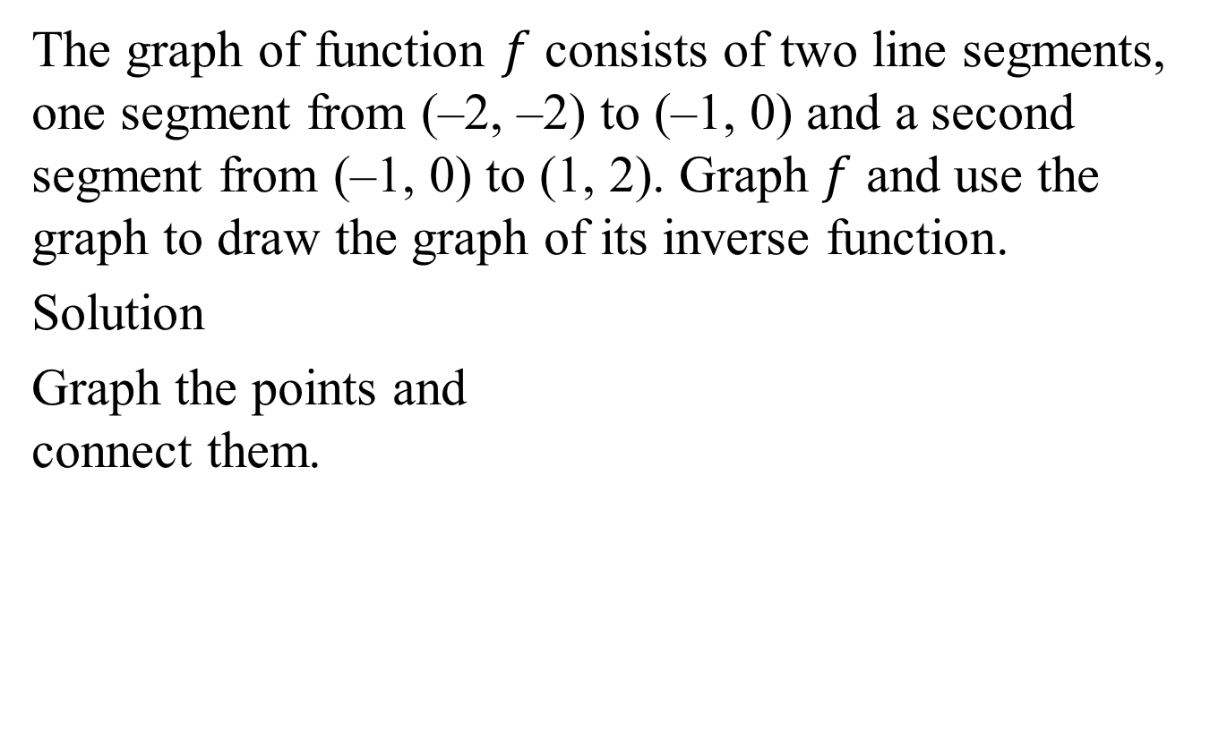
Example 6: Graphing the Inverse Function
The graph of function $f$ consists of two line segments, one segment from (–2, –2) to (–1, 0) and a second segment from (–1, 0) to (1, 2). Graph $f$ and use the graph to draw the graph of its inverse function.
Solution
Graph the points and
connect them.
$$y=f(x)$$

Slide 11
Example 6: Graphing the Inverse Function (continued)
The inverse function has ordered pairs that are reversed.
(–2, –2) stays as (–2, –2)
(–1, 0) reversed becomes (0, –1)
(1, 2) reversed becomes (2, 1)
Plot points and connect.
Verify with y = x.
$$y=f(x)$$
$$y=f^{−1}(x)$$

