Slide 1

Chapter 6
Additional Topics in Trigonometry
6.4 Graphs of Polar Equations

Slide 2
Objectives:
Use point plotting to graph polar equations.
Use symmetry to graph polar equations.

Slide 3
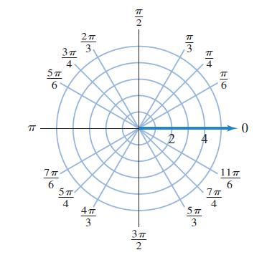
Using Polar Grids to Graph
A polar equation is an equation whose variables are r and $θ.$
The graph of a polar equation is the set of all points whose
polar coordinates satisfy the equation.
We use polar grids like the
one in the figure to graph
polar equations.

Slide 4
Example 1: Graphing an Equation Using the Point-Plotting Method
Graph the equation r = 4 sin $θ$ with $θ$ in radians. Use multiples of $\frac{π}{6}$ from 0 to π to generate coordinates for points (r, $θ$).
We construct a partial table of coordinates for r = 4 sin $θ$
using multiples of $\frac{π}{6}.$ Then we plot the points and join them in a smooth curve.

Slide 5
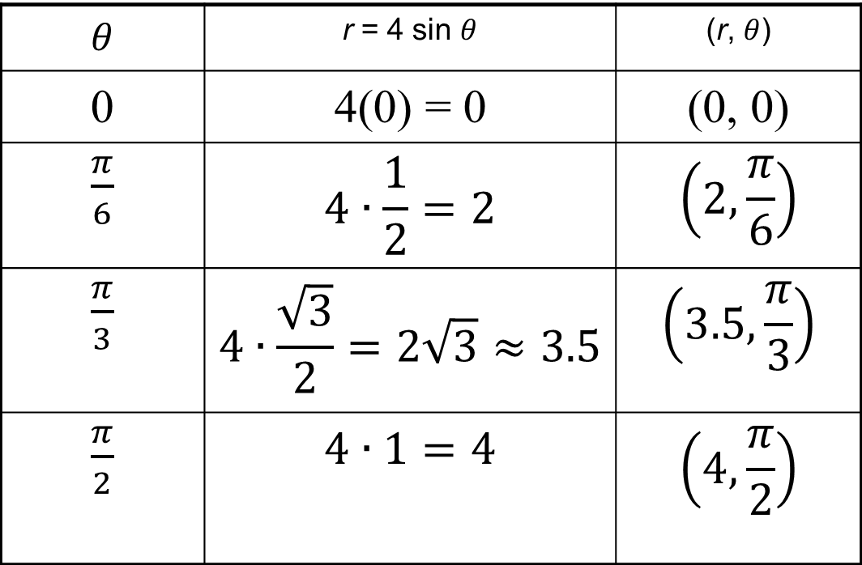
Example 1: Graphing an Equation Using the Point-Plotting Method (continued)
Graph r = 4 sin $θ$
$θ$ | r = 4 sin $θ$ | (r, $θ$)
0 | 4(0) = 0 | (0, 0)
$\frac{π}{6}$ | $$4∙\frac{1}{2}=2$$ | $$\left(2,\frac{π}{6}\right)$$
$\frac{π}{3}$ | $$4∙\frac{\sqrt{3}}{2}=2\sqrt{3}≈3.5$$ | $$\left(3.5,\frac{π}{3}\right)$$
$\frac{π}{2}$ | $$4∙1=4$$ | $$\left(4,\frac{π}{2}\right)$$

Slide 6
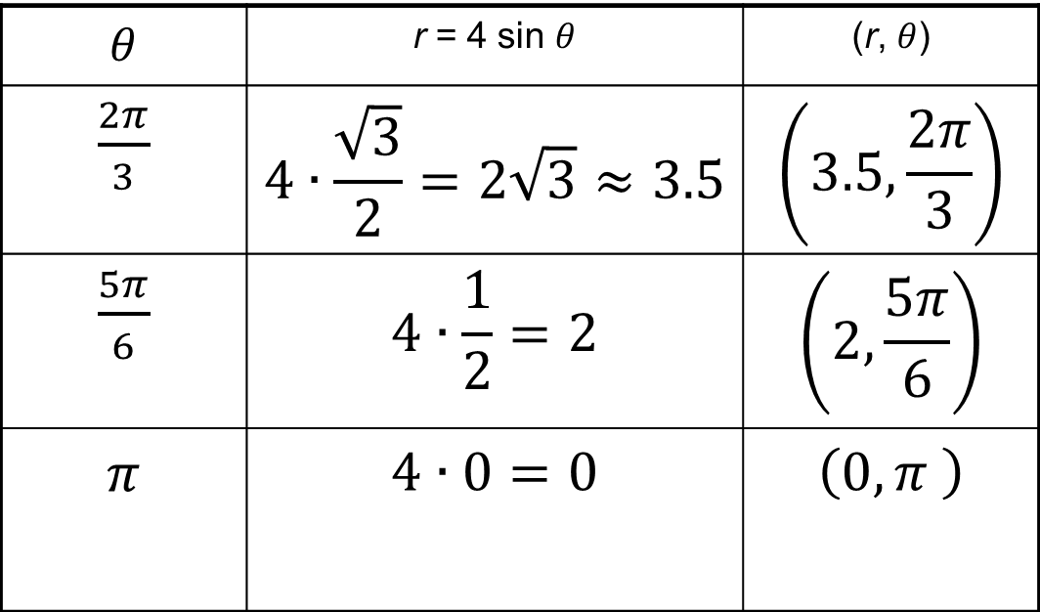
Example 1: Graphing an Equation Using the Point-Plotting Method (continued)
Graph r = 4 sin $θ$
$θ$ | r = 4 sin $θ$ | (r, $θ$)
$\frac{2π}{3}$ | $$4∙\frac{\sqrt{3}}{2}=2\sqrt{3}≈3.5$$ | $$\left(3.5,\frac{2π}{3}\right)$$
$\frac{5π}{6}$ | $$4∙\frac{1}{2}=2$$ | $$\left(2,\frac{5π}{6}\right)$$
$π$ | $$4∙0=0$$ | $$\left(0,π \right)$$

Slide 7
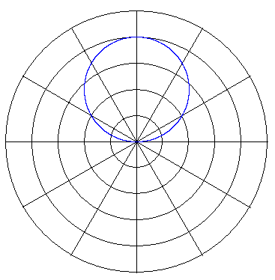
Example 1: Graphing an Equation Using the Point-Plotting Method (continued)
$$r=4sinθ$$
Graph r = 4 sin $θ$
$$r^{2}=4rsinθ$$
$$x^{2}+y^{2}=4y$$
$$x^{2}+y^{2}−4y=0$$
$$x^{2}+y^{2}−4y+4=4$$
$$x^{2}+{\left(y−2\right)}^{2}=4$$
The graph is a
circle with center
at (0, 2) and r = 2.
We can verify
that the graph
is a circle by
changing from
polar to rectangular
form.

Slide 8
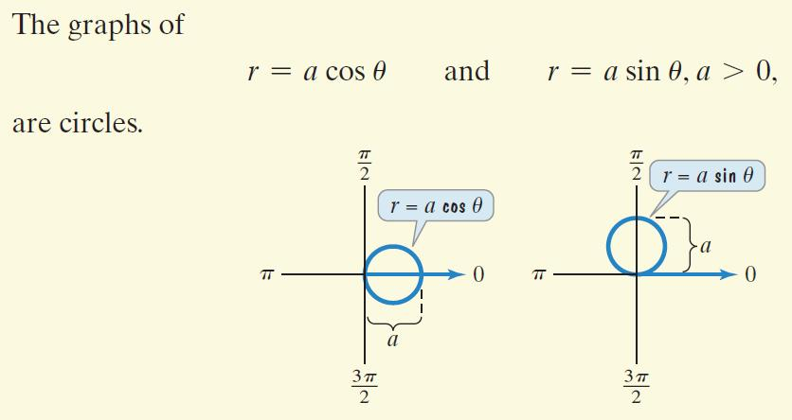
Circles in Polar Coordinates

Slide 9
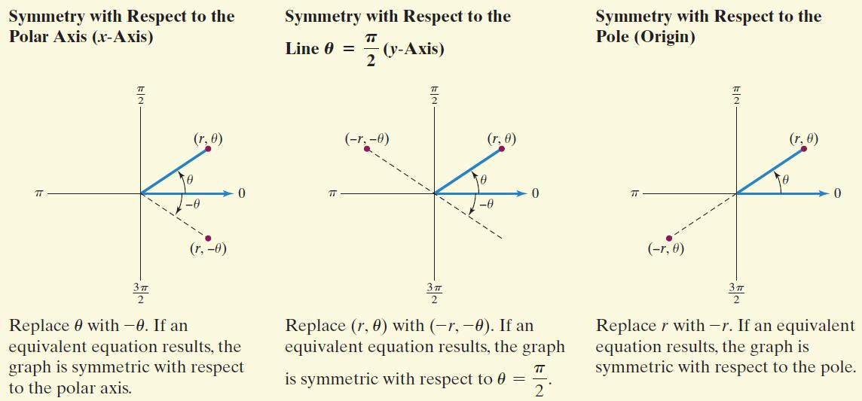
Tests for Symmetry in Polar Coordinates

Slide 10
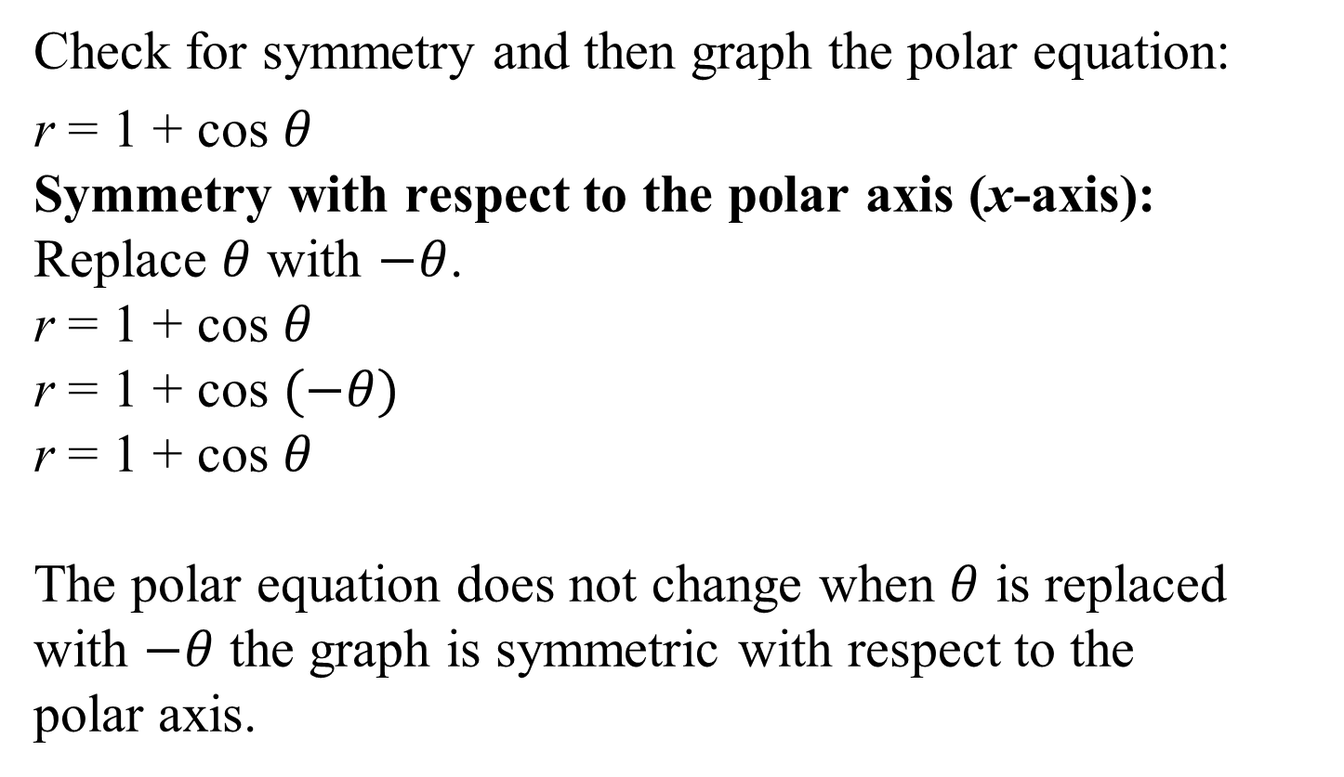
Example 2: Graphing a Polar Equation Using Symmetry
Check for symmetry and then graph the polar equation:
r = 1 + cos $θ$
Symmetry with respect to the polar axis (x-axis):
Replace $θ$ with $−θ$.
r = 1 + cos $θ$
r = 1 + cos $(−θ)$
r = 1 + cos $θ$
The polar equation does not change when $θ$ is replaced with $−θ$ the graph is symmetric with respect to the
polar axis.

Slide 11
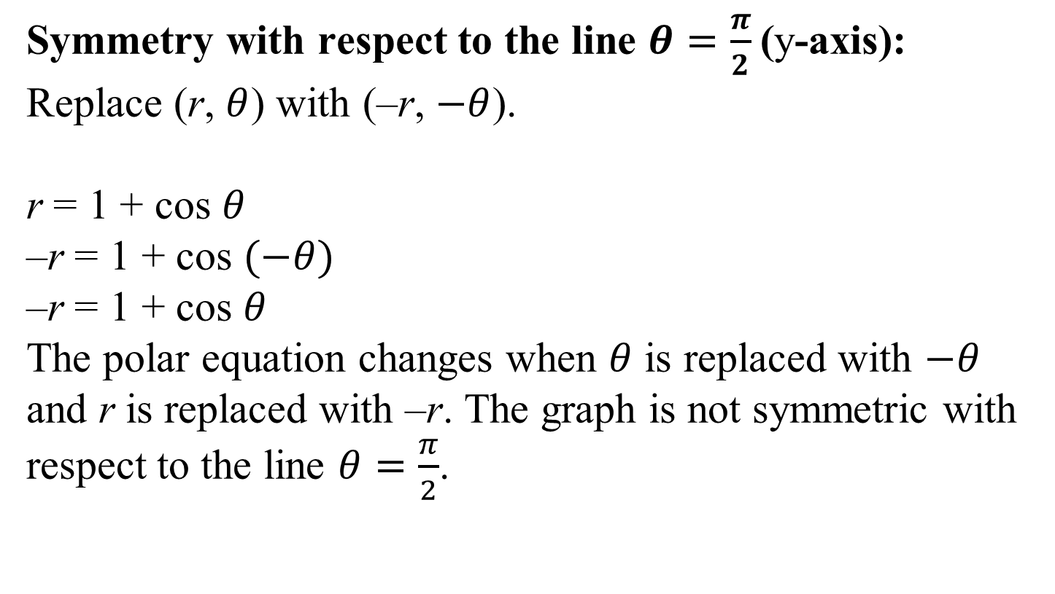
Example 2: Graphing a Polar Equation Using Symmetry (continued)
Symmetry with respect to the line $θ=\frac{π}{2}$(y-axis):
Replace (r, $θ$) with (–r, $−θ$).
r = 1 + cos $θ$
–r = 1 + cos $(−θ)$
–r = 1 + cos $θ$
The polar equation changes when $θ$ is replaced with $−θ$ and r is replaced with –r. The graph is not symmetric with respect to the line $θ=\frac{π}{2}$.

Slide 12
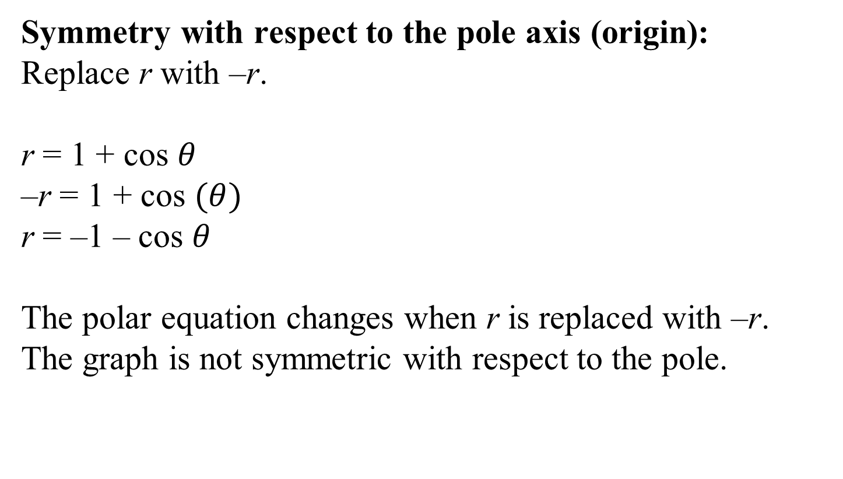
Example 2: Graphing a Polar Equation Using Symmetry (continued)
Symmetry with respect to the pole axis (origin):
Replace r with –r.
r = 1 + cos $θ$
–r = 1 + cos $(θ)$
r = –1 – cos $θ$
The polar equation changes when r is replaced with –r. The graph is not symmetric with respect to the pole.

Slide 13
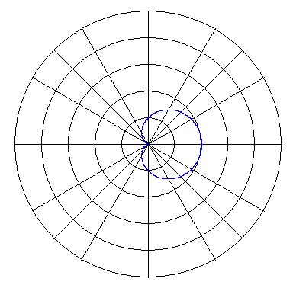
Example 2: Graphing a Polar Equation Using Symmetry (continued)
Check for symmetry and then graph the polar equation: r = 1 + cos $θ$
Complete a table of values for the function:
$$θ$$ | r = 1 + cos $θ$ | $$θ$$ | r = 1 + cos $θ$
 | 2 | $$\frac{2π}{3}$$ | 0.5
$$\frac{π}{6}$$ | 1.87 | $$\frac{5π}{6}$$ | 0.13
$$\frac{π}{3}$$ | 1.5 | $$π$$ | 0
$$\frac{π}{2}$$ | 1

Slide 14
Example 2: Graphing a Polar Equation Using Symmetry (continued)
The graph of r = 1 + cos $θ$ is an example of a limaçon.

Slide 15
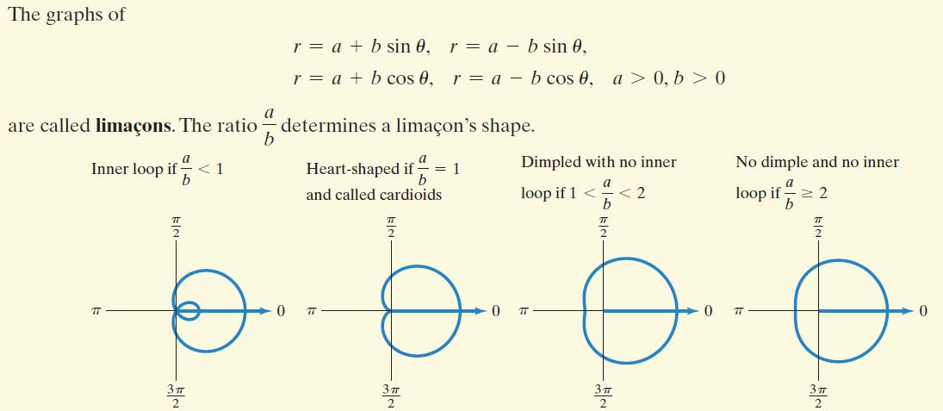
Limaçons

Slide 16

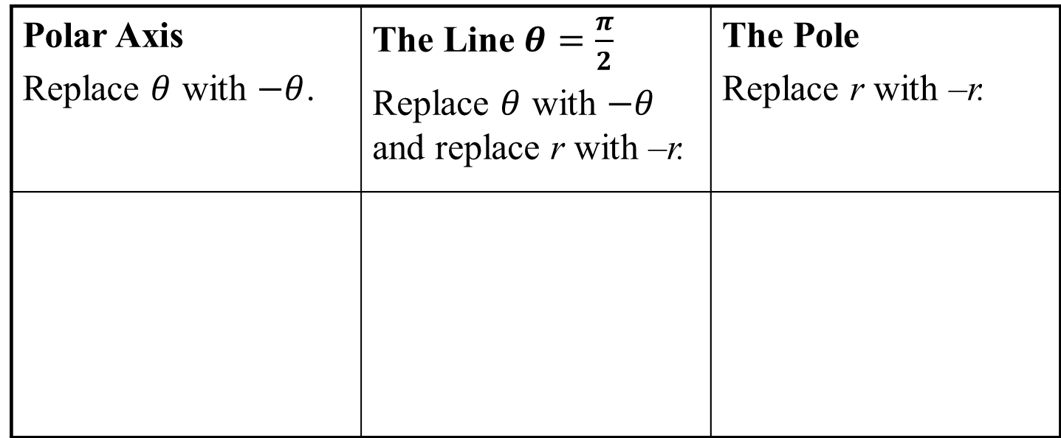
Example 4: Graphing a Polar Equation
Graph the polar equation: $r=3\cos{2θ}$
We first check for symmetry:
Polar Axis Replace $θ$ with $−θ$. | The Line $θ=\frac{π}{2}$ Replace $θ$ with $−θ$ and replace r with –r. | The Pole Replace r with –r.
$$\left.r=3cos2(−θ\right)$$
$$\left.−r=3cos2(−θ\right)$$
$$−r=3cos2θ$$
$$r=3cos2θ$$
$$−r=3cos2θ$$
Equation changes and fails this symmetry test.
Equation does not change.
Equation changes and fails this symmetry test.

Slide 17
Example 4: Graphing a Polar Equation (continued)
Graph the polar equation: $r=3\cos{2θ}$
Complete a table of values for the function:
$$θ$$ | 0 | $$\frac{π}{6}$$ | $$\frac{π}{4}$$ | $$\frac{π}{3}$$ | $$\frac{π}{2}$$ | $$\frac{2π}{3}$$ | $$\frac{3π}{4}$$ | $$\frac{5π}{6}$$ | $$π$$
r | 3 | $$\frac{3}{2}$$ | 0 | $$−\frac{3}{2}$$ | –3 | $$−\frac{3}{2}$$ | 0 | $$\frac{3}{2}$$ | 3

Slide 18
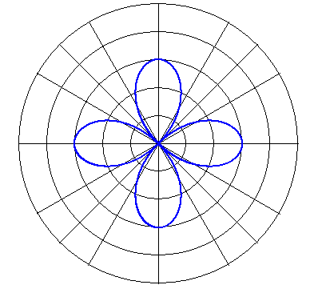
Example 4: Graphing a Polar Equation (continued)
Graph the polar equation: $r=3\cos{2θ}$
The graph is an example
of a rose curve.
$$r=3\cos{2θ}$$

Slide 19
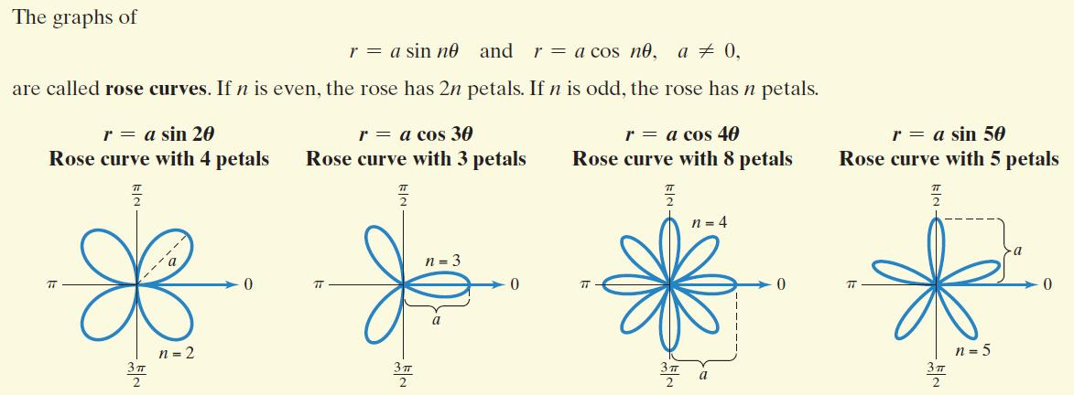
Rose Curves

Slide 20





Example 5: Graphing a Polar Equation
Graph the polar equation: $r^{2}=4\cos{2θ}$
We first check for symmetry:
Polar Axis Replace $θ$ with $−θ$. | The Line $θ=\frac{π}{2}$ Replace $θ$ with $−θ$ and replace r with –r. | The Pole Replace r with –r.
$$r^{2}=4\cos{2(−θ)}$$
$${(−r)}^{2}=4\cos{2(−θ)}$$
$${(−r)}^{2}=4\cos{2θ}$$
$$r^{2}=4\cos{2θ}$$
$$r^{2}=4\cos{2θ}$$
$$r^{2}=4\cos{2θ}$$
Equation does not change.
Equation does not change.
Equation does not change.

Slide 21
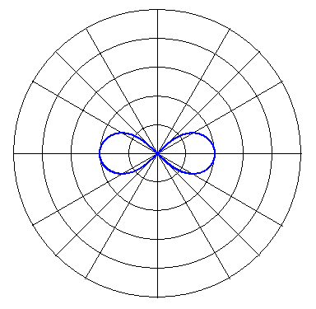
Example 5: Graphing a Polar Equation (continued)
Graph the polar equation: $r^{2}=4\cos{2θ}$
Complete a table of values
for the function:
The graph of the polar equation
is an example of a lemniscate.
$$θ$$ | 0 | $$\frac{π}{6}$$ | $$\frac{π}{4}$$
r | $$±2$$ | $$±1.4$$ | 0

Slide 22
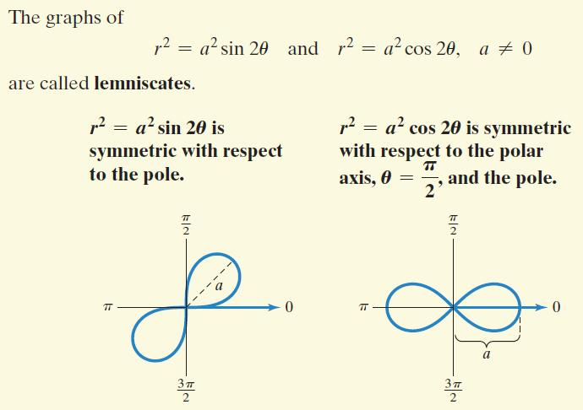
Lemniscates

