Slide 1

Chapter 6
Additional Topics in Trigonometry
6.3 Polar Coordinates

Slide 2
Objectives:
Plot points in the polar coordinate system.
Find multiple sets of polar coordinates for a given point.
Convert a point from polar to rectangular coordinates.
Convert a point from rectangular to polar coordinates.
Convert an equation from rectangular to polar coordinates.
Convert an equation from polar to rectangular coordinates.

Slide 3
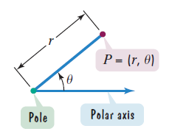
Plotting Points in the Polar Coordinate System
The foundation of the polar coordinate system is a horizontal ray that extends to the right. The ray is called the polar axis. The endpoint of the ray is called the pole. A point P in the polar coordinate system is represented by an ordered pair of numbers $\left(r, θ\right)$. We refer to the ordered pair $P=\left(r, θ\right)$ as the polar coordinates of P.

Slide 4
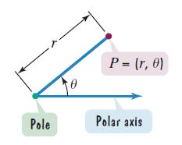
Plotting Points in the Polar Coordinate System
(continued)
r is a directed distance from the pole to P.
$θ$ is an angle from the polar axis to the line segment from the pole to P. This angle can be measured in degrees or radians. Positive angles are measured counterclockwise from the polar axis. Negative angles are measured clockwise from the polar axis.

Slide 5
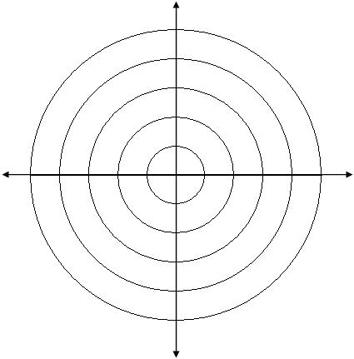
Example 1a: Plotting Points in a Polar Coordinate System
Plot the point with the following polar coordinates: $\left(3, {315}^{°}\right)$
Because 315° is a positive angle,
draw $θ=$ ${315}^{°}$ counterclockwise
from the polar axis.
Because r = 3 is positive, plot the
point going out three units on the
terminal side of $θ$.

Slide 6
Example 1b: Plotting Points in a Polar Coordinate System
Plot the point with the following polar coordinates: $\left(−2, π\right)$.
Because π is a positive angle,
draw $θ=π$ counterclockwise
from the polar axis.
Because r = –2 is negative, plot the
point going out two units along
the ray opposite the terminal side
of $θ$.

Slide 7
Example 1c: Plotting Points in a Polar Coordinate System
Plot the point with the following polar coordinates: $\left(−1, −\frac{π}{2}\right)$.
Because $−\frac{π}{2}$ is a negative angle,
draw $θ=−\frac{π}{2}$ clockwise
from the polar axis.
Because r = –1 is negative, plot the
point going out one unit along the
ray opposite the terminal side of $θ$.

Slide 8
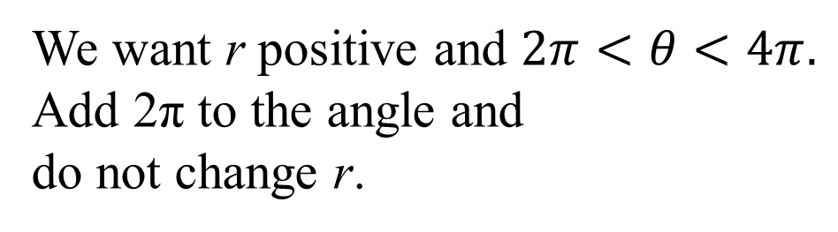
Example 2a: Finding Other Polar Coordinates for a Given Point
Find another representation of $\left(5, \frac{π}{4}\right)$ in which r is positive and $2π<θ<4π$.
We want r positive and $2π<θ<4π.$
Add 2π to the angle and
do not change r.
$$\left(5,\frac{π}{4}\right)=\left(5,\frac{π}{4}+2π\right)$$
$$=\left(5,\frac{π}{4}+\frac{8π}{4}\right)$$
$$=\left(5,\frac{9π}{4}\right)$$

Slide 9
Example 2b: Finding Other Polar Coordinates for a Given Point
Find another representation of $\left(5, \frac{π}{4}\right)$ in which r is negative and $0<θ<2π$.
We want r negative and $0<θ<2π$.
Add π to the angle and replace r
with –r.
$$\left(5,\frac{π}{4}\right)=\left(−5,\frac{π}{4}+π\right)$$
$$=\left(−5,\frac{π}{4}+\frac{4π}{4}\right)$$
$$=\left(−5,\frac{5π}{4}\right)$$

Slide 10
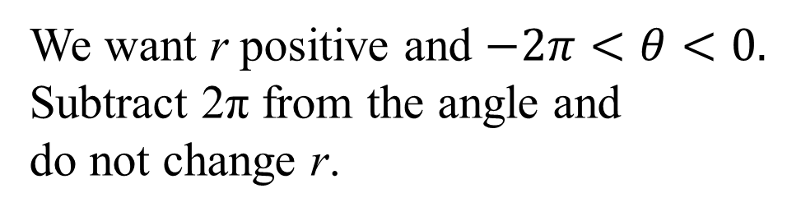
Example 2c: Finding Other Polar Coordinates for a Given Point
Find another representation of $\left(5, \frac{π}{4}\right)$ in which r is positive and $−2π<θ<0$.
We want r positive and $−2π<θ<0.$
Subtract 2π from the angle and
do not change r.
$$\left(5,\frac{π}{4}\right)=\left(5,\frac{π}{4}−2π\right)$$
$$=\left(5,\frac{π}{4}−\frac{8π}{4}\right)$$
$$=\left(5,−\frac{7π}{4}\right)$$

Slide 11
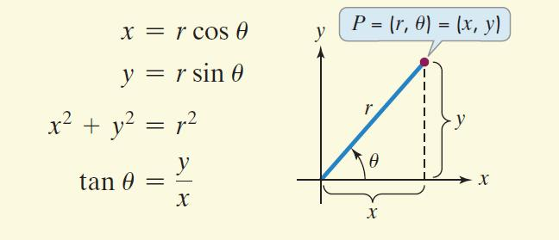
Relations between Polar and Rectangular Coordinates

Slide 12
Point Conversion from Polar to Rectangular Coordinates
To convert a point from polar coordinates $\left(r, θ\right)$ to rectangular coordinates (x, y), use the formulas
$x=r\cos{θ}$ and $y=r\sin{θ}$.

Slide 13
Example 3a: Polar-to-Rectangular Point Conversion
Find the rectangular coordinates of the point with the following polar coordinates: $\left(3, π\right)$
$$\left(r, θ\right)=\left(3, π\right)$$
$$x=r\cos{θ}$$
$$y=r\sin{θ}$$
The rectangular coordinates of $\left(3, π\right)$ are (–3, 0).
$$=3cosπ$$
$$=3(−1)=−3$$
$$=3sinπ$$
$$=3·0=0$$

Slide 14
Example 3b: Polar-to-Rectangular Point Conversion
Find the rectangular coordinates of the point with the following polar coordinates: $\left(−10, \frac{π}{6}\right)$
$\left(r, θ\right)=\left(−10, \frac{π}{6}\right)$
$$x=r\cos{θ}$$
$$y=r\sin{θ}$$
The rectangular coordinates of $\left(−10, \frac{π}{6}\right)$ are
$$=−10\left(\frac{\sqrt{3}}{2}\right)=−5\sqrt{3}$$
$=−10cos\frac{π}{6}$
$$=−10sin\frac{π}{6}$$
$$=−10\left(\frac{1}{2}\right)=−5$$
$$\left(−5\sqrt{3},−5\right).$$

Slide 15
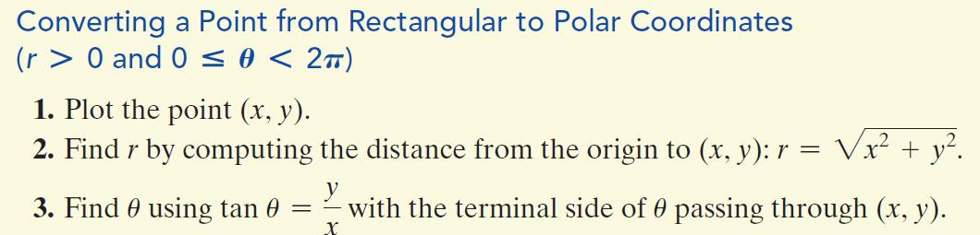
Point Conversion from Rectangular to Polar Coordinates

Slide 16
Example 4: Rectangular-to-Polar Point Conversion
Find polar coordinates of the point whose rectangular coordinates are $\left(1, −\sqrt{3}\right)$.
Step 1 Plot the point (x, y).
Step 2 Find r by computing the
distance from the origin to (x, y).
$$r=\sqrt{x^{2}+y^{2}}$$
$$=\sqrt{{\left(1\right)}^{2}+{\left(−\sqrt{3}\right)}^{2}}$$
$$=\sqrt{1+3}=\sqrt{4}=2$$

Slide 17

Example 4: Rectangular-to-Polar Point Conversion (cont)
Step 3 Find $θ$ using $\tan{θ=\frac{y}{x}}$ with the terminal side of
$θ$ passing through (x, y).
$$\tan{θ=\frac{y}{x}}$$
One representation of $\left(1, −\sqrt{3}\right)$
in polar coordinates is
$$=\frac{−\sqrt{3}}{1}=−\sqrt{3}$$
$$θ=\frac{5π}{3}$$
$$(r,θ)=\left(2,\frac{5π}{3}\right).$$

Slide 18
Equation Conversion from Rectangular to Polar Coordinates
A polar equation is an equation whose variables are r and $θ.$
To convert a rectangular equation in x and y to a polar equation in r and $θ$, replace x with $r\cos{θ}$ and y with $r\sin{θ.}$

Slide 19
Example 6a: Converting Equations from Rectangular to Polar Coordinates
Convert the following rectangular equation to a polar equation that expresses r in terms of $θ.$
3x – y = 6
$$3rcosθ−rsinθ=6$$
$$r(3cosθ−sinθ)=6$$
$$r=\frac{6}{3cosθ−sinθ}$$

Slide 20

Example 6b: Converting Equations from Rectangular to Polar Coordinates
Convert the following rectangular equation to a polar equation that expresses r in terms of $θ:$ x² + (y + 1)² = 1
$${\left(rcosθ\right)}^{2}+{\left(rsinθ+1\right)}^{2}=1$$
$$r^{2}\cos^{2}θ+r^{2}\sin^{2}θ+2rsinθ+1=1$$
$$r^{2}(\cos^{2}θ+\sin^{2}θ)+2rsinθ+1=1$$
$$r^{2}(1)+2rsinθ+1=1$$
$$r^{2}+2rsinθ+1=1$$
$$r^{2}+2rsinθ=0$$
$$r(r+2sinθ)=0$$
$$r=0 or r+2sinθ=0$$
$$r=−2sinθ$$

Slide 21
Equation Conversion from Polar to Rectangular Coordinates
When we convert an equation from polar to rectangular coordinates, our goal is to obtain an equation in which the variables are x and y rather than r and $θ.$ We use one or more of the following equations:
To use these equations, it is sometimes necessary to square both sides, to use an identity, to take the tangent of both sides, or to multiply both sides by r.
$$r^{2}=x^{2}+y^{2}$$
$$rcosθ=x$$
$$rsinθ=y$$
$$tanθ=\frac{y}{x}$$

Slide 22
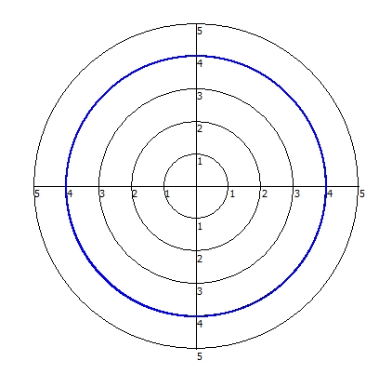
Example 7a: Converting Equations from Polar to Rectangular Form
Convert the polar equation to a rectangular equation in x and y: r = 4.
r² = x² + y²
r = 4
r² = 16
x² + y² = 16
The rectangular equation for
r = 4 is x² + y² = 16.

Slide 23
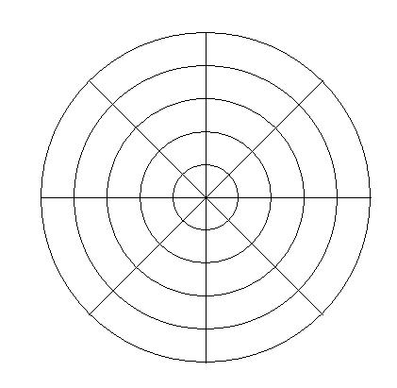
Example 7b: Converting Equations from Polar to Rectangular Form
Convert the polar equation to a rectangular equation in x and y: $θ=\frac{3π}{4}$.
The rectangular equation for $θ=\frac{3π}{4}$ is y = –x .
$$θ=\frac{3π}{4}$$
$$tanθ=tan\frac{3π}{4}$$
$$\frac{y}{x}=−1$$
$$tanθ=−1$$
$$tanθ=\frac{y}{x}$$
$$y=−x$$

Slide 24
Example 7c: Converting Equations from Polar to Rectangular Form
Convert the polar equation to a rectangular equation in x and y: $r=−2\sec{θ}$.
$$r=−2\sec{θ}$$
The rectangular equation for
$r=−2\sec{θ}$ is x = –2.
$$r=\frac{−2}{cosθ}$$
$$rcosθ=−2$$
$$x=−2$$

Slide 25
Example 7d: Converting Equations from Polar to Rectangular Form
Convert the polar equation to a rectangular equation in x and y:$r=10\sin{θ}$
$$r=10\sin{θ}$$
$$r^{2}=r(10\sin{θ)}$$
$$r^{2}=10r\sin{θ}$$
$$r\sin{θ=y}$$
$$r^{2}=10y$$
$$r^{2}= x^{2}+y^{2}$$
$$x^{2}+y^{2}=10y$$
The rectangular equation for $r=10\sin{θ}$ is
x² + (y – 5)² = 25.
$$x^{2}+y^{2}−10y=0$$
$$x^{2}+y^{2}−10y+25=25$$
$$x^{2}+{\left(y−5\right)}^{2}=25$$

Slide 26
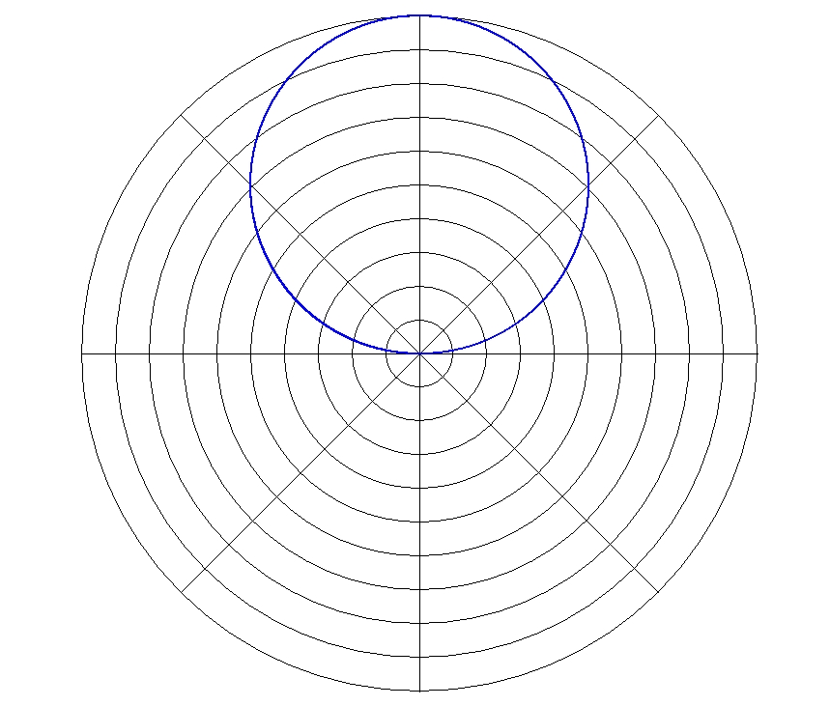
Example 7d: Converting Equations from Polar to Rectangular Form (continued)
Convert the polar equation
to a rectangular equation
in x and y: $r=10\sin{θ}$
The rectangular equation
for $r=10\sin{θ}$
is x² + (y – 5)² = 25.

