Slide 1

Chapter 6
Additional Topics in Trigonometry
6.2 The Law of Cosines

Slide 2
Objectives
Use the Law of Cosines to solve oblique triangles.
Solve applied problems using the Law of Cosines.
Use Heron’s formula to find the area of a triangle.

Slide 3
Solving Oblique Triangles
Solving an oblique triangle means finding the lengths of its sides and the measurements of its angles.
The Law of Cosines is used to solve triangles in which two sides and the included angle (SAS) are known, or those in which three sides (SSS) are known.

Slide 4
The Law of Cosines
If A, B, and C are the measures of the angles of a triangle, and a, b, and c are the lengths of the sides opposite these angles, then
a² = b² + c² − 2bc cos A
b² = a² + c² − 2ac cos B
c² = a² + b² − 2ab cos C.
The square of a side of a triangle equals the sum of the squares of the other two sides minus twice their product times the cosine of their included angle.

Slide 5
Solving an SAS Triangle
1. Use the Law of Cosines to find the side opposite the given angle.
2. Use the Law of Sines to find the angle opposite the shorter of the two given sides. This angle is always acute.
3. Find the third angle by subtracting the measure of the given angle and the angle found in step 2 from 180°.

Slide 6
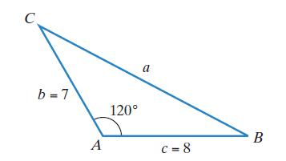
Example 1: Solving an SAS Triangle
Solve the triangle shown in the figure with A = 120°, b = 7, and c = 8. Round lengths of sides to the nearest tenth and angle measures to the nearest degree.
Step 1 Use the Law of Cosines to find
the side opposite the given angle.
$$a^{2}=b^{2}+c^{2}−2bccosA$$
$$a^{2}=7^{2}+8^{2}−2(7)(8)cos120°$$
$$a^{2}=49+64−112\left(−\frac{1}{2}\right)$$
$$a^{2}=169$$
$$a=\sqrt{169}=13$$

Slide 7
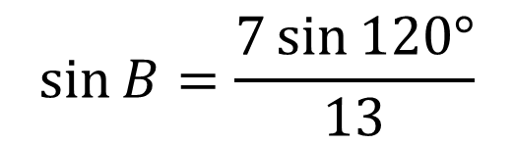


Example 1: Solving an SAS Triangle (cont)
Step 2 Use the Law of Sines to find the angle opposite the shorter of the two given sides. This angle is always acute.
$$\frac{b}{sinB}=\frac{a}{sinA}$$
$$\frac{7}{sinB}=\frac{13}{sin120°}$$
$$13\sin{B}=7\sin{120°}$$
$$\sin{B}=\frac{7\sin{120°}}{13}$$
$$≈0.4663$$
$$B=\sin^{−1}(0.4663)≈28°$$

Slide 8
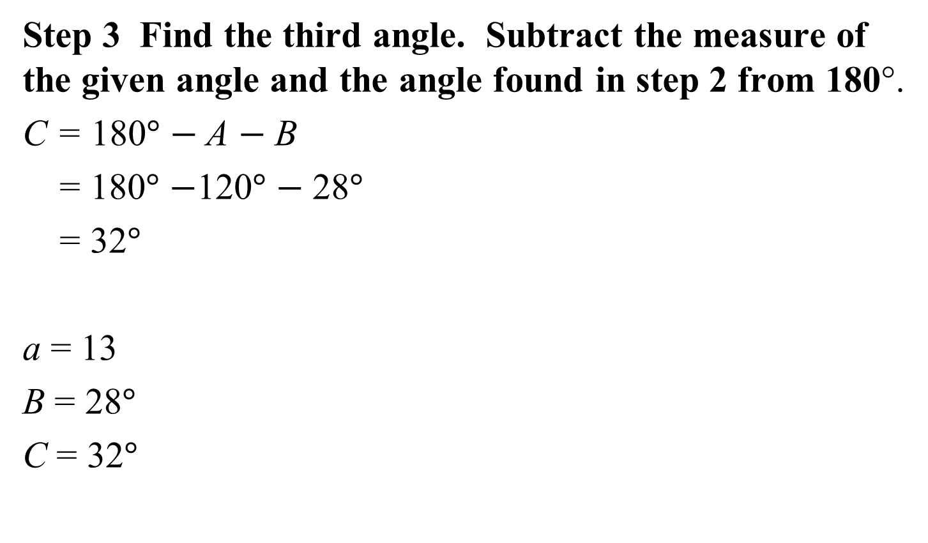
Example 1: Solving an SAS Triangle (cont)
Step 3 Find the third angle. Subtract the measure of the given angle and the angle found in step 2 from 180°.
C = 180$°$ $−$A $−$ B
= 180$°$ $−$120$°$ $−$ 28$°$
= 32$°$
a = 13
B = 28$°$
C = 32$°$

Slide 9
Solving an SSS Triangle:
1. Use the Law of Cosines to find the angle opposite the longest side.
2. Use the Law of Sines to find either of the two remaining acute angles.
3. Find the third angle by subtracting the measures of the angles found in steps 1 and 2 from 180°.

Slide 10
Example 2: Solving an SSS Triangle
Solve triangle ABC if a = 8, b = 10, and c = 5. Round angle measures to the nearest degree.
Step 1 Use the Law of Cosines to find the angle opposite the longest side.
Because cosB is negative, B is an obtuse angle.
$$b^{2}=a^{2}+c^{2}−2accosB$$
$$2accosB=a^{2}+c^{2}−b^{2}$$
$$cosB=\frac{a^{2}+c^{2}−b^{2}}{2ac}$$
$$=\frac{8^{2}+5^{2}−{10}^{2}}{\left.2(8)(5\right)}$$
$$=−\frac{11}{80}$$
$$\cos^{−1}\left(\frac{11}{80}\right)≈82°$$
$$B≈180°−82°≈98°$$

Slide 11
Example 2: Solving an SSS Triangle (cont)
Step 2 Use the Law of Sines to find either of the two remaining acute angles.
$$\frac{b}{sinB}=\frac{a}{sinA}$$
$$\frac{10}{sin 98°}=\frac{8}{sinA}$$
$$10\sin{A=8\sin{98°}}$$
$$\sin{A=\frac{8\sin{98°}}{10}}$$
$$≈0.7922$$
$$\sin^{−1}(0.7922)≈52°$$

Slide 12
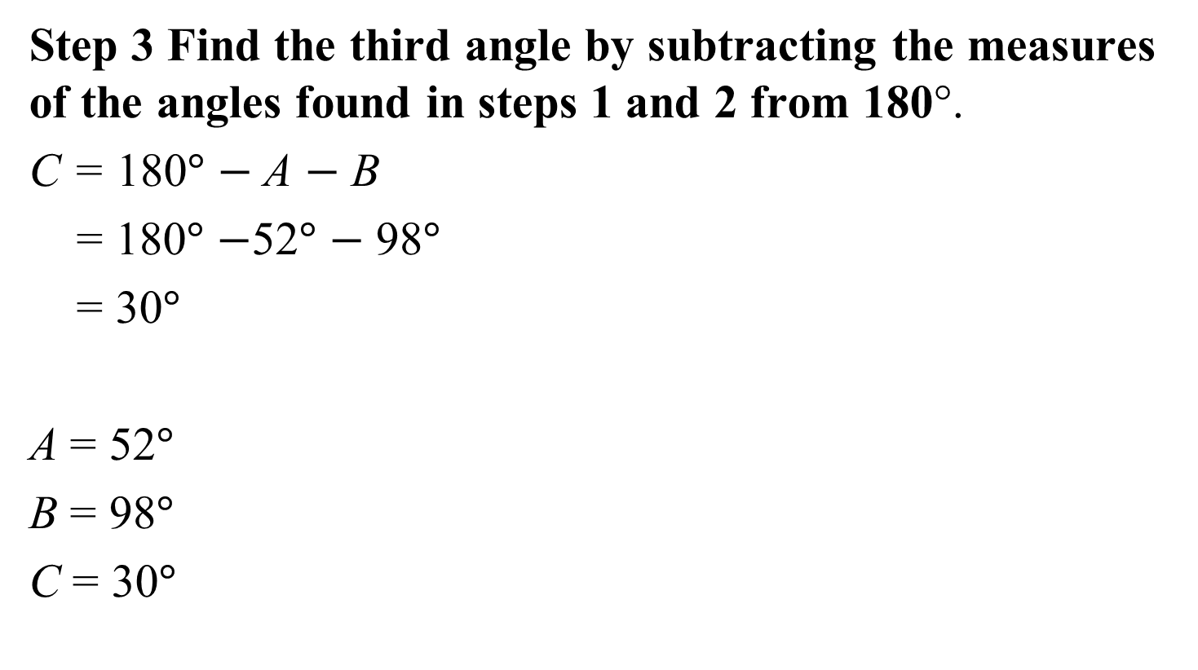
Example 2: Solving an SSS Triangle (cont)
Step 3 Find the third angle by subtracting the measures of the angles found in steps 1 and 2 from 180°.
C = 180$°$ $−$A $−$ B
= 180$°$ $−$52$°$ $−$ 98$°$
= 30$°$
A = 52$°$
B = 98$°$
C = 30$°$

Slide 13
Example 3: Application
Two airplanes leave an airport at the same time on different runways. One flies directly north at 400 miles per hour. The other airplane flies on a bearing of N75°E at 350 miles per hour. How far apart will the airplanes be after two hours?
$$b^{2}=a^{2}+c^{2}−2accosB$$
$$b^{2}={700}^{2}+{800}^{2}−2(700)(800)cos75°$$
$$b^{2}≈840122.670$$
$$b≈\sqrt{840122.670}≈917$$
After two hours, the planes are
approximately 917 miles apart.

Slide 14
Heron’s Formula
The area of a triangle with sides a, b, and c is
$$Area= \sqrt{s(s−a)(s−b)(s−c)}$$
where s is one-half its perimeter: $s=\frac{1}{2}(a+b+c)$.

Slide 15
Example 4: Using Heron’s Formula
Find the area of the triangle with a = 6 meters, b = 16 meters, and c = 18 meters. Round to the nearest square meter.
$$s=\frac{1}{2}(a+b+c)$$
$$=\frac{1}{2}\left(6+16+18\right)$$
$$=20$$
The area of the triangle is approximately 47 square meters.
$$Area= \sqrt{s(s−a)(s−b)(s−c)}$$
$$=\sqrt{\left.20(20−6)(20−16)(20−18\right)}$$
$$=\sqrt{2240}≈47$$

