Slide 1
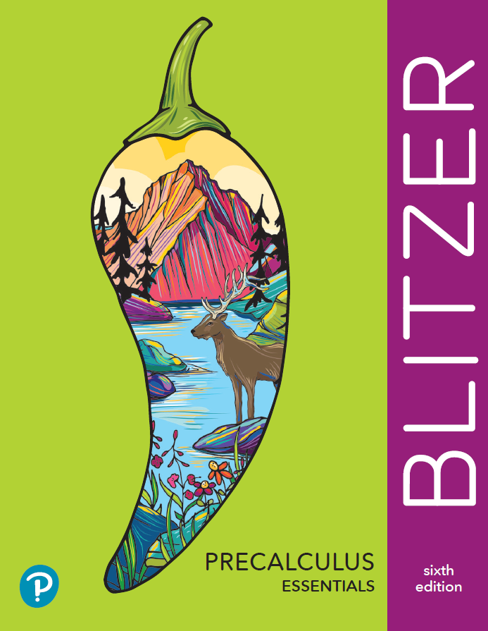
Chapter 6
Additional Topics in Trigonometry
6.1 The Law of Sines

Slide 2
Objectives:
Use the Law of Sines to solve oblique triangles.
Use the Law of Sines to solve, if possible, the triangle or triangles in the ambiguous case.
Find the area of an oblique triangle using the sine function.
Solve applied problems using the Law of Sines.

Slide 3
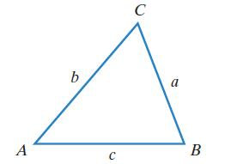
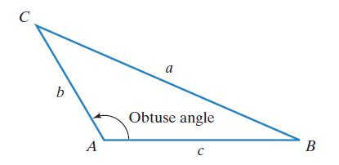
Oblique Triangles
An oblique triangle is a triangle that does not contain a right angle.
An oblique triangle has
either three acute angles
or two acute angles and
one obtuse angle.
The relationships among the sides
and angles of right triangles
defined by the trigonometric
functions are not valid for
oblique triangles.

Slide 4
The Law of Sines
If A, B, and C are the measures of the angles of a triangle, and a, b, and c are the lengths of the sides opposite these angles, then
$$\frac{a}{\sin{A}}=\frac{b}{\sin{B}}=\frac{c}{\sin{C}}$$
The ratio of the length of the side of any triangle to the sine of the angle opposite that side is the same for all three sides of the triangle.

Slide 5
Solving Oblique Triangles
Solving an oblique triangle means finding the lengths of its sides and the measurements of its angles.
The Law of Sines can be used to solve a triangle in which one side and two angles are known. The three known measurements can be abbreviated using SAA (a side and two angles are known) or ASA (two angles and the side between them are known).

Slide 6
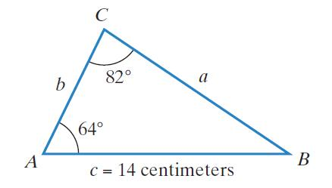
Example 1: Solving an SAA Triangle Using the Law of Sines
Solve the triangle with A = 64°, C = 82°, and c = 14 centimeters. Round lengths of sides to the nearest tenth.
$$A+B+C=180°$$
$$64°+B+82°=180°$$
$$146°+B=180°$$
$$B=34°$$
$$a=\frac{csinA}{sinC}$$
$$\frac{a}{sinA}=\frac{c}{sinC}$$
$$=\frac{14sin64°}{sin82°}$$
$$asinC=csinA$$
$≈12.7$cm

Slide 7
Example 1: Solving an SAA Triangle Using the Law of Sines (continued)
A = 64°, C = 82°, and c = 14 centimeters.
$$\frac{b}{sinB}=\frac{c}{sinC}$$
$$bsinC=csinB$$
$$b=\frac{csinB}{sinC}$$
$$=\frac{14sin34°}{sin82°}$$
$≈7.9$ cm

Slide 8
Example 2: Solving an ASA Triangle Using the Law of Sines
Solve triangle ABC if A = 40°, C = 22.5°, and b = 12. Round measures to the nearest tenth.
$$A+B+C=180°$$
$$40°+B+22.5°=180°$$
$$62.5°+B=180°$$
$$B=117.5°$$
$$\frac{b}{sinB}=\frac{a}{sinA}$$
$$bsinA=asinB$$
$$a=\frac{bsinA}{sinB}$$
$$=\frac{12sin40°}{sin117.5°}$$
$$≈8.7$$

Slide 9
Example 2: Solving an ASA Triangle Using the Law of Sines (continued)
A = 40°, C = 22.5°, and b = 12
$$\frac{b}{sinB}=\frac{c}{sinC}$$
$$csinB=bsinC$$
$$c=\frac{bsinC}{sinB}$$
$$=\frac{12sin22.5°}{sin117.5°}$$
$$≈5.2$$

Slide 10
The Ambiguous Case (SSA)
If we are given two sides and an angle opposite one of the two sides (SSA), the given information may result in one triangle, two triangles, or no triangle at all.
SSA is known as the ambiguous case when using the Law of Sines because the given information may result in one triangle, two triangles, or no triangle at all.

Slide 11
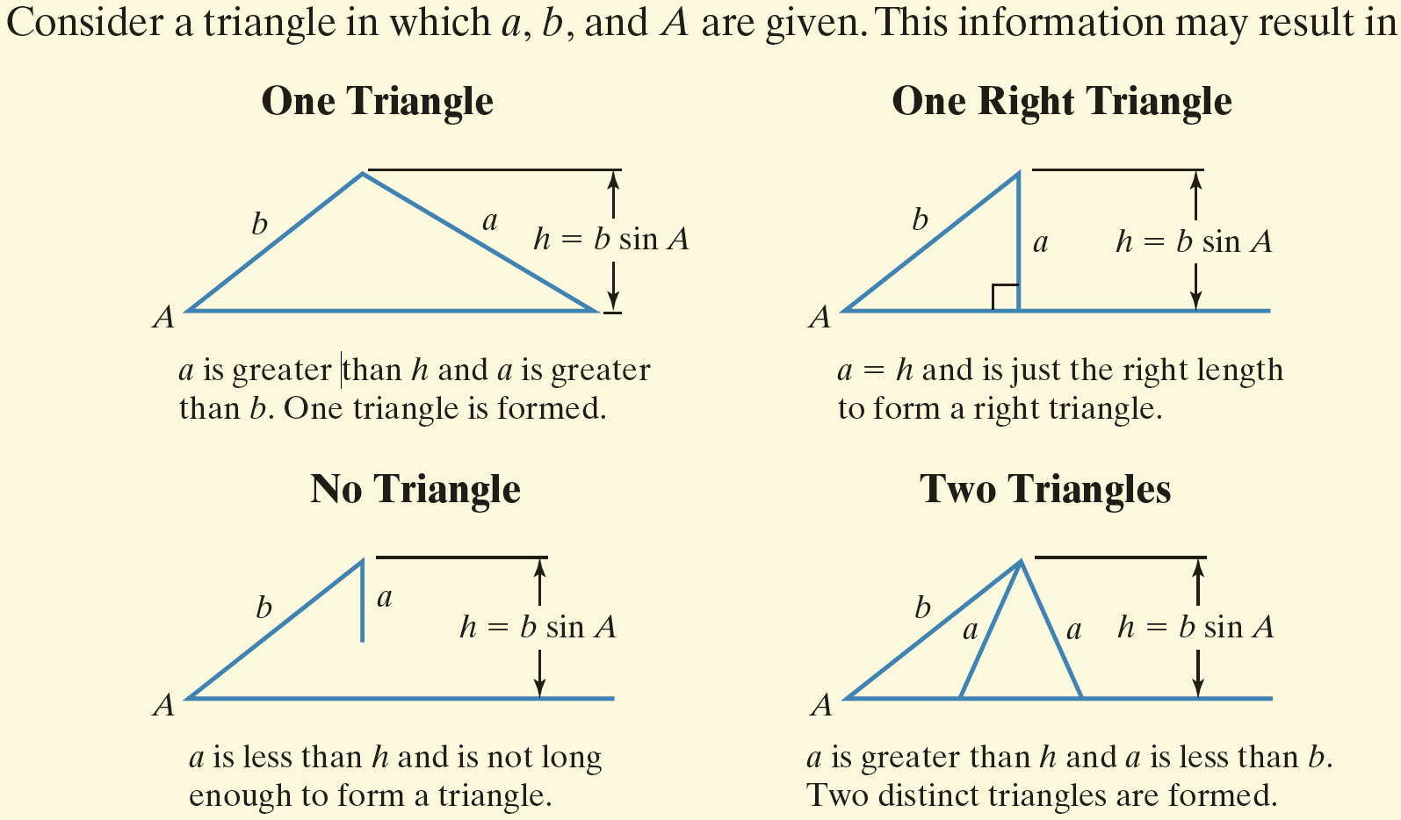
The Ambiguous Case (SSA) (continued)

Slide 12
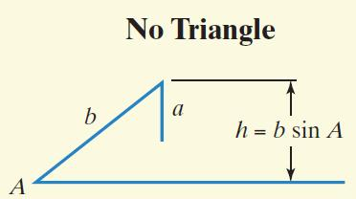

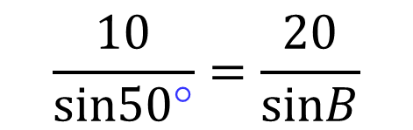
Example 4: Solving an SSA Triangle Using the Law of Sines (No Solution)
Solve triangle ABC if A = 50°, a = 10, and b = 20.
There is no angle B for which the sine is greater than 1.
There is no triangle with the given measurements.
$$\frac{a}{sinA}=\frac{b}{sinB}$$
$$\frac{10}{sin50\text{°}}=\frac{20}{sinB}$$
$$10\sin{B=20\sin{50\text{°}}}$$
$$=\frac{20sin50°}{10}$$
$$\sin{B}≈1.53$$

Slide 13
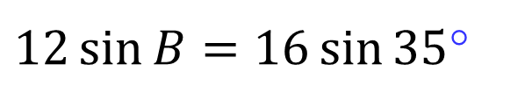

Example 5: Solving an SSA Triangle Using the Law of Sines (Two Solutions)
Solve triangle ABC if A = 35°, a = 12, and b = 16. Round lengths of sides to the nearest tenth and angle measures to the nearest degree.
There are two angles between 0° and 180° for which
sin B = 0.7648.
$$\sin{B}=\frac{16sin35°}{12}$$
$$\frac{a}{sinA}=\frac{b}{sinB}$$
$$\sin{B}≈0.7648$$
$$\frac{12}{sin35\text{°}}=\frac{16}{sinB}$$
$$\sin^{−1}0.7648=50°$$
$12\sin{B=16\sin{35}}$°

Slide 14



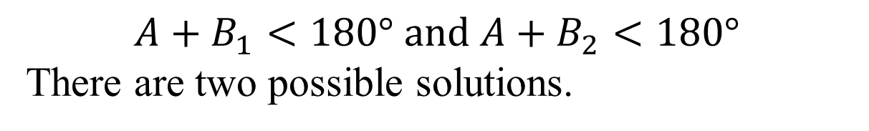
Example 5: Solving an SSA Triangle Using the Law of Sines (Two Solutions) (continued)
B₁ = $50°$
$$\sin^{−1}0.7648=50°$$
$$B_{2}=180°−50°=130°$$
$$A+B_{1}=35°+50°=85°$$
$$A+B_{2}=35°+130°=165°$$
$$A+B_{1}<180° and A+B_{2}<180°$$
There are two possible solutions.

Slide 15

Example 5: Solving an SSA Triangle Using the Law of Sines (Two Solutions) (continued)
B₁ = 50$°$ B₂ = 130$°$
$$A+B_{1}+C_{1}=180°$$
$$A+B_{2}+C_{2}=180°$$
$$35°+50°+C_{1}=180°$$
$$35°+130°+C_{2}=180°$$
$$85°+C_{1}=180°$$
$$165°+C_{2}=180°$$
$$C_{1}=95°$$
$$C_{2}=15°$$

Slide 16
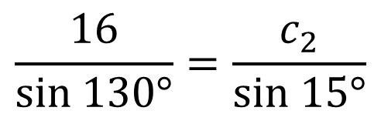


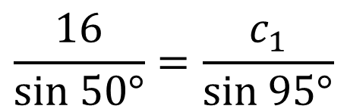

Example: Solving an SSA Triangle Using the Law of Sines (Two Solutions) (continued)
B₁ = 50$°$ and C₁ = 95$°$ B₂ = 130$°$ and C₂ = 15$°$
$$\frac{b}{sinB_{1}}=\frac{c_{1}}{sinC_{1}}$$
$$\frac{b}{sinB_{2}}=\frac{c_{2}}{sinC_{2}}$$
$$\frac{16}{sin 50°}=\frac{c_{1}}{sin 95°}$$
$$\frac{16}{sin 130°}=\frac{c_{2}}{sin 15°}$$
$$c_{2}=\frac{16sin15°}{sin130°}$$
$$c_{1}=\frac{16sin95°}{sin50°}$$
$$≈20.8$$
$$≈5.4$$

Slide 17
Example 5: Solving an SSA Triangle Using the Law of Sines (Two Solutions) (continued)
Solve triangle ABC if A = 35°, a = 12, and b = 16. Round lengths of sides to the nearest tenth and angle measures to the nearest degree.
There are two triangles. In one triangle, the solution is
B₁ = 50 degrees, C₁ = 95 degrees and c₁ is about 20.8.
In the other triangle the solution is
B₂ = 130 degrees, C₂ = 15 degrees and c₂ is about 5.4.

Slide 18
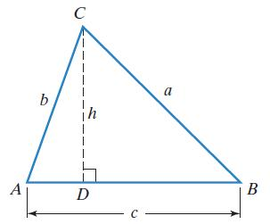
The Area of an Oblique Triangle
The area of a triangle equals one-half the product of the lengths of two sides times the sine of their included angle. In the figure, this wording can be expressed by the formulas
$$Area=\frac{1}{2}bc\sin{A}=\frac{1}{2}ab\sin{C}=\frac{1}{2}ac\sin{B.}$$

Slide 19
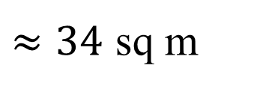
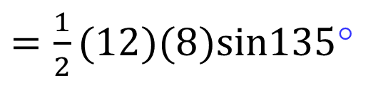
Example 6: Finding the Area of an Oblique Triangle
Find the area of a triangle having two sides of length 8 meters and 12 meters and an included angle of 135°. Round to the nearest square meter.
$$Area=\frac{1}{2}absinC$$
$=\frac{1}{2}(12)(8)sin135$°
$≈34$ sq m

Slide 20
Example 7: Application
Two fire-lookout stations are 13 miles apart, with station B directly east of station A. Both stations spot a fire. The bearing of the fire from station A is N35°E and the bearing of the fire from station B is N49°W. How far, to the nearest tenth of a mile, is the fire from station B?
$$A=90°−35°=55°$$
$$B=90°−49°=41°$$
$$A+B+C=180°$$
$$55°+41°+C=180°$$
$$96°+C=180°$$
$$C=84°$$

Slide 21
Example 7: Application (continued)
Two fire-lookout stations are 13 miles apart, with station B directly east of station A. Both stations spot a fire. The bearing of the fire from station A is N35°E and the bearing of the fire from station B is N49°W. How far, to the nearest tenth of a mile, is the fire from station B?
The fire is approximately 10.7 miles from station B.
$$\frac{c}{sinC}=\frac{a}{sinA}$$
$$\frac{13}{sin84}=\frac{a}{sin55}$$
$$a=\frac{13sin55°}{sin84°}$$
$$≈10.707$$

