Slide 1

Chapter 4
Exponential and Logarithmic Functions
4.1 Exponential Functions

Slide 2
Objectives
Evaluate exponential functions.
Graph exponential functions.
Evaluate functions with base e.
Use compound interest formulas.

Slide 3

Definition of the Exponential Function
The exponential function f with base b is defined by
$f\left(x\right)=b^{x}$ or $y=$ $b^{x}$
where b is a positive constant other than 1 (b > 0 and
b ≠ 1) and x is any real number.

Slide 4
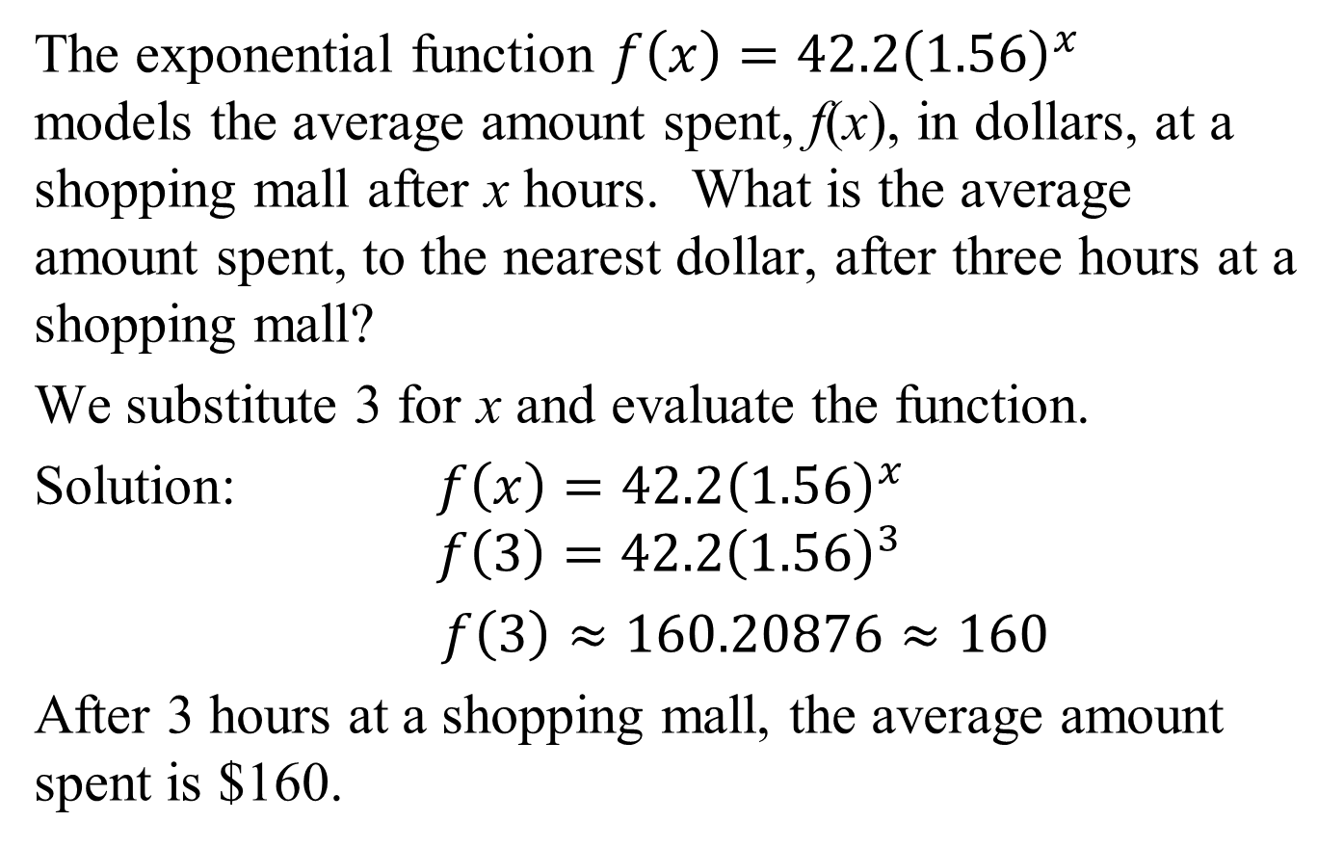
Example 1: Evaluating an Exponential Function
The exponential function $f\left(x\right)=42.2{\left(1.56\right)}^{x}$ models the average amount spent, f(x), in dollars, at a shopping mall after x hours. What is the average amount spent, to the nearest dollar, after three hours at a shopping mall?
We substitute 3 for x and evaluate the function.
Solution: $f\left(x\right)=42.2{\left(1.56\right)}^{x}$
$$f\left(3\right)=42.2{\left(1.56\right)}^{3}$$
$f\left(3\right)≈160.20876≈160$
After 3 hours at a shopping mall, the average amount spent is $160.

Slide 5

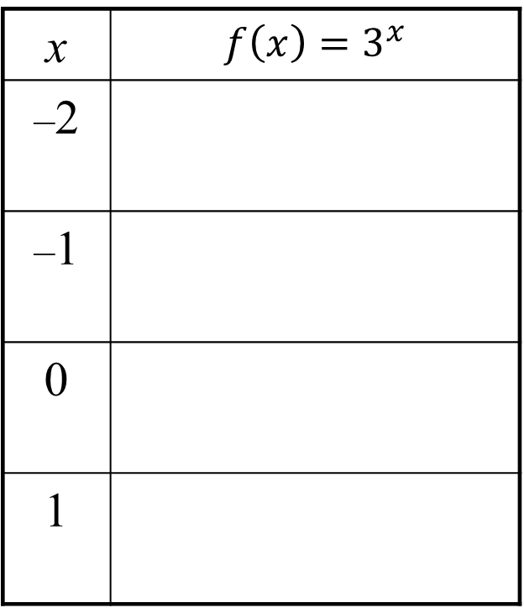


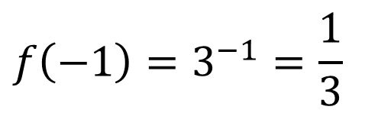
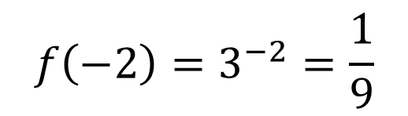
Example 2: Graphing an Exponential Function
Graph: $f\left(x\right)=3^{x}.$
We set up a table of coordinates, then plot these points, connecting them with a smooth, continuous curve.
x | $$f\left(x\right)=3^{x}$$
–2
–1
0
1
$$f\left(−2\right)=3^{−2}=\frac{1}{9}$$
$$f\left(−1\right)=3^{−1}=\frac{1}{3}$$
$$f\left(0\right)=3^{0}=1$$
$$f\left(1\right)=3^{1}=3$$

Slide 6
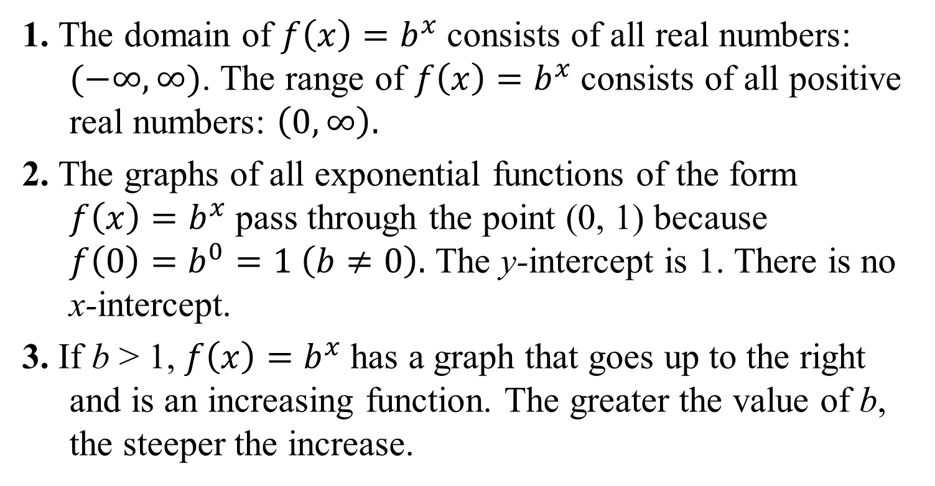
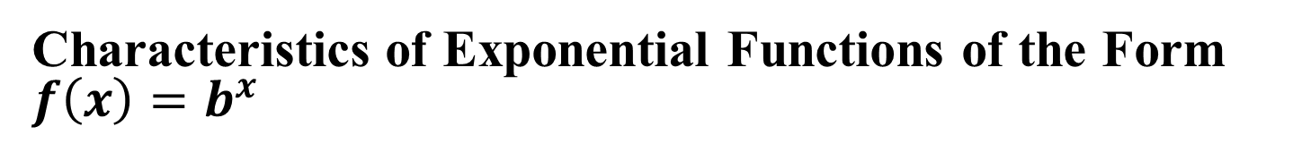
Characteristics of Exponential Functions of the Form $f\left(x\right)=b^{x}$
1. The domain of $f\left(x\right)=b^{x}$consists of all real numbers: $(−∞, ∞)$. The range of $f\left(x\right)=b^{x}$consists of all positive real numbers: $\left(0, ∞\right).$
2. The graphs of all exponential functions of the form $f\left(x\right)=b^{x}$pass through the point (0, 1) because
$f\left(0\right)=b^{0}=1 \left(b≠0\right).$ The y-intercept is 1. There is no
x-intercept.
3. If b > 1, $f\left(x\right)=b^{x}$has a graph that goes up to the right and is an increasing function. The greater the value of b, the steeper the increase.

Slide 7
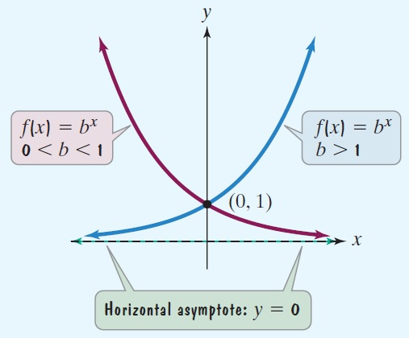
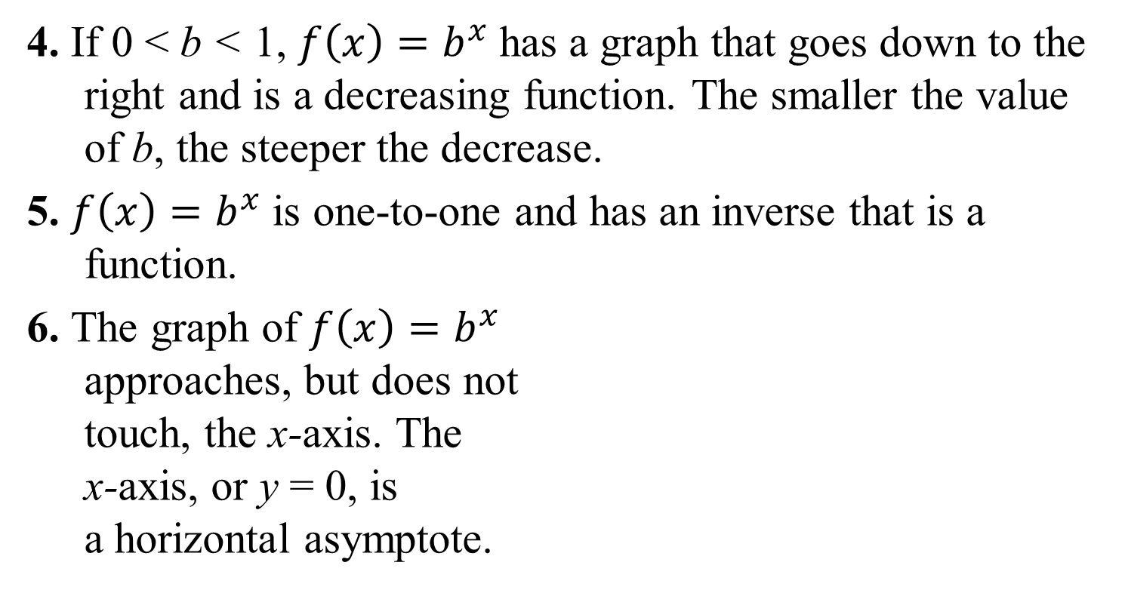
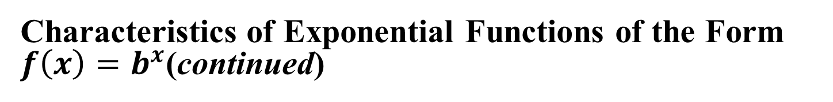
Characteristics of Exponential Functions of the Form $f\left(x\right)=b^{x}$(continued)
4. If 0 < b < 1, $f\left(x\right)=b^{x}$has a graph that goes down to the right and is a decreasing function. The smaller the value of b, the steeper the decrease.
5. $f\left(x\right)=b^{x}$is one-to-one and has an inverse that is a function.
6. The graph of $f\left(x\right)=b^{x}$
approaches, but does not
touch, the x-axis. The
x-axis, or y = 0, is
a horizontal asymptote.

Slide 8
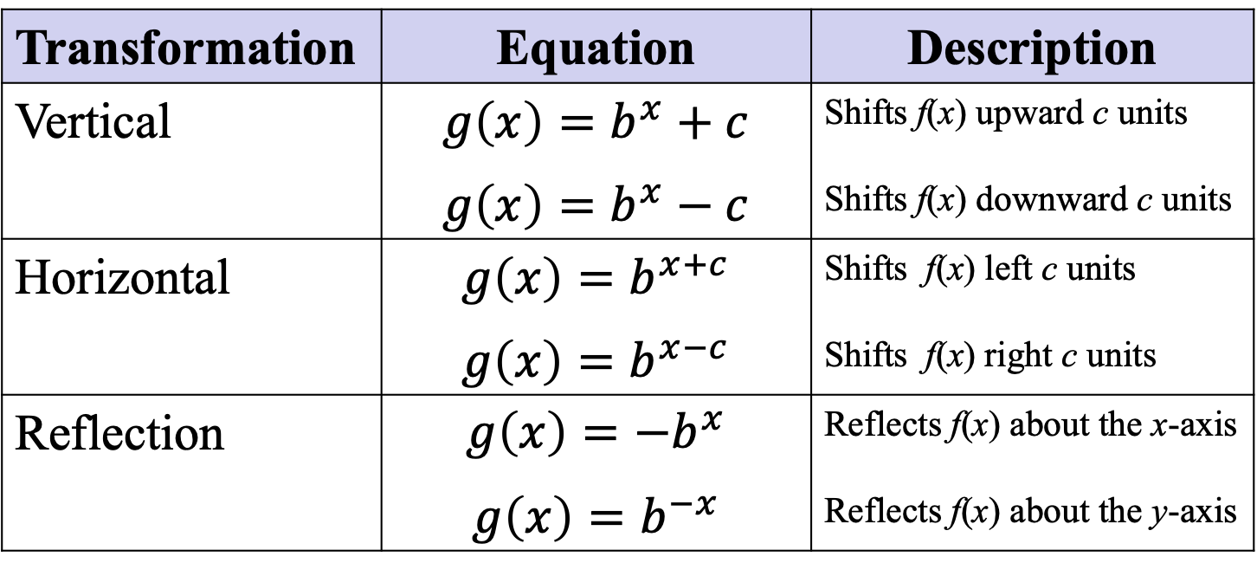
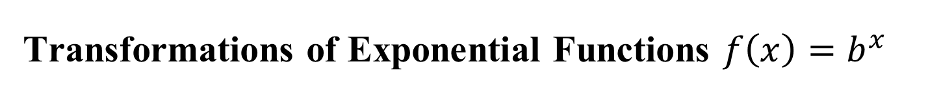
Transformations of Exponential Functions $f\left(x\right)=b^{x}$
In each case, c represents a positive real number.
Transformation | Equation | Description
Vertical | $$g\left(x\right)=b^{x}+c$$ $$g\left(x\right)=b^{x}−c$$ | Shifts f(x) upward c units Shifts f(x) downward c units
Horizontal | $$g\left(x\right)=b^{x+c}$$ $$g\left(x\right)=b^{x−c}$$ | Shifts f(x) left c units Shifts f(x) right c units
Reflection | $$g\left(x\right)={−b}^{x}$$ $$g\left(x\right)=b^{−x}$$ | Reflects f(x) about the x-axis Reflects f(x) about the y-axis

Slide 9
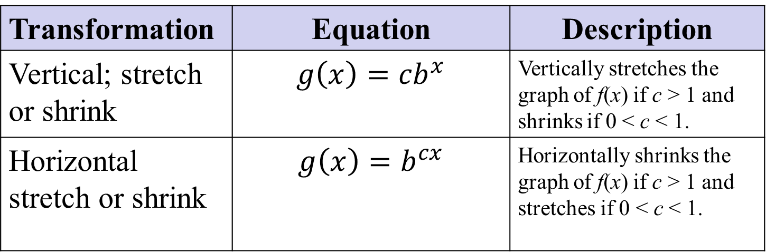
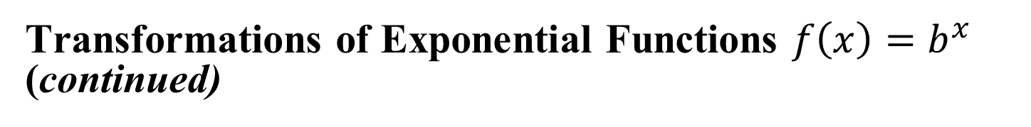
Transformations of Exponential Functions $f\left(x\right)=b^{x}$ (continued)
In each case, c represents a positive real number.
Transformation | Equation | Description
Vertical; stretch or shrink | $$g\left(x\right)={cb}^{x}$$ | Vertically stretches the graph of f(x) if c > 1 and shrinks if 0 < c < 1.
Horizontal stretch or shrink | $$g\left(x\right)=b^{cx}$$ | Horizontally shrinks the graph of f(x) if c > 1 and stretches if 0 < c < 1.

Slide 10
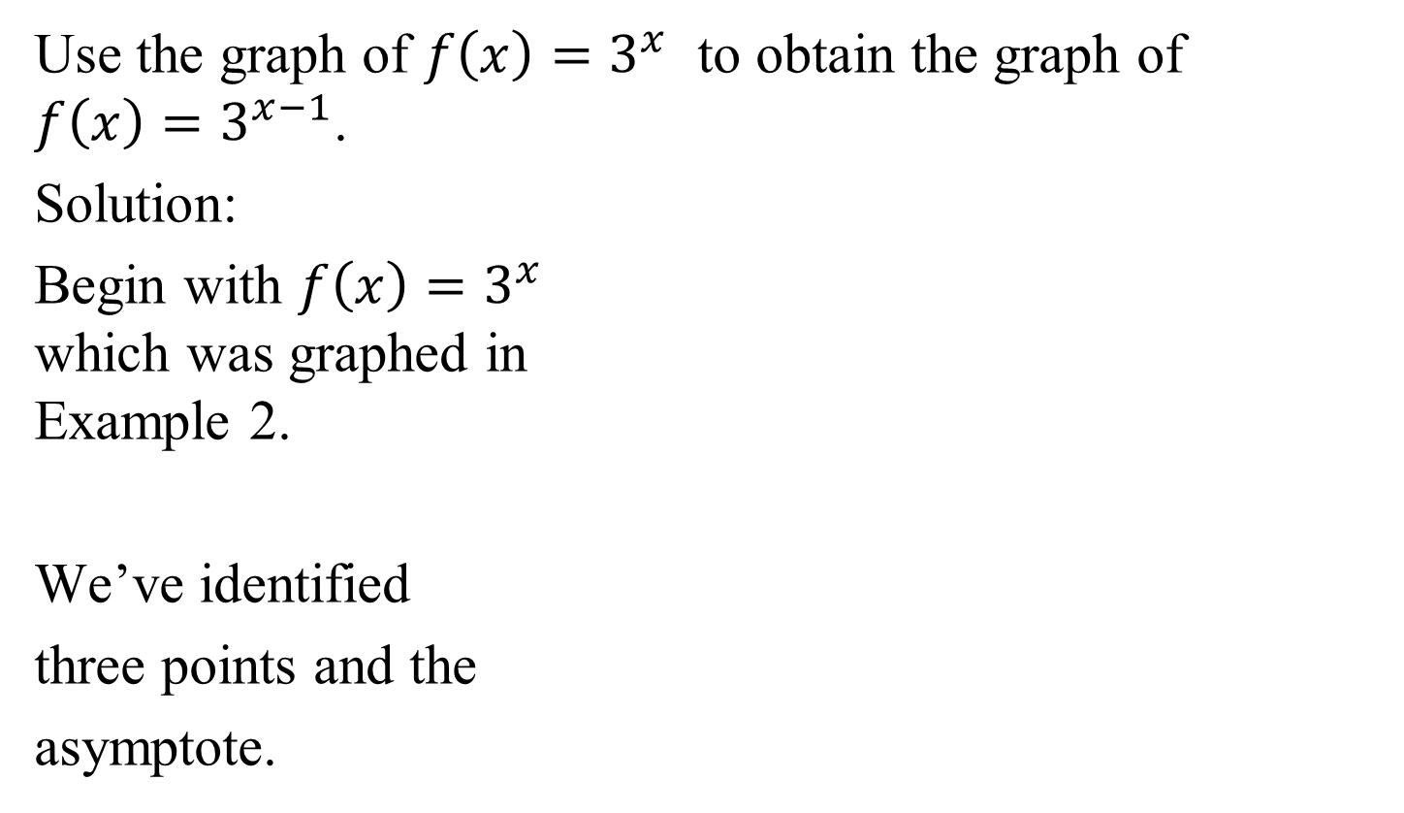

Example 4: Transformations Involving Exponential Functions
Use the graph of $f\left(x\right)=3^{x}$ to obtain the graph of
$f\left(x\right)=3^{x−1}$.
Solution:
Begin with $f\left(x\right)=3^{x}$
which was graphed in
Example 2.
We’ve identified
three points and the
asymptote.
(1, 3)
(0, 1)
$$\left(−1,\frac{1}{3}\right)$$
Horizontal
asymptote
y = 0

Slide 11

Example 4: Transformations Involving Exponential Functions (continued)
The graph will shift 1 unit to the right.
Add 1 to each x-coordinate.
(1, 3)
(0, 1)
(2, 3)
$$\left(−1,\frac{1}{3}\right)$$
(1, 1)
$$\left(0,\frac{1}{3}\right)$$
Horizontal
asymptote
y = 0

Slide 12
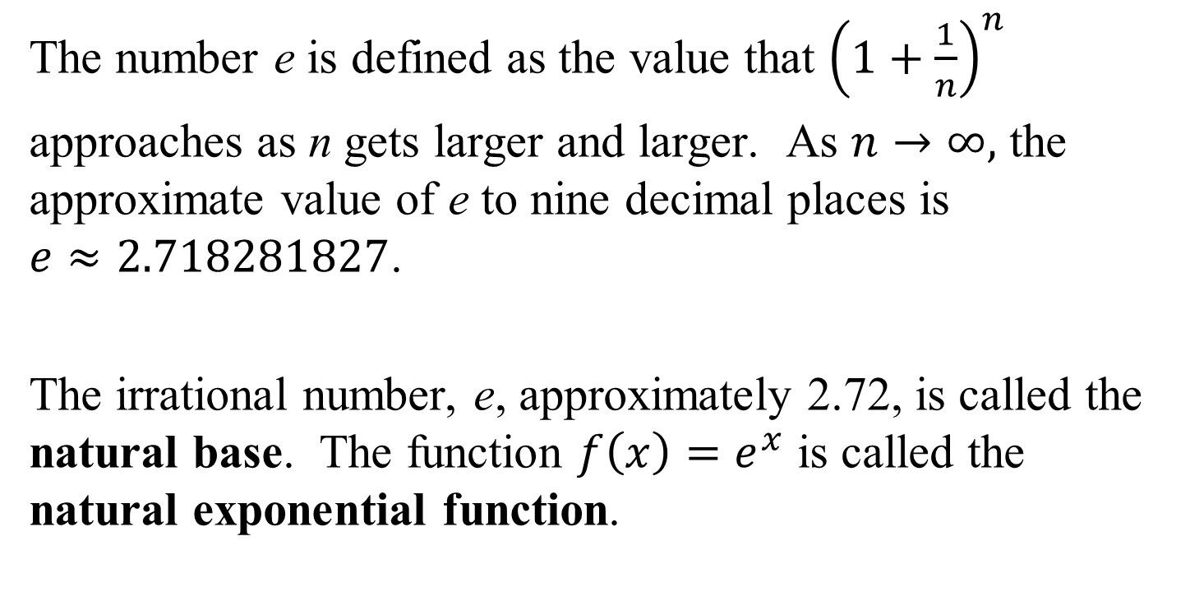
The Natural Base e
The number e is defined as the value that ${\left(1+\frac{1}{n}\right)}^{n}$
approaches as n gets larger and larger. As $n→∞,$ the approximate value of e to nine decimal places is
$e≈2.718281827$.
The irrational number, e, approximately 2.72, is called the natural base. The function $f\left(x\right)=e^{x}$ is called the natural exponential function.

Slide 13
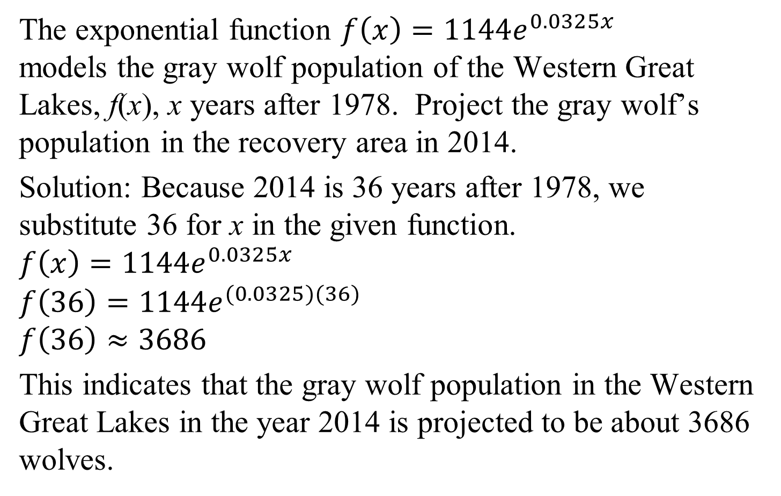
Example 6: Gray Wolf Population
The exponential function $f\left(x\right)=1144e^{0.0325x}$ models the gray wolf population of the Western Great Lakes, f(x), x years after 1978. Project the gray wolf’s population in the recovery area in 2014.
Solution: Because 2014 is 36 years after 1978, we substitute 36 for x in the given function.
$$f\left(x\right)=1144e^{0.0325x}$$
$$f\left(36\right)=1144e^{(0.0325)(36)}$$
$$f\left(36\right)≈3686$$
This indicates that the gray wolf population in the Western Great Lakes in the year 2014 is projected to be about 3686 wolves.

Slide 14
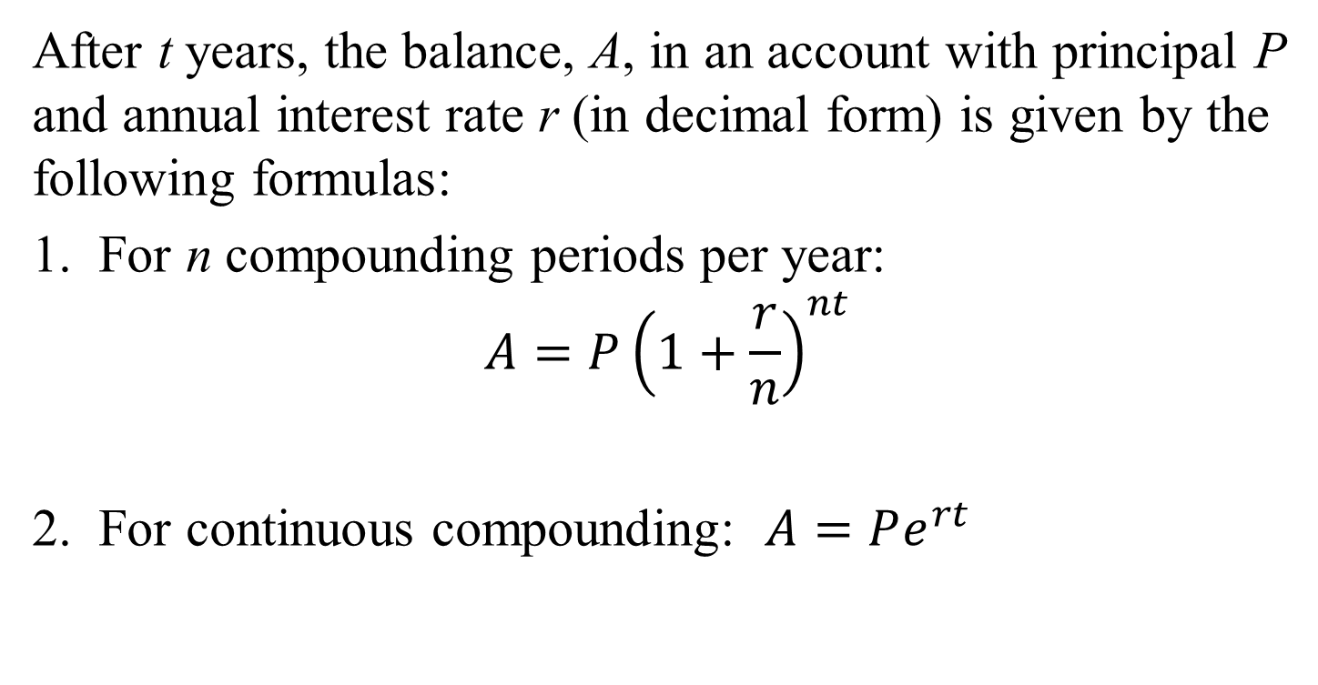
Formulas for Compound Interest
After t years, the balance, A, in an account with principal P and annual interest rate r (in decimal form) is given by the following formulas:
1. For n compounding periods per year:
$$A={P\left(1+\frac{r}{n}\right)}^{nt}$$
2. For continuous compounding: $A=Pe^{rt}$

Slide 15
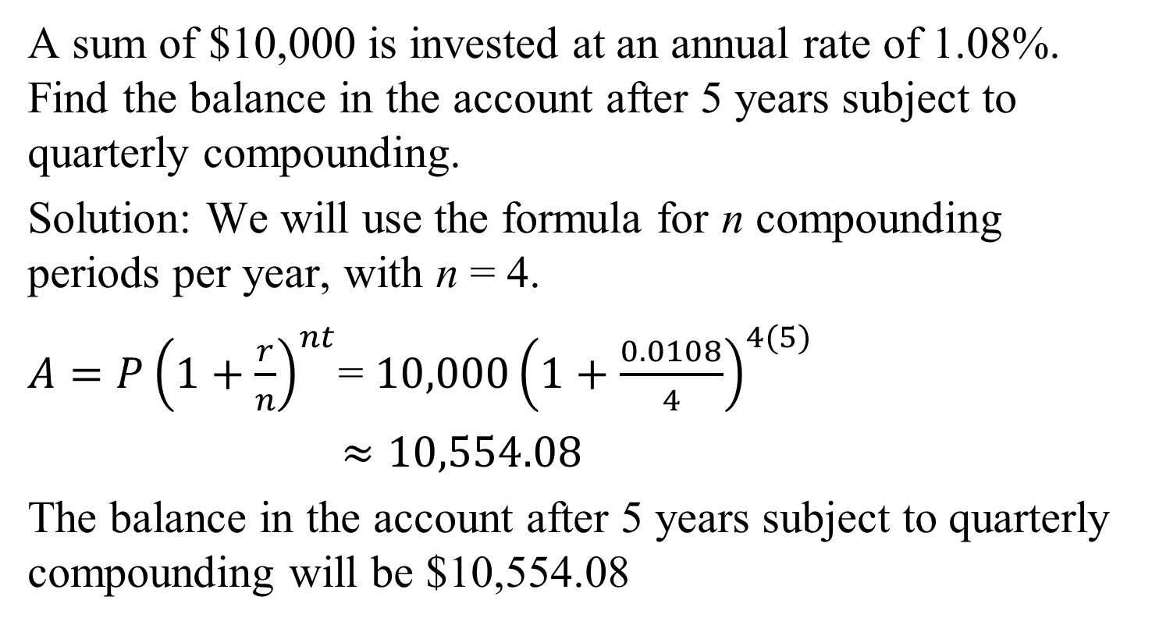
Example 7a: Using Compound Interest Formulas
A sum of $10,000 is invested at an annual rate of 1.08%. Find the balance in the account after 5 years subject to quarterly compounding.
Solution: We will use the formula for n compounding periods per year, with n = 4.
$A={P\left(1+\frac{r}{n}\right)}^{nt}$= ${10,000\left(1+\frac{0.0108}{4}\right)}^{4(5)}$
$≈10,554.08$
The balance in the account after 5 years subject to quarterly compounding will be $10,554.08

Slide 16
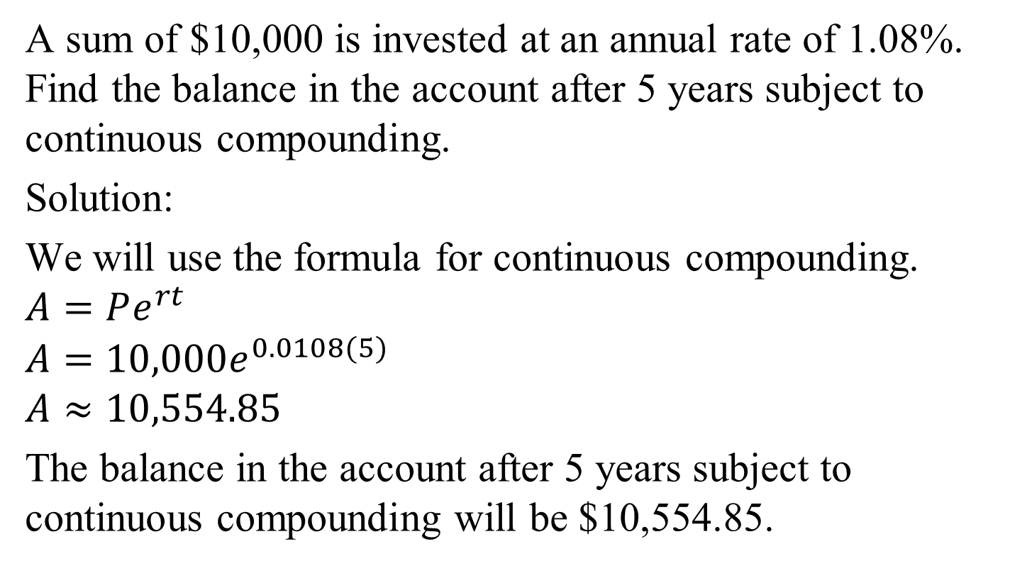
Example 7b: Using Compound Interest Formulas
A sum of $10,000 is invested at an annual rate of 1.08%. Find the balance in the account after 5 years subject to continuous compounding.
Solution:
We will use the formula for continuous compounding.
$$A=Pe^{rt}$$
$$A=10,000e^{0.0108(5)}$$
$$A≈10,554.85$$
The balance in the account after 5 years subject to continuous compounding will be $10,554.85.

