Slide 1

Chapter 3
Polynomial and Rational Functions
3.2 Polynomial Functions and Their Graphs

Slide 2
Objectives
Identify polynomial functions.
Recognize characteristics of graphs of polynomial functions.
Determine end behavior.
Use factoring to find zeros of polynomial functions.
Identify zeros and their multiplicities.
Use the Intermediate Value Theorem.
Understand the relationship between degree and turning points.
Graph polynomial functions.

Slide 3
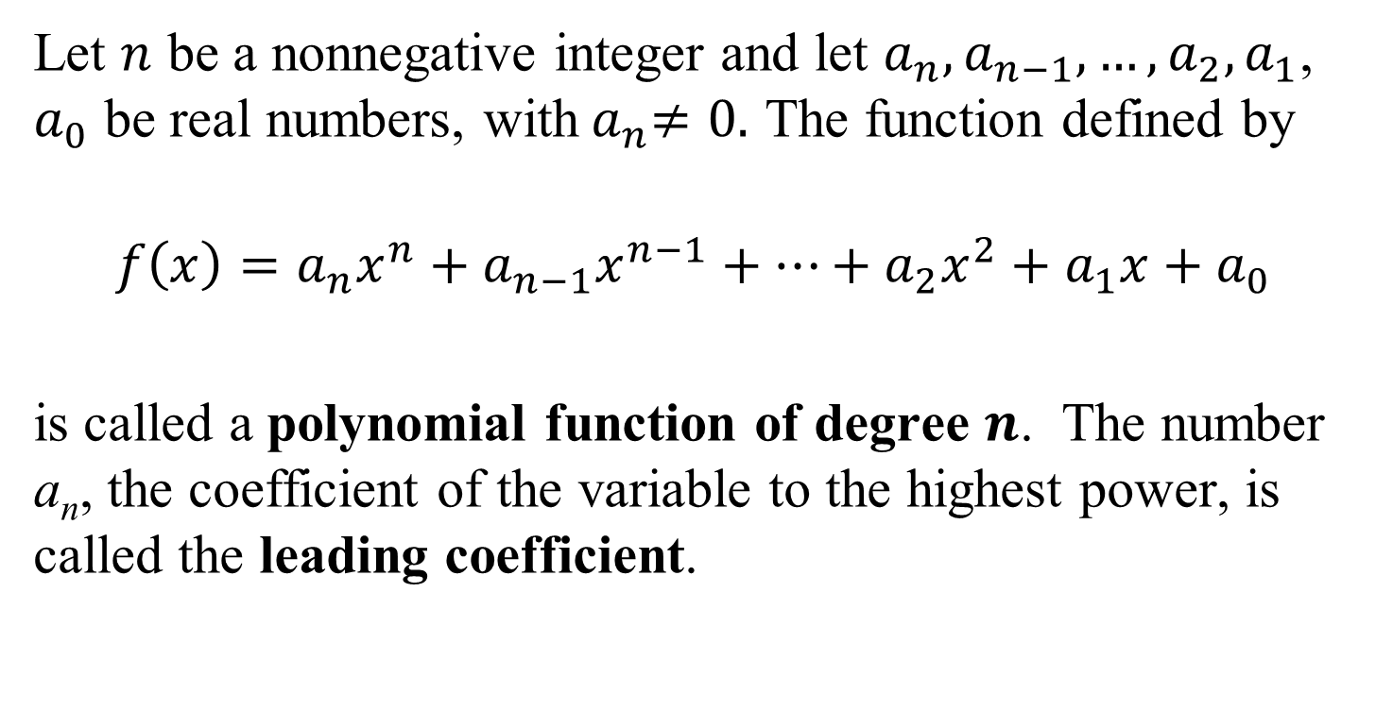
Definition of a Polynomial Function
Let $n$ be a nonnegative integer and let $a_{n},a_{n−1},…,a_{2},a_{1}$, $a_{0}$ be real numbers, with${ a}_{n}≠0.$ The function defined by
$$f\left(x\right)=a_{n}x^{n}+a_{n−1}x^{n−1}+…+a_{2}x^{2}+a_{1}x+a_{0}$$
is called a polynomial function of degree $n$. The number a_{n}, the coefficient of the variable to the highest power, is called the leading coefficient.

Slide 4
Graphs of Polynomial Functions – Smooth and Continuous
Polynomial functions of degree 2 or higher have graphs that are smooth and continuous.
By smooth, we mean that the graphs contain only rounded curves with no sharp corners.
By continuous, we mean that the graphs have no breaks and can be drawn without lifting your pencil from the rectangular coordinate system.

Slide 5
End Behavior of Polynomial Functions
The behavior of the graph of a function to the far left or the far right is called its end behavior.
Although the graph of a polynomial function may have intervals where it increases or decreases, the graph will eventually rise or fall without bound as it moves far to the left or far to the right.
The sign of the leading coefficient, a_{n}, and the degree, n, of the polynomial function reveal its end behavior.

Slide 6
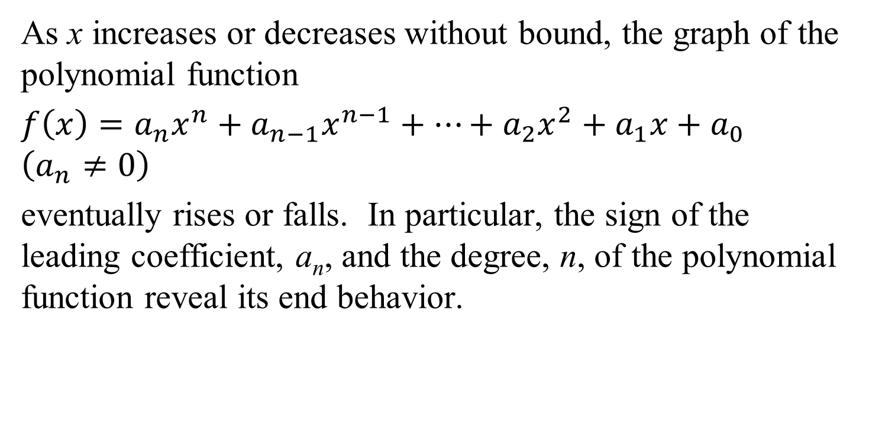
The Leading Coefficient Test
As x increases or decreases without bound, the graph of the polynomial function
$f\left(x\right)=a_{n}x^{n}+a_{n−1}x^{n−1}+…+a_{2}x^{2}+a_{1}x+a_{0}$ $\left(a_{n}≠0\right)$
eventually rises or falls. In particular, the sign of the leading coefficient, a_{n}, and the degree, n, of the polynomial function reveal its end behavior.

Slide 7
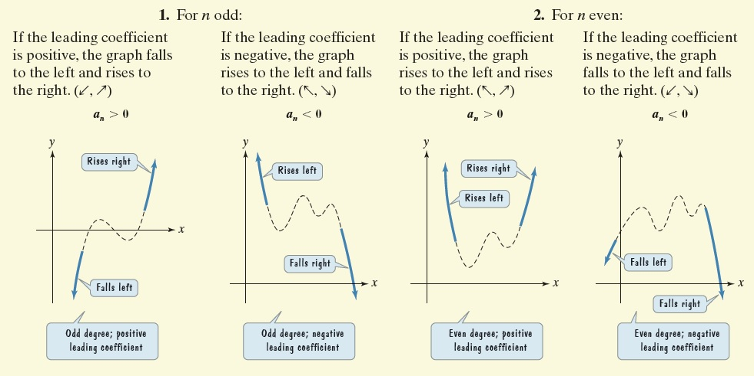
The Leading Coefficient Test (continued)

Slide 8
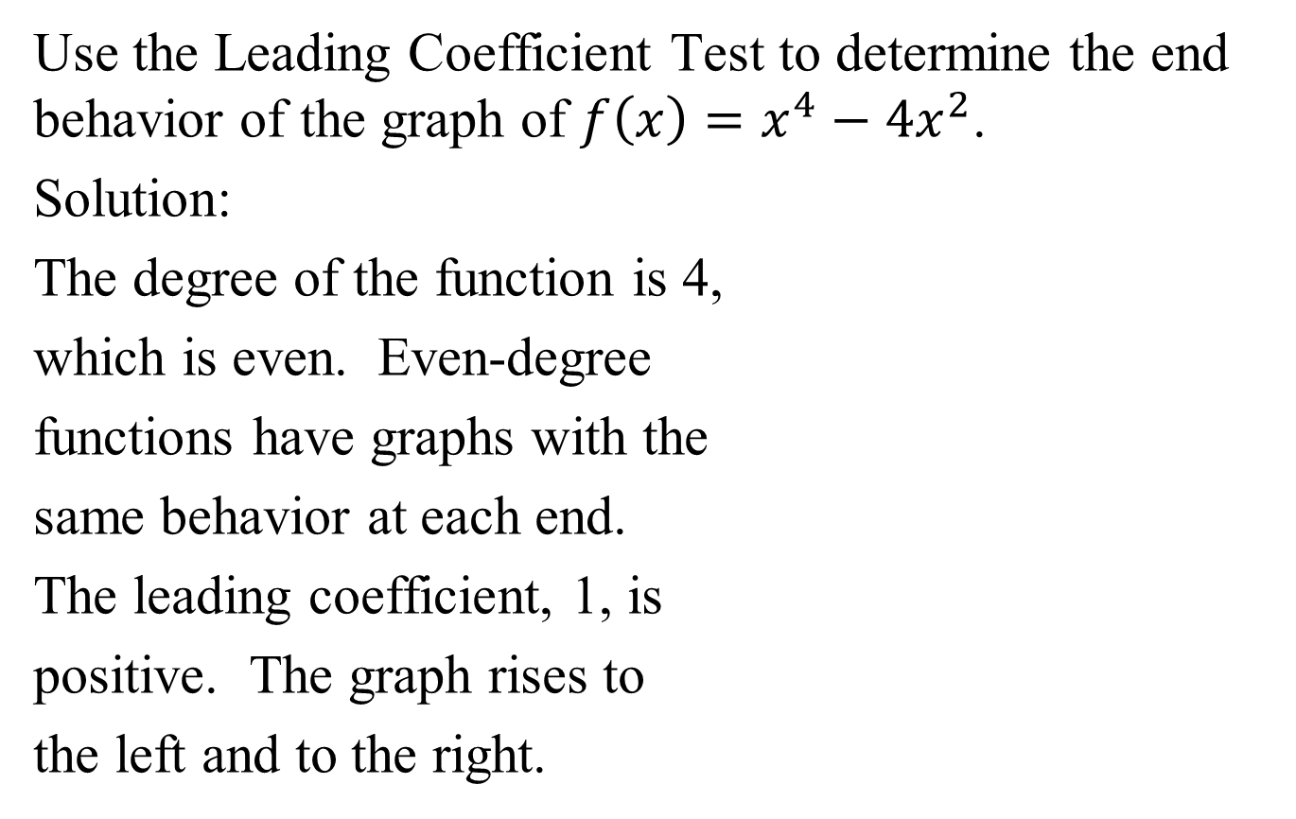
Example 1: Using the Leading Coefficient Test
Use the Leading Coefficient Test to determine the end behavior of the graph of $f\left(x\right)=x^{4}−4x^{2}$.
Solution:
The degree of the function is 4,
which is even. Even-degree
functions have graphs with the
same behavior at each end.
The leading coefficient, 1, is
positive. The graph rises to
the left and to the right.

Slide 9
Zeros of Polynomial Functions
If f is a polynomial function, then the values of x for which f(x) is equal to 0 are called the zeros of f.
These values of x are the roots, or solutions, of the polynomial equation f(x) = 0.
Each real root of the polynomial equation appears as an
x-intercept of the graph of the polynomial function.

Slide 10
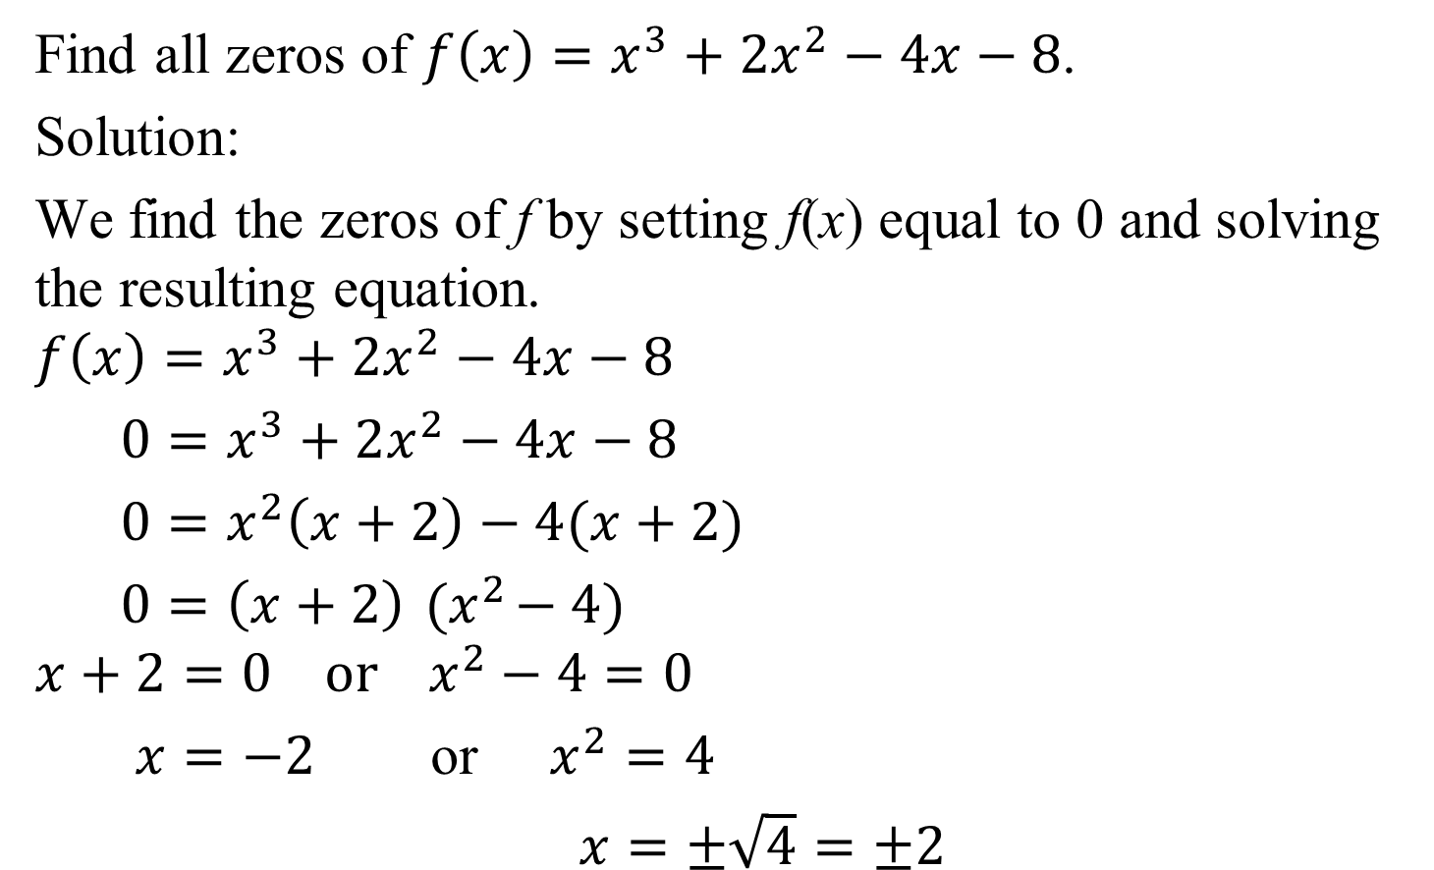
Example 5: Finding Zeros of a Polynomial Function
Find all zeros of $f\left(x\right)=x^{3}+2x^{2}−4x−8$.
Solution:
We find the zeros of f by setting f(x) equal to 0 and solving the resulting equation.
$$f\left(x\right)=x^{3}+2x^{2}−4x−8$$
$0=x^{3}+2x^{2}−4x−8$
$0=x^{2}\left(x+2\right)−4(x+2)$
$0=\left(x+2\right){ (x}^{2}−4)$
$$x+2=0 or x^{2}−4=0$$
$x=−2$ or $x^{2}=4$
$x=±\sqrt{4}=±2$

Slide 11

Example 5: Finding Zeros of a Polynomial Function
(continued)
Find all zeros of$f\left(x\right)=x^{3}+2x^{2}−4x−8$.
The zeros of f are –2 and 2.
The graph of f shows that
each zero is an x-intercept.
The graph passes through
(–2, 0) and (2, 0).
(–2, 0)
(2, 0)

Slide 12
Multiplicity and x-Intercepts
If r is a zero of even multiplicity, then the graph touches the x-axis and turns around at r. If r is a zero of odd multiplicity, then the graph crosses the x-axis at r. Regardless of whether the multiplicity of a zero is even or odd, graphs tend to flatten out near zeros with multiplicity greater than one.

Slide 13
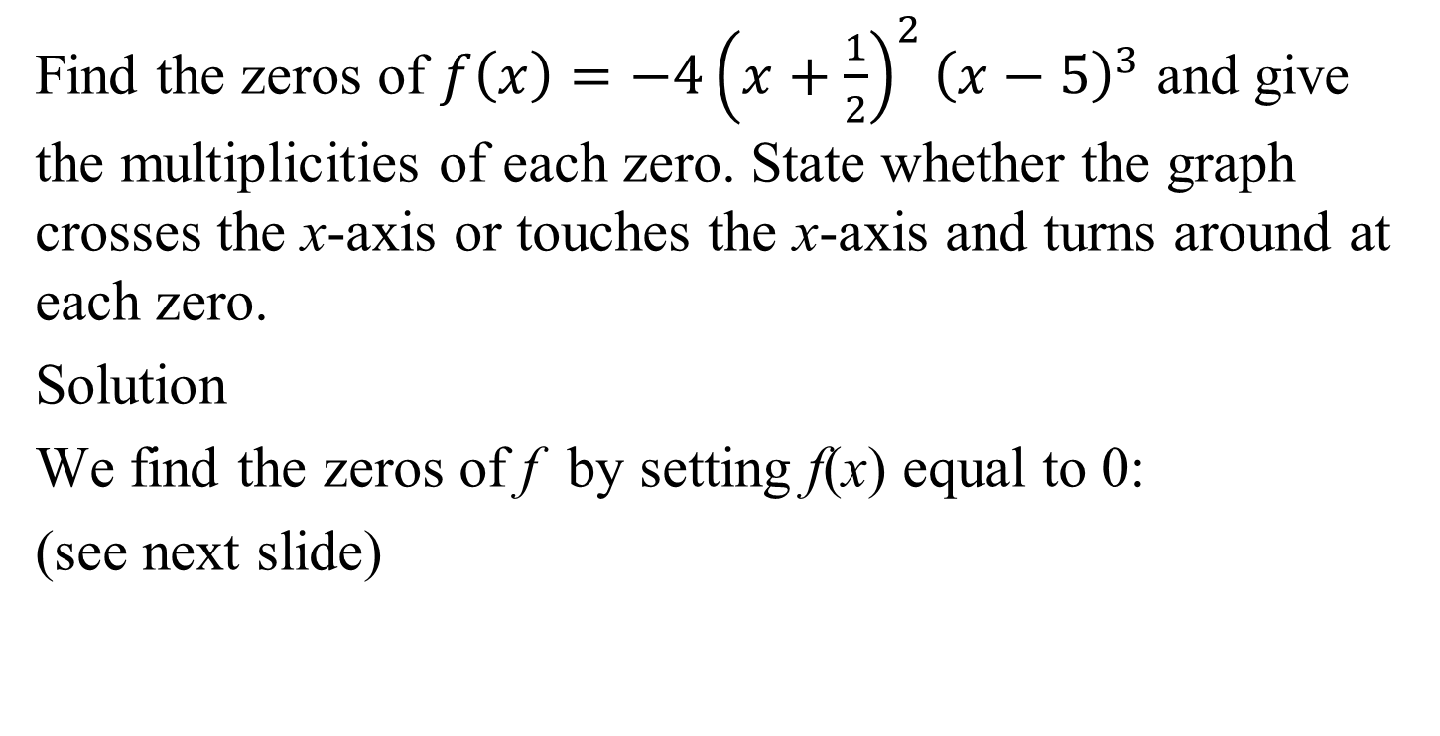
Example 7: Finding Zeros and Their Multiplicities
Find the zeros of $f\left(x\right)=−4{\left(x+\frac{1}{2}\right)}^{2}{\left(x−5\right)}^{3}$ and give the multiplicities of each zero. State whether the graph crosses the x-axis or touches the x-axis and turns around at each zero.
Solution
We find the zeros of f by setting f(x) equal to 0:
(see next slide)

Slide 14
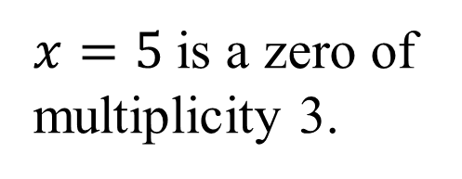

Example 7: Finding Zeros and Their Multiplicities
(continued)
$$−4{\left(x+\frac{1}{2}\right)}^{2}{\left(x−5\right)}^{3}=0$$
$${\left(x+\frac{1}{2}\right)}^{2}{=0 \text{or} \left(x−5\right)}^{3}=0$$
$$x=−\frac{1}{2}$$
is a zero of
multiplicity 2.
$x=5$is a zero of multiplicity 3.

Slide 15





Example 7: Finding Zeros and Their Multiplicities
(continued)
For the function $f\left(x\right)=−4{\left(x+\frac{1}{2}\right)}^{2}{\left(x−5\right)}^{3}$
$$x=5$$
$$x=−\frac{1}{2}$$
is a zero of
multiplicity 2.
is a zero of
multiplicity 3.
The graph touches and
turns at
The graph
crosses
the x-axis at
$$x=−\frac{1}{2}$$
$$x=5$$

Slide 16
The Intermediate Value Theorem
Let f be a polynomial function with real coefficients. If f(a) and f(b) have opposite signs, then there is at least one value of c between a and b for which f(c) = 0. Equivalently, the equation f(x) = 0 has at least one real root between a and b.

Slide 17
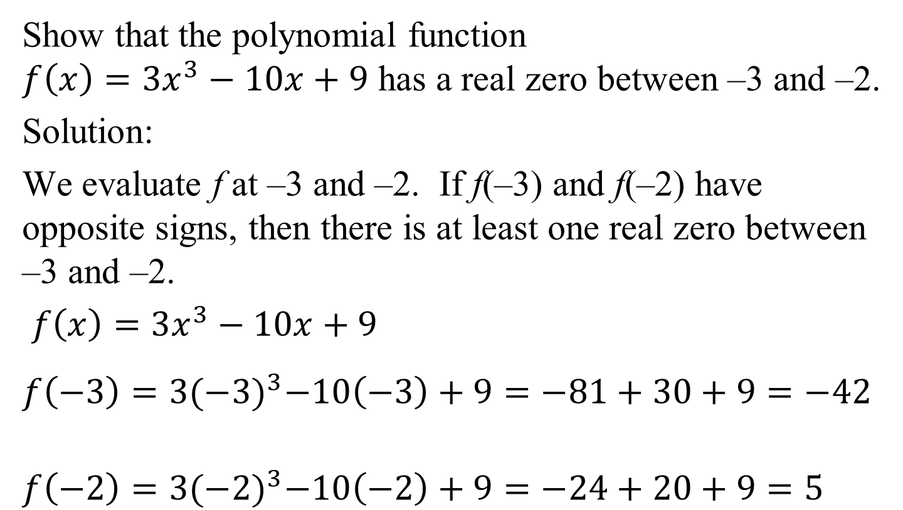
Example 8: Using the Intermediate Value Theorem
Show that the polynomial function
$f\left(x\right)=3x^{3}−10x+9$ has a real zero between –3 and –2.
Solution:
We evaluate f at –3 and –2. If f(–3) and f(–2) have opposite signs, then there is at least one real zero between –3 and –2.
$f\left(x\right)=3x^{3}−10x+9$
$$f\left(−3\right)=3{(−3)}^{3}−10\left(−3\right)+9=−81+30+9=−42$$
$$f\left(−2\right)=3{(−2)}^{3}−10\left(−2\right)+9=−24+20+9=5$$

Slide 18

Example 8: Using the Intermediate Value Theorem
(continued)
For $f\left(x\right)=3x^{3}−10x+9$
f(–3) = –42
and f(–2) = 5.
The sign change shows
that the polynomial
function has a real zero
between –3 and –2.
(–2, 5)
(–3, –42)

Slide 19
Turning Points of Polynomial Functions
In general, if f is a polynomial function of degree n, then the graph of f has at most n – 1 turning points.

Slide 20
Graphing a Polynomial Function
1. Use the Leading Coefficient Test to determine the graph’s end behavior.
2. Find x-intercepts by setting f(x) = 0 and solving the resulting polynomial equation. If there is an x-intercept at r as a result of (x – r)^{k} in the complete factorization of f(x), then
a. If k is even, the graph touches the x-axis at r
and turns around.
b. If k is odd, the graph crosses the x-axis at r.
c. If k > 1, the graph flattens out near (r, 0).

Slide 21
A Strategy for Graphing Polynomial Functions (cont)
3. Find the y-intercept by computing f(0).
4. Use symmetry, if applicable, to help draw the graph:
a. y-axis symmetry: f(–x) = f(x)
b. Origin symmetry: f(–x) = –f(x).
5. Use the fact that the maximum number of turning points of the graph is n – 1, where n is the degree of the polynomial function, to check whether it is drawn correctly.

Slide 22
Example 10: Graphing a Polynomial Function
Use the five-step strategy to graph f(x) = 2(x + 2)²(x – 3).
Solution:
Step 1 Determine end behavior.
Identify the sign of a_{n}, the leading coefficient, and the degree, n, of the polynomial function.
a_{n} = 2 and n = 3
The degree, 3, is odd. The leading
coefficient, 2, is a positive number.
The graph will rise on the right and
fall on the left.

Slide 23
Example 10: Graphing a Polynomial Function
(continued)
Use the five-step strategy to graph f(x) = 2(x + 2)²(x – 3).
Solution (continued):
Step 2 Find x-intercepts (zeros of the function) by setting f(x) = 0.
f(x) = 2(x + 2)²(x – 3)
2(x + 2)²(x – 3) = 0
x + 2 = 0 or x – 3 = 0
x = –2 or x = 3
x = –2 is a zero of multiplicity 2.
x = 3 is a zero of multiplicity 1.

Slide 24
Example 10: Graphing a Polynomial Function
(continued)
Use the five-step strategy to graph f(x) = 2(x + 2)²(x – 3).
Solution (continued):
Step 2 (continued) Find x-intercepts (zeros of the function) by setting f(x) = 0.
x = –2 is a zero of multiplicity 2.
The graph touches the x-axis
at x = –2, flattens and turns around.
x = 3 is a zero of multiplicity 1.
The graph crosses the x-axis
at x = 3.
x = –2
x = 3

Slide 25
Example 10: Graphing a Polynomial Function
(continued)
Use the five-step strategy to graph f(x) = 2(x + 2)²(x – 3).
Solution (continued):
Step 3 Find the y-intercept by computing f(0).
f(x) = 2(x + 2)²(x – 3)
f(0) = 2(0 + 2)²(0 – 3)
= 2(4)(–3) = –24
The y-intercept is –24.
The graph passes through the
y-axis at (0, –24).

Slide 26
Example 10: Graphing a Polynomial Function
(continued)
Use the five-step strategy to graph f(x) = 2(x + 2)²(x – 3).
Solution (continued):
Step 3 (continued) Find the y-intercept by computing f(0).
To help us determine how to scale the graph, we will evaluate f(x) at x = 1 and x = 2.
f(x) = 2(x + 2)²(x – 3)
f(1) = 2(1 + 2)²(1 – 3) = 2(9)(–2) = –36
f(2) = 2(2 + 2)²(2 – 3) = 2(16)(–1) = –32

Slide 27
Example 10: Graphing a Polynomial Function
(continued)
Use the five-step strategy to graph f(x) = 2(x + 2)²(x – 3).
Solution (continued):
Step 4 Use possible symmetry to help draw the graph.
Our partial graph illustrates
that we have neither y-axis
symmetry nor origin symmetry.

Slide 28
Example 10: Graphing a Polynomial Function
(continued)
Use the five-step strategy to graph f(x) = 2(x + 2)²(x – 3).
Solution (continued):
Step 4 (continued) Use possible symmetry to help draw the graph.
Using end behavior, intercepts,
and the additional points, we
graph the function.

Slide 29
Example 10: Graphing a Polynomial Function
(continued)
Use the five-step strategy to graph f(x) = 2(x + 2)²(x – 3)
Solution (continued):
Step 5 Use the fact that the maximum number of turning points of the graph is n − 1 to check
whether it is drawn correctly.
The degree is 3. The maximum
number of turning points will
be 3 – 1 or 2. Because the graph
has two turning points, we have not
violated the maximum number possible.

