Slide 1

Chapter 4
Exponential and Logarithmic Functions
4.4 Exponential and Logarithmic Equations

Slide 2
Objectives
Use like bases to solve exponential equations.
Use logarithms to solve exponential equations.
Use the definition of a logarithm to solve logarithmic equations.
Use the one-to-one property of logarithms to solve logarithmic equations.
Solve applied problems involving exponential and logarithmic equations.

Slide 3

Solving Exponential Equations by Expressing Each Side as a Power of the Same Base
If $b^{M}=b^{N}$ then M = N.
1. Rewrite the equation in the form $b^{M}=b^{N}$.
2. Set M = N.
3. Solve for the variable.

Slide 4

Example 1a: Solving Exponential Equations
Solve: $5^{3x−6}=125$.
Solution:
$5^{3x−6}=125$
$5^{3x−6}=5^{3}$
$3x−6=3$
$3x=9$
$x=3$
The solution set is {3}.

Slide 5
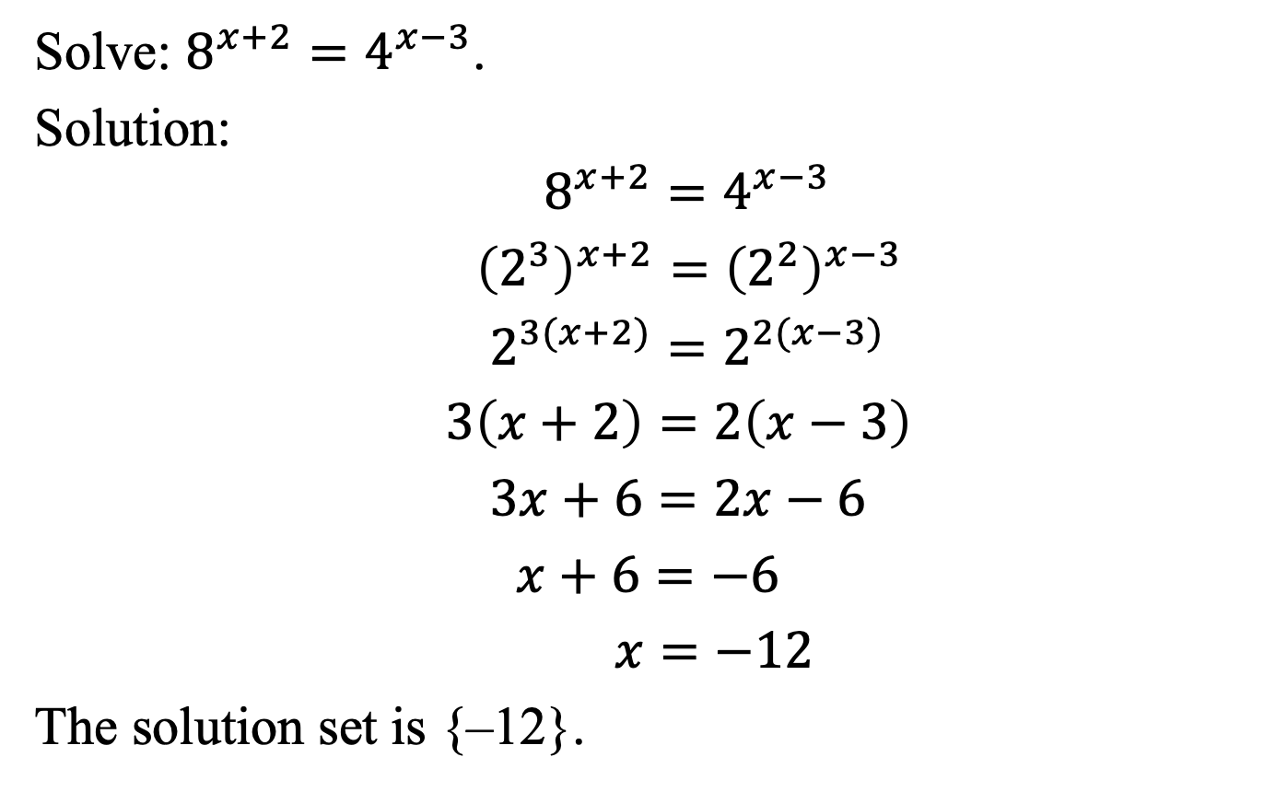
Example 1b: Solving Exponential Equations
Solve: $8^{x+2}=4^{x−3}$.
Solution:
$8^{x+2}=4^{x−3}$
${\left(2^{3}\right)}^{x+2}={\left(2^{2}\right)}^{x−3}$
$2^{3(x+2)}=2^{2(x−3)}$
$3\left(x+2\right)=2\left(x−3\right)$
$3x+6=2x−6$
$x+6=−6$
$x=−12$
The solution set is {–12}.

Slide 6
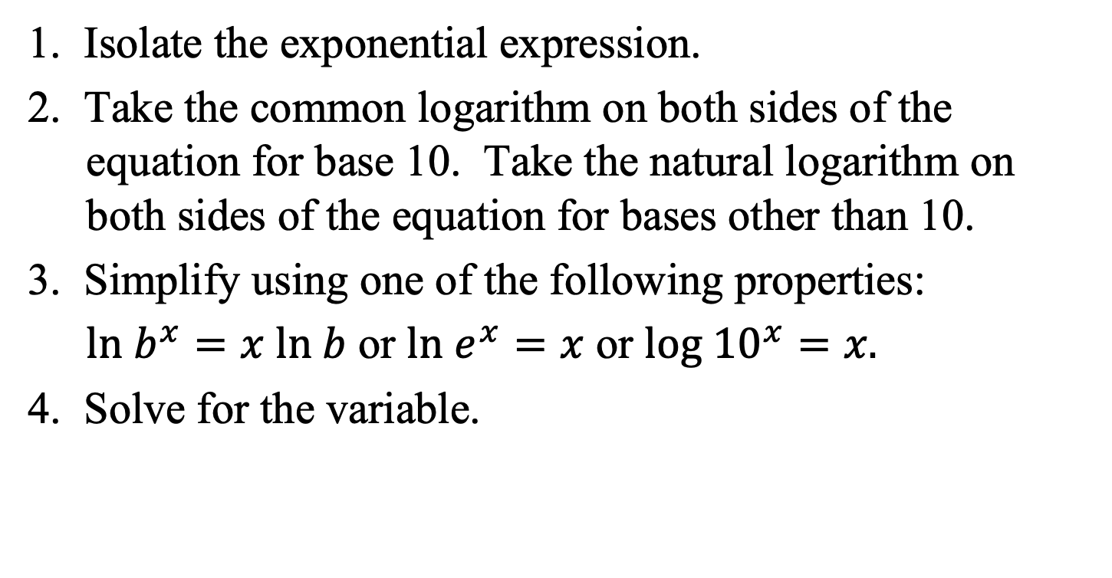
Using Logarithms to Solve Exponential Equations
1. Isolate the exponential expression.
2. Take the common logarithm on both sides of the equation for base 10. Take the natural logarithm on both sides of the equation for bases other than 10.
3. Simplify using one of the following properties:
$ln{ b}^{x}=x ln b$ or $ln{ e}^{x}=x$ or $log {10}^{x}=x.$
4. Solve for the variable.

Slide 7
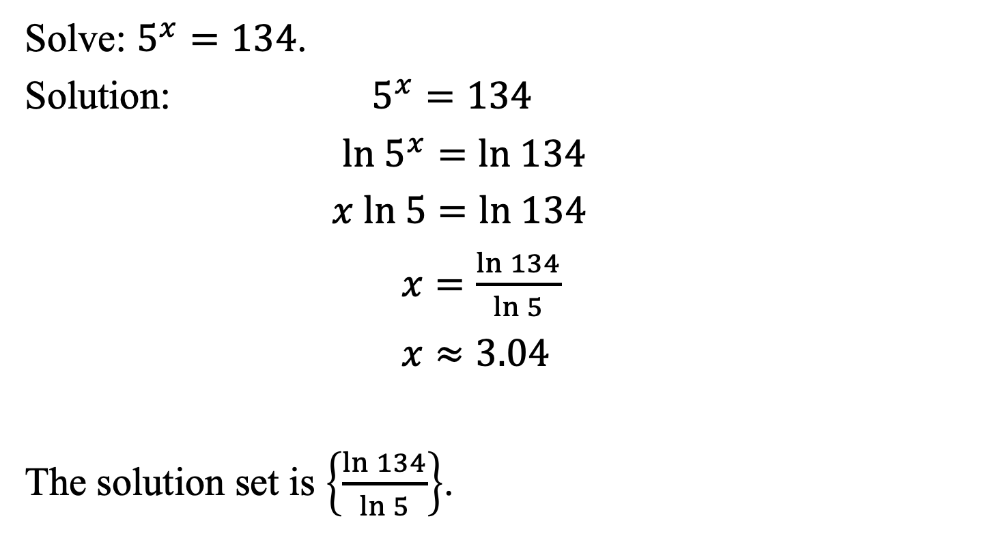
Example 2a: Solving Exponential Equations
Solve: $5^{x}=134$.
Solution: $5^{x}=134$
$ln 5^{x}=ln 134$
$x ln 5=ln 134$
$x=\frac{ln 134}{ln 5}$
$x≈3.04$
The solution set is $\left\{\frac{ln 134}{ln 5}\right\}$.

Slide 8
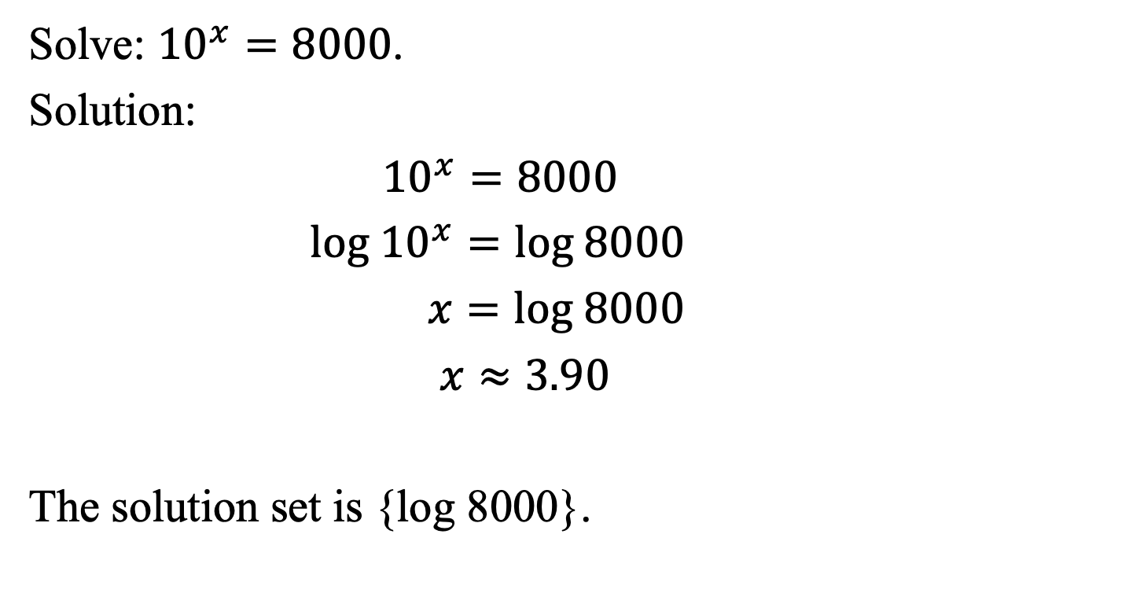
Example 2b: Solving Exponential Equations
Solve: ${10}^{x}=8000$.
Solution:
${10}^{x}=8000$
$log {10}^{x}=log 8000$
$x=log 8000$
$x≈3.90$
The solution set is {log 8000}.

Slide 9

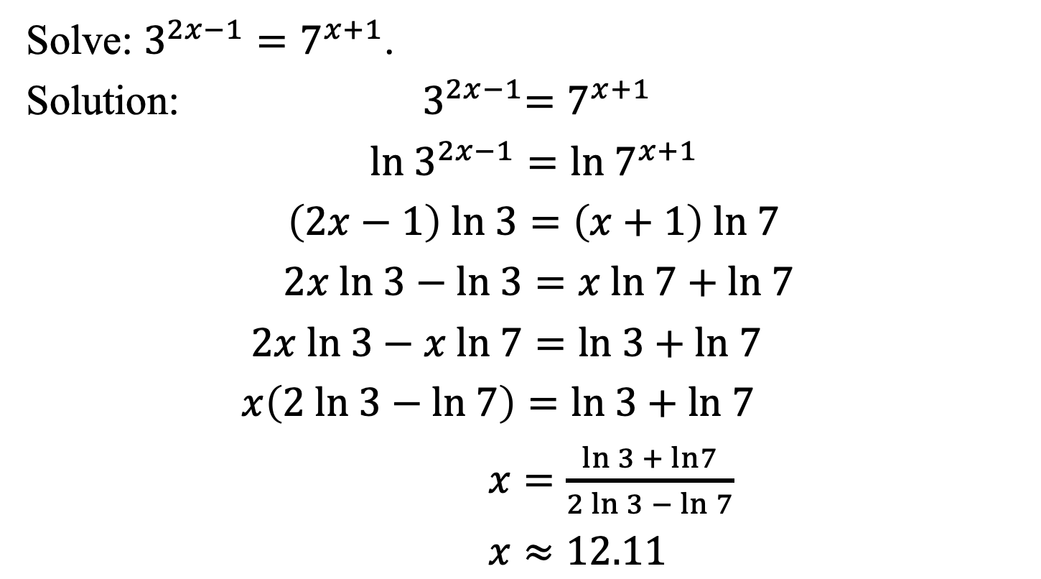
Example 4: Solving an Exponential Equation
Solve: $3^{2x−1}=7^{x+1}$.
Solution: ${ 3}^{2x−1}=7^{x+1}$
${ln 3}^{2x−1}={ln 7}^{x+1}$
$\left(2x−1\right) ln 3=\left(x+1\right) ln 7$
$2x ln 3−ln 3=x ln 7+ln 7$
$2x ln 3−x ln 7=ln 3+ln 7$
$x\left(2 ln 3−ln 7\right)=ln 3+ln 7$
$x=\frac{ln 3 + ln7}{2 ln 3 − ln 7}$
$x≈12.11$
The solution set
is $\left\{\frac{ln 3 + ln 7}{2 ln 3 − ln 7}\right\}$.

Slide 10
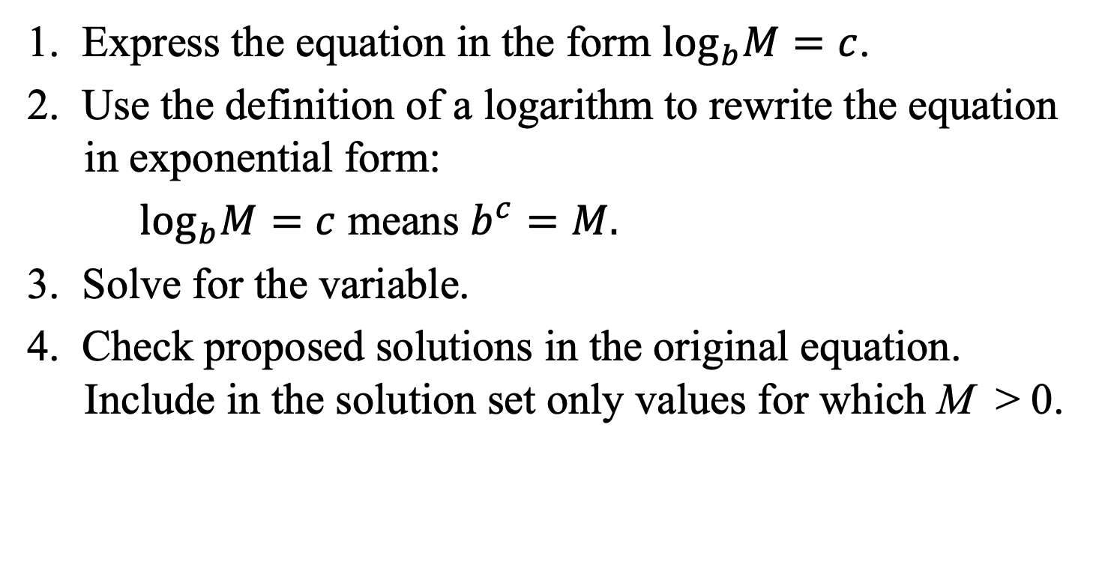
Using the Definition of a Logarithm to Solve Logarithmic Equations
1. Express the equation in the form $\log_{b}M=c$.
2. Use the definition of a logarithm to rewrite the equation in exponential form:
$\log_{b}M=c$ means $b^{c}=M.$
3. Solve for the variable.
4. Check proposed solutions in the original equation. Include in the solution set only values for which M > 0.

Slide 11
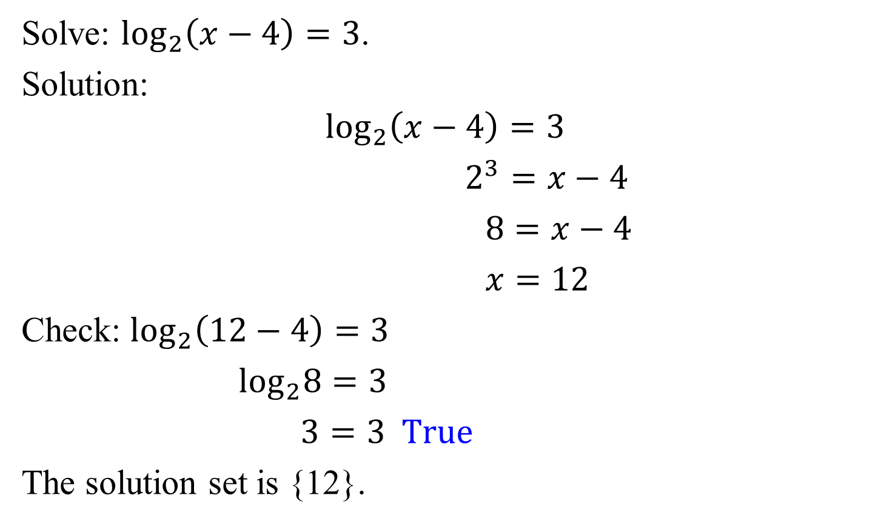
Example 6a: Solving Logarithmic Equations
Solve: $\log_{2}\left(x−4\right)=3$.
Solution:
$$\log_{2}\left(x−4\right)=3$$
$2^{3}=x−4$
$8=x−4$
$x=12$
Check: $\log_{2}\left(12−4\right)=3$
$\log_{2}8=3$
$3=3 True$
The solution set is {12}.

Slide 12





Example 6b: Solving Logarithmic Equations
Solve: $4 ln\left(3x\right)=8$.
Solution:
$$4 ln\left(3x\right)=8$$
$ln\left(3x\right)=2$
$e^{2}=3x$
$x=\frac{e^{2}}{3}$
The solution set is $\left\{\frac{e^{2}}{3}\right\}$.
Check:
$$4 ln\left(3∙\frac{e^{2}}{3}\right)=8$$
$$4lne^{2}=8$$
$$4·2=8$$
$$8=8$$

Slide 13
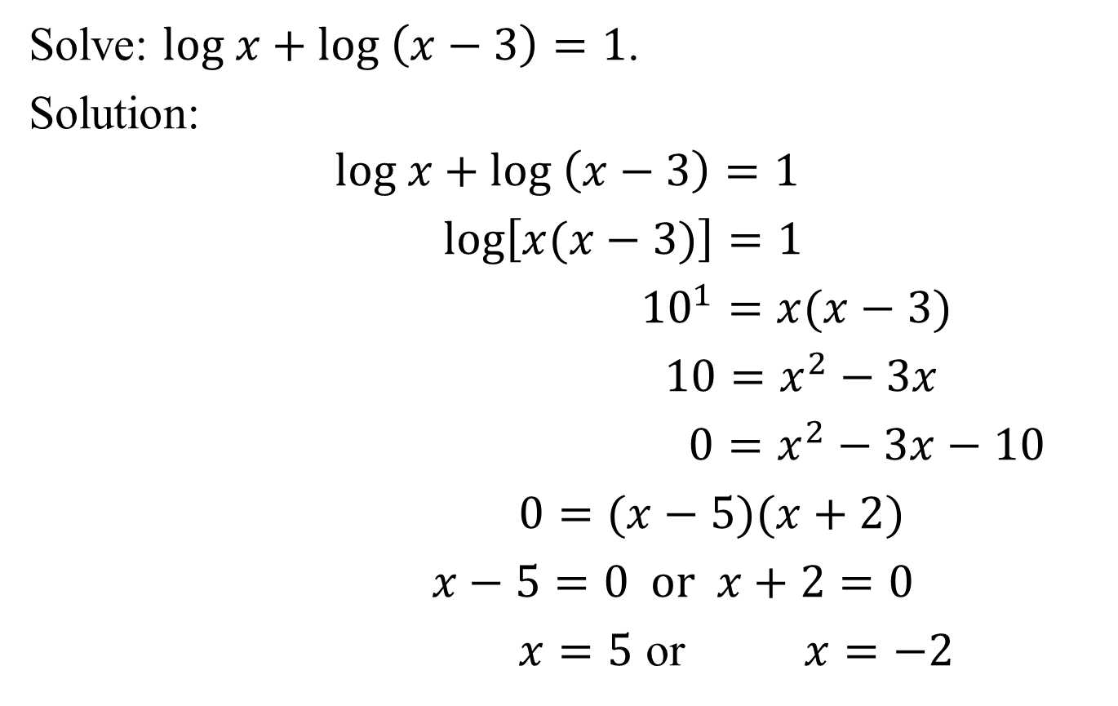
Example 7: Solving Logarithmic Equations
Solve: $log x+log \left(x−3\right)=1$.
Solution:
$$log x+log \left(x−3\right)=1$$
$log\left[x(x−3)\right]=1$
${10}^{1}=x(x−3)$
$10=x^{2}−3x$
$0=x^{2}−3x−10$
$0=(x−5)(x+2)$
$x−5=0 or x+2=0$
$x=5$ or $x=−2$

Slide 14

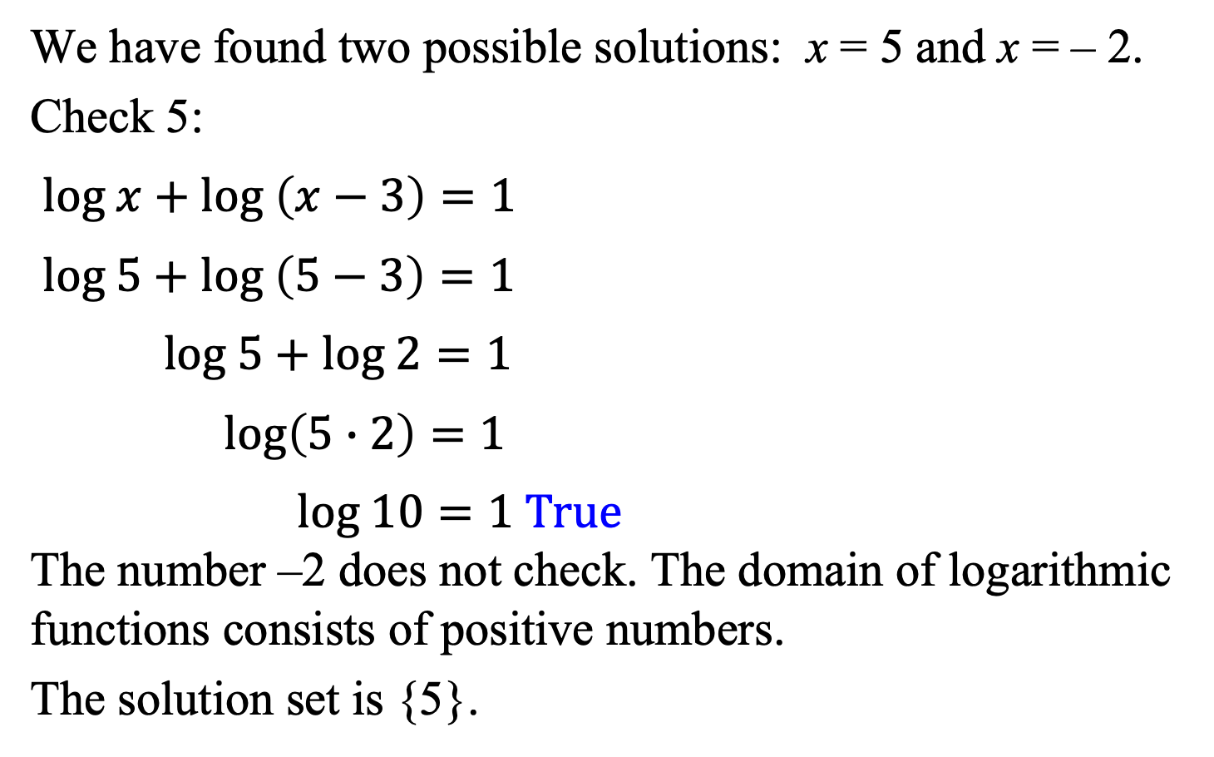
Example 7: Solving Logarithmic Equations (continued)
We have found two possible solutions: x = 5 and x = – 2.
Check 5:
$log x+log \left(x−3\right)=1$
$log 5+log \left(5−3\right)=1$
$log 5+log 2=1$
$log\left(5∙2\right)=1$
$log 10=1 True$
The number –2 does not check. The domain of logarithmic functions consists of positive numbers.
The solution set is {5}.
Check –2:
$$log (−2)+log \left(−2−3\right)=1$$

Slide 15
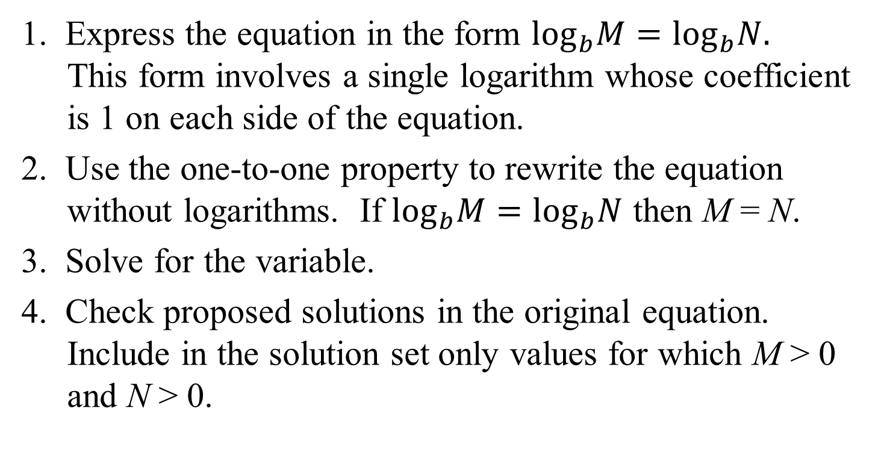
Using the One-to-One Property of Logarithms to Solve Logarithmic Equations
1. Express the equation in the form $\log_{b}M=\log_{b}N.$ This form involves a single logarithm whose coefficient is 1 on each side of the equation.
2. Use the one-to-one property to rewrite the equation without logarithms. If $\log_{b}M=\log_{b}N$ then M = N.
3. Solve for the variable.
4. Check proposed solutions in the original equation. Include in the solution set only values for which M > 0 and N > 0.

Slide 16



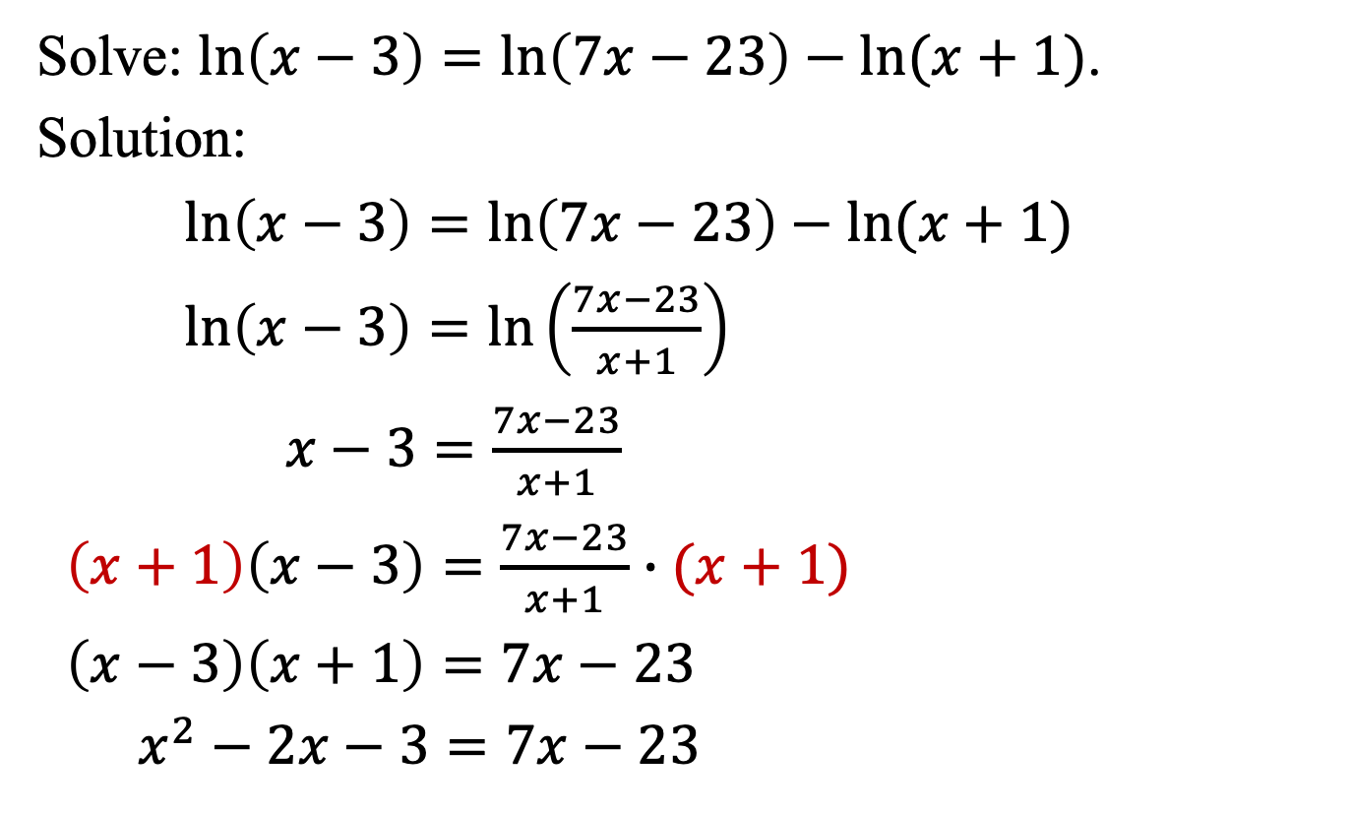



Example 8: Solving a Logarithmic Equation
Solve: $ln\left(x−3\right)=ln\left(7x−23\right)−ln(x+1)$.
Solution:
$ln\left(x−3\right)=ln\left(7x−23\right)−ln(x+1)$
$ln\left(x−3\right)=ln\left(\frac{7x−23}{x+1}\right)$
$x−3=\frac{7x−23}{x+1}$
$\left(x+1\right)\left(x−3\right)=\frac{7x−23}{x+1}∙(x+1)$
$\left(x−3\right)\left(x+1\right)=7x−23$
$x^{2}−2x−3=7x−23$
$$x^{2}−9x+20=0$$
$$\left(x−5\right)\left(x−4\right)=0$$
$$x−5=0$$
$$x−4=0$$
$$x=5$$
$$x=4$$

Slide 17
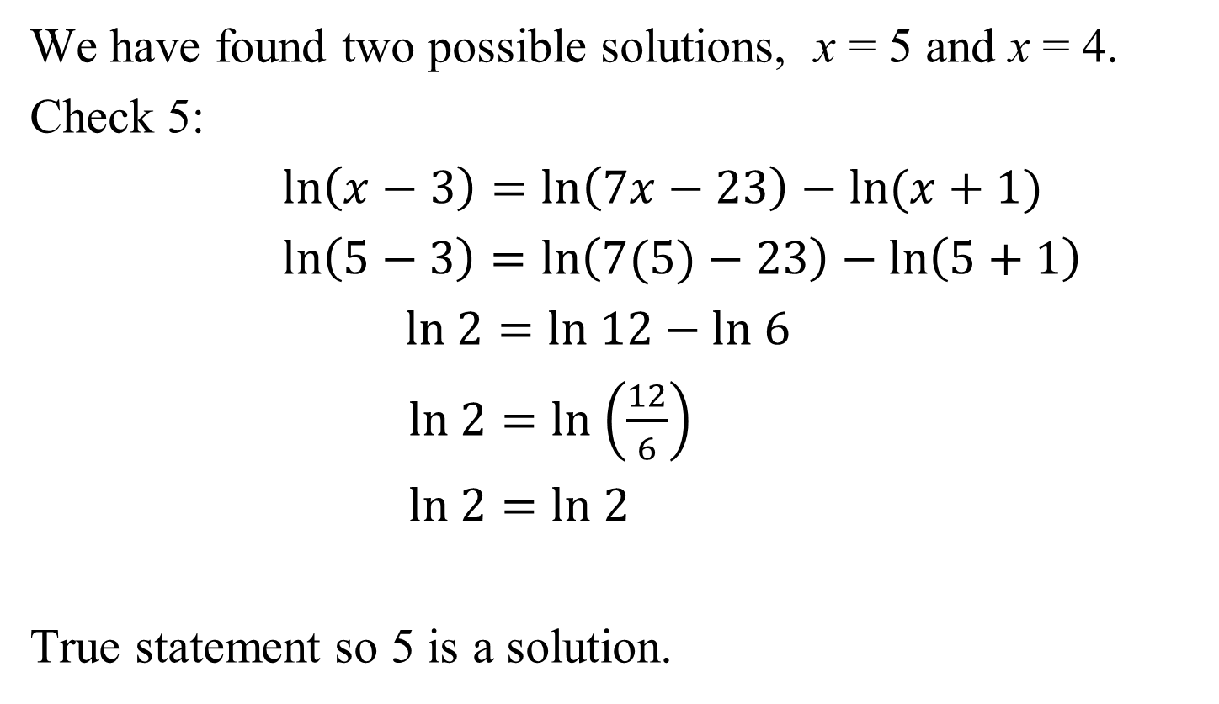
Example 8: Solving a Logarithmic Equation (continued)
We have found two possible solutions, x = 5 and x = 4.
Check 5:
$ln\left(x−3\right)=ln\left(7x−23\right)−ln(x+1)$
$ln\left(5−3\right)=ln\left(7(5)−23\right)−ln\left(5+1\right)$
$ln 2=ln 12−ln 6$
$ln 2=ln$ $\left(\frac{12}{6}\right)$
$ln 2=ln 2$
True statement so 5 is a solution.

Slide 18
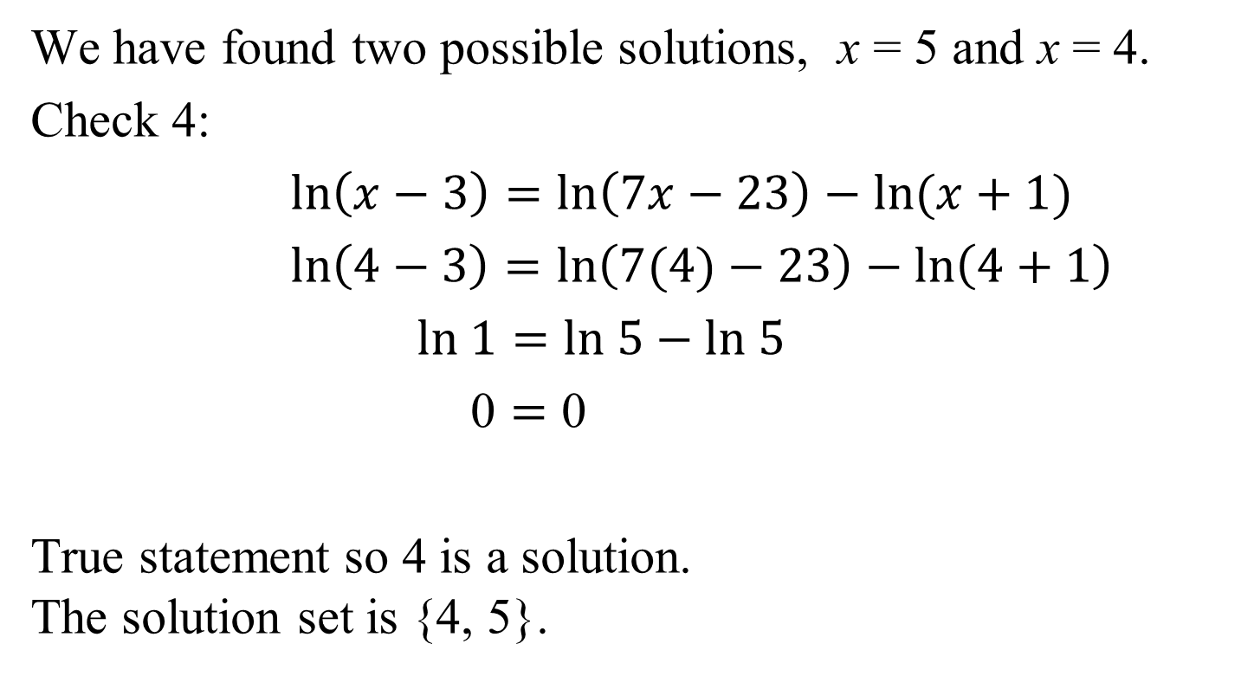
Example 8: Solving a Logarithmic Equation (continued)
We have found two possible solutions, x = 5 and x = 4.
Check 4:
$ln\left(x−3\right)=ln\left(7x−23\right)−ln(x+1)$
$ln\left(4−3\right)=ln\left(7(4)−23\right)−ln\left(4+1\right)$
$ln 1=ln 5−ln 5$
$\text{0}=\text{0}$
True statement so 4 is a solution.
The solution set is {4, 5}.

Slide 19

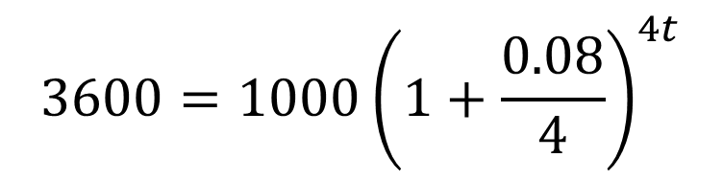

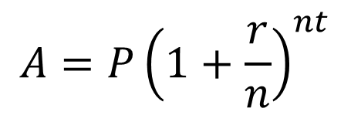





Example 10: Application (Compound Interest)
How long, to the nearest tenth of a year, will it take $1000 to grow to $3600 at 8% annual interest compounded quarterly?
Solution:
$$ln3.6=ln{\left(1.02\right)}^{4t}$$
$$A=P{\left(1+\frac{r}{n}\right)}^{nt}$$
$$ln 3.6=4t ln(1.02)$$
$$3600=1000{\left(1+\frac{0.08}{4}\right)}^{4t}$$
$$t=\frac{ln3.6}{\left.4 ( ln1.02\right)}$$
$$≈16.2$$
$$3600=1000{\left(1+0.02\right)}^{4t}$$
After approximately 16.2 years,
$1000 will grow to an
accumulated value of $3600.
$$3600=1000{\left(1.02\right)}^{4t}$$
$$3.6={\left(1.02\right)}^{4t}$$

Slide 20
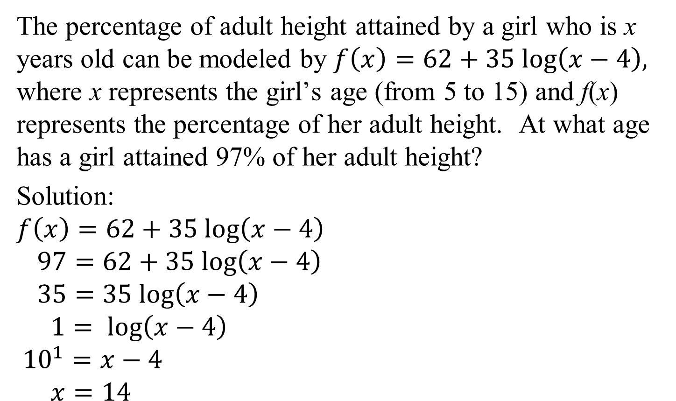
Example 11: Application (Height)
The percentage of adult height attained by a girl who is x years old can be modeled by $f\left(x\right)=62+35 log\left(x−4\right),$ where x represents the girl’s age (from 5 to 15) and f(x) represents the percentage of her adult height. At what age has a girl attained 97% of her adult height?
Solution:
$$f\left(x\right)=62+35 log\left(x−4\right)$$
$97=62+35 log\left(x−4\right)$
$35=35 log\left(x−4\right)$
$1= log\left(x−4\right)$
$${10}^{1}=x−4$$
$x=14$
At approximately age 14, a girl has attained 97% of her adult height.

