Slide 1

Chapter 3
Polynomial and Rational Functions
3.4 Zeros of Polynomial Functions

Slide 2
Objectives
Use the Rational Zero Theorem to find possible rational zeros.
Find zeros of a polynomial function.
Solve polynomial equations.
Use the Linear Factorization Theorem to find polynomials with given zeros.
Use Descartes’s Rule of Signs.

Slide 3
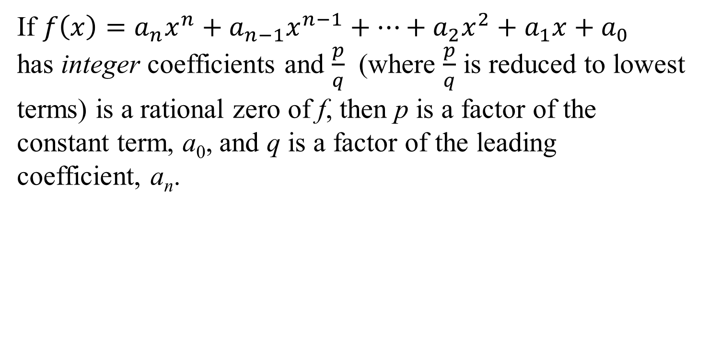
The Rational Zero Theorem
If $f\left(x\right)=a_{n}x^{n}+a_{n−1}x^{n−1}+…+a_{2}x^{2}+a_{1}x+a_{0}$ has integer coefficients and $\frac{p}{q}$ (where $\frac{p}{q}$ is reduced to lowest terms) is a rational zero of f, then p is a factor of the constant term, a₀, and q is a factor of the leading coefficient, a_{n}.

Slide 4

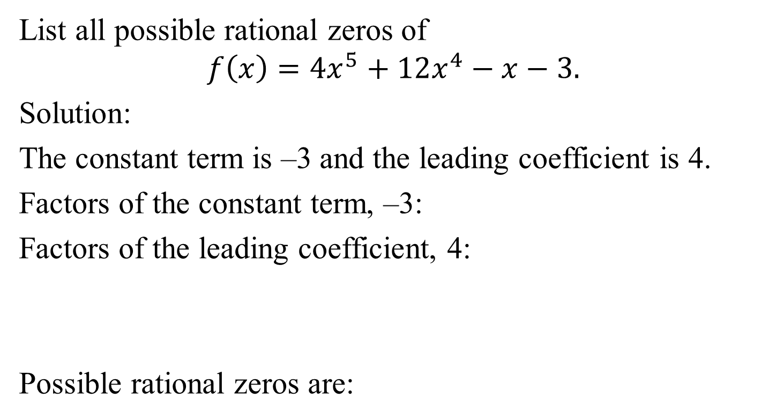
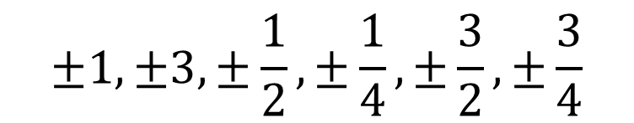
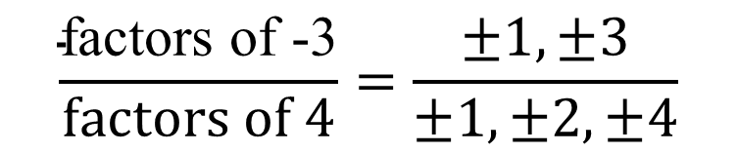

Example 2: Using the Rational Zero Theorem
List all possible rational zeros of
$$f\left(x\right)=4x^{5}+12x^{4}−x−3.$$
Solution:
The constant term is –3 and the leading coefficient is 4.
Factors of the constant term, –3:
Factors of the leading coefficient, 4:
Possible rational zeros are:
$$±1,±3$$
$$±1,±2,±4$$
$$\frac{\text{factors} \text{of}\text{ −3}}{\text{factors} \text{of}\text{ 4}}=\frac{±1,±3}{±1,±2,±4}$$
$$±1,±3,±\frac{1}{2},±\frac{1}{4},±\frac{3}{2},±\frac{3}{4}$$

Slide 5
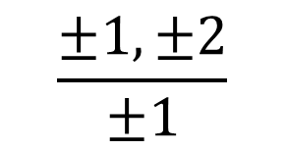


Example 4: Finding Zeros of a Polynomial Function
Find all zeros of $f\left(x\right)=x^{3}+x^{2}−5x−2.$
Solution:
We begin by listing all possible rational zeros.
Possible rational zeros =
We now use synthetic division to see if we can find a rational zero among the four possible rational zeros.
$$\frac{±1,±2}{±1}$$
$$=±1,±2$$

Slide 6
Example 4: Finding Zeros of a Polynomial Function
(continued)
Solution (continued):
Possible rational zeros are 1, –1, 2, and –2. We will use synthetic division to test the possible rational zeros.
Neither –2 nor –1 is a zero. We continue testing possible rational zeros.
 |  | –2 | 2 | 6
 | 1 | –1 | –3 | 4
 |  | –1 | 0 | 5
 | 1 | 0 | –5 | 3
–2 | 1 | 1 | –5 | –2
–1 | 1 | 1 | –5 | –2

Slide 7
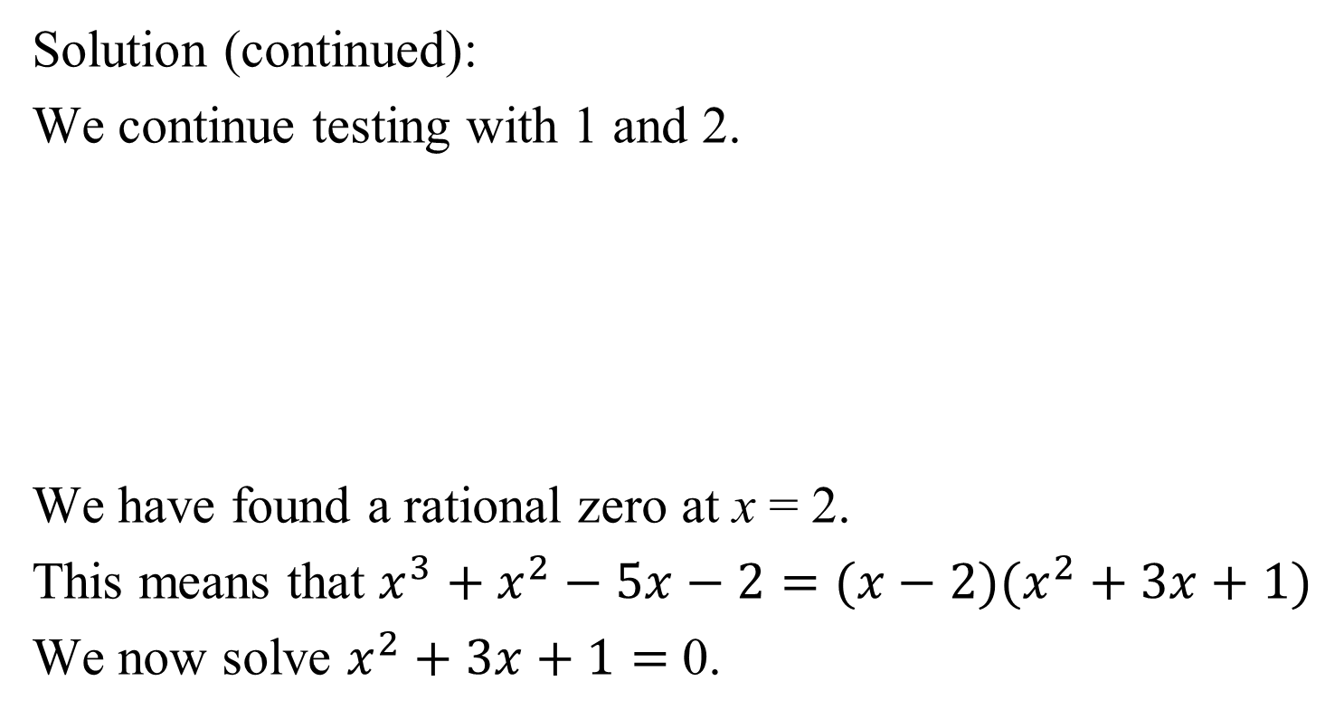
Example 4: Finding Zeros of a Polynomial Function
(continued)
Solution (continued):
We continue testing with 1 and 2.
We have found a rational zero at x = 2.
This means that $x^{3}+x^{2}−5x−2=(x−2)(x^{2}+3x+1)$
We now solve $x^{2}+3x+1=$ 0.
 |  | 1 | 2 | –3
 | 1 | 2 | –3 | –5
 |  | 2 | 6 | 2
 | 1 | 3 | 1 | 0
1 | 1 | 1 | –5 | –2
2 | 1 | 1 | –5 | –2

Slide 8


Example 4: Finding Zeros of a Polynomial Function
(continued)
We now solve $x^{2}+3x+1=$ 0.
$$x=\frac{−b±\sqrt{b^{2}−4ac}}{2a}=\frac{−3±\sqrt{3^{2}−4(1)(1)}}{2(1)}$$
The zeros are 2, $\frac{−3+\sqrt{5}}{2}$, $\frac{−3−\sqrt{5}}{2}.$
$$=\frac{−3±\sqrt{5}}{2}$$

Slide 9
Properties of Roots of Polynomial Equations
1. If a polynomial equation is of degree n, then counting multiple roots separately, the equation has n roots.
2. If a + bi is a root of a polynomial equation with real coefficients (b ≠ 0), then the imaginary number a – bi is also a root. Imaginary roots, if they exist, occur in conjugate pairs.

Slide 10
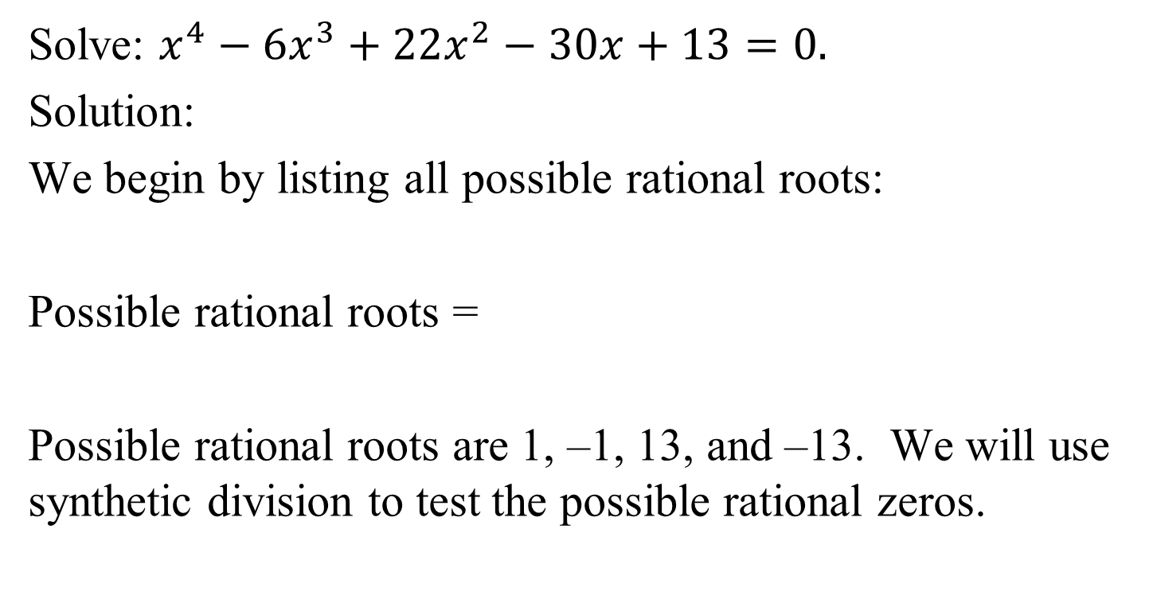

Example 5: Solving a Polynomial Equation
Solve: $x^{4}−6x^{3}+22x^{2}−30x+13=0.$
Solution:
We begin by listing all possible rational roots:
Possible rational roots =
Possible rational roots are 1, –1, 13, and –13. We will use synthetic division to test the possible rational zeros.
$$\frac{±1,±13}{±1}$$

Slide 11
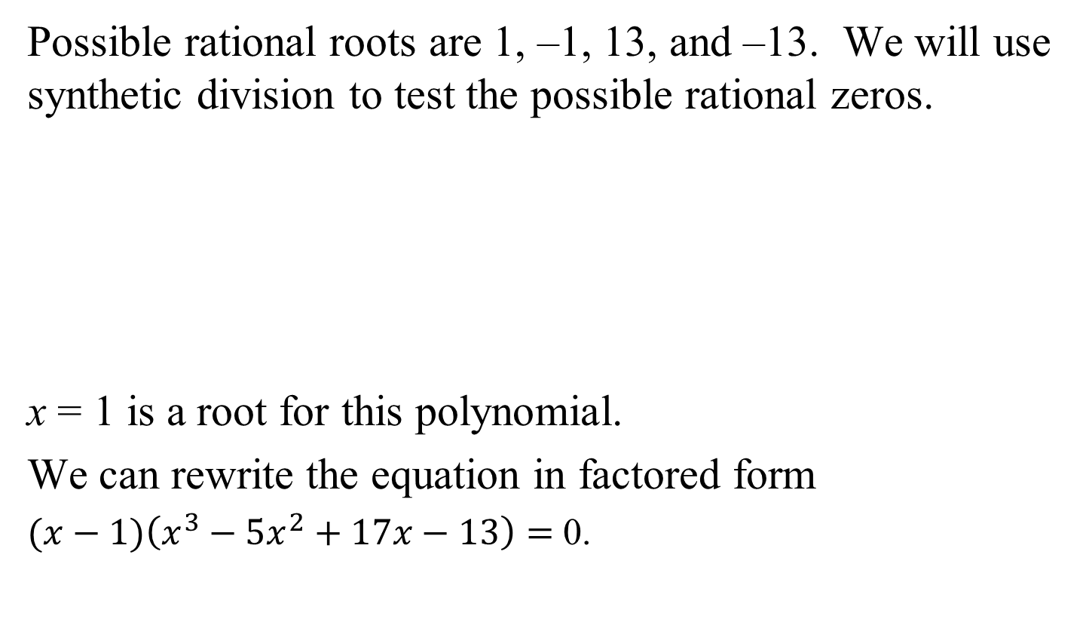
Example 5: Solving a Polynomial Equation
(continued)
Possible rational roots are 1, –1, 13, and –13. We will use synthetic division to test the possible rational zeros.
x = 1 is a root for this polynomial.
We can rewrite the equation in factored form
$(x−1)\left(x^{3}−5x^{2}+17x−13\right)=$ 0.
–1 | 1 | –6 | 22 | –30 | 13
1 | 1 | –6 | 22 | –30 | 13
 |  | –1 | 7 | –29 | 59
 | 1 | –7 | 29 | –59 | 72
 |  | 1 | –5 | 17 | –13
 | 1 | –5 | 17 | –13 | 0

Slide 12

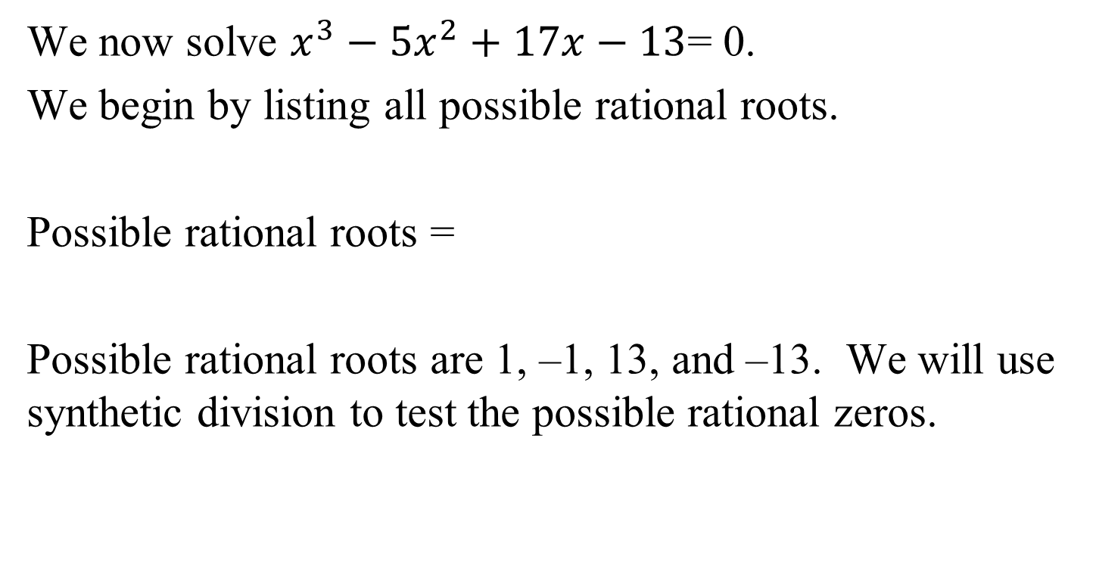
Example 5: Solving a Polynomial Equation
(continued)
We now solve $x^{3}−5x^{2}+17x−13$= 0.
We begin by listing all possible rational roots.
Possible rational roots =
Possible rational roots are 1, –1, 13, and –13. We will use synthetic division to test the possible rational zeros.
$$\frac{±1,±13}{±1}$$

Slide 13
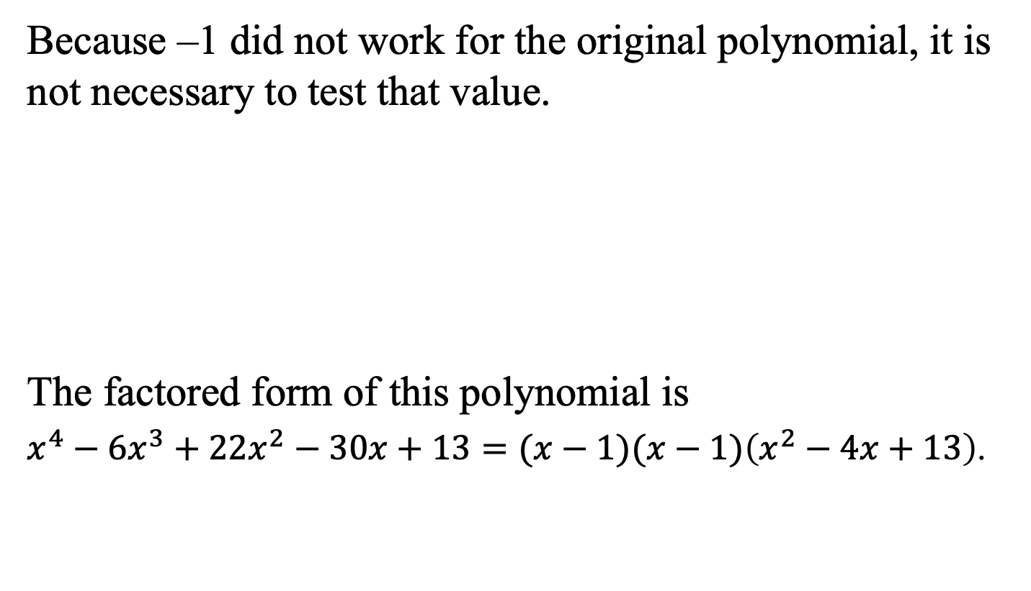
Example 5: Solving a Polynomial Equation
(continued)
Because –1 did not work for the original polynomial, it is not necessary to test that value.
The factored form of this polynomial is
$x^{4}−6x^{3}+22x^{2}−30x+13=(x−1)(x−1)\left(x^{2}−4x+13\right)$.
1 | 1 | –5 | 17 | –13
x = 1 is a (repeated) root
for this polynomial.
 |  | 1 | –4 | 13
 | 1 | –4 | 13 | 0

Slide 14
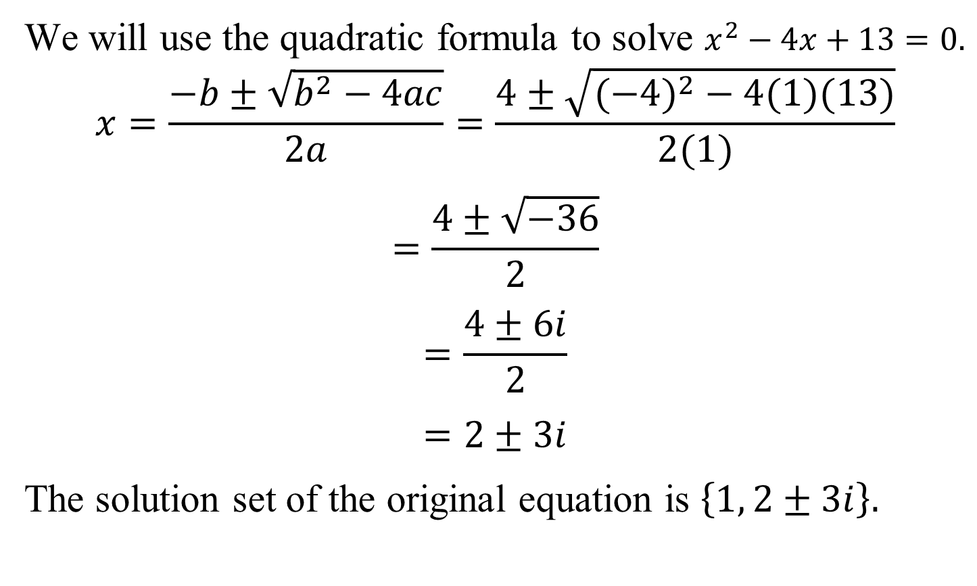
Example 5: Solving a Polynomial Equation
(continued)
We will use the quadratic formula to solve $x^{2}−4x+13=0.$
$$x=\frac{−b±\sqrt{b^{2}−4ac}}{2a}=\frac{4±\sqrt{({−4)}^{2}−4(1)(13)}}{2(1)}$$
$$=\frac{4±\sqrt{−36}}{2}$$
$$=\frac{4±6i}{2}$$
$$=2±3i$$
The solution set of the original equation is $\left\{1, 2±3i\right\}.$

Slide 15

The Fundamental Theorem of Algebra
If f(x) is a polynomial of degree n, where $n≥1$, then the equation f(x) = 0 has at least one complex root.

Slide 16
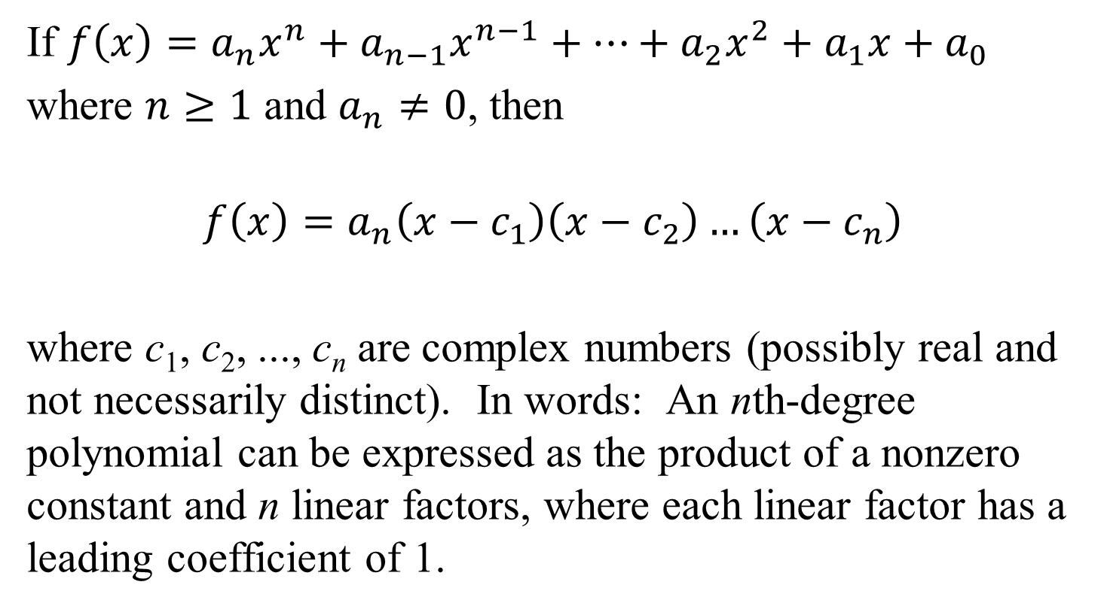
The Linear Factorization Theorem
If $f\left(x\right)=a_{n}x^{n}+a_{n−1}x^{n−1}+…+a_{2}x^{2}+a_{1}x+a_{0}$
where $n≥1$ and $a_{n}≠0$, then
$$f\left(x\right)=a_{n}\left(x−c_{1}\right)\left(x−c_{2}\right)…\left(x−c_{n}\right)$$
where c₁, c₂, ..., c_{n} are complex numbers (possibly real and not necessarily distinct). In words: An nth-degree polynomial can be expressed as the product of a nonzero constant and n linear factors, where each linear factor has a leading coefficient of 1.

Slide 17
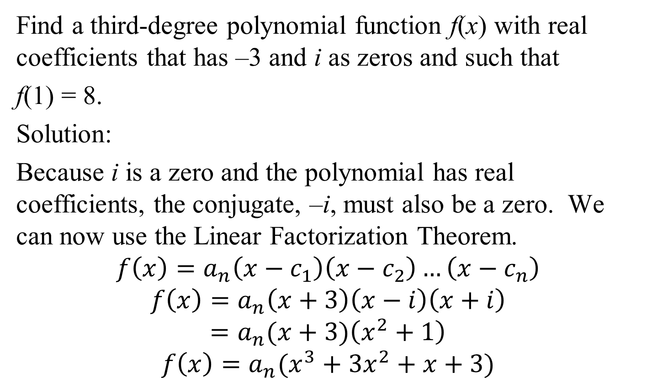
Example 6: Finding a Polynomial Function with Given Zeros
Find a third-degree polynomial function f(x) with real coefficients that has –3 and i as zeros and such that
f(1) = 8.
Solution:
Because i is a zero and the polynomial has real coefficients, the conjugate, –i, must also be a zero. We can now use the Linear Factorization Theorem.
$$f\left(x\right)=a_{n}\left(x−c_{1}\right)\left(x−c_{2}\right)…\left(x−c_{n}\right)$$
$$f\left(x\right)=a_{n}\left(x+3\right)\left(x−i\right)\left(x+i\right)$$
$$=a_{n}(x+3)\left(x^{2}+1\right)$$
$$f\left(x\right)=a_{n}(x^{3}+3x^{2}+x+3)$$

Slide 18
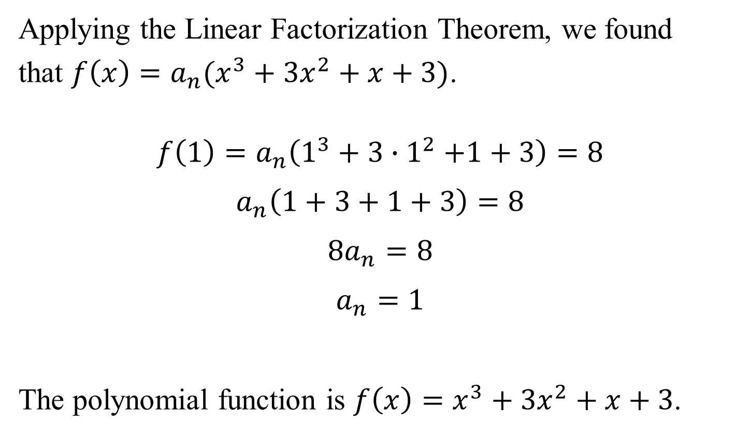
Example 6: Finding a Polynomial Function with Given Zeros (continued)
Applying the Linear Factorization Theorem, we found
that $f\left(x\right)=a_{n}(x^{3}+3x^{2}+x+3)$.
$$f\left(1\right)=a_{n}\left(1^{3}+3{∙1}^{2}+1+3\right)=8$$
$$a_{n}\left(1+3+1+3\right)=8$$
$${8a}_{n}=8$$
$$a_{n}=1$$
The polynomial function is $f\left(x\right)=x^{3}+3x^{2}+x+3$.

Slide 19
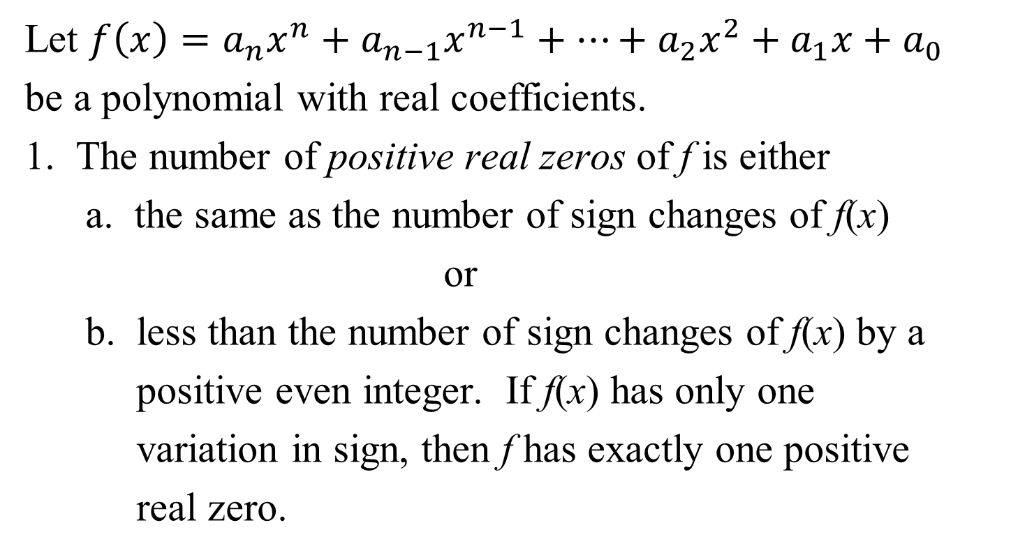
Descartes’s Rule of Signs
Let $f\left(x\right)=a_{n}x^{n}+a_{n−1}x^{n−1}+…+a_{2}x^{2}+a_{1}x+a_{0}$
be a polynomial with real coefficients.
1. The number of positive real zeros of f is either
a. the same as the number of sign changes of f(x)
or
b. less than the number of sign changes of f(x) by a
positive even integer. If f(x) has only one
variation in sign, then f has exactly one positive
real zero.

Slide 20
Descartes’ Rule of Signs (continued)
2. The number of negative real zeros of f is either
a. The same as the number of sign changes in f(–x)
or
b. less than the number of sign changes in f(–x) by
a positive even integer. If f(–x) has only one
variation in sign, then f has exactly one negative
real zero.

Slide 21
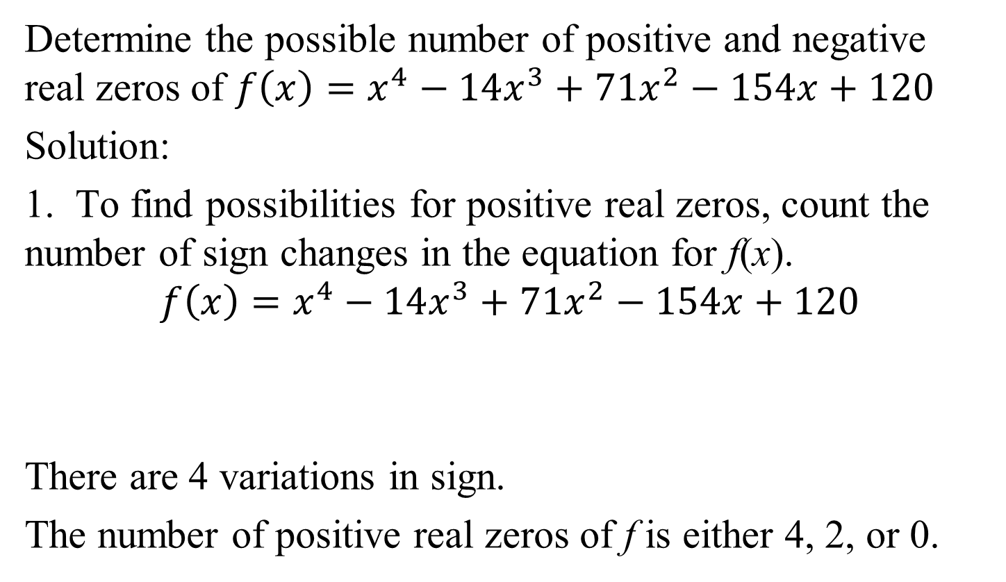
Example 7: Using Descartes’s Rule of Signs
Determine the possible number of positive and negative real zeros of $f\left(x\right)=x^{4}−14x^{3}+71x^{2}−154x+120$
Solution:
1. To find possibilities for positive real zeros, count the number of sign changes in the equation for f(x).
$$f\left(x\right)=x^{4}−14x^{3}+71x^{2}−154x+120$$
There are 4 variations in sign.
The number of positive real zeros of f is either 4, 2, or 0.
sign change
sign change
sign change
sign change

Slide 22
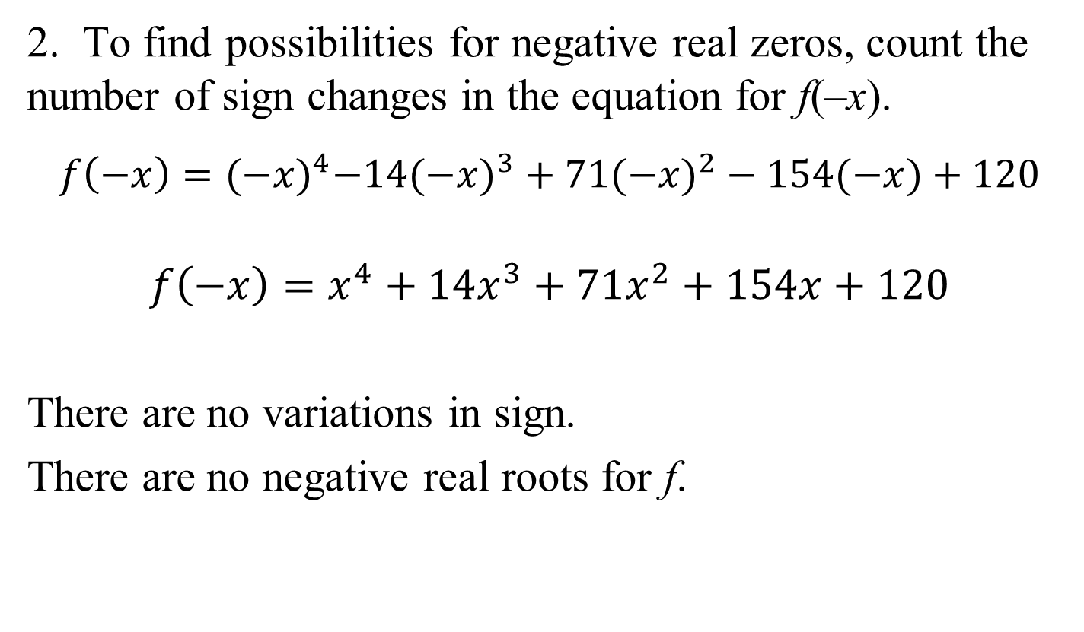
Example 7: Using Descartes’ Rule of Signs
2. To find possibilities for negative real zeros, count the number of sign changes in the equation for f(–x).
$$f\left(−x\right)={(−x)}^{4}−14({−x)}^{3}+71(−{x)}^{2}−154(−x)+120$$
$$f\left(−x\right)=x^{4}+14x^{3}+71x^{2}+154x+120$$
There are no variations in sign.
There are no negative real roots for f.

