Slide 1

Chapter 3
Polynomial and Rational Functions
3.1 Quadratic Functions

Slide 2
Objectives
Recognize characteristics of parabolas.
Graph parabolas.
Determine a quadratic function’s minimum or maximum value.
Solve problems involving a quadratic function’s minimum or maximum value.

Slide 3
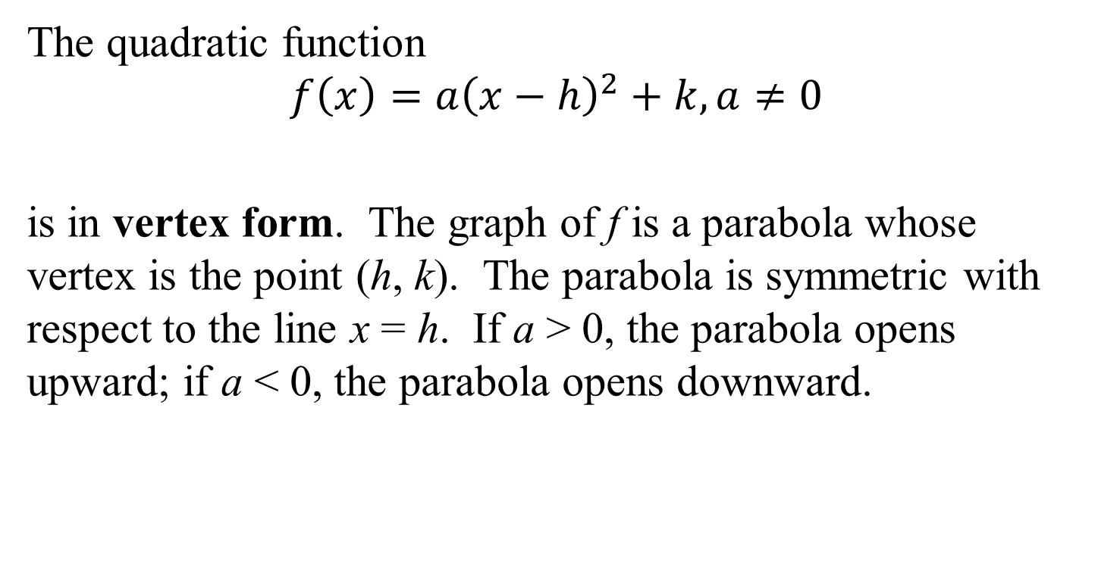
The Standard Form of a Quadratic Function
The quadratic function
$$f\left(x\right)=a{\left(x−h\right)}^{2}+k, a≠0$$
is in vertex form. The graph of f is a parabola whose vertex is the point (h, k). The parabola is symmetric with respect to the line x = h. If a > 0, the parabola opens upward; if a < 0, the parabola opens downward.

Slide 4
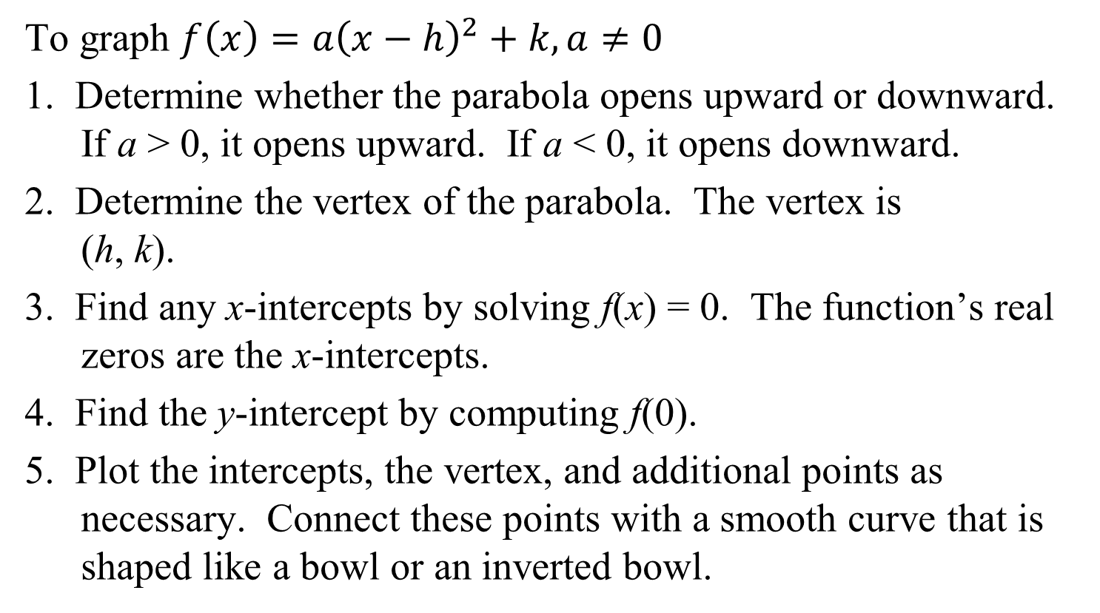
Graphing Quadratic Functions with Equations in Vertex Form
To graph $f\left(x\right)=a{\left(x−h\right)}^{2}+k, a≠0$
1. Determine whether the parabola opens upward or downward. If a > 0, it opens upward. If a < 0, it opens downward.
2. Determine the vertex of the parabola. The vertex is
(h, k).
3. Find any x-intercepts by solving f(x) = 0. The function’s real zeros are the x-intercepts.
4. Find the y-intercept by computing f(0).
5. Plot the intercepts, the vertex, and additional points as necessary. Connect these points with a smooth curve that is shaped like a bowl or an inverted bowl.

Slide 5
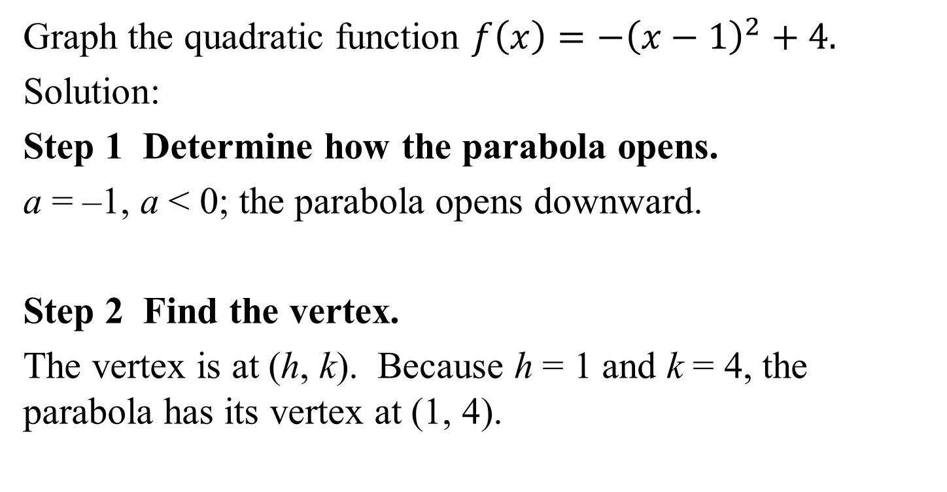
Example 1: Graphing a Quadratic Function in Vertex Form
Graph the quadratic function $f\left(x\right)=−{\left(x−1\right)}^{2}+4.$
Solution:
Step 1 Determine how the parabola opens.
a = –1, a < 0; the parabola opens downward.
Step 2 Find the vertex.
The vertex is at (h, k). Because h = 1 and k = 4, the parabola has its vertex at (1, 4).

Slide 6
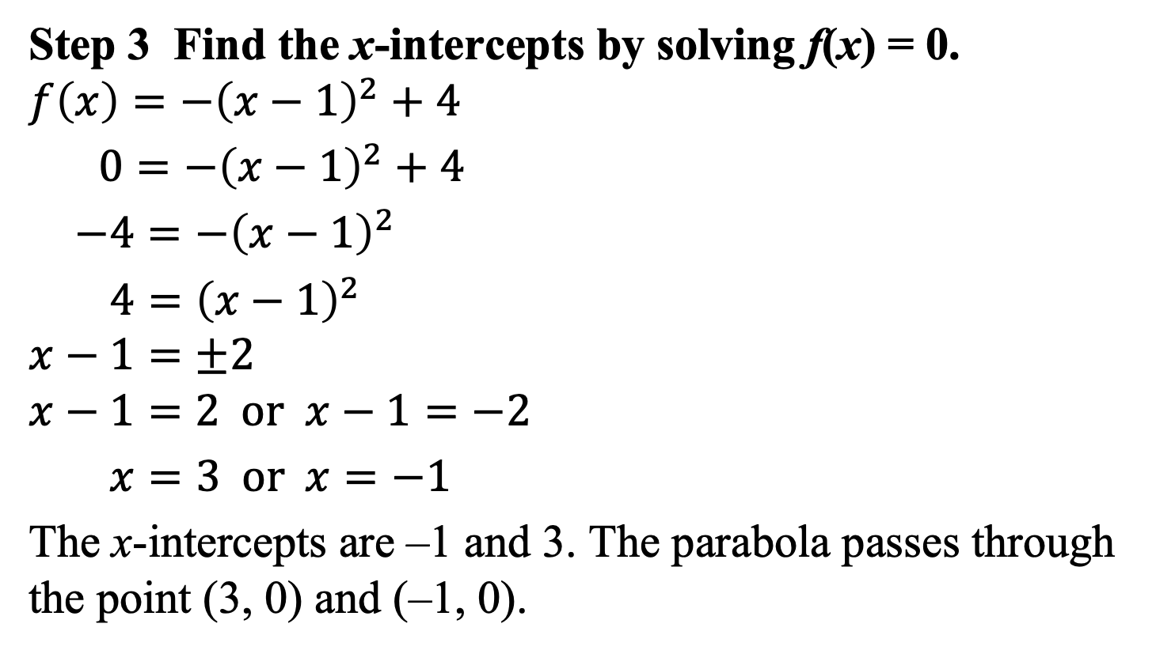
Example 1: Graphing a Quadratic Function in Vertex Form (continued)
Step 3 Find the x-intercepts by solving f(x) = 0.
$$f\left(x\right)=−{\left(x−1\right)}^{2}+4$$
$0=−{\left(x−1\right)}^{2}+4$
$−4=−{\left(x−1\right)}^{2}$
$4={\left(x−1\right)}^{2}$
$$x−1=±2$$
$$x−1=2 or x−1=−2$$
$x=3 or x=−1$
The x-intercepts are –1 and 3. The parabola passes through the point (3, 0) and (–1, 0).

Slide 7
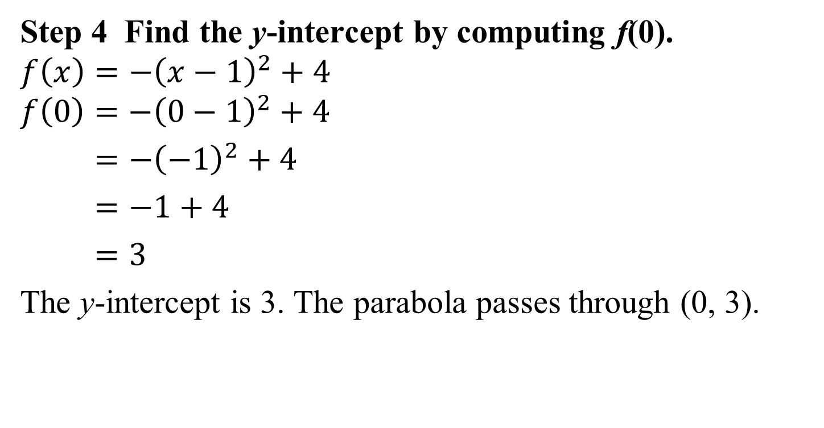
Example 1: Graphing a Quadratic Function in Vertex Form (continued)
Step 4 Find the y-intercept by computing f(0).
$$f\left(x\right)=−{\left(x−1\right)}^{2}+4$$
$$f\left(0\right)=−{\left(0−1\right)}^{2}+4$$
$=−{\left(−1\right)}^{2}+4$
$=−1+4$
$=3$
The y-intercept is 3. The parabola passes through (0, 3).

Slide 8

Example 1: Graphing a Quadratic Function in Vertex Form (continued)
Graph: $f\left(x\right)=−{\left(x−1\right)}^{2}+4$.
The parabola opens downward.
The x-intercepts are –1 and 3.
The y-intercept is 3.
The vertex is (1, 4).

Slide 9
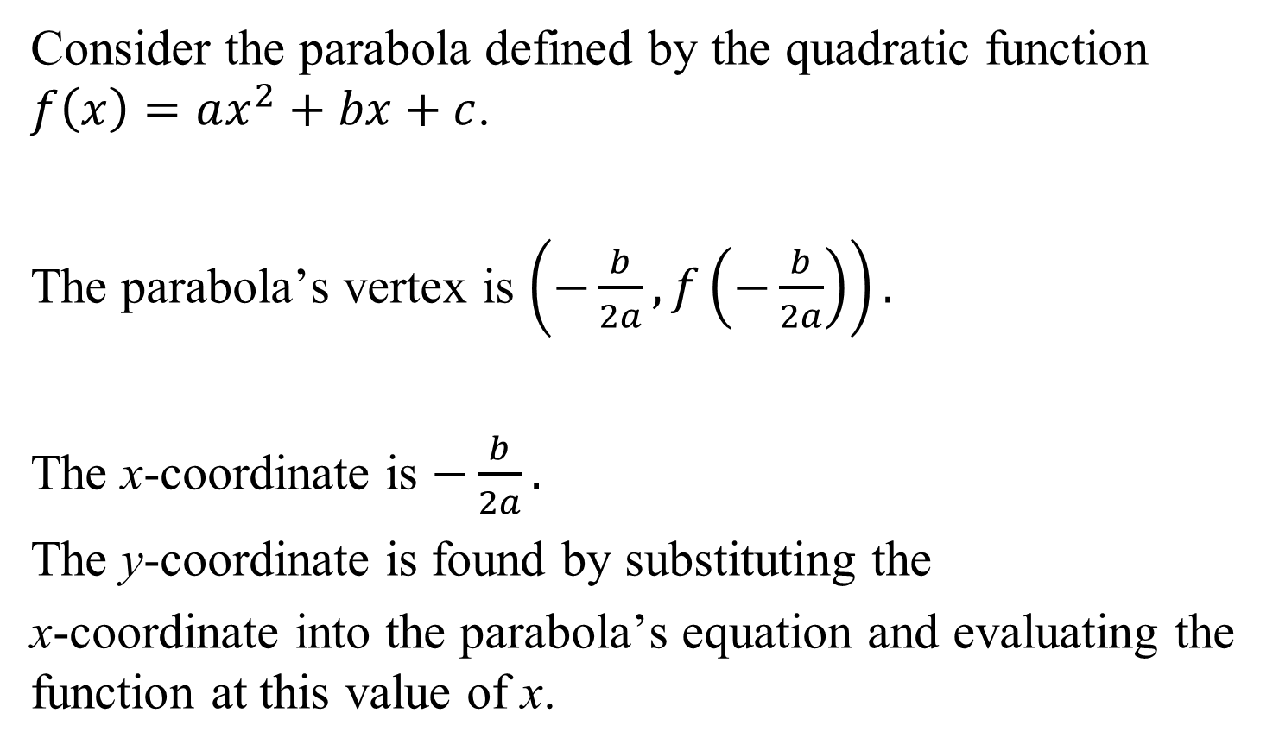
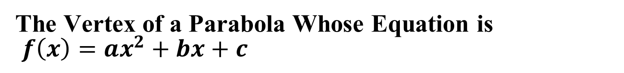
The Vertex of a Parabola Whose Equation is
$f\left(x\right)=ax^{2}+bx+c$
Consider the parabola defined by the quadratic function $f\left(x\right)=ax^{2}+bx+c$.
The parabola’s vertex is $\left(−\frac{b}{2a},f\left(−\frac{b}{2a}\right)\right).$
The x-coordinate is $−\frac{b}{2a}.$
The y-coordinate is found by substituting the
x-coordinate into the parabola’s equation and evaluating the function at this value of x.

Slide 10
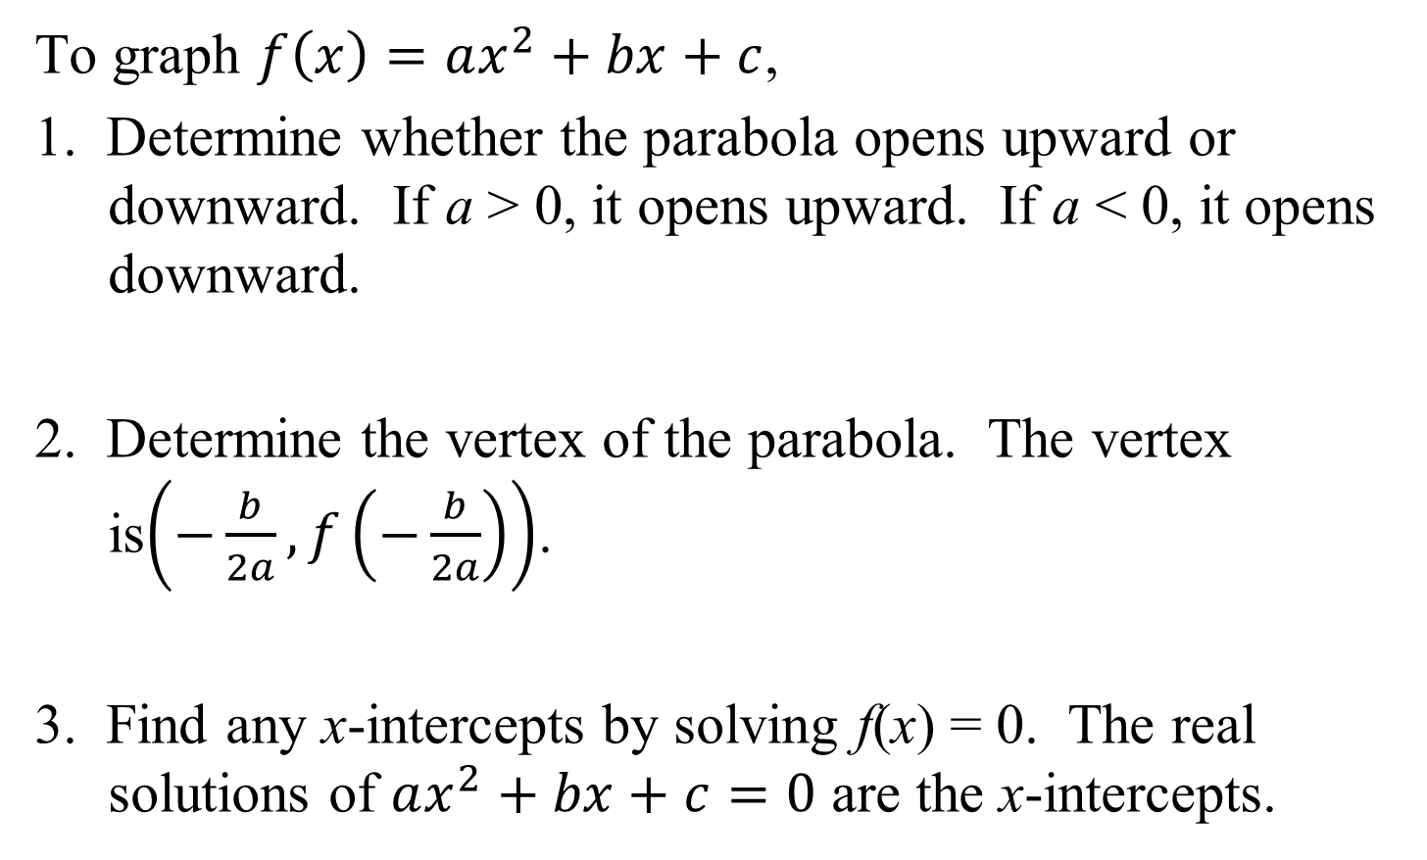

Graphing Quadratic Functions with Equations in the Form$f\left(x\right)=ax^{2}+bx+c$
To graph $f\left(x\right)=ax^{2}+bx+c$,
1. Determine whether the parabola opens upward or downward. If a > 0, it opens upward. If a < 0, it opens downward.
2. Determine the vertex of the parabola. The vertex is$\left(−\frac{b}{2a},f\left(−\frac{b}{2a}\right)\right)$.
3. Find any x-intercepts by solving f(x) = 0. The real solutions of $ax^{2}+bx+c=0$ are the x-intercepts.

Slide 11

Graphing Quadratic Functions with Equations in the Form$f\left(x\right)=ax^{2}+bx+c$ (continued)
4. Find the y-intercept by computing f(0). Because f(0) = c (the constant term in the function’s equation), the
y-intercept is c and the parabola passes through (0, c).
5. Plot the intercepts, the vertex, and additional points as necessary. Connect these points with a smooth curve.

Slide 12
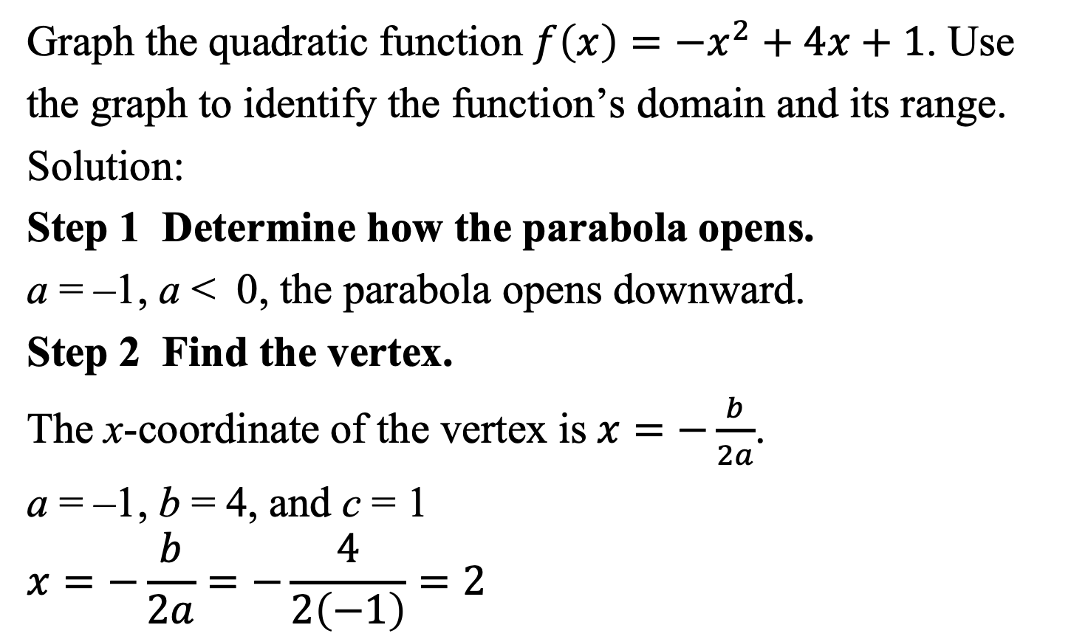

Example 3: Graphing a Quadratic Function in the Form $f\left(x\right)=ax^{2}+bx+c$
Graph the quadratic function $f\left(x\right)=−x^{2}+4x+1$. Use
the graph to identify the function’s domain and its range.
Solution:
Step 1 Determine how the parabola opens.
a = –1, a < 0, the parabola opens downward.
Step 2 Find the vertex.
The x-coordinate of the vertex is$x=−\frac{b}{2a}$.
a = –1, b = 4, and c = 1
$$x=−\frac{b}{2a}=−\frac{4}{2\left(−1\right)}=2$$

Slide 13
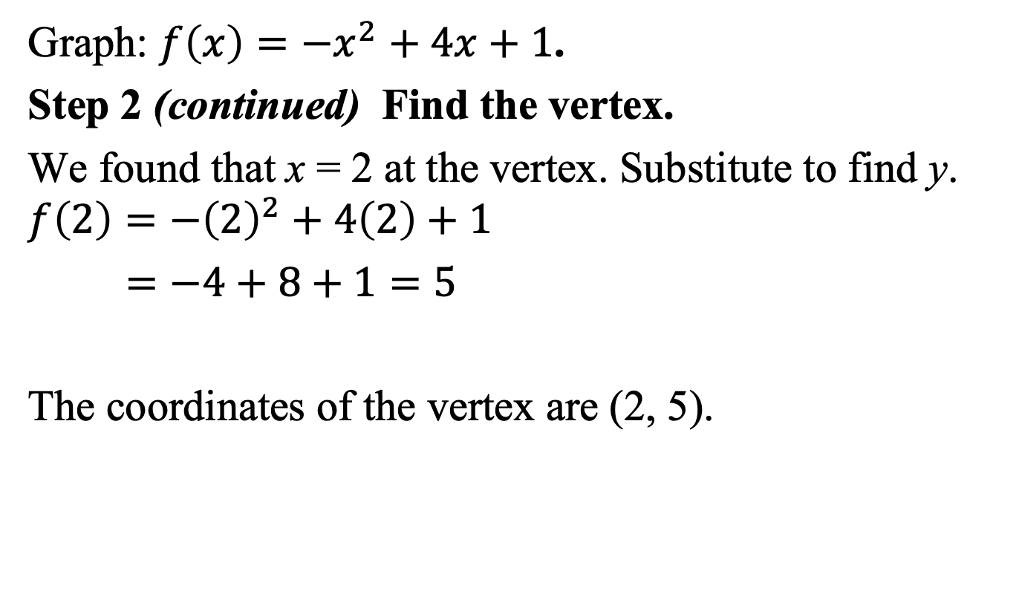

Example 3: Graphing a Quadratic Function in the Form $f\left(x\right)=ax^{2}+bx+c$ (continued)
Graph: $f\left(x\right)=−x^{2}+4x+1$.
Step 2 (continued) Find the vertex.
We found that x = 2 at the vertex. Substitute to find y.
$$f\left(2\right)=−{\left(2\right)}^{2}+4\left(2\right)+1$$
$=−4+8+1=5$
The coordinates of the vertex are (2, 5).

Slide 14
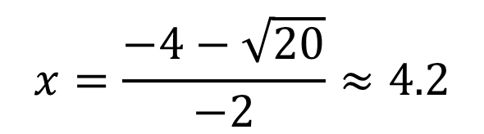
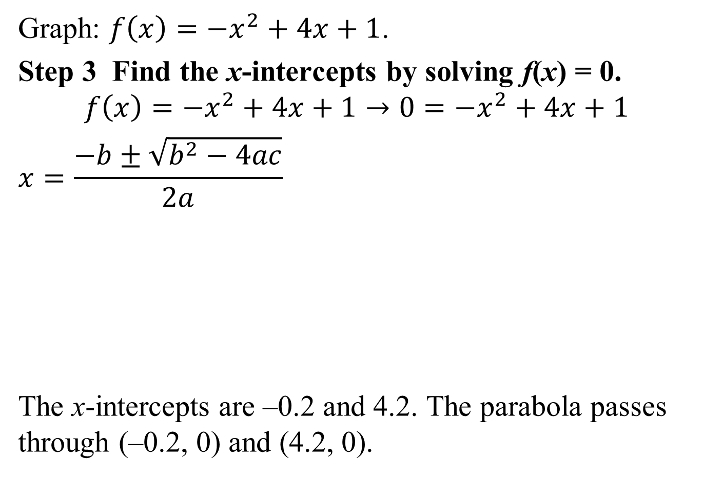
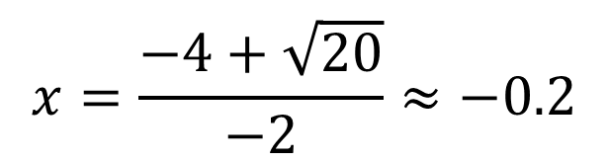


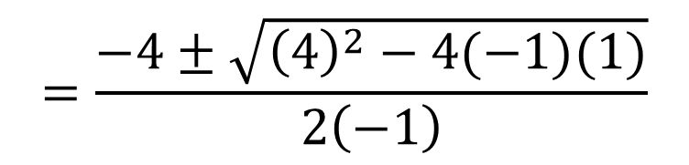
Example 3: Graphing a Quadratic Function in the Form $f\left(x\right)=ax^{2}+bx+c$ (continued)
Graph: $f\left(x\right)=−x^{2}+4x+1$.
Step 3 Find the x-intercepts by solving f(x) = 0.
$$f\left(x\right)=−x^{2}+4x+1→0=−x^{2}+4x+1$$
$$x=\frac{−b±\sqrt{b^{2}−4ac}}{2a}$$
The x-intercepts are –0.2 and 4.2. The parabola passes through (–0.2, 0) and (4.2, 0).
$$=\frac{−4±\sqrt{{\left(4\right)}^{2}−4(−1)(1)}}{\left.2 ( −1\right)}$$
$$=\frac{−4±\sqrt{16+4}}{−2}$$
$$=\frac{−4±\sqrt{20}}{−2}$$
$$x=\frac{−4+\sqrt{20}}{−2}≈−0.2$$
$$x=\frac{−4−\sqrt{20}}{−2}≈4.2$$

Slide 15
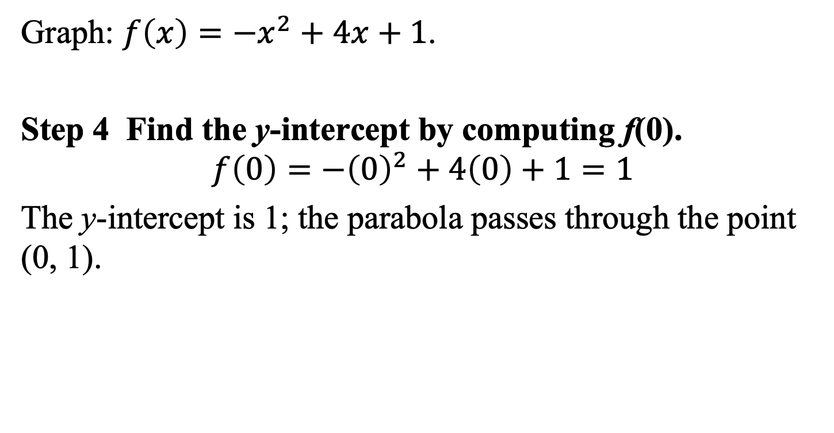
Example 3: Graphing a Quadratic Function in the Form $f\left(x\right)=ax^{2}+bx+c$ (continued)
Graph: $f\left(x\right)=−x^{2}+4x+1$.
Step 4 Find the y-intercept by computing f(0).
$$f\left(0\right)=−{\left(0\right)}^{2}+4\left(0\right)+1=1$$
The y-intercept is 1; the parabola passes through the point (0, 1).

Slide 16

Example 3: Graphing a Quadratic Function in the Form $f\left(x\right)=ax^{2}+bx+c$ (continued)
Graph: $f\left(x\right)=−x^{2}+4x+1$.
Step 5 Graph the parabola.
The graph passes through
the x-intercepts at (–0.2, 0)
and (4.2, 0).
The graph passes through
the y-intercept at (0, 1).
The vertex is (2, 5).
The axis of symmetry is x = 2.

Slide 17


Example 3: Graphing a Quadratic Function in the Form $f\left(x\right)=ax^{2}+bx+c$ (continued)
Graph: $f\left(x\right)=−x^{2}+4x+1$. Use the graph to identify the function’s domain and its range.
The domain is $\left(−∞, ∞\right).$
The range is $\left(−∞, \right.\left.5\right]$.

Slide 18
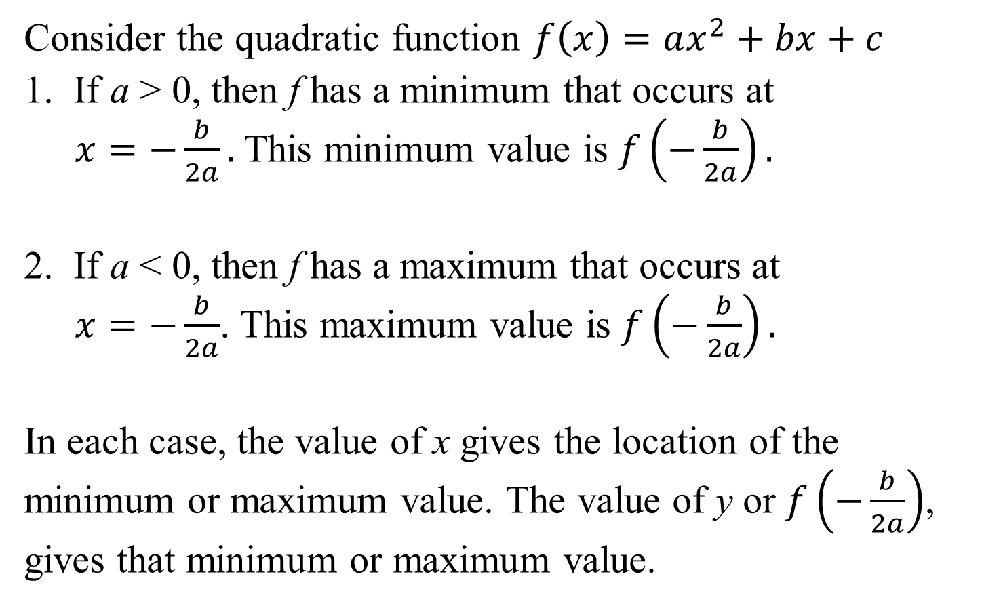
Minimum and Maximum: Quadratic Functions
Consider the quadratic function $f\left(x\right)=ax^{2}+bx+c$
1. If a > 0, then f has a minimum that occurs at
$x=−\frac{b}{2a}.$This minimum value is $f\left(−\frac{b}{2a}\right).$
2. If a < 0, then f has a maximum that occurs at
$x=−\frac{b}{2a}$. This maximum value is $f\left(−\frac{b}{2a}\right).$
In each case, the value of x gives the location of the minimum or maximum value. The value of y or $f\left(−\frac{b}{2a}\right)$, gives that minimum or maximum value.

Slide 19
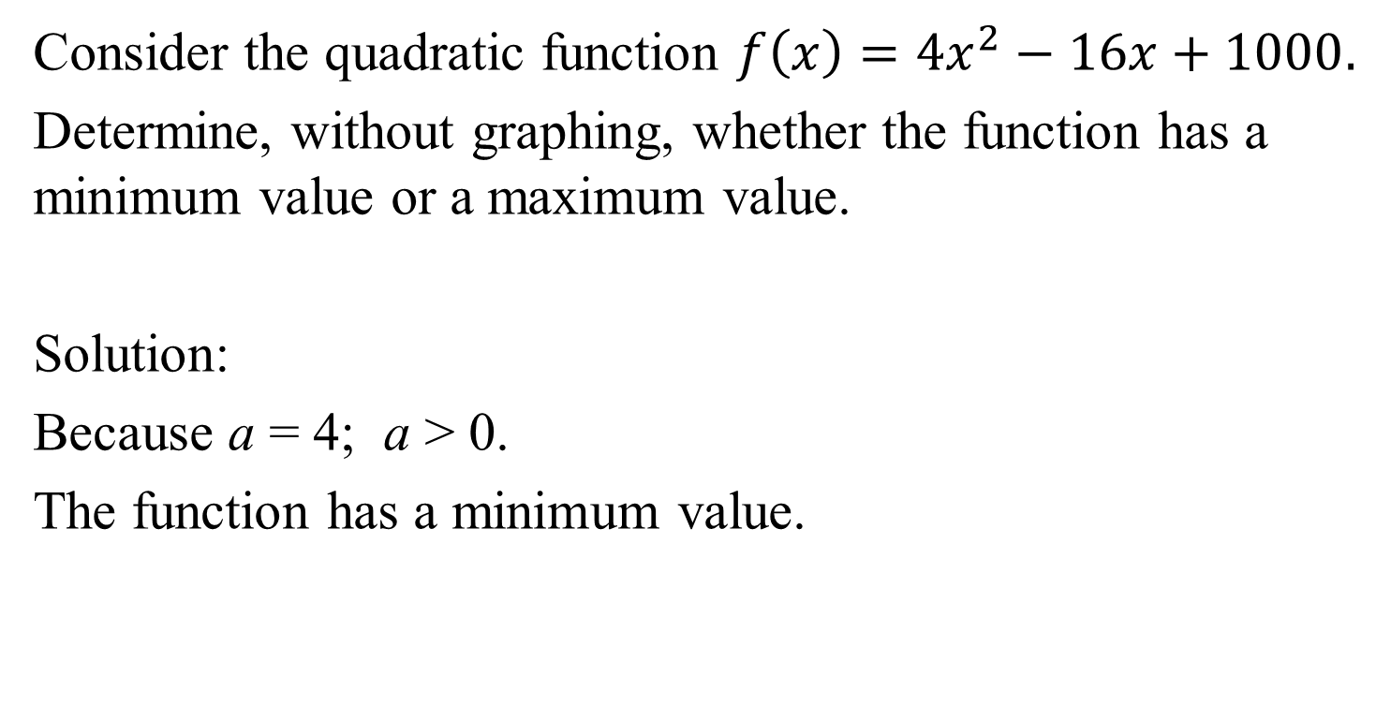
Example 4a: Obtaining Information about a Quadratic Function from Its Equation
Consider the quadratic function $f\left(x\right)=4x^{2}−16x+1000.$
Determine, without graphing, whether the function has a minimum value or a maximum value.
Solution:
Because a = 4; a > 0.
The function has a minimum value.

Slide 20
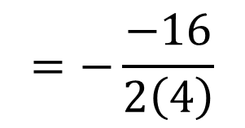
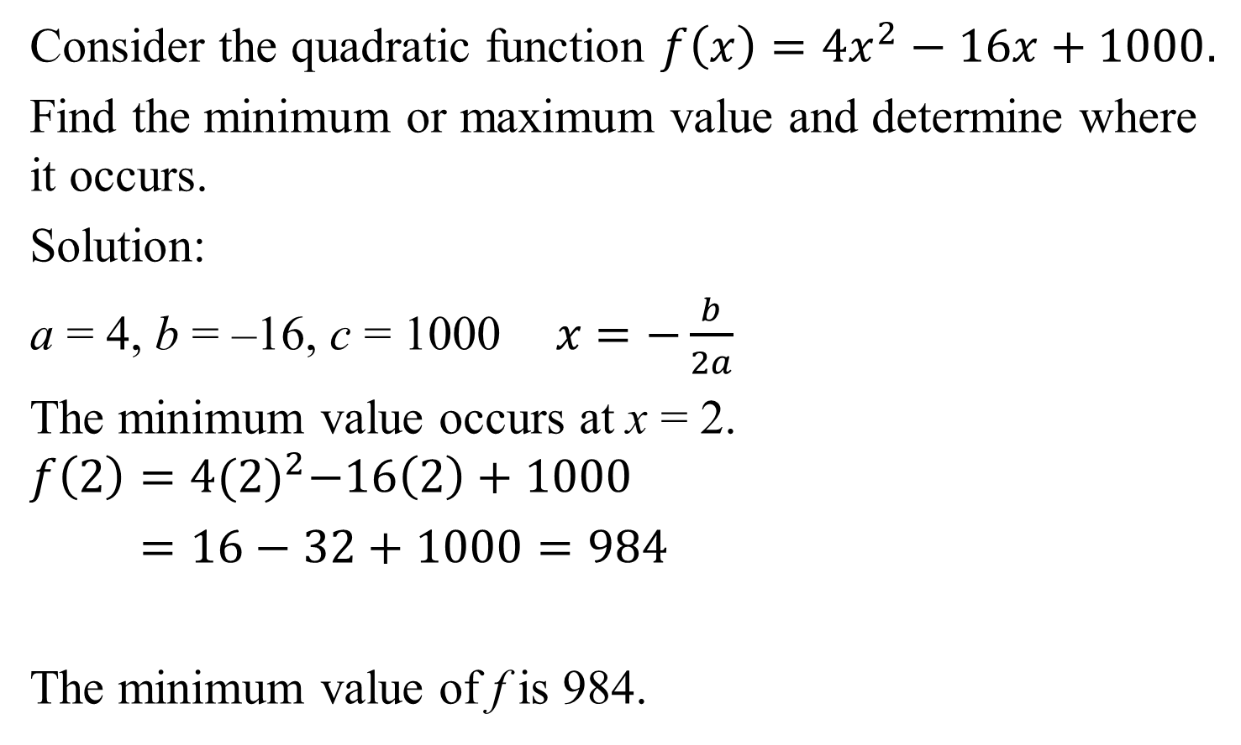

Example 4b: Obtaining Information about a Quadratic Function from Its Equation (continued)
Consider the quadratic function $f\left(x\right)=4x^{2}−16x+1000.$
Find the minimum or maximum value and determine where it occurs.
Solution:
a = 4, b = –16, c = 1000$x=−\frac{b}{2a}$
The minimum value occurs at x = 2.
$$f\left(2\right)=4{(2)}^{2}−16\left(2\right)+1000$$
$=16−32+1000=984$
The minimum value of f is 984.
$$=−\frac{−16}{\left.2 ( 4\right)}$$
$$=\frac{16}{8}=2$$

Slide 21
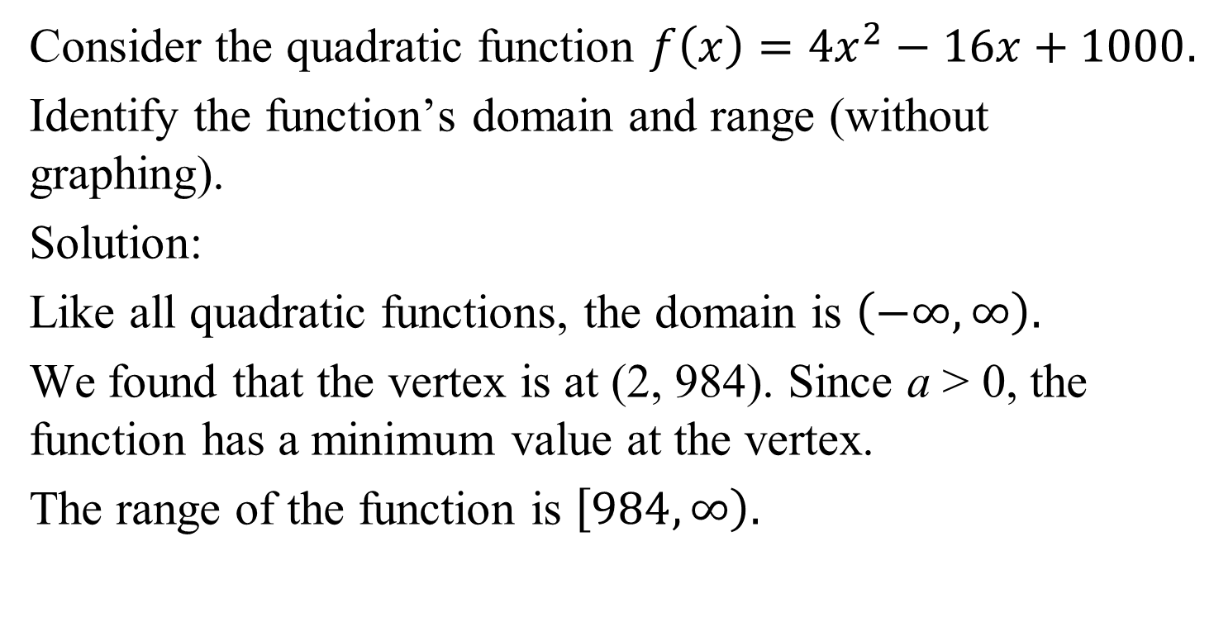
Example 4c: Obtaining Information about a Quadratic Function from Its Equation (continued)
Consider the quadratic function $f\left(x\right)=4x^{2}−16x+1000.$
Identify the function’s domain and range (without graphing).
Solution:
Like all quadratic functions, the domain is $\left(−∞,∞\right).$
We found that the vertex is at (2, 984). Since a > 0, the function has a minimum value at the vertex.
The range of the function is $\left[984, ∞\right).$

Slide 22
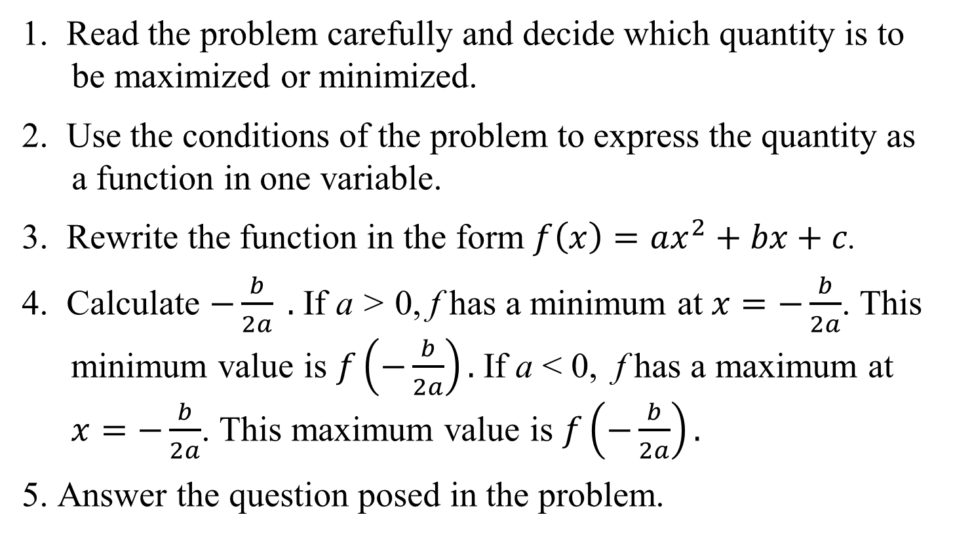
Strategy for Solving Problems Involving Maximizing or Minimizing Quadratic Functions
1. Read the problem carefully and decide which quantity is to be maximized or minimized.
2. Use the conditions of the problem to express the quantity as a function in one variable.
3. Rewrite the function in the form $f\left(x\right)=ax^{2}+bx+c$.
4. Calculate $−\frac{b}{2a} .$ If a > 0, f has a minimum at $x=−\frac{b}{2a}$. This minimum value is $f\left(−\frac{b}{2a}\right).$If a < 0, f has a maximum at $x=−\frac{b}{2a}$. This maximum value is $f\left(−\frac{b}{2a}\right).$
5. Answer the question posed in the problem.

Slide 23
Example 7: Maximizing Area
You have 120 feet of fencing to enclose a rectangular region. Find the dimensions of the rectangle that maximize the enclosed area. What is the maximum area?
Solution:
Step 1 Decide what must be maximized or minimized.
We must maximize area. We do not know the dimensions of the rectangular region.

Slide 24





Example 7: Maximizing Area (continued)
Step 2 Express this quantity as a function in one variable.
We must maximize the area of the rectangle, A = xy.
We have 120 feet of fencing, so the perimeter of the rectangle is 120. 2x + 2y = 120
Solve this equation for y:
$$2y=120−2x$$
$$y=\frac{120−2x}{2}$$
$$A=xy$$
$$=60−x$$
$$A(x)=x(60−x)$$

Slide 25


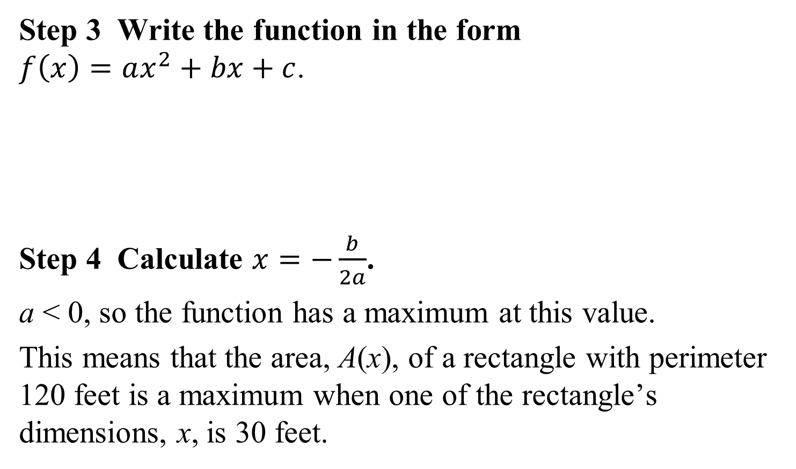



Example 7: Maximizing Area (continued)
Step 3 Write the function in the form
$f\left(x\right)=ax^{2}+bx+c$.
Step 4 Calculate $x=−\frac{b}{2a}$.
a < 0, so the function has a maximum at this value.
This means that the area, A(x), of a rectangle with perimeter 120 feet is a maximum when one of the rectangle’s dimensions, x, is 30 feet.
$$A(x)=x(60−x)$$
$$A(x)=60x−x^{2}$$
$$A(x)=−x^{2}+60x$$
$$x=−\frac{60}{\left.2 ( −1\right)}$$
$$=30$$

Slide 26
Example 7: Maximizing Area (continued)
Step 5 Answer the question posed by the problem.
You have 120 feet of fencing to enclose a rectangular region. Find the dimensions of the rectangle that maximize the enclosed area. What is the maximum area? The other dimension is y = 60 – 30 = 30 ft.
The rectangle that gives the maximum area has dimensions 30 ft by 30 ft.
The maximum area is (30)(30) = 900 square feet.

