Slide 1

Chapter 2
Functions and Graphs
2.3 Linear Functions and Slope

Slide 2
Objectives
Calculate a line’s slope.
Write the point-slope form of the equation of a line.
Write and graph the slope-intercept form of the equation of a line.
Graph horizontal or vertical lines.
Recognize and use the general form of a line’s equation.
Use intercepts to graph the general form of a line’s equation.
Model data with linear functions and make predictions.

Slide 3
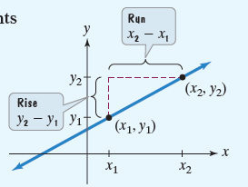

Definition of Slope
The slope of the line through the distinct points
$\left(x_{1},y_{1}\right)$ and $\left(x_{2},y_{2}\right)$ is
$$\frac{Change in y}{Change in x}=\frac{rise}{run}$$
$$=\frac{y_{2}−y_{1}}{x_{2}−x_{1}}$$
where $x_{2}−x_{1}≠0.$
Vertical change
Horizontal change

Slide 4

Example 1b: Using the Definition of Slope
Find the slope of the line passing through the points
(4, –2) and (–1, 5)
Solution:
$$m=\frac{y_{2}−y_{1}}{x_{2}−x_{1}}$$
$$=\frac{5−(−2)}{−1−4}$$
$$=\frac{7}{−5}=−\frac{7}{5}$$

Slide 5

Point-Slope Form of the Equation of a Line
The point-slope form of the equation of a nonvertical line with slope m that passes through the point $\left(x_{1},y_{1}\right)$ is
$$y−y_{1}=m\left(x−x_{1}\right).$$

Slide 6
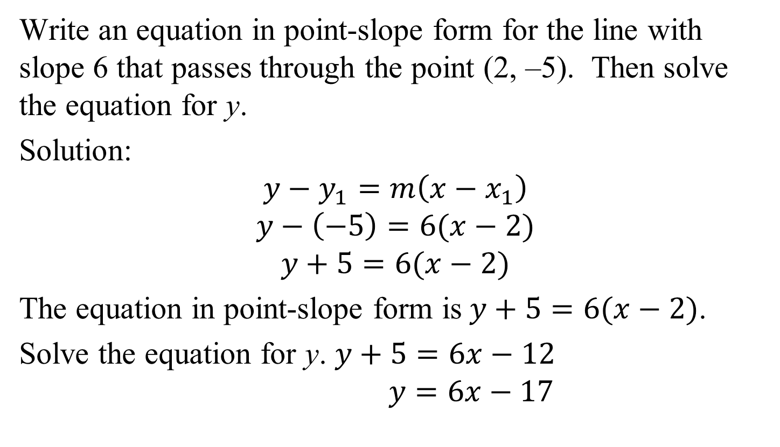
Example 2: Writing an Equation in Point-Slope Form
Write an equation in point-slope form for the line with slope 6 that passes through the point (2, –5). Then solve the equation for y.
Solution:
$$y−y_{1}=m\left(x−x_{1}\right)$$
$$y−\left(−5\right)=6(x−2)$$
$$y+5=6(x−2)$$
The equation in point-slope form is$y+5=6(x−2)$.
Solve the equation for y. $y+5=6x−12$
$$y=6x−17$$

Slide 7

Slope-Intercept Form of the Equation of a Line
The slope-intercept form of the equation of a nonvertical line with slope m and y-intercept b is
$$y=mx+b.$$

Slide 8

Graphing $y=mx+b$Using the Slope and y-Intercept
1. Plot the point containing the y-intercept on the
y-axis. This is the point (0, b).
2. Obtain a second point using the slope, m. Write m as a fraction, and use rise over run, starting at the point containing the y-intercept, to plot this point.
3. Use a straightedge to draw a line through the two points. Draw arrowheads at the ends of the line to show that the line continues indefinitely in both directions.

Slide 9

Example 4: Graphing Using the Slope and y-Intercept
Graph the linear function: $f\left(x\right)=\frac{3}{5}x+1.$
Solution:
Step 1 Plot the point containing the y-intercept on the y-axis.
The y-intercept is 1.
We plot the point (0, 1)

Slide 10

Example 4: Graphing Using the Slope and y-Intercept
(continued)
Step 2 Obtain a second point using the slope, m. Write m as a fraction, and use rise over run, starting at the point containing the y-intercept, to plot this point.
$$m=\frac{3}{5}$$
run = 5
rise = 3
y-intercept=1
We plot the
point (5, 4)

Slide 11

Example 4: Graphing Using the Slope and y-Intercept
(continued)
Step 3 Use a straightedge to draw a line through the two points. Draw arrowheads at the ends of the line to show that the line continues indefinitely in both directions.
run = 5
$$m=\frac{3}{5}$$
rise = 3
y-intercept=1
We plot the
point (5, 4)

Slide 12

Equation of a Horizontal Line
A horizontal line is given by an equation of the form
$y=b,$
where b is the y-intercept of the line.
The slope of a horizontal line is zero.

Slide 13

Example 5: Graphing a Horizontal Line
Graph $y=3$ in the rectangular coordinate system.
Solution:
All ordered pairs that are solutions
have a value of y that is
always 3.
x | y
–2 | 3
0 | 3
2 | 3

Slide 14

Equation of a Vertical Line
A vertical line is given by an equation of the form
$x=a,$
where a is the x-intercept of the line.
The slope of a vertical line is undefined.

Slide 15

General Form of the Equation of a Line
Every line has an equation that can be written in the general form
$Ax+By+C=0$
where A, B, and C are real numbers, and A and B are not both zero.

Slide 16

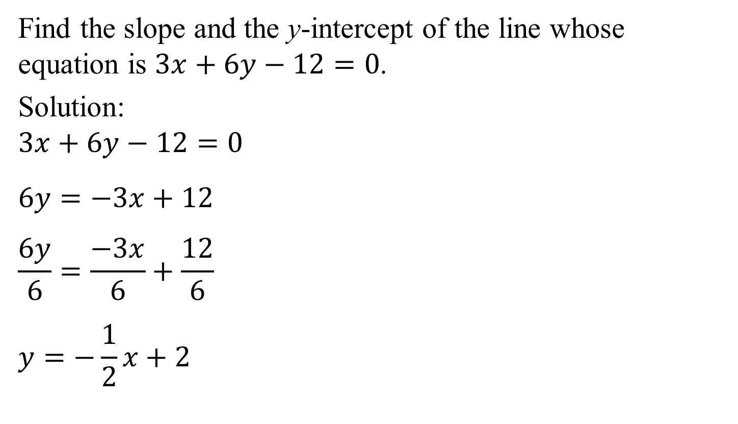
Example 7: Finding the Slope and the y-Intercept
Find the slope and the y-intercept of the line whose equation is $3x+6y−12=0$.
Solution:
$$3x+6y−12=0$$
$$6y=−3x+12$$
$$\frac{6y}{6}=\frac{−3x}{6}+\frac{12}{6}$$
$$y=−\frac{1}{2}x+2$$
The slope is $−\frac{1}{2}.$
The y-intercept is 2.

Slide 17
Using Intercepts to Graph Ax + By + C = 0
1. Find the x-intercept. Let y = 0 and solve for x. Plot the point containing the x-intercept on the x-axis.
2. Find the y-intercept. Let x = 0 and solve for y. Plot the point containing the y-intercept on the y-axis.
3. Use a straightedge to draw a line through the points containing the intercepts. Draw arrowheads at the ends of the line to show that the line continues indefinitely in both directions.
As long as none of A, B, and C is zero, the graph of Ax + By + C = 0 will have distinct x- and y-intercepts, and this three-step method can be used to graph the equation.

Slide 18
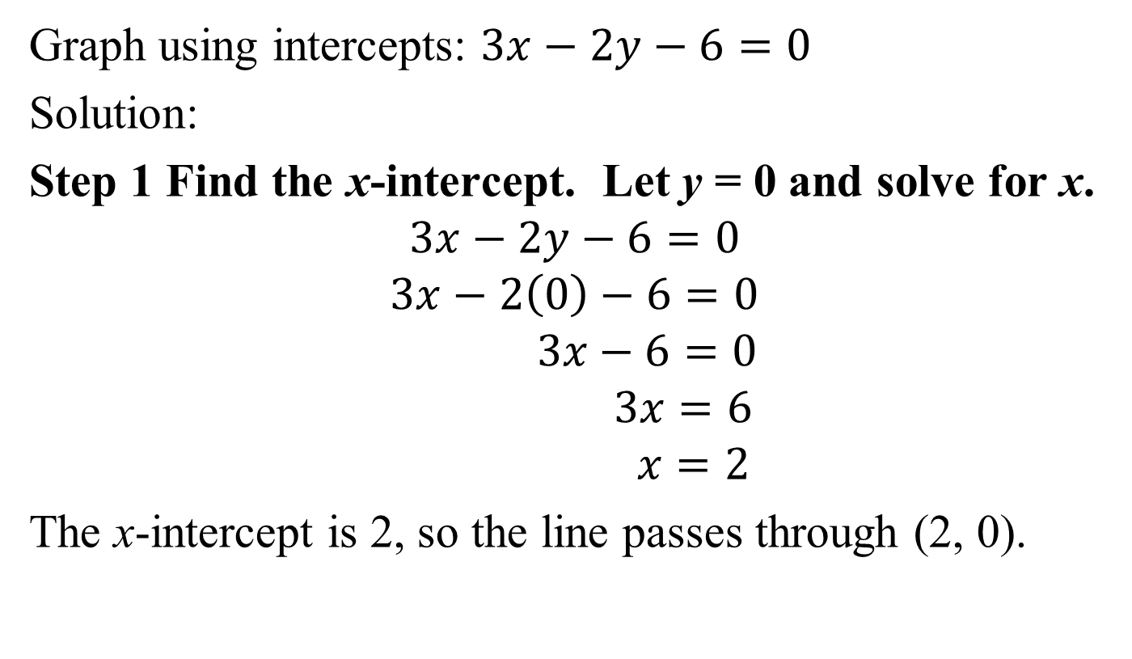
Example 8: Using Intercepts to Graph a Linear Equation
Graph using intercepts: $3x−2y−6=0$
Solution:
Step 1 Find the x-intercept. Let y = 0 and solve for x.
$$3x−2y−6=0$$
$$3x−2\left(0\right)−6=0$$
$$3x−6=0$$
$$3x=6$$
$$x=2$$
The x-intercept is 2, so the line passes through (2, 0).

Slide 19
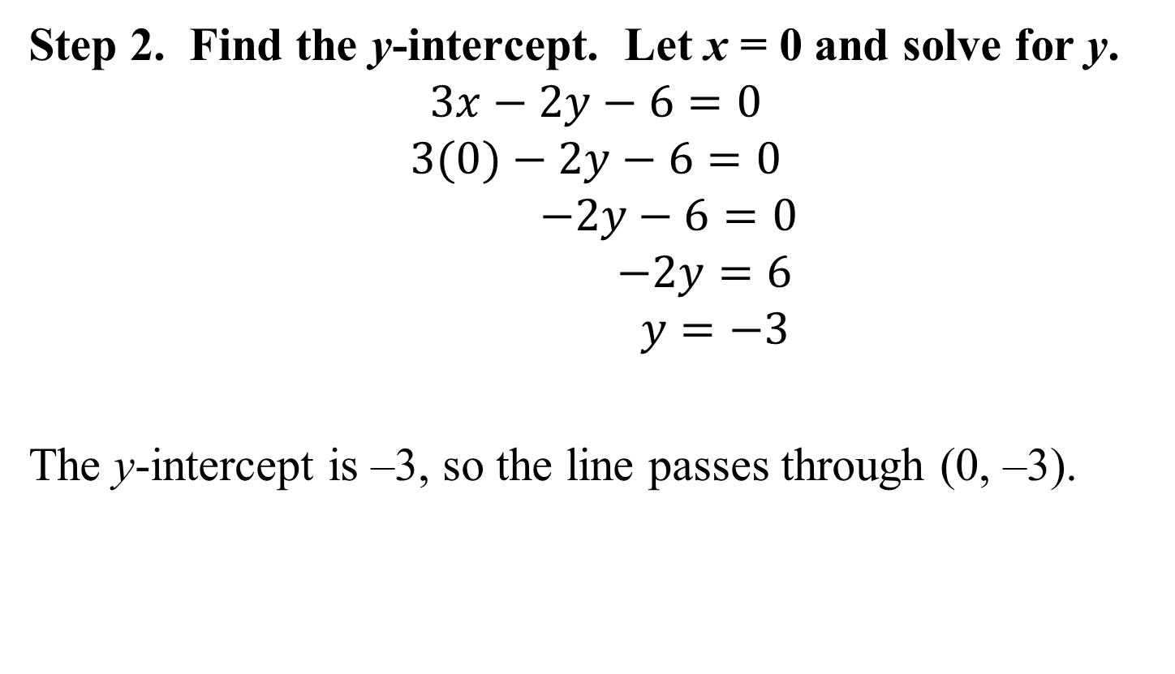
Example 8: Using Intercepts to Graph a Linear Equation (continued)
Step 2. Find the y-intercept. Let x = 0 and solve for y.
$$3x−2y−6=0$$
$$3(0)−2y−6=0$$
$$−2y−6=0$$
$$−2y=6$$
$$y=−3$$
The y-intercept is –3, so the line passes through (0, –3).

Slide 20
Example 8: Using Intercepts to Graph a Linear Equation (continued)
Step 3 Graph the equation by drawing a line through the two points containing the intercepts.

Slide 21
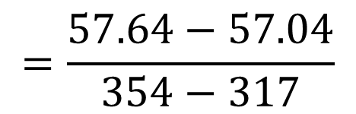
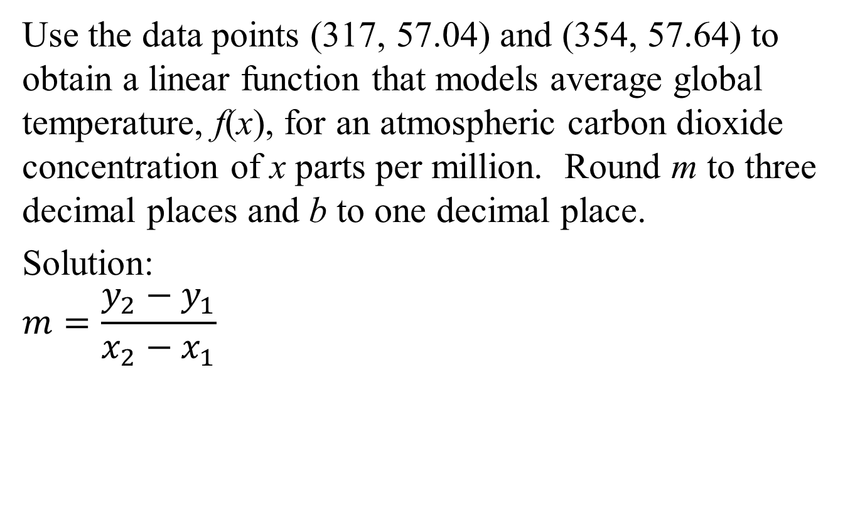


Example 9: Application
Use the data points (317, 57.04) and (354, 57.64) to obtain a linear function that models average global temperature, f(x), for an atmospheric carbon dioxide concentration of x parts per million. Round m to three decimal places and b to one decimal place.
Solution:
$$m=\frac{y_{2}−y_{1}}{x_{2}−x_{1}}$$
$$=\frac{57.64−57.04}{354−317}$$
$$=\frac{0.60}{37}$$
$$≈0.016$$

Slide 22
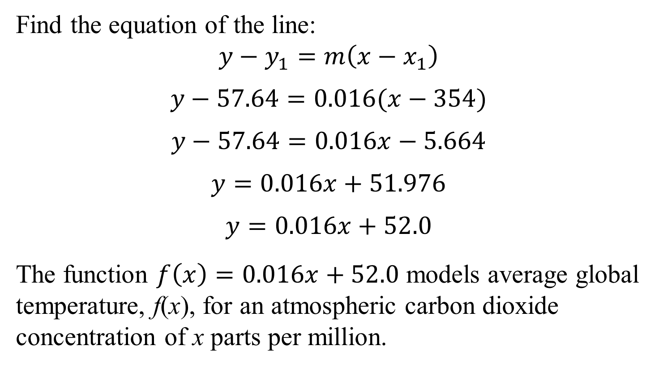
Example 9: Application (continued)
Find the equation of the line:
$$y−y_{1}=m\left(x−x_{1}\right)$$
$$y−57.64=0.016(x−354)$$
$$y−57.64=0.016x−5.664$$
$$y=0.016x+51.976$$
$$y=0.016x+52.0$$
The function $f\left(x\right)=0.016x+52.0$ models average global temperature, f(x), for an atmospheric carbon dioxide concentration of x parts per million.

