Slide 1

Chapter 2
Functions and Graphs
2.6 Combinations of Functions; Composite Functions

Slide 2
Objectives
Find the domain of a function.
Combine functions using the algebra of functions, specifying domains.
Form composite functions.
Determine domains for composite functions.
Write functions as compositions.

Slide 3
Finding a Function’s Domain
If a function f does not model data or verbal conditions, its domain is the largest set of real numbers for which the value of f(x) is a real number. Exclude from a function’s domain real numbers that cause division by zero and real numbers that result in an even root, such as a square root, of a negative number.

Slide 4

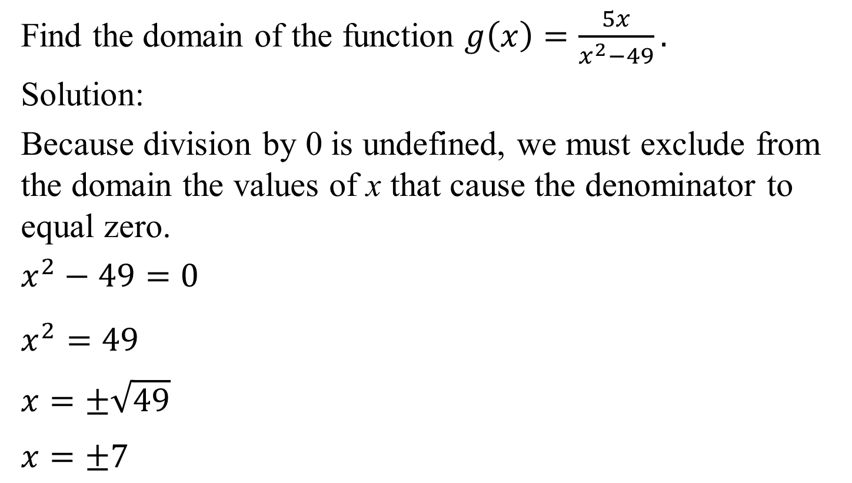
Example 1b: Finding the Domain of a Function
Find the domain of the function $g\left(x\right)=\frac{5x}{x^{2}−49}.$
Solution:
Because division by 0 is undefined, we must exclude from the domain the values of x that cause the denominator to equal zero.
$x^{2}−49=0$
$x^{2}=49$
$$x=±\sqrt{49}$$
$$x=±7$$
We exclude 7 and –7 from the domain of g.
The domain of g is
$\left(−∞,−7\right)∪\left(−7, 7\right)∪(7, ∞)$.

Slide 5
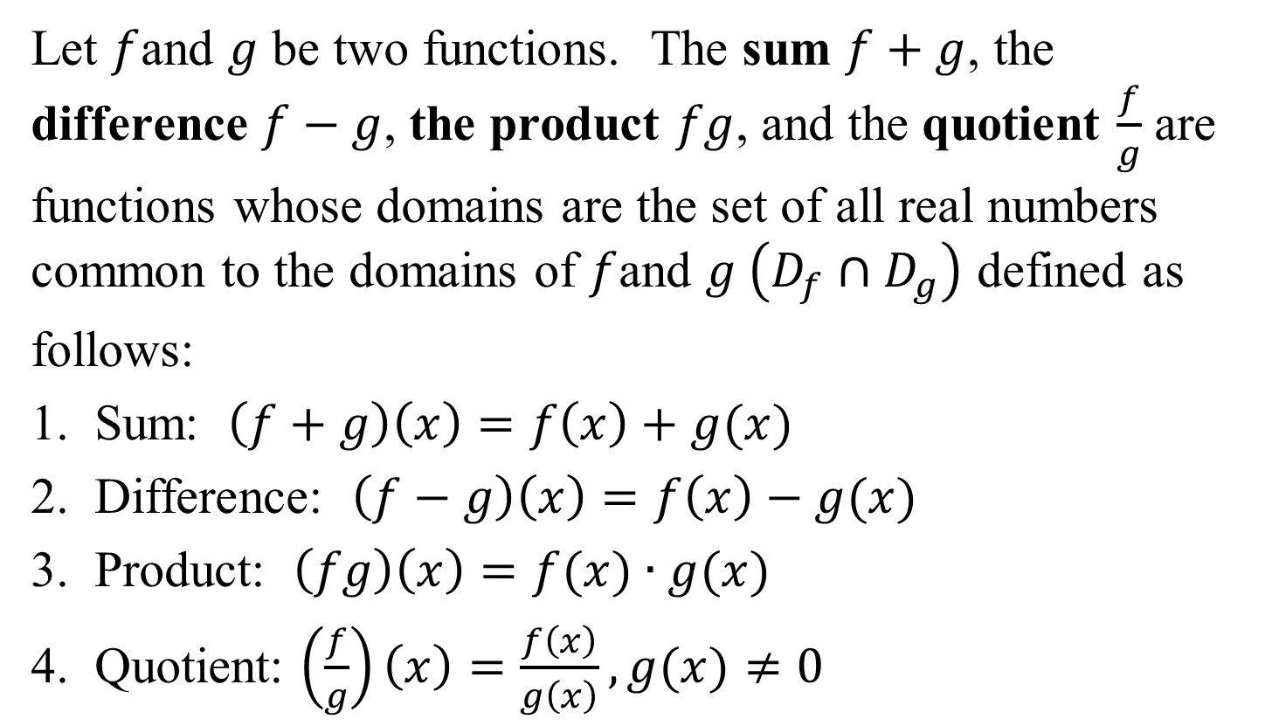
The Algebra of Functions: Sum, Difference, Product, and Quotient of Functions
Let $f$and $g$ be two functions. The sum $f+g$, the difference $f−g$, the product $fg$, and the quotient $\frac{f}{g}$ are functions whose domains are the set of all real numbers common to the domains of $f$and $g \left(D_{f}∩D_{g}\right)$ defined as
follows:
1. Sum: $\left(f+g\right)\left(x\right)=f\left(x\right)+g(x)$
2. Difference: $\left(f−g\right)\left(x\right)=f\left(x\right)−g(x)$
3. Product: $\left(fg\right)\left(x\right)=f(x)∙g(x)$
4. Quotient: $\left(\frac{f}{g}\right)\left(x\right)=\frac{f\left(x\right)}{g\left(x\right)},g(x)≠0$

Slide 6
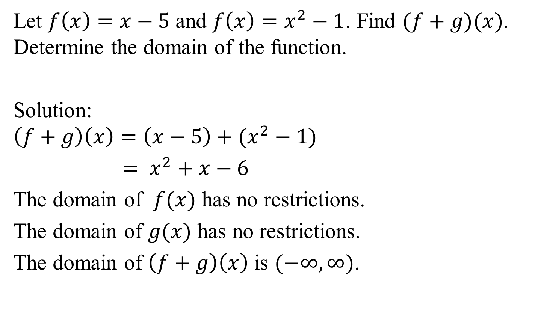
Example 2a: Combining Functions
Let $f\left(x\right)=x−5$ and $f\left(x\right)=x^{2}−1$. Find $(f+g)(x)$. Determine the domain of the function.
Solution:
$$\left(f+g\right)\left(x\right)=\left(x−5\right)+(x^{2}−1)$$
$= x^{2}+x−6$
The domain of $f(x)$ has no restrictions.
The domain of $g(x)$ has no restrictions.
The domain of $\left(f+g\right)\left(x\right)$ is $(−∞, ∞)$.

Slide 7
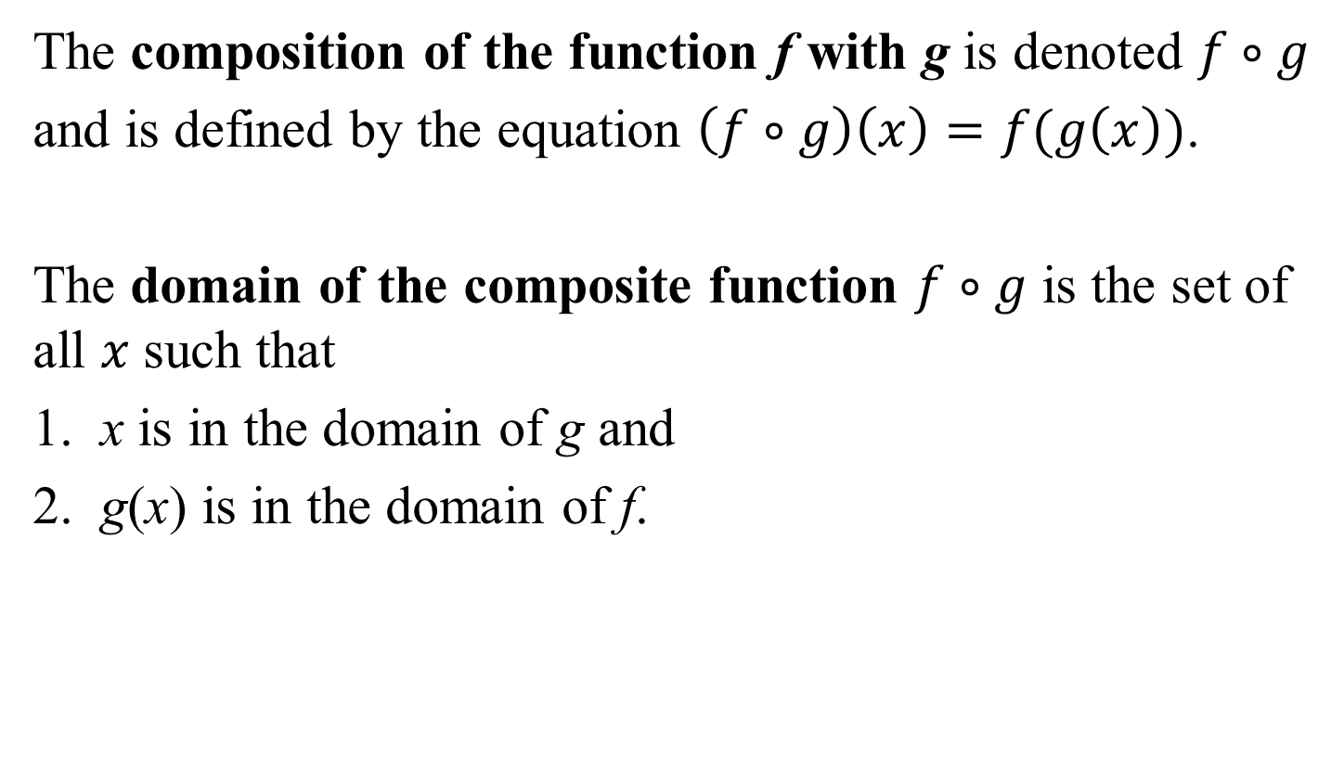
The Composition of Functions
The composition of the function f with g is denoted $f∘g$
and is defined by the equation $\left(f∘g\right)\left(x\right)=f(g\left(x\right))$.
The domain of the composite function $f∘g$ is the set of all $x$such that
1. x is in the domain of g and
2. g(x) is in the domain of f.

Slide 8
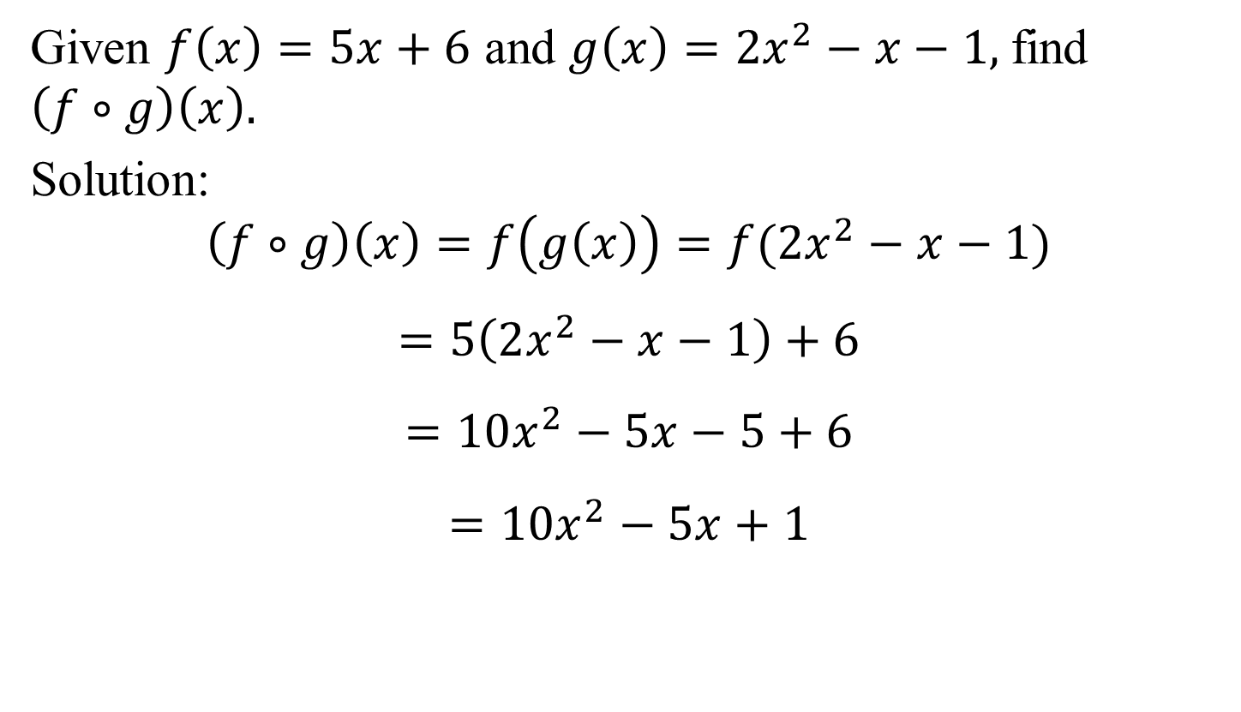
Example 5a: Forming Composite Functions
Given $f\left(x\right)=5x+6$ and $g\left(x\right)=2x^{2}−x−1,$find
$$\left(f∘g\right)\left(x\right).$$
Solution:
$$\left(f∘g\right)\left(x\right)=f\left(g\left(x\right)\right)=f(2x^{2}−x−1)$$
$$=5\left(2x^{2}−x−1\right)+6$$
$$=10x^{2}−5x−5+6$$
$$=10x^{2}−5x+1$$

Slide 9
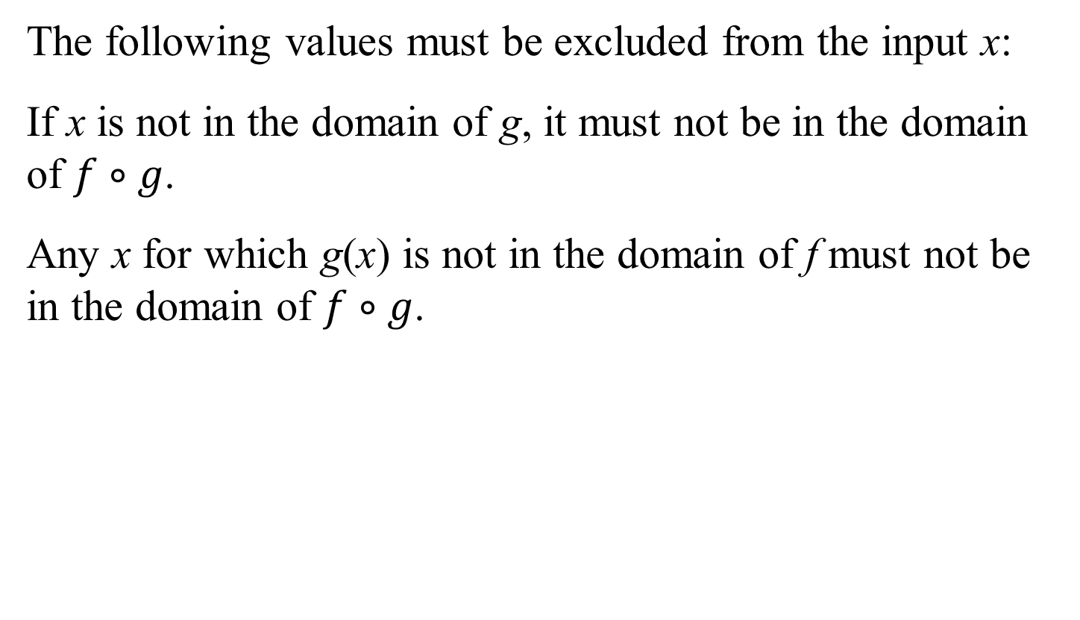
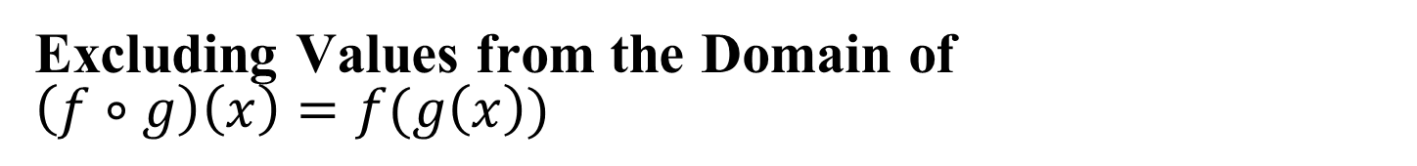
Excluding Values from the Domain of
$\left(f∘g\right)\left(x\right)=f(g\left(x\right))$
The following values must be excluded from the input x:
If x is not in the domain of g, it must not be in the domain of $f∘g$.
Any x for which g(x) is not in the domain of f must not be in the domain of $f∘g$.

Slide 10


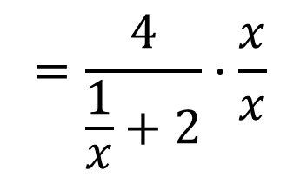
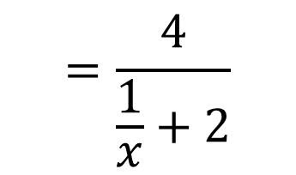
Example 6a: Forming a Composite Function and Finding Its Domain
Given $f\left(x\right)=\frac{4}{x+2}$ and $g\left(x\right)=\frac{1}{x}$, find $(f∘g)(x)$
Solution:
$\left(f∘g\right)\left(x\right)=f(g\left(x\right))$
$$\left(f∘g\right)\left(x\right)=f\left(g\left(x\right)\right)=\frac{4x}{1+2x}$$
$$=f\left(\frac{1}{x}\right)$$
$$=\frac{4}{\frac{1}{x}+2}$$
$$=\frac{4}{\frac{1}{x}+2}·\frac{x}{x}$$

Slide 11
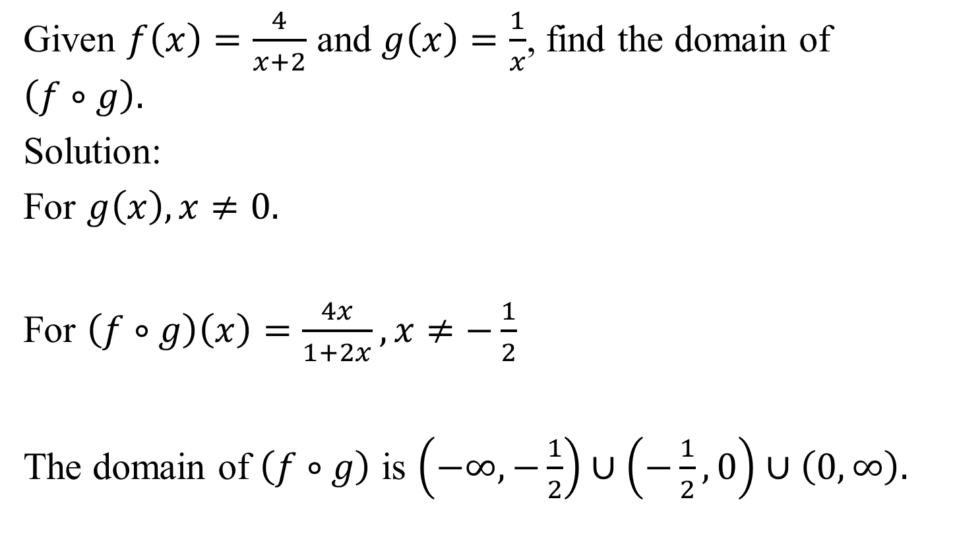
Example 6b: Forming a Composite Function and Finding Its Domain
Given $f\left(x\right)=\frac{4}{x+2}$ and $g\left(x\right)=\frac{1}{x}$, find the domain of
$$\left(f∘g\right).$$
Solution:
For $g\left(x\right), x≠0.$
For $\left(f∘g\right)\left(x\right)=\frac{4x}{1+2x},x≠−\frac{1}{2}$
The domain of $\left(f∘g\right)$ is $\left(−∞,−\frac{1}{2}\right)∪\left(−\frac{1}{2},0\right)∪\left(0,∞\right).$

Slide 12

Example 7: Writing a Function as a Composition
Express $h(x)$ as a composition of two functions:
$$h\left(x\right)=\sqrt{x^{2}+5}$$
Solution:
If $f\left(x\right)=\sqrt{x}$ and $g\left(x\right)=x^{2}+5$, $h\left(x\right)=\left(f∘g\right)(x)$

