Slide 1

Chapter 2
Functions and Graphs
2.4 More on Slope

Slide 2
Objectives
1. Find slopes and equations of parallel and perpendicular lines.
2. Interpret slope as rate of change.
3. Find a function’s average rate of change.

Slide 3
Slope and Parallel Lines
1. If two nonvertical lines are parallel, then they have the same slope.
2. If two distinct nonvertical lines have the same slope, then they are parallel.
3. Two distinct vertical lines, both with undefined slopes, are parallel.

Slide 4
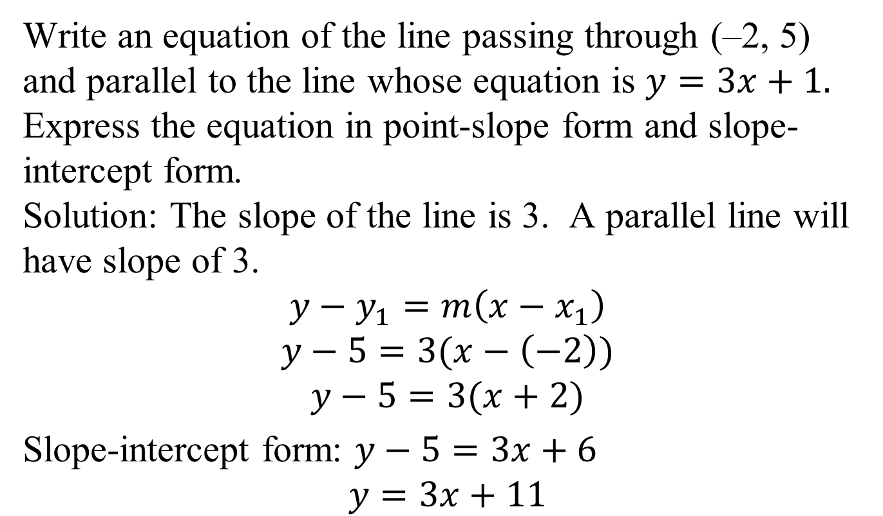
Example 1: Writing Equations of a Line Parallel to a Given Line
Write an equation of the line passing through (–2, 5) and parallel to the line whose equation is $y=3x+1.$ Express the equation in point-slope form and slope-intercept form.
Solution: The slope of the line is 3. A parallel line will have slope of 3.
$$y−y_{1}=m\left(x−x_{1}\right)$$
$$y−5=3(x−\left(−2\right))$$
$$y−5=3(x+2)$$
Slope-intercept form: $y−5=3x+6$
$$y=3x+11$$

Slide 5
Slope and Perpendicular Lines
1. If two nonvertical lines are perpendicular, then the product of their slopes is –1.
2. If the product of the slopes of two lines is –1, then the lines are perpendicular.
3. A horizontal line having zero slope is perpendicular to a vertical line having undefined slope.

Slide 6
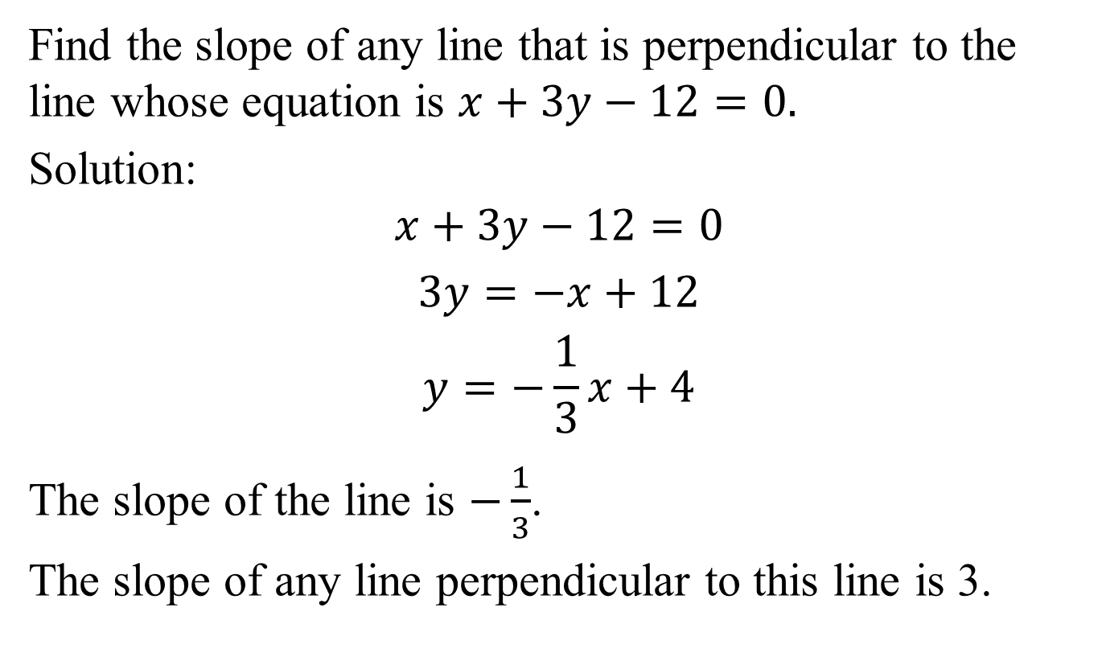
Example 2a: Writing Equations of a Line Perpendicular to a Given Line
Find the slope of any line that is perpendicular to the line whose equation is $x+3y−12=0.$
Solution:
$$x+3y−12=0$$
$$3y=−x+12$$
$$y=−\frac{1}{3}x+4$$
The slope of the line is $−\frac{1}{3}$.
The slope of any line perpendicular to this line is 3.

Slide 7
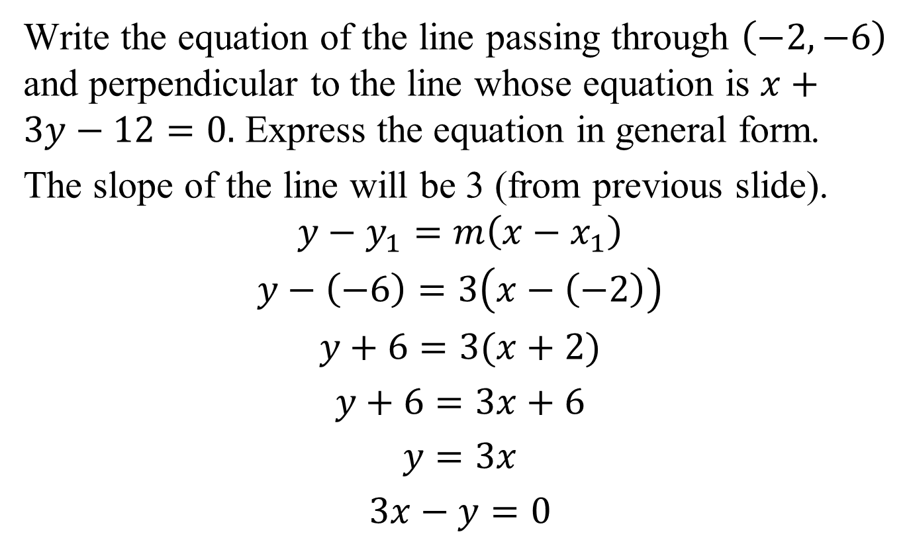
Example 2b: Writing Equations of a Line Perpendicular to a Given Line
Write the equation of the line passing through $\left(−2,−6\right)$ and perpendicular to the line whose equation is $x+3y−12=0.$ Express the equation in general form.
The slope of the line will be 3 (from previous slide).
$$y−y_{1}=m\left(x−x_{1}\right)$$
$$y−\left(−6\right)=3\left(x−\left(−2\right)\right)$$
$$y+6=3(x+2)$$
$$y+6=3x+6$$
$$y=3x$$
$$3x−y=0$$

Slide 8
Slope as Rate of Change
Slope is defined as the ratio of the change in y to a corresponding change in x. It describes how fast y is changing with respect to x. For a linear function, slope may be interpreted as the rate of change of the dependent variable per unit change in the independent variable.

Slide 9
Example 3: Slope as Rate of Change
In 2000, 11.9% of young adults lived with their parents. In 2017, 22.0% of young adults lived with their parents. Use this information to find the slope of the linear function representing young adults living with their parents. Express the slope correct to two decimal places and describe what it represents.
Solution:
We form the ordered pairs (2000, 11.9) and
(2017, 22.0).

Slide 10
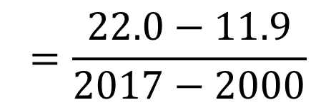
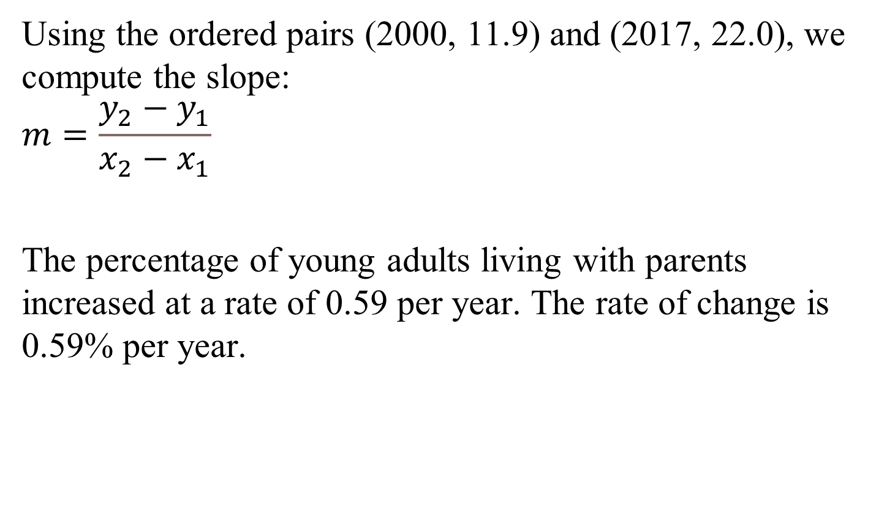
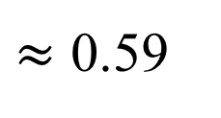

Example 3: Slope as Rate of Change (continued)
Using the ordered pairs (2000, 11.9) and (2017, 22.0), we compute the slope:
$$m=\frac{y_{2}−y_{1}}{x_{2}−x_{1}}$$
The percentage of young adults living with parents increased at a rate of 0.59 per year. The rate of change is 0.59% per year.
$$=\frac{22.0−11.9}{2017−2000}$$
$$=\frac{10.1}{17}$$
$≈$ 0.59

Slide 11
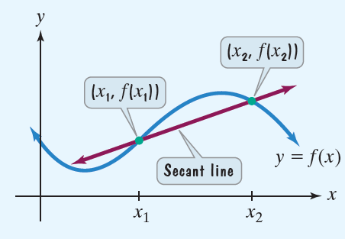

The Average Rate of Change of a Function
Let (x₁, f(x₁)) and (x₂, f(x₂)) be distinct points on the graph of a function f. The average rate of change of f from x₁ to x₂ is
$$\frac{\left.f(x_{2})−f(x_{1}\right)}{x_{2}−x_{1}}$$

Slide 12




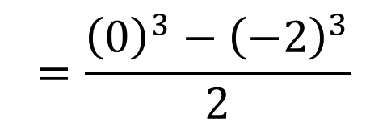

Example 4c: Finding the Average Rate of Change
Find the average rate of change for $f\left(x\right)=x^{3}$ from
x₁ = –2 to x₂ = 0.
Solution:
$$\frac{\left.f(x_{2})−f(x_{1}\right)}{x_{2}−x_{1}}$$
$$=\frac{\left.f(0)−f(−2\right)}{\left.0−(−2\right)}$$
$$=\frac{{\left(0\right)}^{3}−{\left(−2\right)}^{3}}{2}$$
$$=\frac{8}{2}$$
$$=4$$

