Slide 1

Chapter 2
Functions and Graphs
2.2 More on Functions and Their Graphs

Slide 2
Objectives
Identify intervals on which a function increases, decreases, or is constant.
Use graphs to locate relative maxima or minima.
Test for symmetry.
Identify even or odd functions and recognize their symmetries.
Understand and use piecewise functions.
Find and simplify a function’s difference quotient.

Slide 3
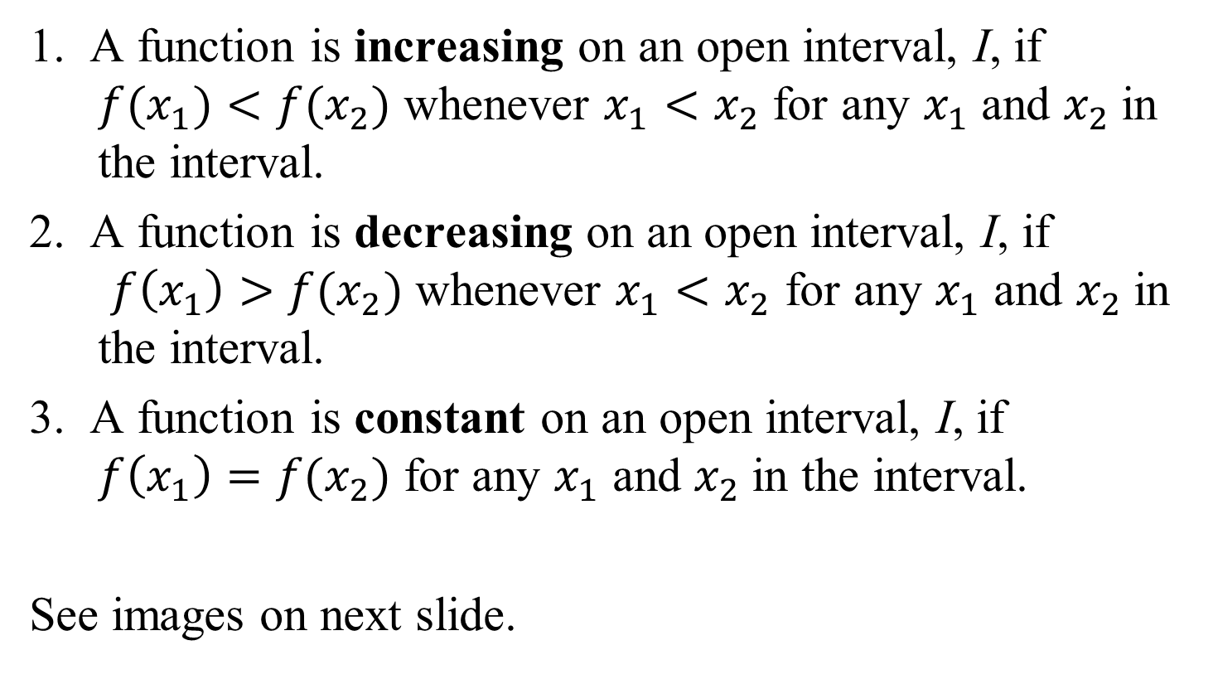
Increasing, Decreasing, and Constant Functions
1. A function is increasing on an open interval, I, if
$f(x_{1})<f(x_{2})$ whenever $x_{1}<x_{2}$ for any $x_{1}$ and $x_{2}$in the interval.
2. A function is decreasing on an open interval, I, if
$f\left(x_{1}\right)>f(x_{2})$ whenever $x_{1}<x_{2}$ for any $x_{1}$ and $x_{2}$in the interval.
3. A function is constant on an open interval, I, if
$f\left(x_{1}\right)=f(x_{2})$ for any $x_{1}$ and $x_{2}$in the interval.
See images on next slide.

Slide 4
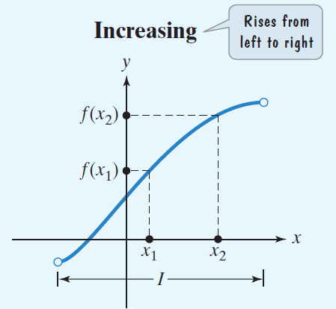
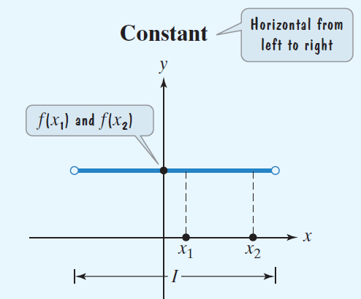
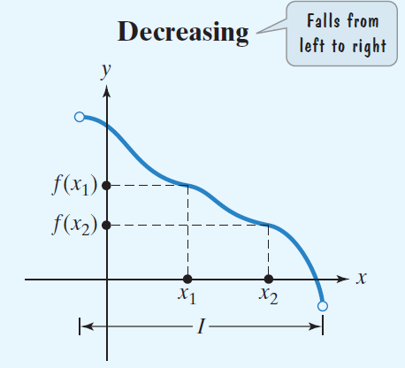
Increasing, Decreasing, and Constant Functions

Slide 5



Example 1: Intervals on Which a Function Increases, Decreases, or is Constant
State the intervals on which the given function is increasing, decreasing, or constant.
Solution:
increasing on
$$\left(−∞,−1\right)$$
decreasing on
$$\left(−1,1\right)$$
increasing on
$$\left(1,∞\right)$$

Slide 6
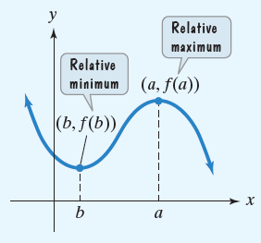
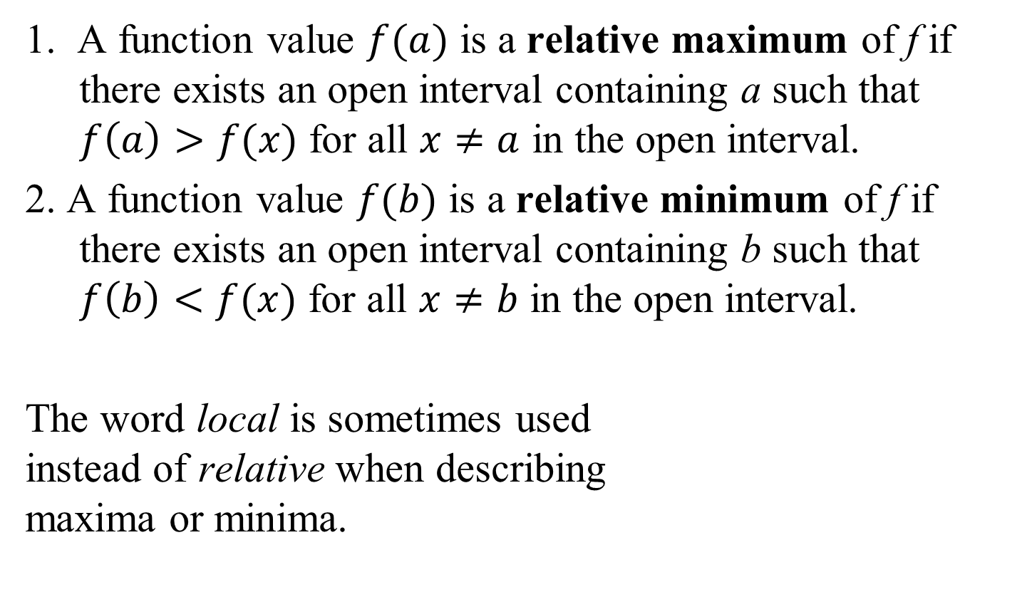
Definitions of Relative Maximum and Relative Minimum
1. A function value $f(a)$ is a relative maximum of f if there exists an open interval containing a such that $f\left(a\right)>f(x)$ for all $x≠a$ in the open interval.
2. A function value $f(b)$ is a relative minimum of f if there exists an open interval containing b such that $f\left(b\right)<f(x)$ for all $x≠b$ in the open interval.
The word local is sometimes used
instead of relative when describing
maxima or minima.

Slide 7
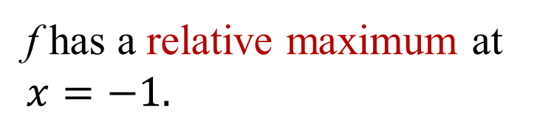
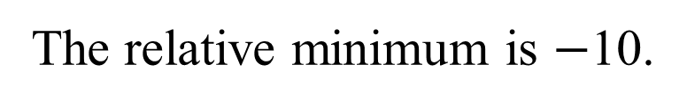
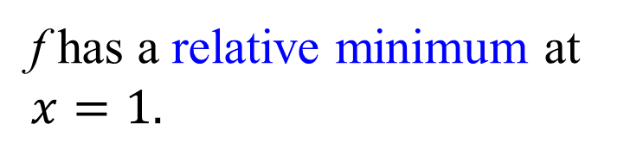
Example: Use Graphs to Locate Relative Maxima or Minima
Identify the relative maxima and minima for the graph of f.
Solution:
y
25
20
15
10
5
-5
-10
-15
-20
-25
f has a relative maximum at
$$x=−1.$$
The relative maximum is 10.
-4 -3 -2 -1 1 2 3 4
x
f has a relative minimum at
$$x=1.$$
The relative minimum is $−$10.

Slide 8
Tests for Symmetry
Definition of Symmetry | Test for Symmetry
The graph of the equation is symmetric with respect to the y-axis if for every point (x, y) on the graph, the point (−x, y) is also on the graph. | Substituting −x for x in the equation results in an equivalent equation.
The graph of the equation is symmetric with respect to the x-axis if for every point (x, y) on the graph, the point (x, −y) is also on the graph. | Substituting −y for y in the equation results in an equivalent equation.

Slide 9
Tests for Symmetry (continued)
Definition of Symmetry | Test for Symmetry
The graph of the equation is symmetric with respect to the origin if for every point (x, y) on the graph, the point (−x, −y) is also on the graph. | Substituting −x for x and −y for y in the equation results in an equivalent equation.

Slide 10
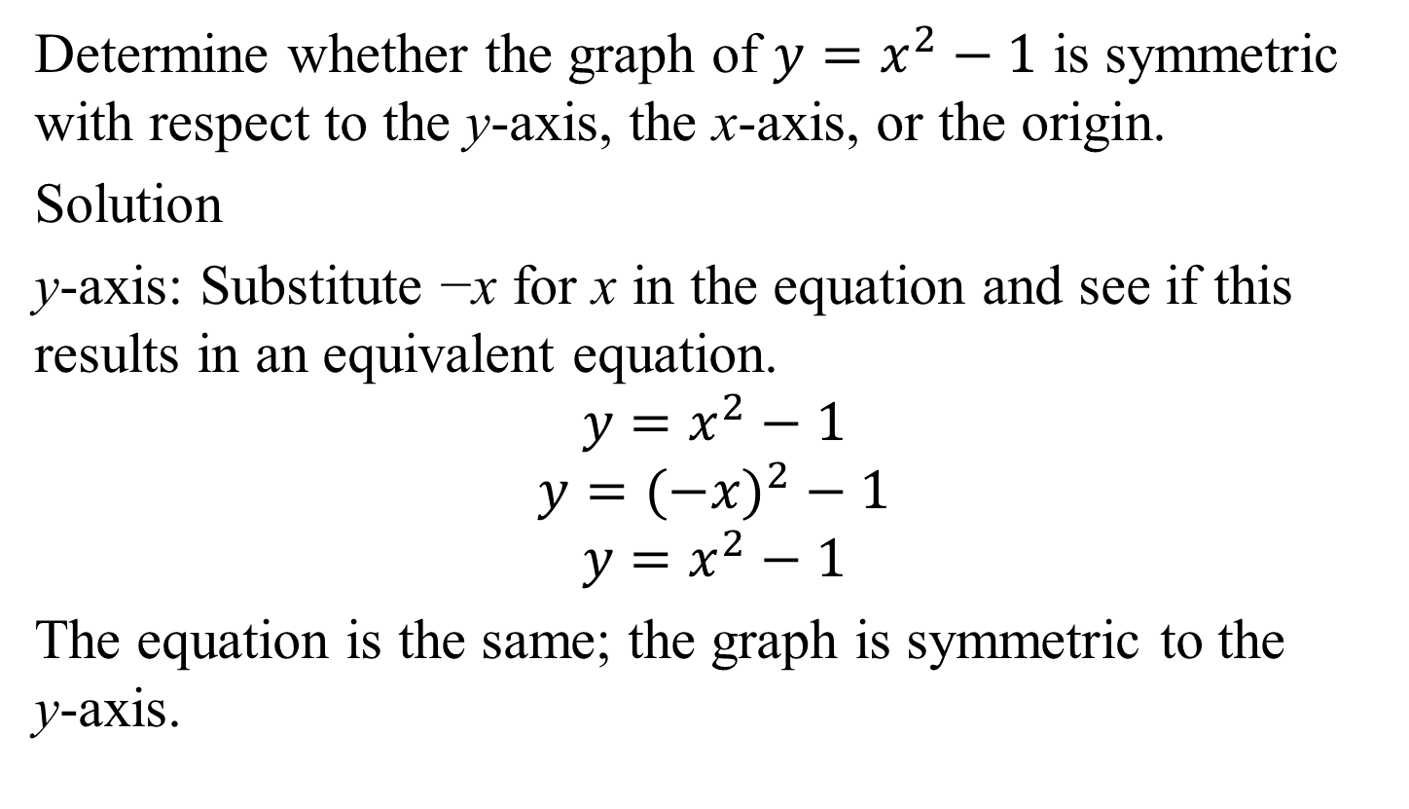
Example 2: Testing for Symmetry
Determine whether the graph of $y=x^{2}−1$ is symmetric with respect to the y-axis, the x-axis, or the origin.
Solution
y-axis: Substitute −x for x in the equation and see if this results in an equivalent equation.
$$y=x^{2}−1$$
$$y=(−{x)}^{2}−1$$
$$y=x^{2}−1$$
The equation is the same; the graph is symmetric to the
y-axis.

Slide 11
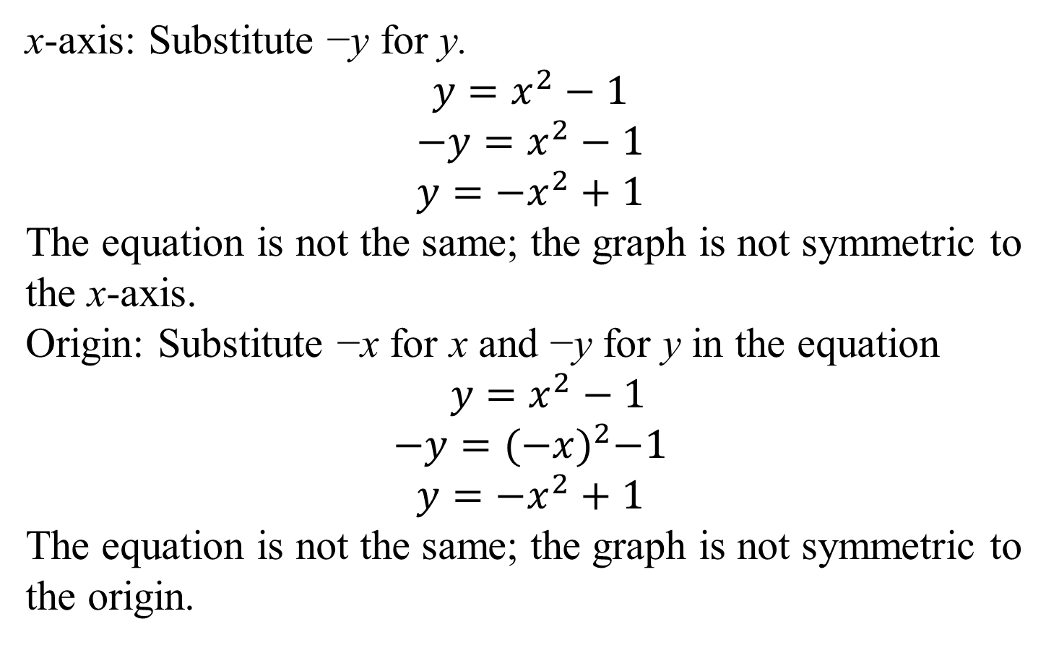
Example 2: Testing for Symmetry (continued)
x-axis: Substitute −y for y.
$$y=x^{2}−1$$
$$−y=x^{2}−1$$
$$y={−x}^{2}+1$$
The equation is not the same; the graph is not symmetric to the x-axis.
Origin: Substitute −x for x and −y for y in the equation $y=x^{2}−1$
$$−y={(−x)}^{2}−1$$
$$y={−x}^{2}+1$$
The equation is not the same; the graph is not symmetric to the origin.

Slide 12
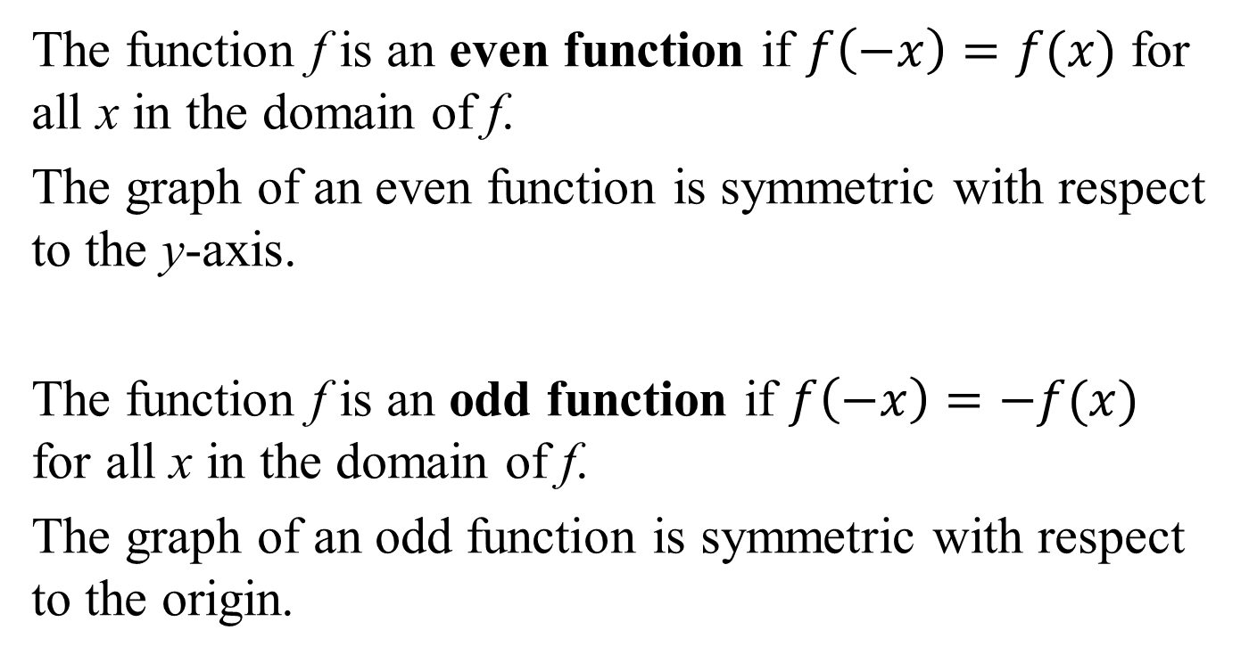
Definitions of Even and Odd Functions
The function f is an even function if $f\left(−x\right)=f(x)$ for all x in the domain of f.
The graph of an even function is symmetric with respect to the y-axis.
The function f is an odd function if $f\left(−x\right)=−f(x)$ for all x in the domain of f.
The graph of an odd function is symmetric with respect to the origin.

Slide 13
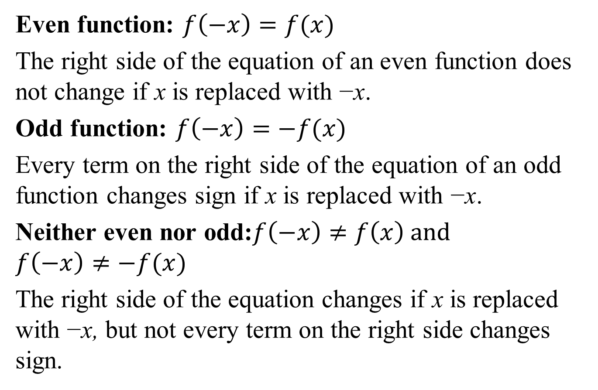
Identifying Even or Odd Functions from Equations
Even function: $f\left(−x\right)=f(x)$
The right side of the equation of an even function does not change if x is replaced with −x.
Odd function: $f\left(−x\right)=−f(x)$
Every term on the right side of the equation of an odd function changes sign if x is replaced with −x.
Neither even nor odd:$f\left(−x\right)≠f\left(x\right) and$
$f\left(−x\right)≠−f(x)$
The right side of the equation changes if x is replaced with −x, but not every term on the right side changes sign.

Slide 14

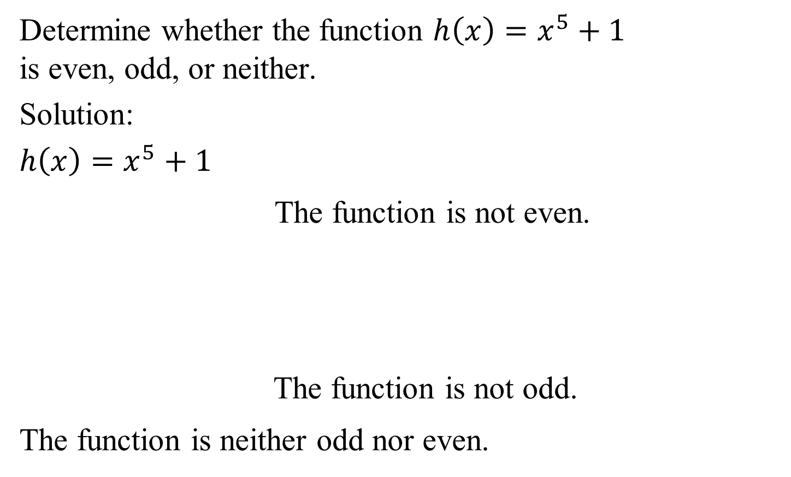


Example 5c: Identifying Even or Odd Functions
Determine whether the function $h\left(x\right)=x^{5}+1$ is even, odd, or neither.
Solution:
$h\left(x\right)=x^{5}+1$
The function is not even.
The function is not odd.
The function is neither odd nor even.
$$h(−x)={\left(−x\right)}^{5}+1=−x^{5}+1$$
$$\left.h(−x)≠h(x\right)$$
$$h(x)=x^{5}+1$$
$$h(−x)={\left(−x\right)}^{5}+1=−x^{5}+1$$
$$−h(x)=−(x^{5}+1)=−x^{5}−1$$
$$\left.h(−x)≠−h(x\right)$$

Slide 15
Piecewise Functions
A function that is defined by two (or more) equations over a specified domain is called a piecewise function.

Slide 16
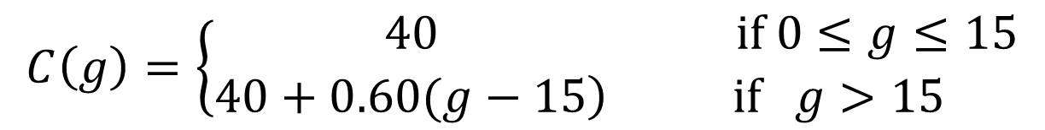



Example 6: Evaluating a Piecewise Function
Given the function
Find C(5):
Find C(50):
$$C\left(50\right)=40+0.60\left(50−15\right)$$
$=40+0.60\left(35\right)$
$=40+21$
$=61$
$$C\left(g\right)=\left\{\begin{matrix}40 & \text{if} 0≤g≤15 \\ \left.40+0.60(g−15\right) & \text{if} g>15\end{matrix}\right.$$
$$C(5)=40$$
$$C\left(50\right)=61$$

Slide 17

Example 7: Graphing a Piecewise Function
Graph the piecewise function defined by
$$f\left(x\right)=\left\{\begin{aligned} 3 if x≤−1 \\ x−2 if x>−1\end{aligned}\right.$$
Solution: We will graph f in two parts, using a partial table of coordinates for each piece of the graph.

Slide 18

Example 7: Graphing a Piecewise Function
(continued)
The graph of $f\left(x\right)=\left\{\begin{aligned} 3 if x≤−1 \\ x−2 if x>−1\end{aligned}\right.$

Slide 19

Definition of the Difference Quotient of a Function
The expression
$$\frac{f\left(x+h\right)−f(x)}{h}$$
for $h≠0$ is called the difference quotient of the
function f.

Slide 20
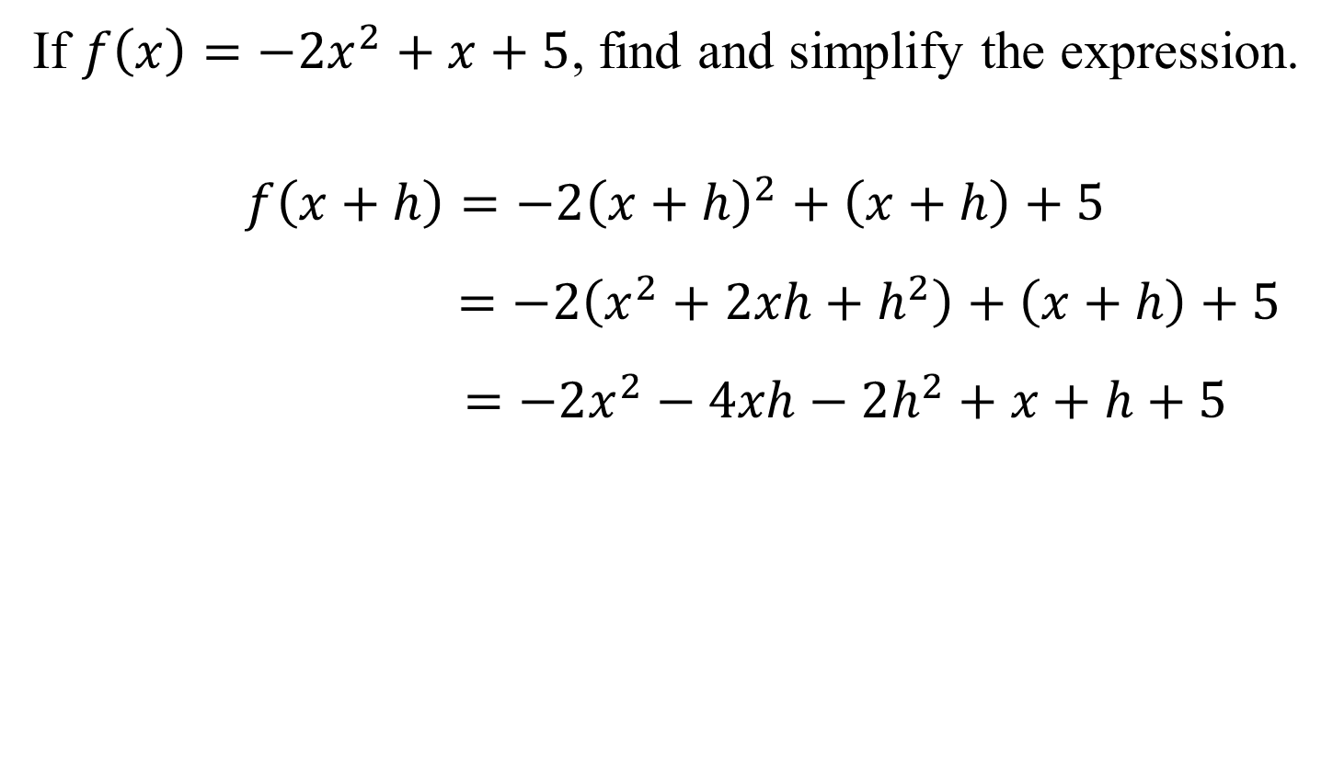
Example 8a: Evaluating and Simplifying a Difference Quotient
If $f\left(x\right)=−2x^{2}+x+5$, find and simplify the expression.
$$f\left(x+h\right)=−2{\left(x+h\right)}^{2}+\left(x+h\right)+5$$
$$=−2\left(x^{2}+2xh+h^{2}\right)+\left(x+h\right)+5$$
$$=−2x^{2}−4xh−2h^{2}+x+h+5$$

Slide 21
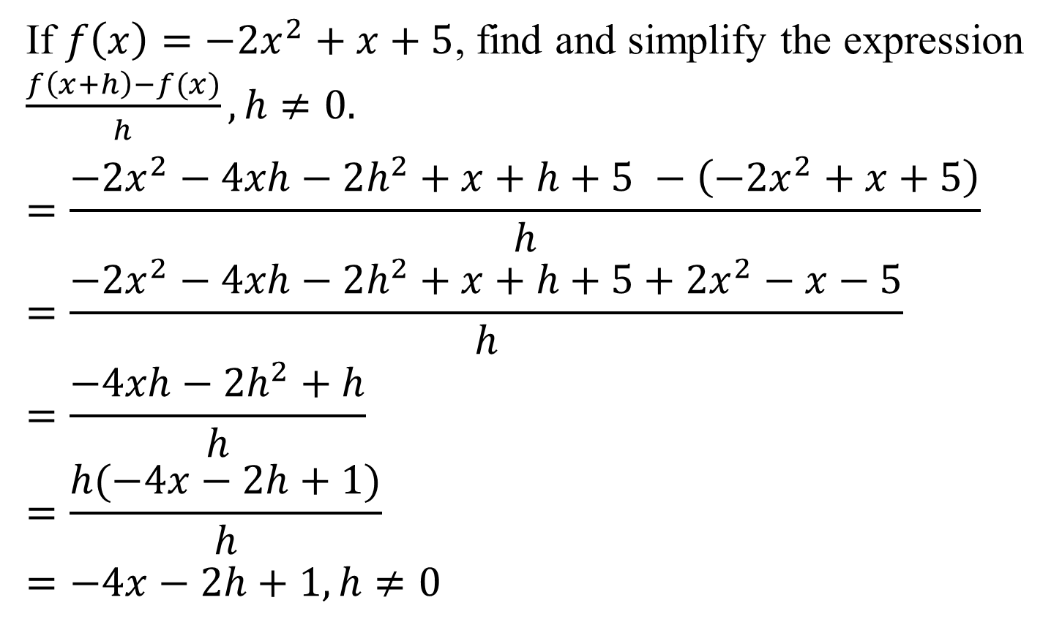
Example 8b: Evaluating and Simplifying a Difference Quotient
If $f\left(x\right)=−2x^{2}+x+5$, find and simplify the expression $\frac{f\left(x+h\right)−f(x)}{h}, h≠0.$
$$=\frac{−2x^{2}−4xh−2h^{2}+x+h+5 −\left(−2x^{2}+x+5\right)}{h}$$
$$=\frac{−2x^{2}−4xh−2h^{2}+x+h+5+2x^{2}−x−5}{h}$$
$$=\frac{−4xh−2h^{2}+h}{h}$$
$$=\frac{h(−4x−2h+1)}{h}$$
$$=−4x−2h+1, h≠0$$

