Slide 1

Chapter 2
Functions and Graphs
2.1 Basics of Functions and Their Graphs

Slide 2
Objectives
Find the domain and range of a relation.
Determine whether a relation is a function.
Determine whether an equation represents a function.
Evaluate a function.
Graph functions by plotting points.
Use the vertical line test to identify functions.
Obtain information about a function from its graph.
Identify the domain and range of a function from its graph.
Identify intercepts from a function’s graph.

Slide 3
Definition of a Relation
A relation is any set of ordered pairs. The set of all first components of the ordered pairs is called the domain of the relation and the set of all second components is called the range of the relation.

Slide 4
Example 1: Finding the Domain and Range of a Relation
Find the domain and range of the relation:
{(0, 187), (1, 212), (2, 225), (3, 238)}.
Solution:
domain: {0, 1, 2, 3}
range: {187, 212, 225, 238}

Slide 5
Definition of a Function
A function is a correspondence from a first set, called the domain, to a second set, called the range, such that each element in the domain corresponds to exactly one element in the range.

Slide 6
Example 2b: Determining Whether a Relation is a Function
Determine whether the relation is a function:
{(1, 2), (3, 4), (6, 5), (8, 5)}
Solution:
Every element of the domain corresponds to exactly one element in the range. No two ordered pairs in the given relation have the same first component and different second components. Thus, the relation is a function.

Slide 7
Functions as Equations
If an equation is solved for y and more than one value of y can be obtained for a given x, then the equation does not define y as a function of x.

Slide 8
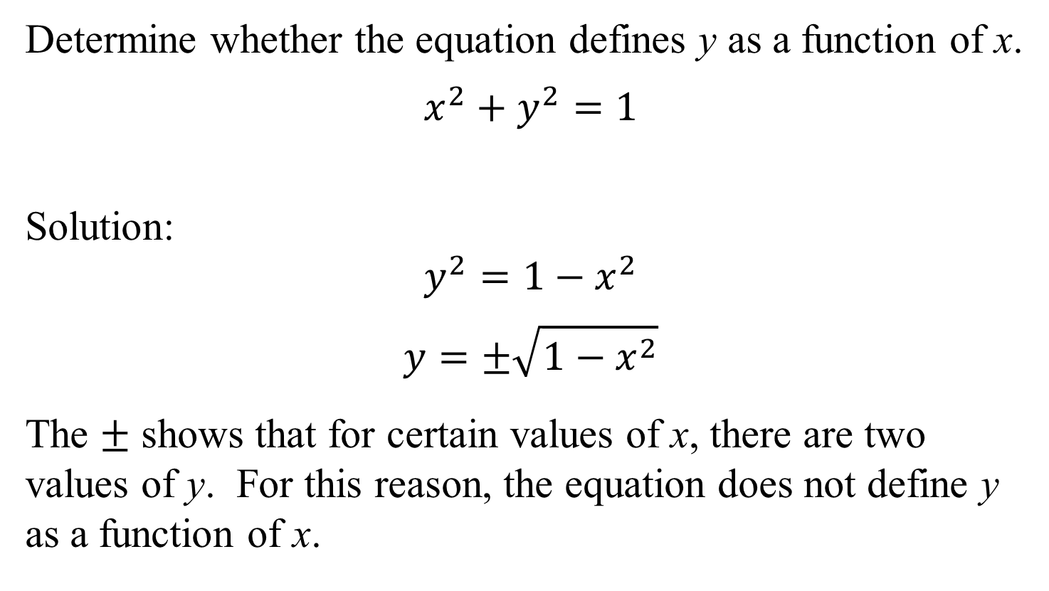
Example 3b: Determining Whether an Equation Represents a Function
Determine whether the equation defines y as a function of x.
$$x^{2}+y^{2}=1$$
Solution:
$$y^{2}=1−x^{2}$$
$$y=±\sqrt{1−x^{2}}$$
The $±$ shows that for certain values of x, there are two values of y. For this reason, the equation does not define y as a function of x.

Slide 9
Function Notation
The special notation f(x), read “f of x” or “f at x”, represents the value of the function at the number x.

Slide 10

Example 4a: Evaluating a Function
If $f\left(x\right)=x^{2}−2x+7$, evaluate $f\left(−5\right).$
Solution:
$$f\left(x\right)=x^{2}−2x+7$$
$$f\left(−5\right)={(−5)}^{2}−2(−5)+7$$
$=25+10+7=42$
Thus, $f\left(−5\right)=42.$

Slide 11
Graphs of Functions
The graph of a function is the graph of its ordered pairs.

Slide 12

Example 5: Graphing Functions
Graph the functions $f\left(x\right)=2x$ and $g\left(x\right)=2x−3$ in the same rectangular coordinate system. Select integers for x, starting with –2 and ending with 2. How is the graph of g related to the graph of f?

Slide 13
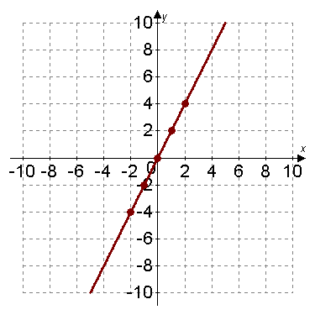
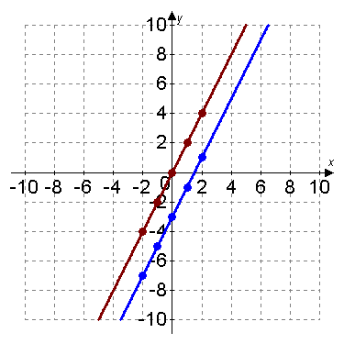


Example 5: Graphing Functions (continued)
Solution: We set up a partial table of coordinates for each function. We then plot the points and connect them.
The graph of g is the graph of f shifted down 3 units.
$$f(x)=2x$$
$$g(x)=2x−3$$
x | y = f (x)
–2 | –4
–1 | –2
0 | 0
1 | 2
2 | 4
x | y = g(x)
–2 | –7
–1 | –5
0 | –3
1 | –1
2 | 1

Slide 14
The Vertical Line Test for Functions
If any vertical line intersects a graph in more than one point, the graph does not define y as a function of x.

Slide 15
Example 6: Using the Vertical Line Test
Use the vertical line test to identify graphs in which y is a function of x.
function
not a function

Slide 16



Example 7: Analyzing the Graph of a Function
Use the graph to find $f(5)$.
$$f(5)=400$$
For what value of x is $f\left(x\right)=100?$
$$\text{f}\text{(9) = 100, }\text{so} \text{x}\text{ = 9.}$$

Slide 17
Identifying Domain and Range from a Function’s Graph
To find the domain of a function from its graph, look for all the inputs on the x-axis that correspond to points on the graph.
To find the range of a function from its graph, look for all the outputs on the y-axis that correspond to points on the graph.

Slide 18

Example 8a: Identifying the Domain and Range of a Function from Its Graph
Use the graph of the function to identify its domain and its range.
Solution:
Domain:
$$\left\{x | −2≤x≤1\right\}.$$
$$[−2,1]$$
Range:
$$\{y|0≤y≤3\}$$
$$[0,3]$$

Slide 19
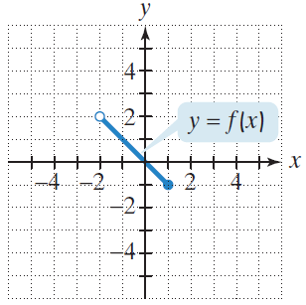

Example 8b: Identifying the Domain and Range of a Function from Its Graph
Use the graph of the function to identify its domain and its range.
Solution:
Domain:
$$\left\{x | −2<x≤1\right\}.$$
$$(−2, 1]$$
Range:
$$\left\{y | −1≤y<2\right\}.$$
$$[−1, 2)$$

Slide 20
Identifying Intercepts from a Function’s Graph
To find the x-intercepts, look for the points at which the graph crosses the x-axis.
To find the y-intercept, look for the point at which the graph crosses the y-axis.
A function can have more than one x-intercept but at most one y-intercept.

Slide 21
Example: Identifying Intercepts from a Function’s Graph
Identify the x- and y-intercepts for the graph of f (x).
Solution:
The graph passes through
(–3, 0), (–1, 0), and (2, 0).
The x-intercepts are
–3, –1, and 2.
The graph passes through
(0, –6).
The y-intercept is –6.

