Slide 1

Chapter P
Prerequisites: Fundamental Concepts of Algebra
P.7 Equations

Slide 2
Objectives
Solve linear equations in one variable.
Solve linear equations containing fractions.
Solve rational equations with variables in the denominators.
Solve a formula for a variable.
Solve equations involving absolute value.
Solve quadratic equations by factoring.
Solve quadratic equations by the square root property.
Solve quadratic equations by completing the square.
Solve quadratic equations using the quadratic formula.

Slide 3
Objectives
Use the discriminant to determine the number and type of solutions of quadratic equations.
Determine the most efficient method to use when solving a quadratic equation
Solve radical equations.

Slide 4

Definition of a Linear Equation
A linear equation in one variable x is an equation that can be written in the form
$ax+b=0$
where a and b are real numbers, and $a≠0.$

Slide 5
Generating Equivalent Equations
An equation can be transformed into an equivalent equation by one or more of the following operations:
1. Simplify an expression by removing grouping symbols and combining like terms.
2. Add (or subtract) the same real number or variable expression on both sides of the equation.
3. Multiply (or divide) by the same nonzero quantity on both sides of the equation.
4. Interchange the two sides of the equation.

Slide 6
Solving a Linear Equation
1. Simplify the algebraic expression on each side by removing grouping symbols and combining like terms.
2. Collect all the variable terms on one side and all the numbers, or constant terms, on the other side.
3. Isolate the variable and solve.
4. Check the proposed solution in the original equation.

Slide 7
Example 1: Solving a Linear Equation
Solve and check: 4(2x + 1) = 29 + 3(2x – 5).
Step 1 Simplify the algebraic expression on each side.
4(2x + 1) = 29 + 3(2x – 5)
8x + 4 = 29 + 6x – 15
8x + 4 = 6x + 14
Step 2 Collect variable terms on one side and constant terms on the other side.
8x – 6x + 4 = 6x – 6x + 14
2x + 4 = 14
2x + 4 – 4 = 14 – 4
2x = 10

Slide 8

Example 1: Solving a Linear Equation (continued)
Solve and check: 4(2x + 1) = 29 + 3(2x – 5).
Step 3 Isolate the variable and solve.
2x = 10
x = 5
$$\frac{2x}{2}=\frac{10}{2}$$

Slide 9
Example 1: Solving a Linear Equation (continued)
Solve and check: 4(2x + 1) = 29 + 3(2x – 5).
Step 4 Check the proposed solution in the original equation.
4(2x + 1) = 29 + 3(2x – 5)
4(2(5) + 1) = 29 + 3(2(5) – 5)
4(11) = 29 + 3(5)
44 = 29 + 15
44 = 44
The true statement 44 = 44 verifies that the solution
set is {5}.

Slide 10
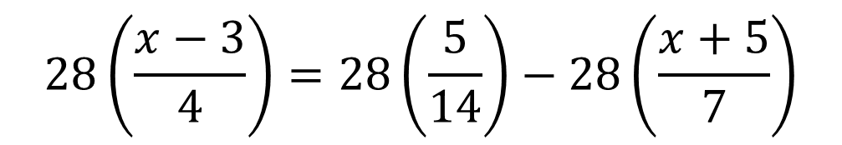
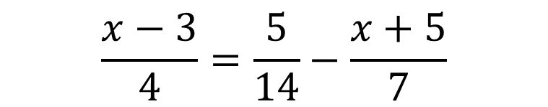



Example 2: Solving a Linear Equation Involving Fractions
Solve and check:
$$\frac{x−3}{4}=\frac{5}{14}−\frac{x+5}{7}$$
The LCD is 28; we will multiply both sides of the
equation by 28.
$$28\left(\frac{x−3}{4}\right)=28\left(\frac{5}{14}\right)−28\left(\frac{x+5}{7}\right)$$
$$\left.7(x−3)=2(5)−4(x+5\right)$$
$$7x−21=10−4x−20$$
$$7x−21=−4x−10$$

Slide 11
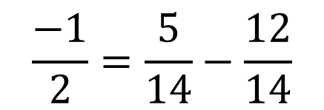

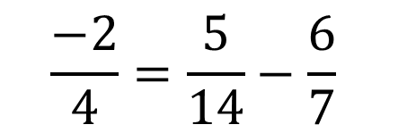

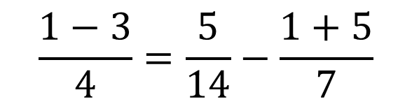
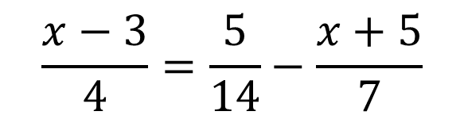
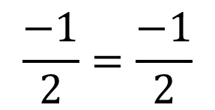

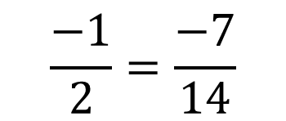
Example 2: Solving a Linear Equation Involving Fractions (continued)
$$11x−21=−10$$
$$11x=11$$
$$x=1$$
Check:
$$\frac{x−3}{4}=\frac{5}{14}−\frac{x+5}{7}$$
$$\frac{−1}{2}=\frac{5}{14}−\frac{12}{14}$$
$$\frac{1−3}{4}=\frac{5}{14}−\frac{1+5}{7}$$
$$\frac{−1}{2}=\frac{−7}{14}$$
$$\frac{−2}{4}=\frac{5}{14}−\frac{6}{7}$$
$$\frac{−1}{2}=\frac{−1}{2}$$

Slide 12

Solving Rational Equations
A rational equation contains one or more rational expressions. When we solved the equation
$\frac{x−3}{4}=\frac{5}{14}−\frac{x+5}{7}$,
we were solving a rational equation with constants in the denominators. A rational equation may also contain the variable in one or more denominators.

Slide 13
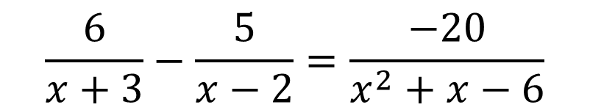
Example 3: Solving a Rational Equation
$$\frac{6}{x+3}−\frac{5}{x−2}=\frac{−20}{x^{2}+x−6}$$
Solve:
We begin by factoring x² + x – 6 = (x + 3)(x – 2)
We see that x cannot equal –3 or 2.
The least common denominator is (x + 3)(x – 2).
We will use this denominator to clear the fractions in this equation.

Slide 14
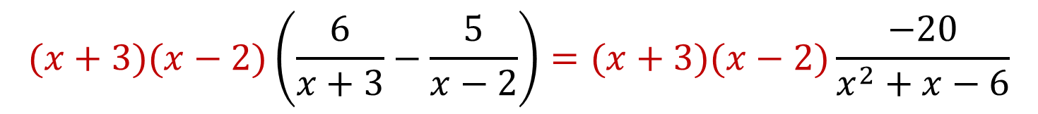




Example 3: Solving a Rational Equation (continued)
$$\frac{6}{x+3}−\frac{5}{x−2}=\frac{−20}{x^{2}+x−6}$$
The solution set is {7}.
$$(x+3)(x−2)\left(\frac{6}{x+3}−\frac{5}{x−2}\right)=(x+3)(x−2)\frac{−20}{x^{2}+x−6}$$
$$6(x−2)−5(x+3)=−20$$
$$6x−12−5x−15=−20$$
$$x−27=−20$$
$$x=7$$

Slide 15
Solving a Formula For a Variable
Solving a formula for a variable means rewriting the formula so that the variable is isolated on one side of the equation.

Slide 16

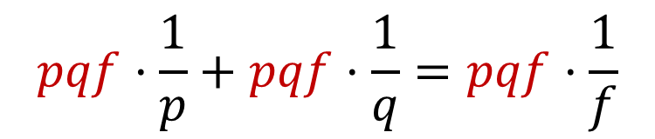



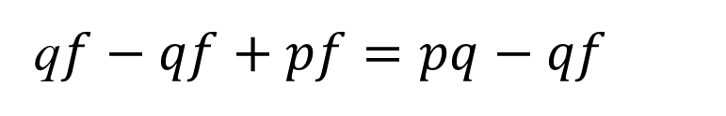

Example 5: Solving a Formula for a Variable
$$\frac{1}{p}+\frac{1}{q}=\frac{1}{f}$$
Solve for q:
$$pqf·\frac{1}{p}+pqf·\frac{1}{q}=pqf·\frac{1}{f}$$
$$qf+pf=pq$$
q$f−qf+pf=pq−qf$
$$pf=pq−qf$$
$$\left.pf=q(p−f\right)$$
$$q=\frac{pf}{p−f}$$

Slide 17
Equations Involving Absolute Value
The absolute value of x describes the distance of x from zero on a number line. To solve an absolute value equation, we rewrite the absolute value equation without absolute value bars.
Rewriting an Absolute Value Equation without Absolute Value Bars
If c is a positive real number and u represents an algebraic expression, then |u| = c is equivalent to u = c or u = – c.

Slide 18





Example 6: Solving an Equation Involving Absolute Value
Solve: $4\left|1−2x\right|−20=0.$
$$4\left|1−2x\right|−20=0$$
$$4\left|1−2x\right|=20$$
$$\left|1−2x\right|=5$$
$$1−2x=5 or 1−2x=−5$$
The solution set is {–2, 3}.
$$−2x=4$$
$$−2x=−6$$
$$x=−2$$
$$x=3$$

Slide 19
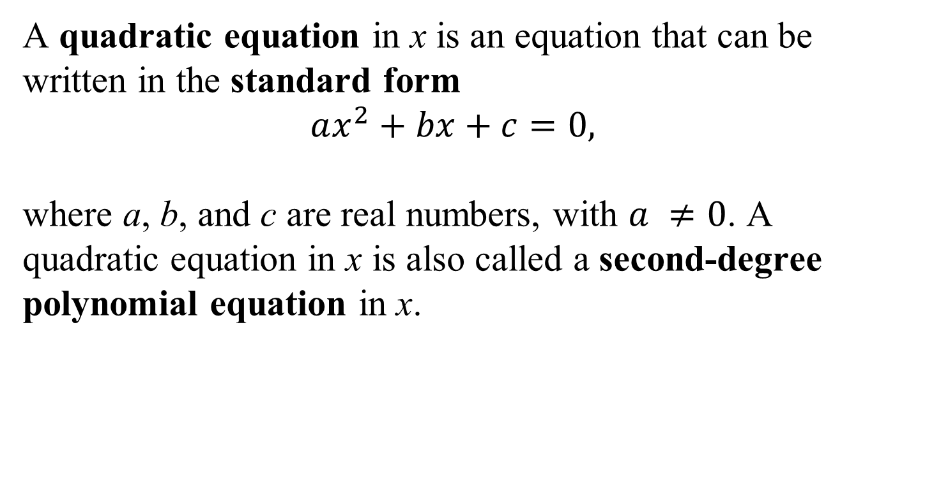
Definition of a Quadratic Equation
A quadratic equation in x is an equation that can be written in the standard form
$ax^{2}+bx+c=0,$
where a, b, and c are real numbers, with $a ≠0$. A quadratic equation in x is also called a second-degree
polynomial equation in x.

Slide 20
The Zero-Product Principle
To solve a quadratic equation by factoring, we apply the zero-product principle which states that:
If the product of two algebraic expressions is zero, then at least one of the factors is equal to zero.
If AB = 0, then A = 0 or B = 0.

Slide 21
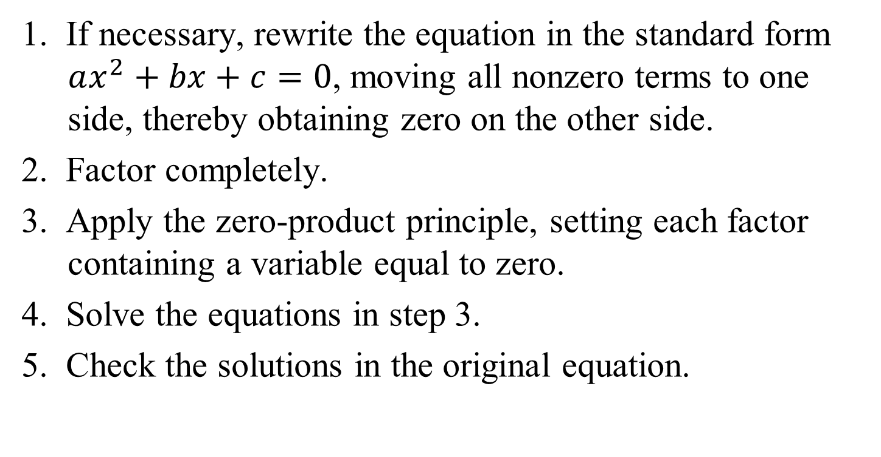
Solving a Quadratic Equation by Factoring
1. If necessary, rewrite the equation in the standard form $ax^{2}+bx+c=0$, moving all nonzero terms to one side, thereby obtaining zero on the other side.
2. Factor completely.
3. Apply the zero-product principle, setting each factor containing a variable equal to zero.
4. Solve the equations in step 3.
5. Check the solutions in the original equation.

Slide 22

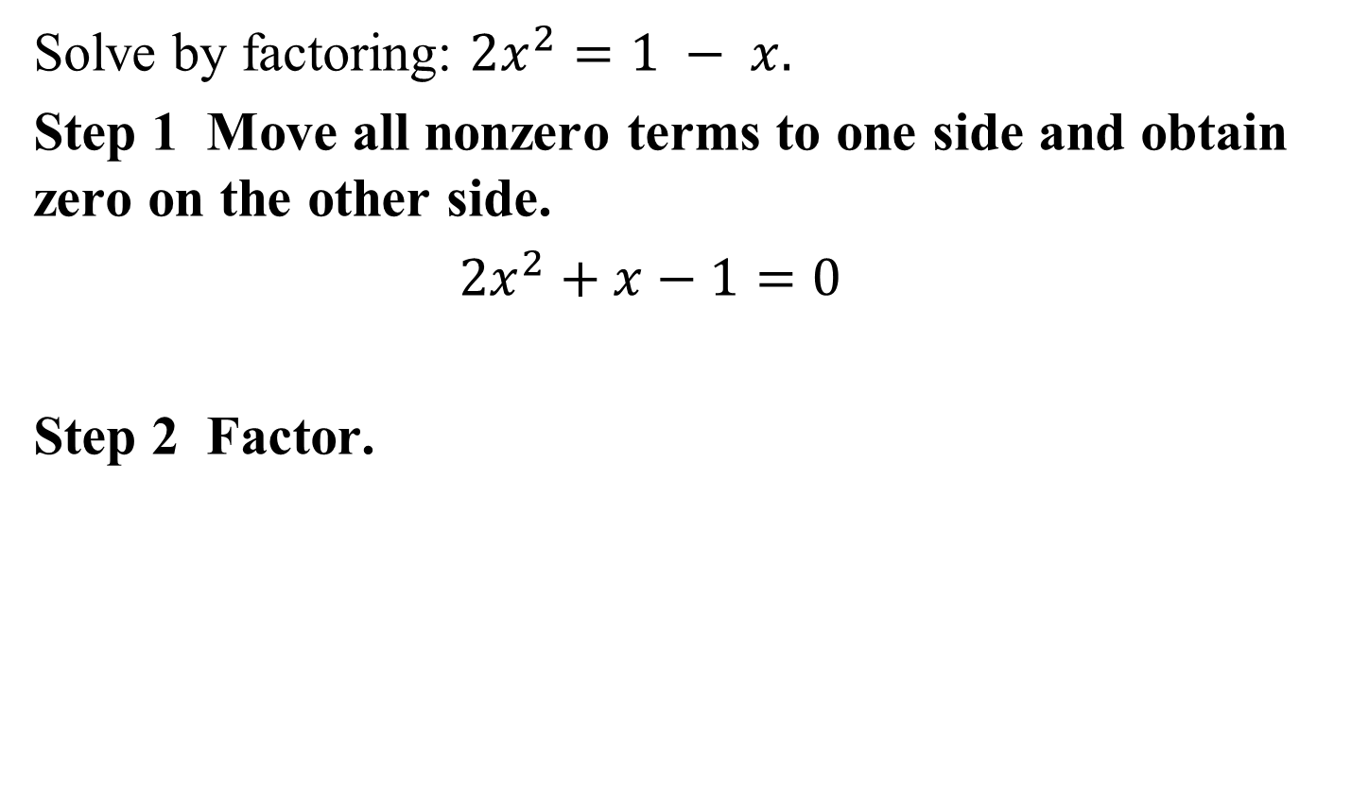
Example 7b: Solving Quadratic Equations by Factoring
Solve by factoring: $2x^{2}=1 − x.$
Step 1 Move all nonzero terms to one side and obtain zero on the other side.
$2x^{2}+x−1=0$
Step 2 Factor.
$$\left(2x−1)(x+1)=0\right.$$

Slide 23






Example 7b: Solving Quadratic Equations by Factoring (continued)
Steps 3 and 4 Set each factor equal to zero and solve the resulting equations.
$$\left(2x−1)(x+1)=0\right.$$
$$2x−1=0$$
$$x+1=0$$
$$2x=1$$
$$x=−1$$
$$x=\frac{1}{2}$$

Slide 24
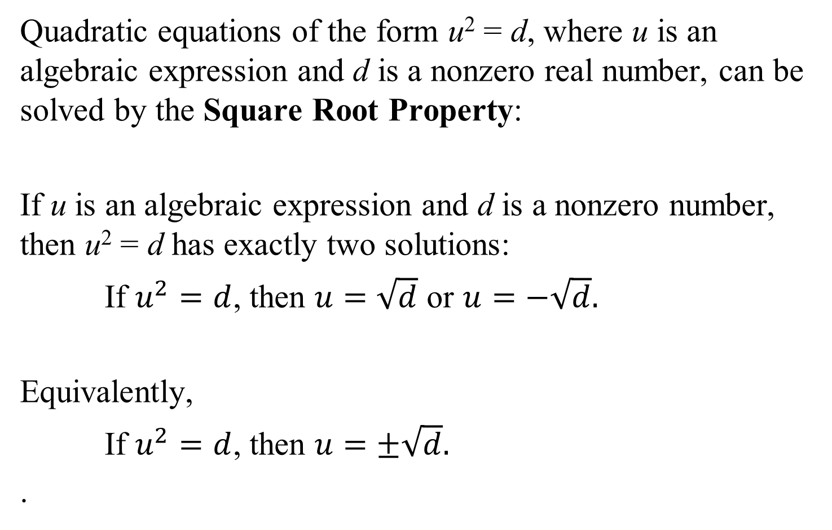
Solving Quadratic Equations by the Square Root Property
Quadratic equations of the form u² = d, where u is an algebraic expression and d is a nonzero real number, can be solved by the Square Root Property:
If u is an algebraic expression and d is a nonzero number, then u² = d has exactly two solutions:
If $u^{2}=d$, then $u=\sqrt{d}$ or $u=−\sqrt{d}.$
Equivalently,
If $u^{2}=d$, then $u=±\sqrt{d}.$
.

Slide 25
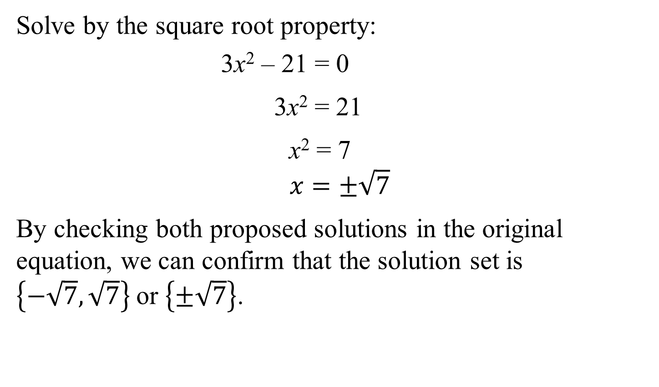
Example 8: Solving Quadratic Equations by the Square Root Property
Solve by the square root property:
3x² – 21 = 0
3x² = 21
x² = 7
$$x=±\sqrt{7}$$
By checking both proposed solutions in the original equation, we can confirm that the solution set is $\left\{−\sqrt{7}, \sqrt{7}\right\}$or $\left\{±\sqrt{7}\right\}$.

Slide 26
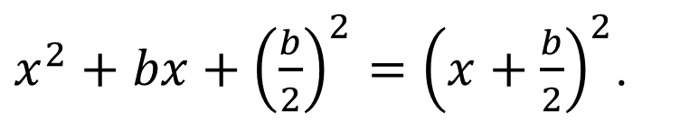
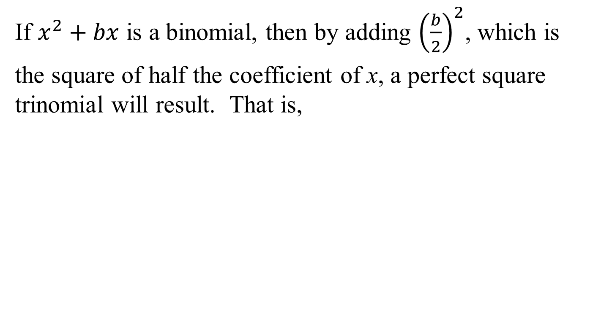
Completing the Square
If $x^{2}+bx$ is a binomial, then by adding ${\left(\frac{b}{2}\right)}^{2}$, which is
the square of half the coefficient of x, a perfect square trinomial will result. That is,
$x^{2}+bx+{\left(\frac{b}{2}\right)}^{2}={\left(x+\frac{b}{2}\right)}^{2}$.

Slide 27


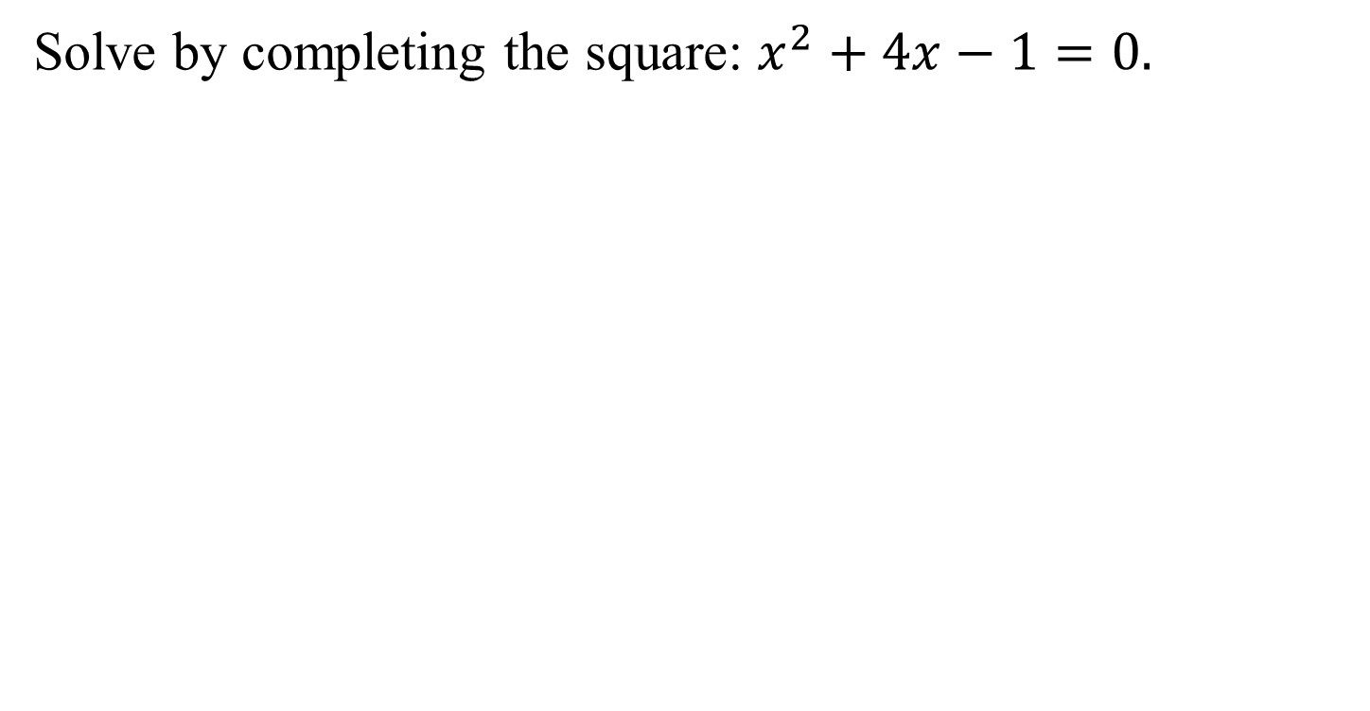


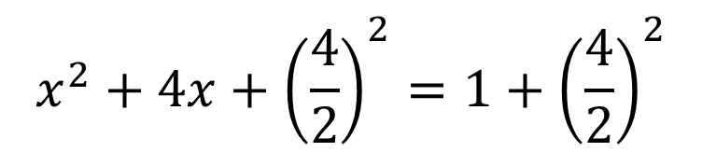
Example 9: Solving a Quadratic Equation by Completing the Square
Solve by completing the square: $x^{2}+4x−1=0.$
$$x^{2}+4x=1$$
$$x^{2}+4x+{\left(\frac{4}{2}\right)}^{2}=1+{\left(\frac{4}{2}\right)}^{2}$$
$${\left(x+2\right)}^{2}=5$$
$$x+2=±\sqrt{5}$$
$$x=−2±\sqrt{5}$$

Slide 28
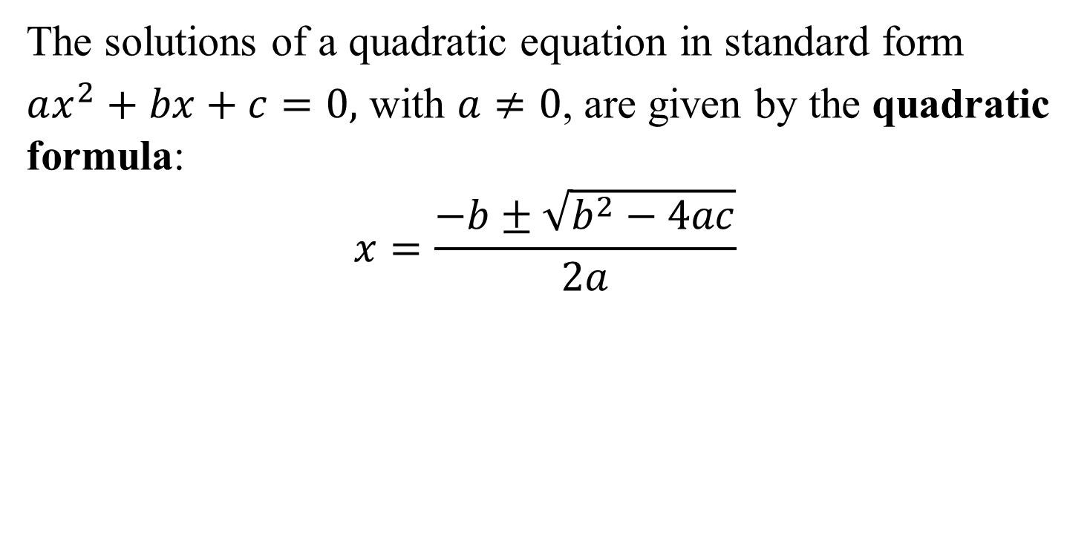
The Quadratic Formula
The solutions of a quadratic equation in standard form
$ax^{2}+bx+c=0,$ with $a≠0$, are given by the quadratic formula:
$$x=\frac{−b±\sqrt{b^{2}−4ac}}{2a}$$

Slide 29
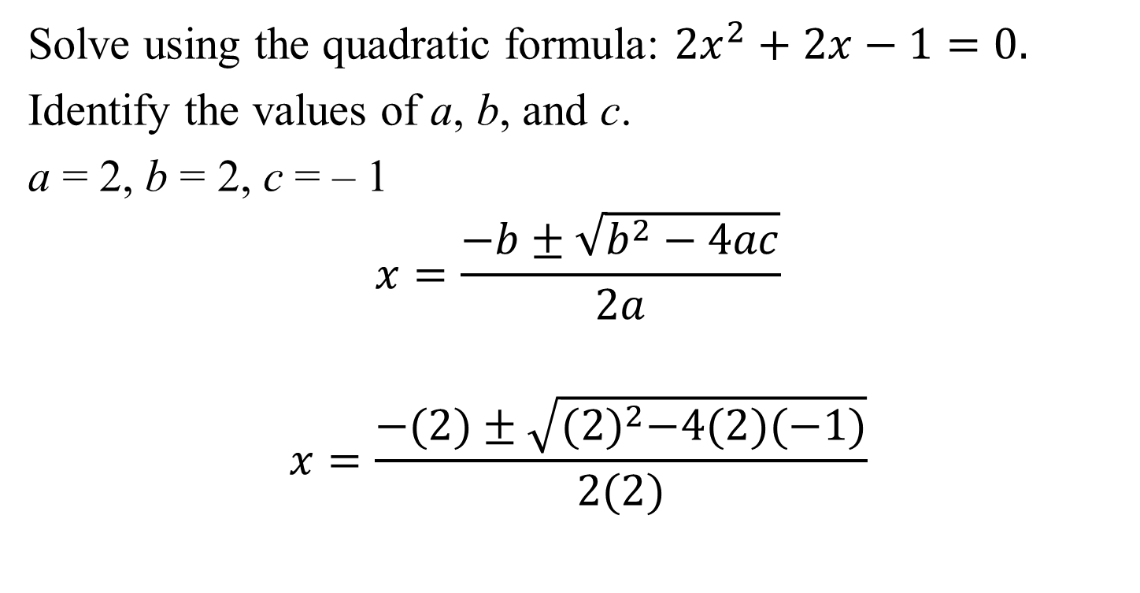
Example 10: Solving a Quadratic Equation Using the Quadratic Formula
Solve using the quadratic formula: $2x^{2}+2x−1=0.$
Identify the values of a, b, and c.
a = 2, b = 2, c = – 1
$$x=\frac{−b±\sqrt{b^{2}−4ac}}{2a}$$
$$x=\frac{−(2)±\sqrt{{(2)}^{2}−4(2)(−1)}}{2(2)}$$

Slide 30
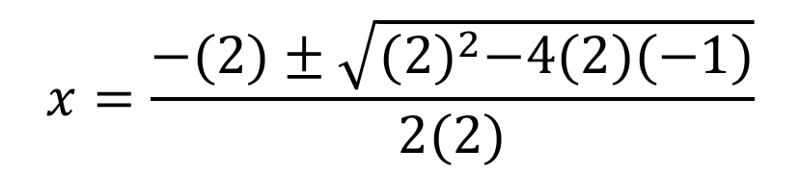
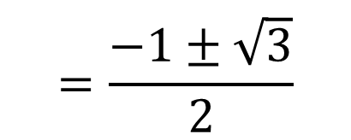
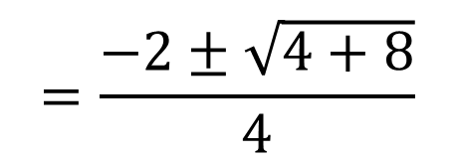
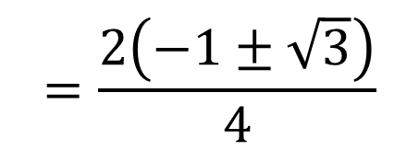
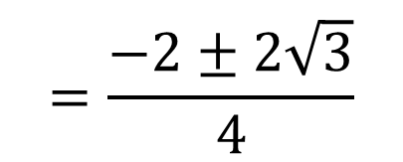
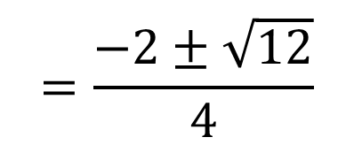
Example 10: Solving a Quadratic Equation Using the Quadratic Formula (continued)
$$x=\frac{−(2)±\sqrt{{(2)}^{2}−4(2)(−1)}}{2(2)}$$
$$=\frac{−2±\sqrt{4+8}}{4}$$
$$=\frac{−2±\sqrt{12}}{4}$$
$$=\frac{−2±2\sqrt{3}}{4}$$
$$=\frac{2\left(−1±\sqrt{3}\right)}{4}$$
$$=\frac{−1±\sqrt{3}}{2}$$

Slide 31
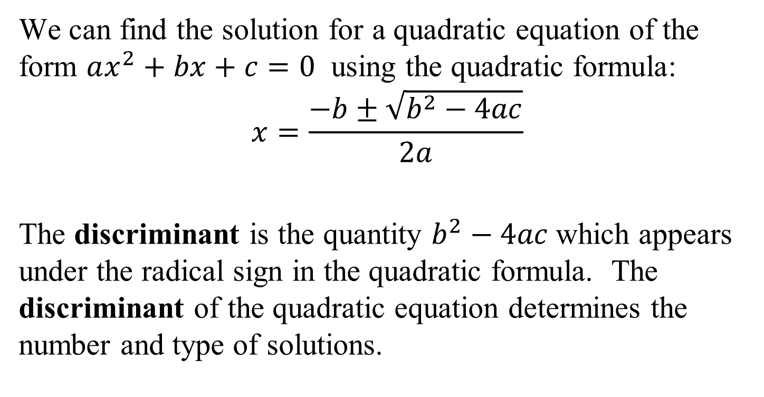
The Discriminant
We can find the solution for a quadratic equation of the form $ax^{2}+bx+c=0$ using the quadratic formula:
$$x=\frac{−b±\sqrt{b^{2}−4ac}}{2a}$$
The discriminant is the quantity $b^{2}−4ac$which appears under the radical sign in the quadratic formula. The discriminant of the quadratic equation determines the number and type of solutions.

Slide 32
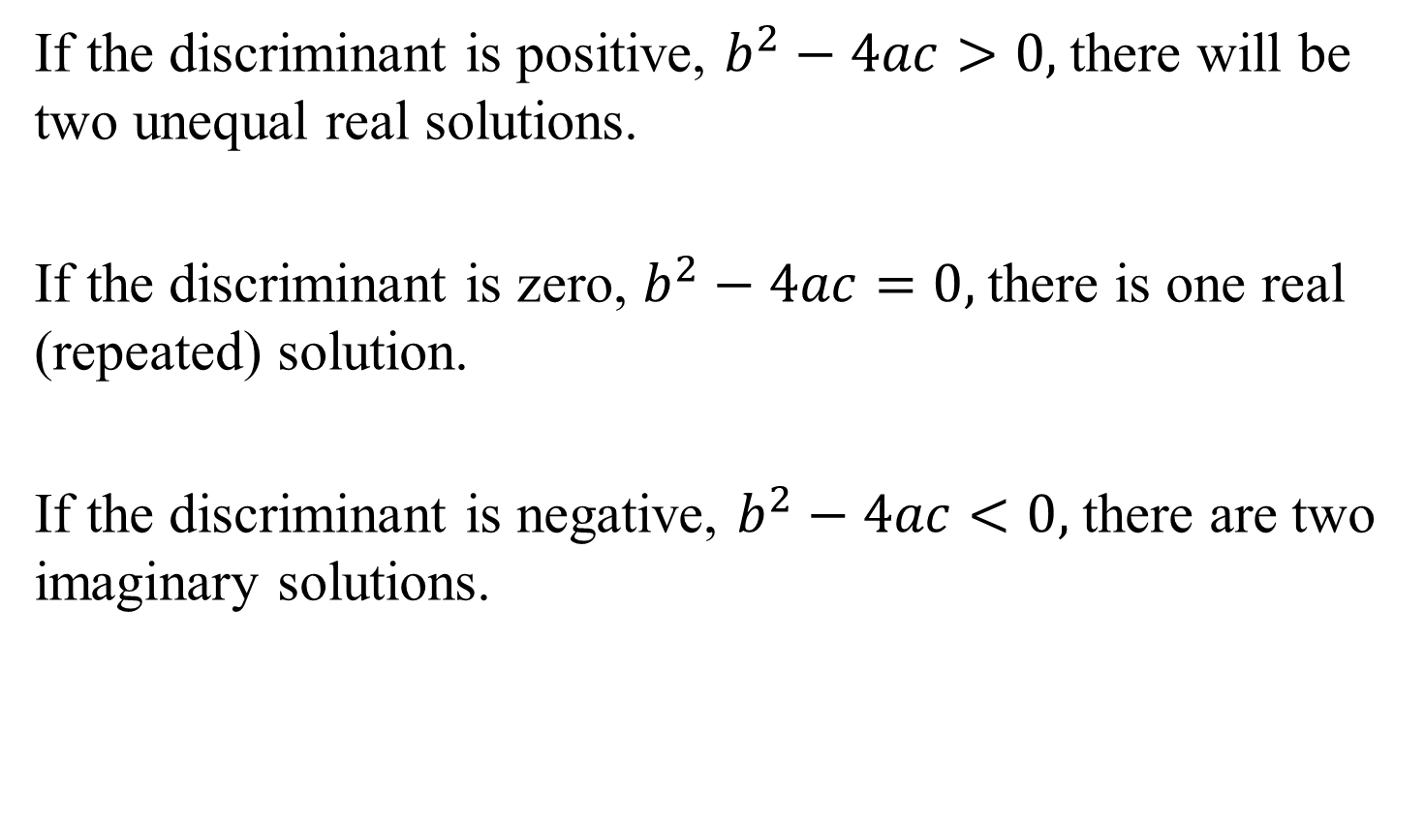
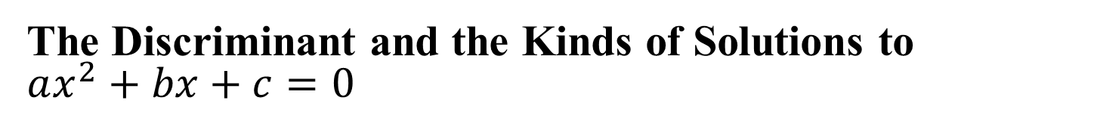
The Discriminant and the Kinds of Solutions to
$ax^{2}+bx+c=0$
If the discriminant is positive, $b^{2}−4ac>0,$there will be two unequal real solutions.
If the discriminant is zero, $b^{2}−4ac=0,$there is one real (repeated) solution.
If the discriminant is negative, $b^{2}−4ac<0,$there are two imaginary solutions.

Slide 33
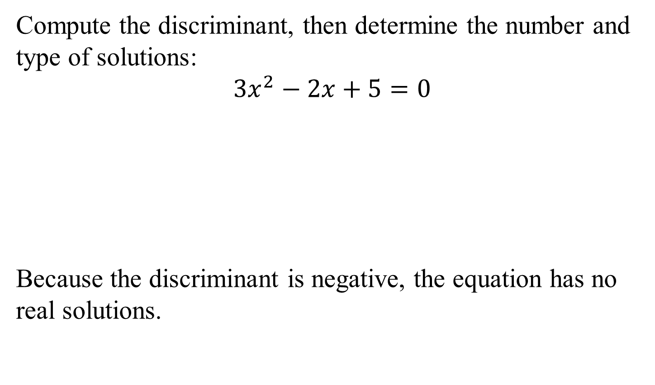
Example 11: Using the Discriminant
Compute the discriminant, then determine the number and type of solutions:
$$3x^{2}−2x+5=0$$
Because the discriminant is negative, the equation has no real solutions.
$$b^{2}−4ac={\left(−2\right)}^{2}−4\left(3\right)\left(5\right)=4−60=−56$$

Slide 34
Radical Equations
A radical equation is an equation in which the variable occurs in a square root, cube root, or any higher root.
We solve radical equations with nth roots by raising both sides of the equation to the nth power.

Slide 35
Solving Radical Equations Containing nth Roots
1. If necessary, arrange terms so that one radical is isolated on one side of the equation.
2. Raise both sides of the equation to the nth power to eliminate the isolated nth root.
3. Solve the resulting equation. If this equation still contains radicals, repeat steps 1 and 2.
4. Check all proposed solutions in the original equation.

Slide 36
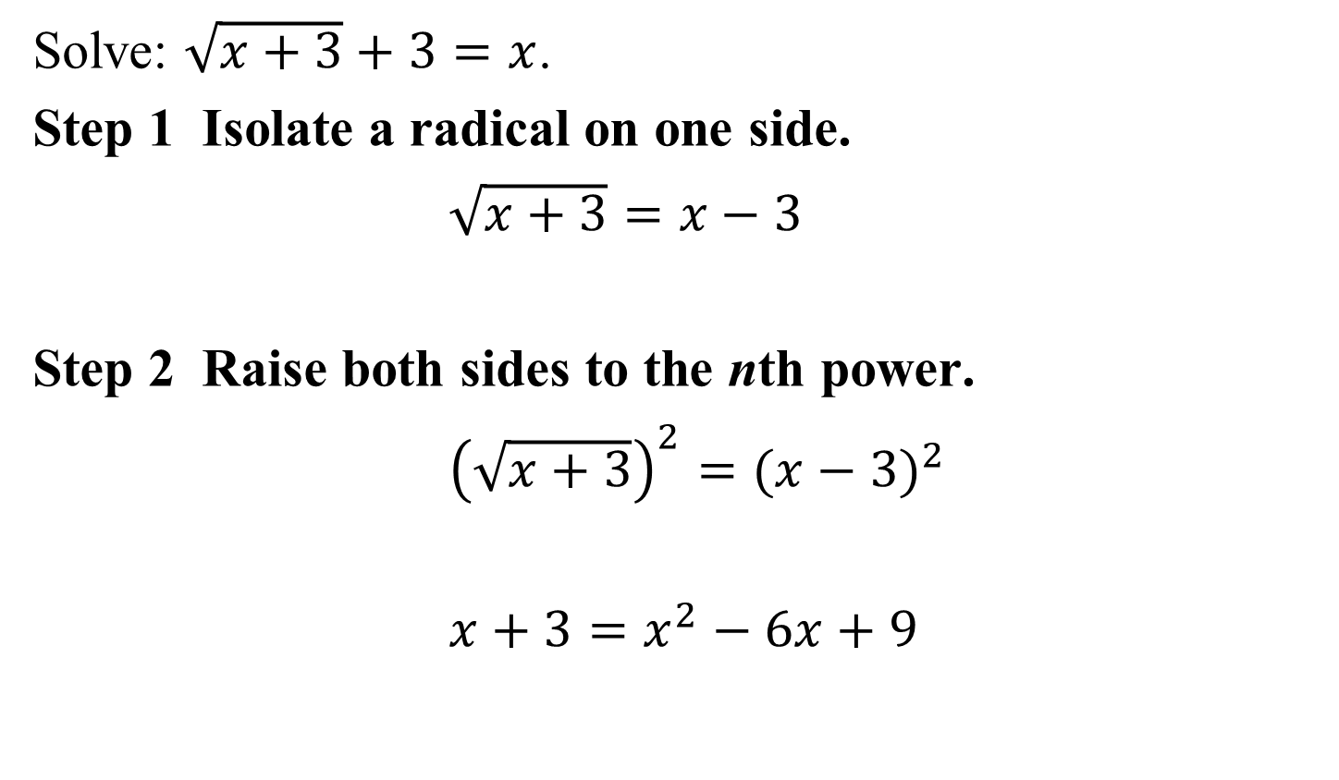
Example 12: Solving a Radical Equation
Solve: $\sqrt{x+3}+3=x$.
Step 1 Isolate a radical on one side.
$\sqrt{x+3}=x−3$
Step 2 Raise both sides to the nth power.
${\left(\sqrt{x+3}\right)}^{2}={(x−3)}^{2}$
$x+3=x^{2}−6x+9$

Slide 37
Example 12: Solving a Radical Equation (continued)
Step 3 Solve the resulting equation.
$$x+3=x^{2}−6x+9$$
$$0=x^{2}−7x+6$$
$$0=(x−6)(x−1)$$
$$x−6=0$$
$$x−1=0$$
$$x=6$$
$$x=1$$

Slide 38
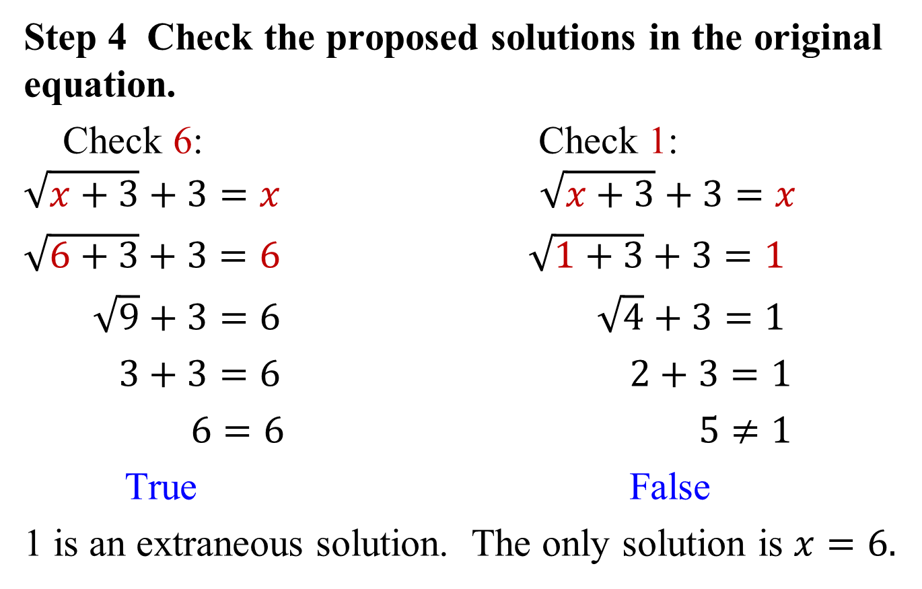
Example 12: Solving a Radical Equation (continued)
Step 4 Check the proposed solutions in the original equation.
Check 6: Check 1:
$$\sqrt{x+3}+3=x \sqrt{x+3}+3=x$$
$\sqrt{6+3}+3=6$ $\sqrt{1+3}+3=1$
$\sqrt{9}+3=6$ $\sqrt{4}+3=1$
$3+3=6$ $2+3=1$
$6=6$ $5≠1$
True False
1 is an extraneous solution. The only solution is $x=6.$

