Slide 1

Chapter 5
Systems of Equations and Inequalities
5.2 Systems of Linear Equations in Three Variables

Slide 2
Objectives
Verify the solution of a system of linear equations in three variables.
Solve systems of linear equations in three variables.
Solve problems using systems in three variables.

Slide 3
Systems of Linear Equations in Three Variables and Their Solutions
In general, any equation of the form Ax + By + Cz = D where A, B, C, and D are real numbers such that A, B, and C are not all 0, is a linear equation in three variables, x, y, and z.
A solution of a system of linear equations in three variables is an ordered triple of real numbers that satisfies all equations of the system. The solution set of the system is the set of all its solutions.

Slide 4
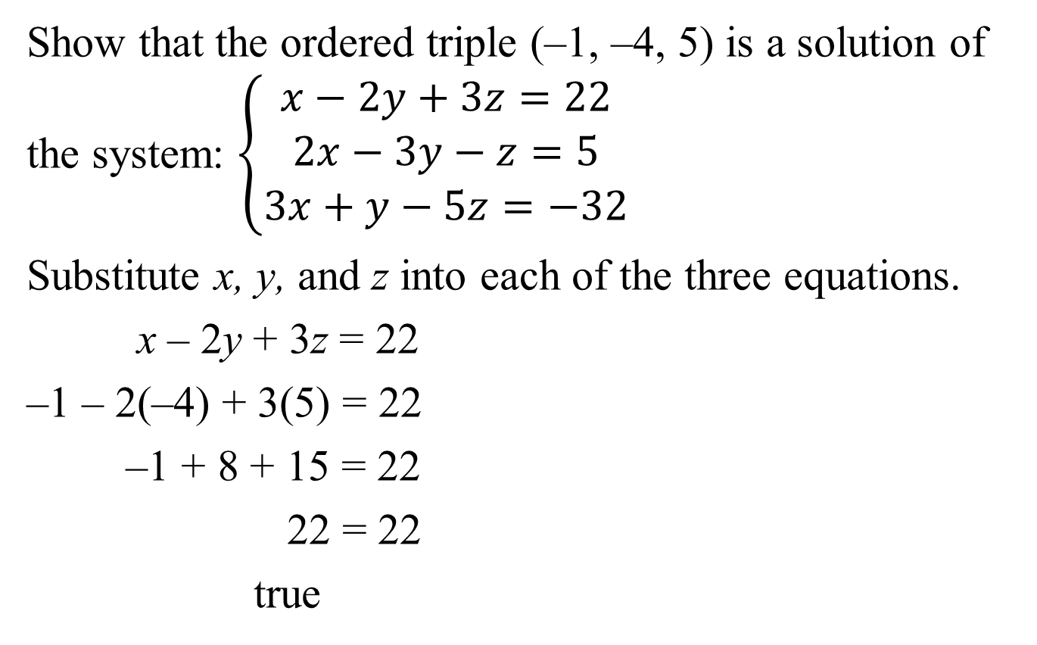
Example 1: Determining Whether an Ordered Triple Satisfies a System
Show that the ordered triple (–1, –4, 5) is a solution of the system: $\left\{\begin{aligned}x−2y+3z=22 \\ 2x−3y−z=5 \\ 3x+y−5z=−32\end{aligned}\right.$
Substitute x, y, and z into each of the three equations.
x – 2y + 3z = 22
–1 – 2(–4) + 3(5) = 22
–1 + 8 + 15 = 22
22 = 22
true
2x – 3y – z = 5
2(–1) – 3(–4) – 5 = 5
–2 + 12 – 5 = 5
5 = 5
true

Slide 5
Example 1: Determining Whether an Ordered Triple Satisfies a System (continued)
3x + y – 5z = –32
3(–1) + (–4) – 5(5) = –32
–3 – 4 – 25 = –32
–32 = –32
true
The ordered triple (–1, –4, 5) satisfies the three equations. It makes each equation true. Thus, the ordered triple is a solution of the system.

Slide 6
Solving Systems of Linear Equations in Three Variables by Eliminating Variables
1. Reduce the system to two equations in two variables. This is usually accomplished by taking two different pairs of equations and using the addition method to eliminate the same variable from both pairs.
2. Solve the resulting system of two equations in two variables using addition or substitution. The result is an equation in one variable that gives the value of that variable.
3. Back-substitute the value of the variable found in step 2 into either of the equations in two variables to find the value of the second variable.

Slide 7
Solving Systems of Linear Equations in Three Variables by Eliminating Variables (continued)
4. Use the values of the two variables from steps 2 and 3 to find the value of the third variable by back-substituting into one of the original equations.
5. Check the proposed solution in each of the original equations.

Slide 8

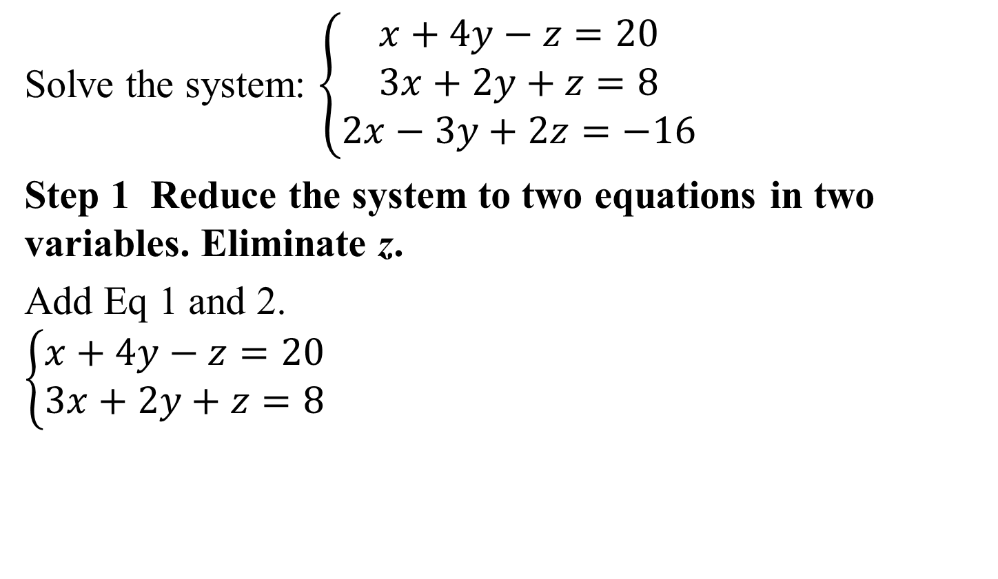

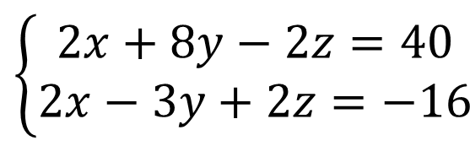
Example 2: Solving a System in Three Variables
Solve the system: $\left\{\begin{aligned}x+4y−z=20 \\ 3x+2y+z=8 \\ 2x−3y+2z=−16\end{aligned}\right.$
Step 1 Reduce the system to two equations in two variables. Eliminate z.
Add Eq 1 and 2.
$$\left\{\begin{aligned}x+4y−z=20 \\ 3x+2y+z=8\end{aligned}\right.$$
Add Eq 1 and 3.
$$\left\{\begin{aligned}2x+8y−2z=40 \\ 2x−3y+2z=−16\end{aligned}\right.$$
Multiply by 2.
No Change
$$4x+6y=28$$
$$4x+5y=24$$

Slide 9

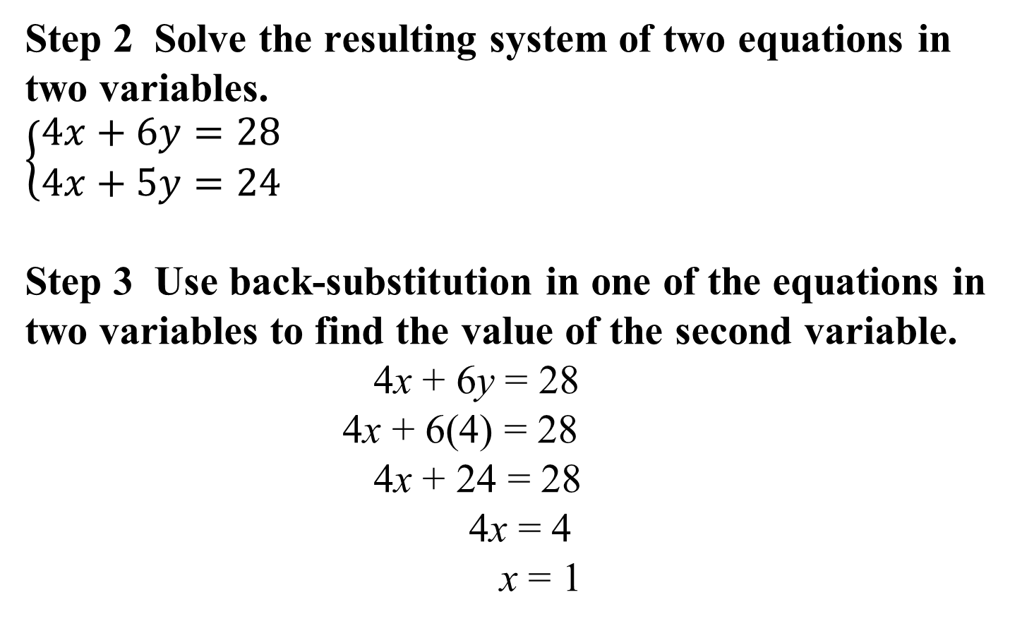
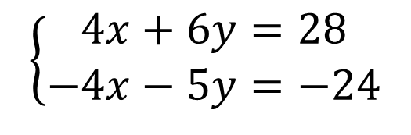
Example 2: Solving a System in Three Variables
(continued)
Step 2 Solve the resulting system of two equations in two variables.
$$\left\{\begin{aligned}4x+6y=28 \\ 4x+5y=24\end{aligned}\right.$$
Step 3 Use back-substitution in one of the equations in two variables to find the value of the second variable.
4x + 6y = 28
4x + 6(4) = 28
4x + 24 = 28
4x = 4
x = 1
No Change
$$\left\{\begin{aligned}4x+6y=28 \\ −4x−5y=−24\end{aligned}\right.$$
Multiply by –1.
$$y=4$$

Slide 10
Example 2: Solving a System in Three Variables
Step 4 Back-substitute the values found for two variables into one of the original equations to find the value of the third variable.
x + 4y – z = 20
1 + 4(4) – z = 20
17 – z = 20
–z = 3
z = –3
The proposed solution is (1, 4, –3). By substituting the values for x, y, and z into each of the original three equations you will find the solution set is {(1, 4, –3)}.

Slide 11



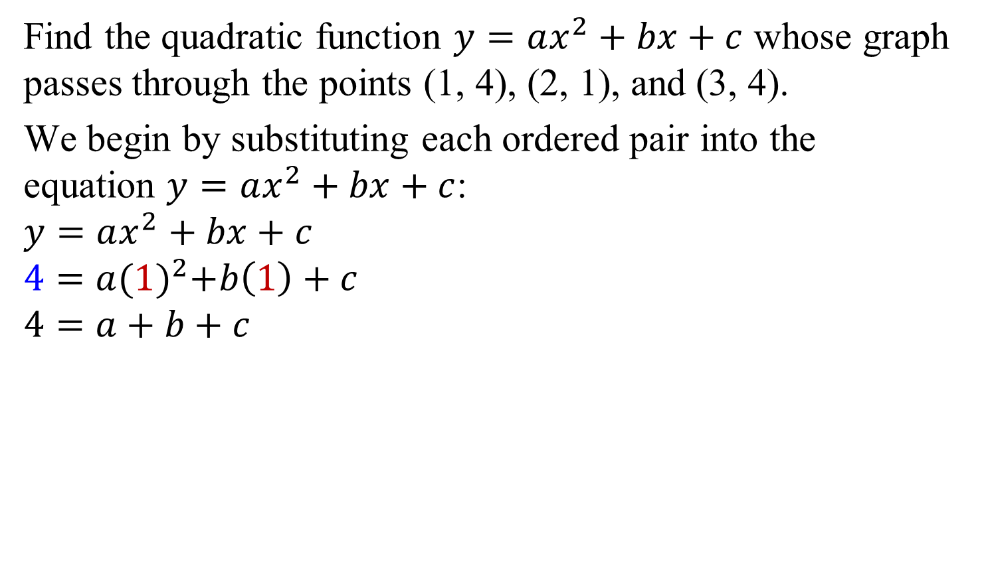



Example 4: Application
Find the quadratic function $y=ax^{2}+bx+c$ whose graph passes through the points (1, 4), (2, 1), and (3, 4).
We begin by substituting each ordered pair into the equation $y=ax^{2}+bx+c$:
$$y=ax^{2}+bx+c$$
$$4=a{(1)}^{2}+b\left(1\right)+c$$
$$4=a+b+c$$
$$y=ax^{2}+bx+c$$
$$4=a{(3)}^{2}+b\left(3\right)+c$$
$$4=9a+3b+c$$
$$y=ax^{2}+bx+c$$
$$1=a{(2)}^{2}+b\left(2\right)+c$$
$$1=4a+2b+c$$

Slide 12

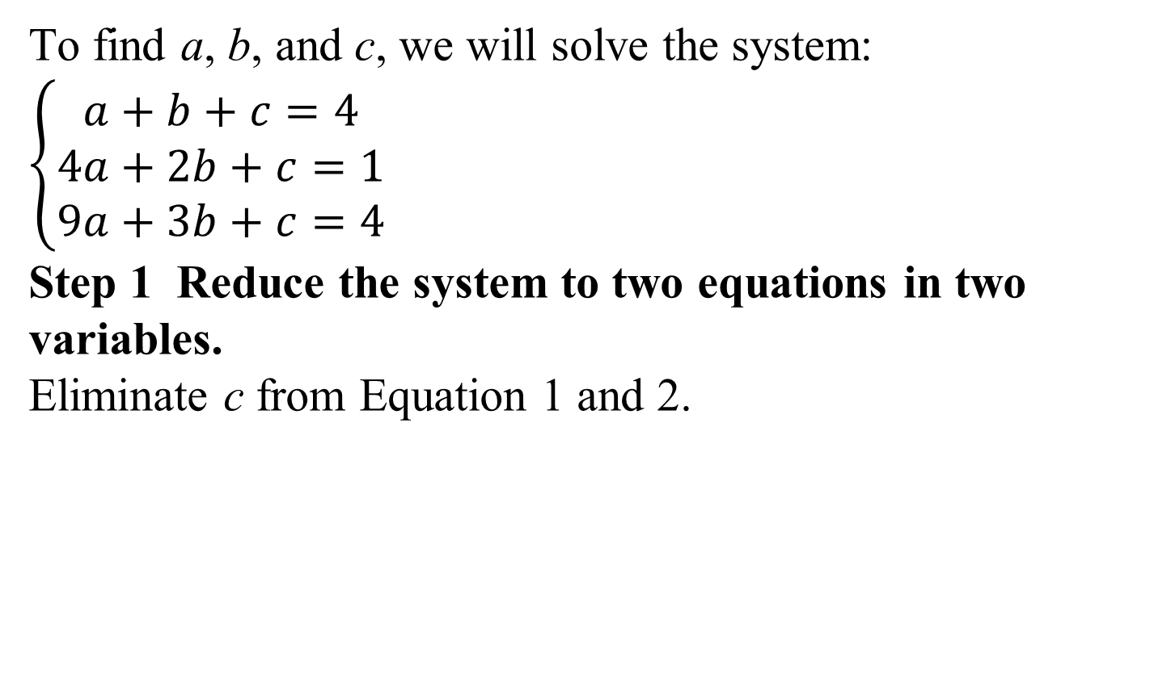
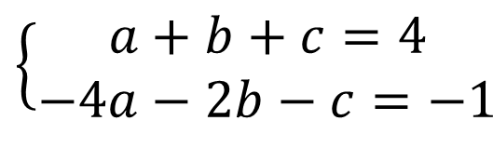
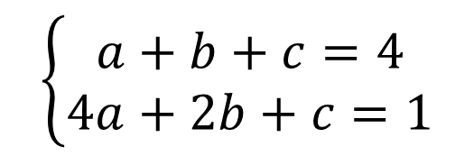
Example 4: Application (continued)
To find a, b, and c, we will solve the system:
$$\left\{\begin{aligned}a+b+c=4 \\ 4a+2b+c=1 \\ 9a+3b+c=4\end{aligned}\right.$$
Step 1 Reduce the system to two equations in two variables.
Eliminate c from Equation 1 and 2.
No Change
$$\left\{\begin{aligned}a+b+c=4 \\ 4a+2b+c=1\end{aligned}\right.$$
$$\left\{\begin{aligned}a+b+c=4 \\ −4a−2b−c=−1\end{aligned}\right.$$
Multiply by –1.
$$−3a−b=3$$

Slide 13

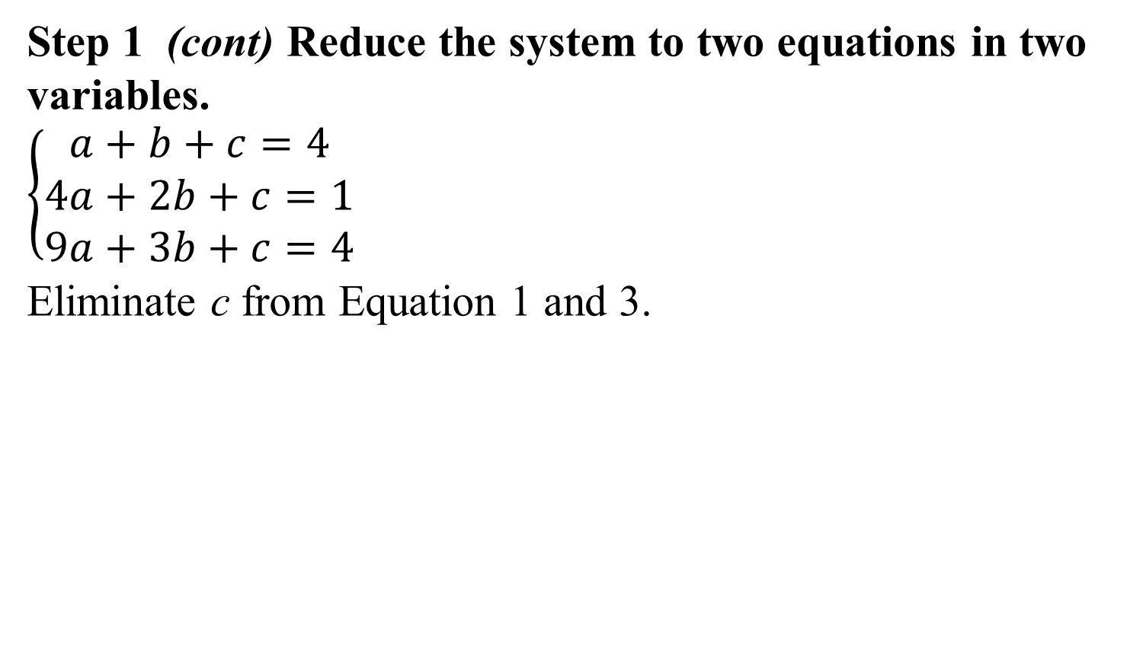
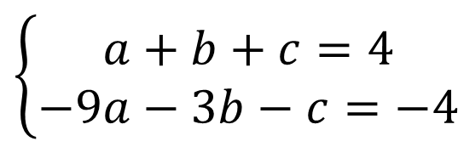

Example 4: Application (continued)
Step 1 (cont) Reduce the system to two equations in two variables.
$$\left\{\begin{aligned}a+b+c=4 \\ 4a+2b+c=1 \\ 9a+3b+c=4\end{aligned}\right.$$
Eliminate c from Equation 1 and 3.
$$\left\{\begin{aligned}a+b+c=4 \\ 9a+3b+c=4\end{aligned}\right.$$
No Change
$$\left\{\begin{aligned}a+b+c=4 \\ −9a−3b−c=−4\end{aligned}\right.$$
Multiply by –1.
$$−8a−2b=0$$

Slide 14



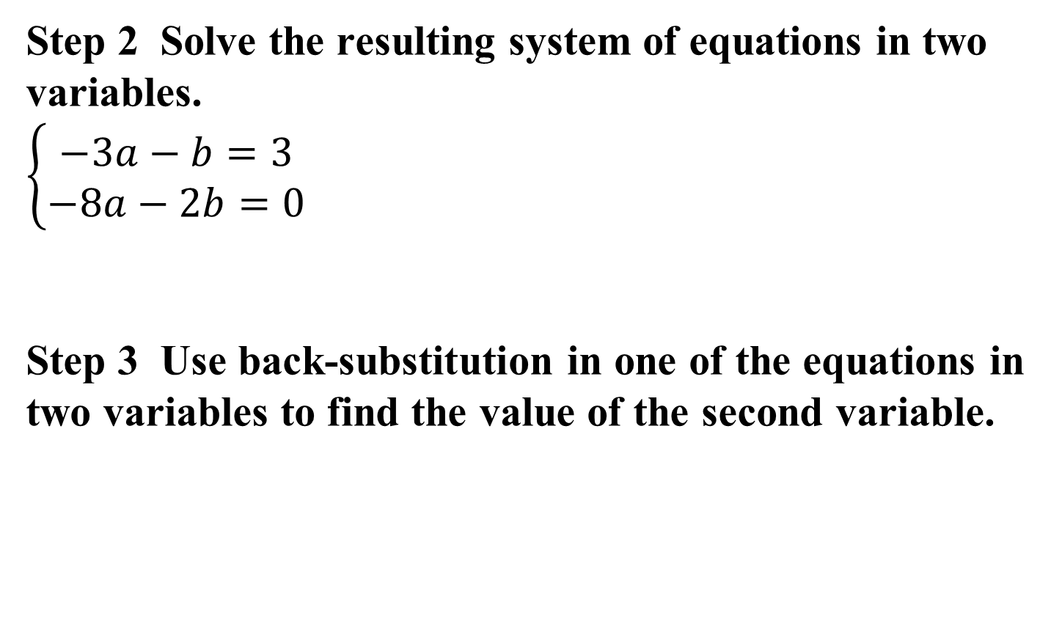


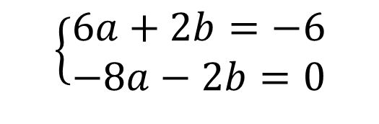

Example 4: Application (continued)
Step 2 Solve the resulting system of equations in two
variables.
$$\left\{\begin{aligned}−3a−b=3 \\ −8a−2b=0\end{aligned}\right.$$
Step 3 Use back-substitution in one of the equations in two variables to find the value of the second variable.
Multiply by –2.
$$\left\{\begin{aligned}6a+2b=−6 \\ −8a−2b=0\end{aligned}\right.$$
No Change
$$−2a=−6$$
$$a=3$$
$$−3a−b=3$$
$$−3\left(3\right)−b=3$$
$$−9−b=3$$
$$b=−12$$

Slide 15
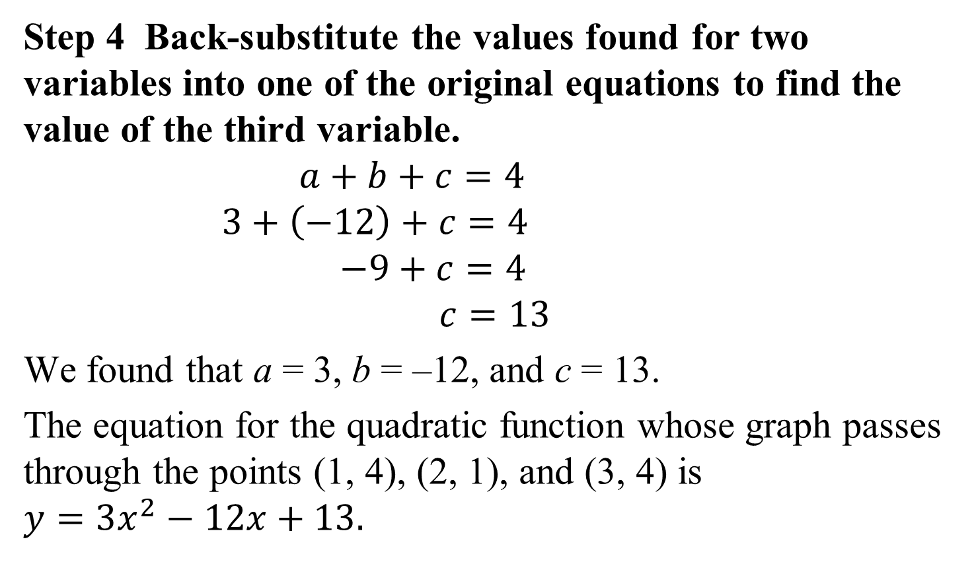
Example 4: Application (continued)
Step 4 Back-substitute the values found for two variables into one of the original equations to find the value of the third variable.
$a+b+c=4$
$3+\left(−12\right)+c=4$
$−9+c=4$
$c=13$
We found that a = 3, b = –12, and c = 13.
The equation for the quadratic function whose graph passes through the points (1, 4), (2, 1), and (3, 4) is
$$y=3x^{2}−12x+13.$$

