Slide 1

Chapter 5
Systems of Equations and Inequalities
5.1 Systems of Linear Equations in Two Variables

Slide 2
Objectives
Decide whether an ordered pair is a solution of a linear system.
Solve linear systems by substitution.
Solve linear systems by addition.
Identify systems that do not have exactly one
ordered-pair solution.
Solve problems using systems of linear equations.

Slide 3
Systems of Linear Equations and Their Solutions
All equations in the form Ax + By = C are straight lines when graphed. Two such equations are called a system of linear equations or a linear system. A solution to a system of linear equations in two variables is an ordered pair that satisfies both equations in the system.
A linear system that has at least one solution is called a consistent system.
A linear system with no solution is called an inconsistent system.

Slide 4
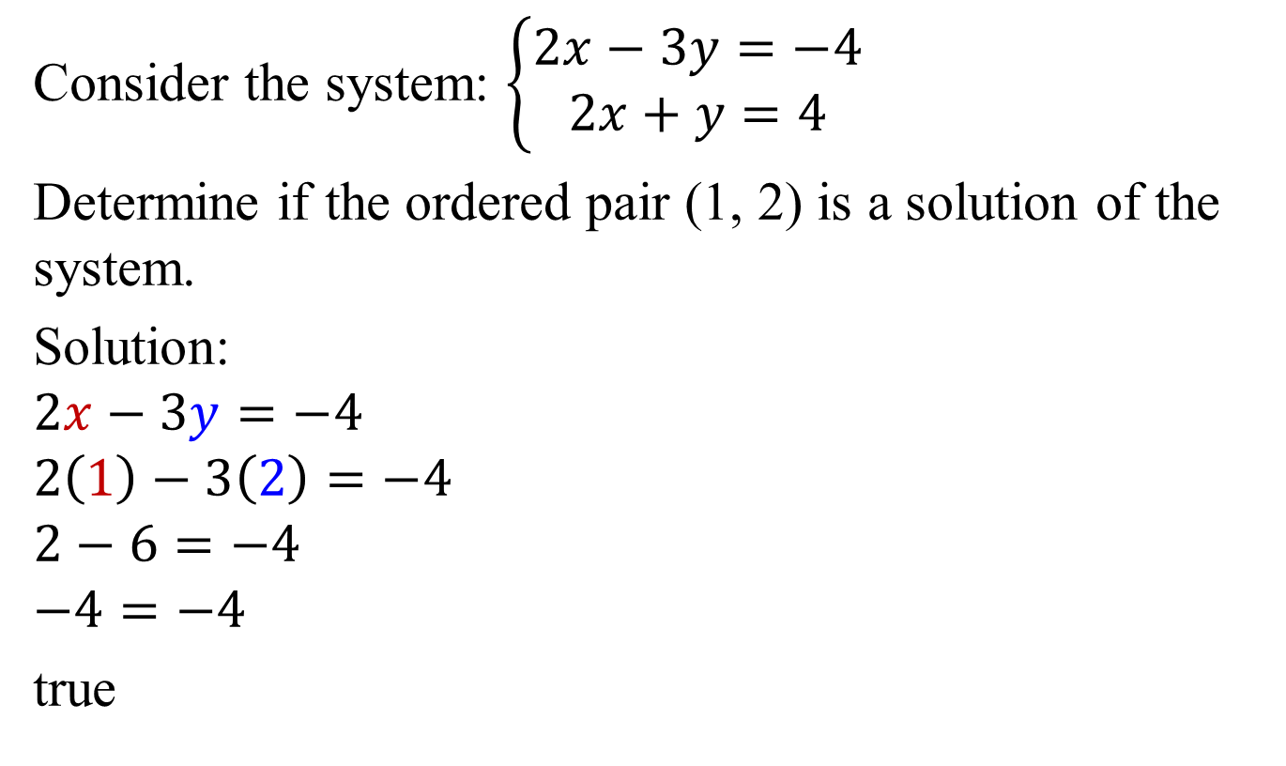




Example 1a: Determining Whether Ordered Pairs are Solutions of a System
Consider the system: $\left\{\begin{aligned}2x−3y=−4 \\ 2x+y=4\end{aligned}\right.$
Determine if the ordered pair (1, 2) is a solution of the system.
Solution:
$$2x−3y=−4$$
$$2\left(1\right)−3\left(2\right)=−4$$
$$2−6=−4$$
$$−4=−4$$
true
$$2x+y=4$$
The ordered pair
(1, 2) satisfies both
equations. (1, 2) is
a solution of
the system.
$$2\left(1\right)+2=4$$
$$2+2=4$$
$$4=4$$
true

Slide 5
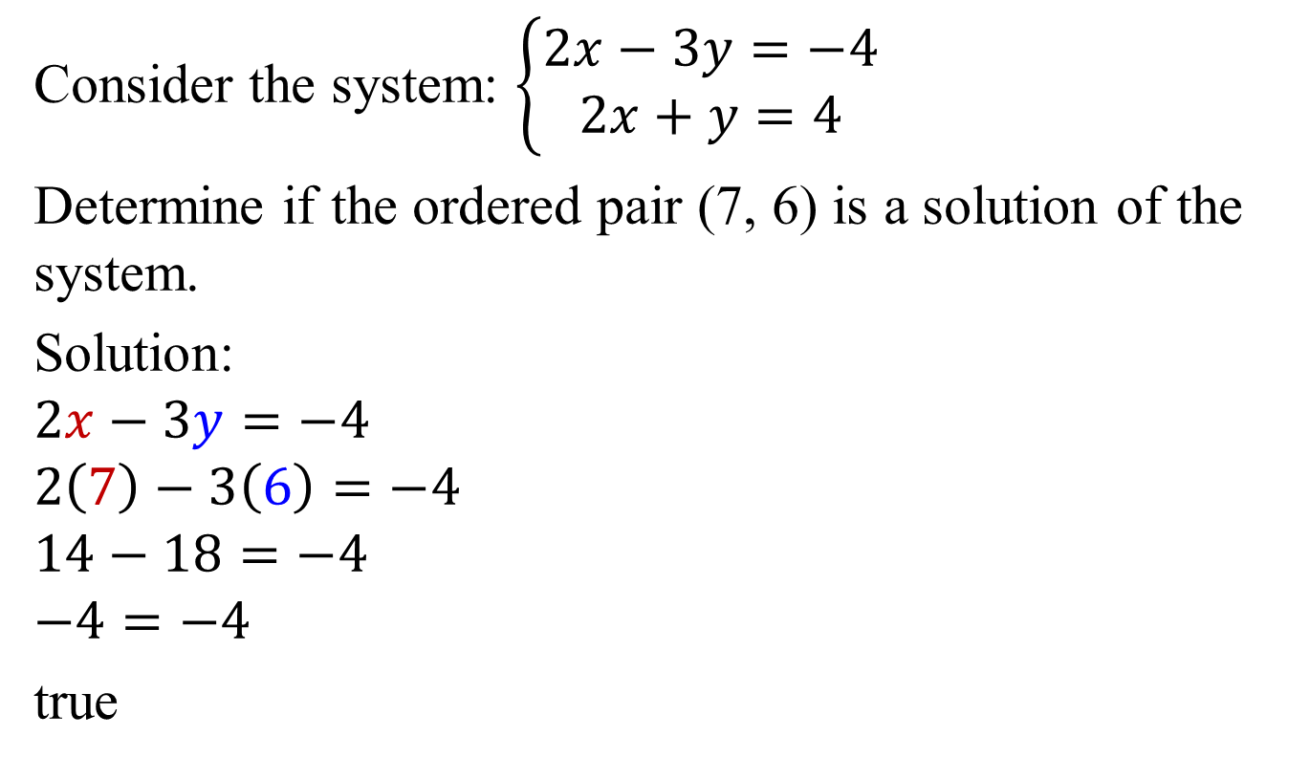



Example 1b: Determining Whether Ordered Pairs are Solutions of a System
Consider the system: $\left\{\begin{aligned}2x−3y=−4 \\ 2x+y=4\end{aligned}\right.$
Determine if the ordered pair (7, 6) is a solution of the system.
Solution:
$$2x−3y=−4$$
$$2\left(7\right)−3\left(6\right)=−4$$
$$14−18=−4$$
$$−4=−4$$
true
The ordered pair
(7, 6) fails to
satisfy both
equations. Thus,
the ordered pair
is not a solution of
the system.
$$2x+y=4$$
$$2\left(7\right)+6=4$$
$$14+6=4$$
$$20=4$$
false

Slide 6
Solving Linear Systems by Substitution
1. Solve either of the equations for one variable in terms of the other. (If one of the equations is already in this form, you can skip this step.)
2. Substitute the expression found in step 1 into the other equation. This will result in an equation in one variable.
3. Solve the equation containing one variable.
4. Back-substitute the value found in step 3 into one of the original equations. Simplify and find the value of the remaining variable.
5. Check the proposed solution in both of the system’s given equations.

Slide 7
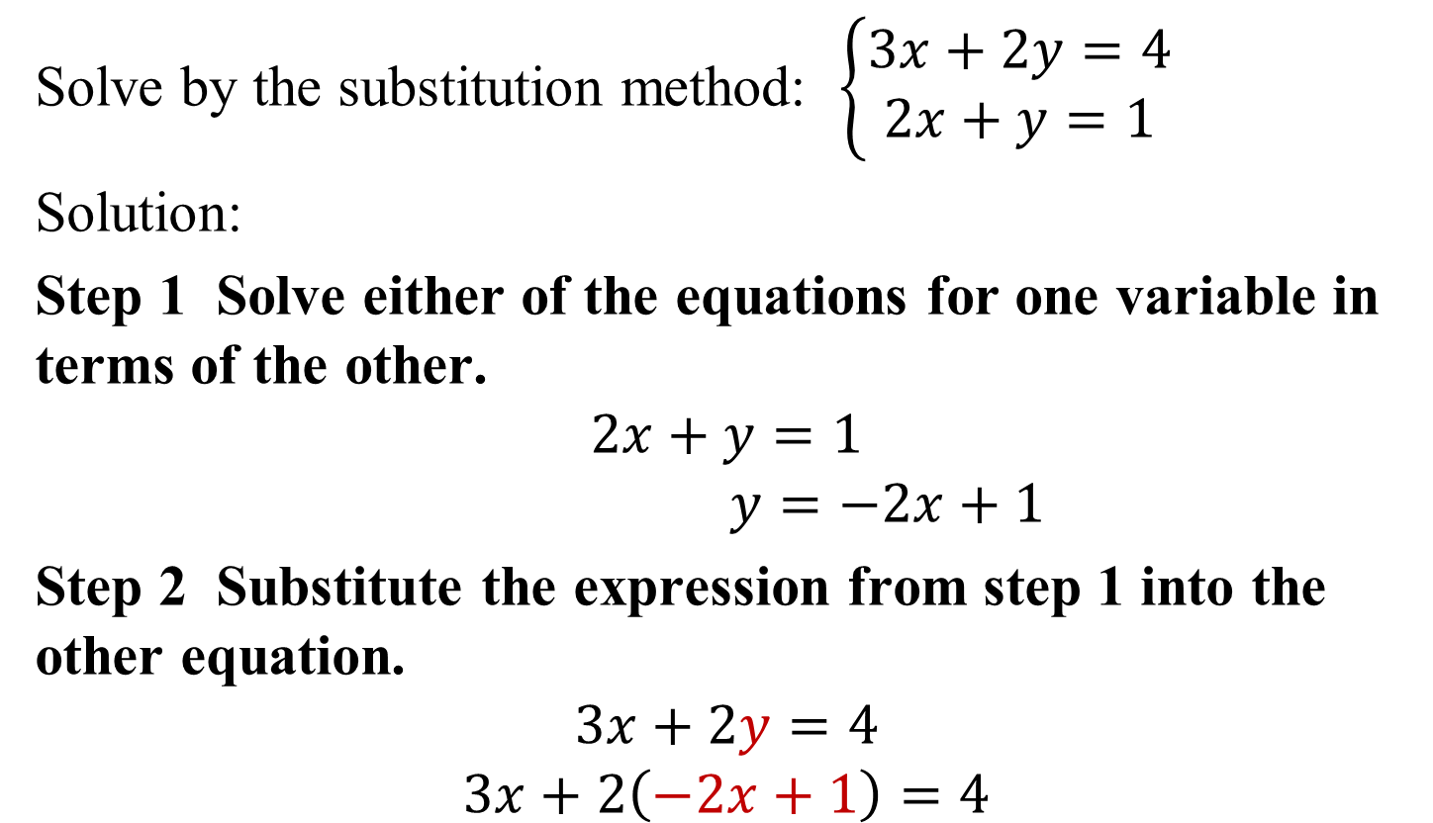
Example 2: Solving a System by Substitution
Solve by the substitution method: $\left\{\begin{aligned}3x+2y=4 \\ 2x+y=1\end{aligned}\right.$
Solution:
Step 1 Solve either of the equations for one variable in terms of the other.
$$2x+y=1$$
$y=−2x+1$
Step 2 Substitute the expression from step 1 into the other equation.
$$3x+2y=4$$
$$3x+2\left(−2x+1\right)=4$$

Slide 8
Example 2: Solving a System by Substitution
(continued)
Step 3 Solve the resulting equation containing one variable.
3x + 2(–2x + 1) = 4
3x – 4x + 2 = 4
–x + 2 = 4
–x = 2
x = –2

Slide 9
Example 2: Solving a System by Substitution
(continued)
Step 4 Back-substitute the obtained value into one of the original equations.
3x + 2y = 4
3(–2) + 2y = 4
–6 + 2y = 4
2y = 10
y = 5
The proposed solution is (–2, 5). A check will show that the ordered pair satisfies both equations. The solution set
is {(–2, 5)}.

Slide 10
Solving Linear Systems by Addition
1. If necessary, rewrite both equations in the form
Ax + By = C.
2. If necessary, multiply either equation or both equations by appropriate nonzero numbers so that the sum of the
x-coefficients or the sum of the y-coefficients is 0.
3. Add the equations in step 2. The sum is an equation in one variable.
4. Solve the equation in one variable.

Slide 11
Solving Linear Systems by Addition (continued)
5. Back-substitute the value obtained in step 4 into either of the given equations and solve for the other variable.
6. Check the solution in both of the original equations.

Slide 12
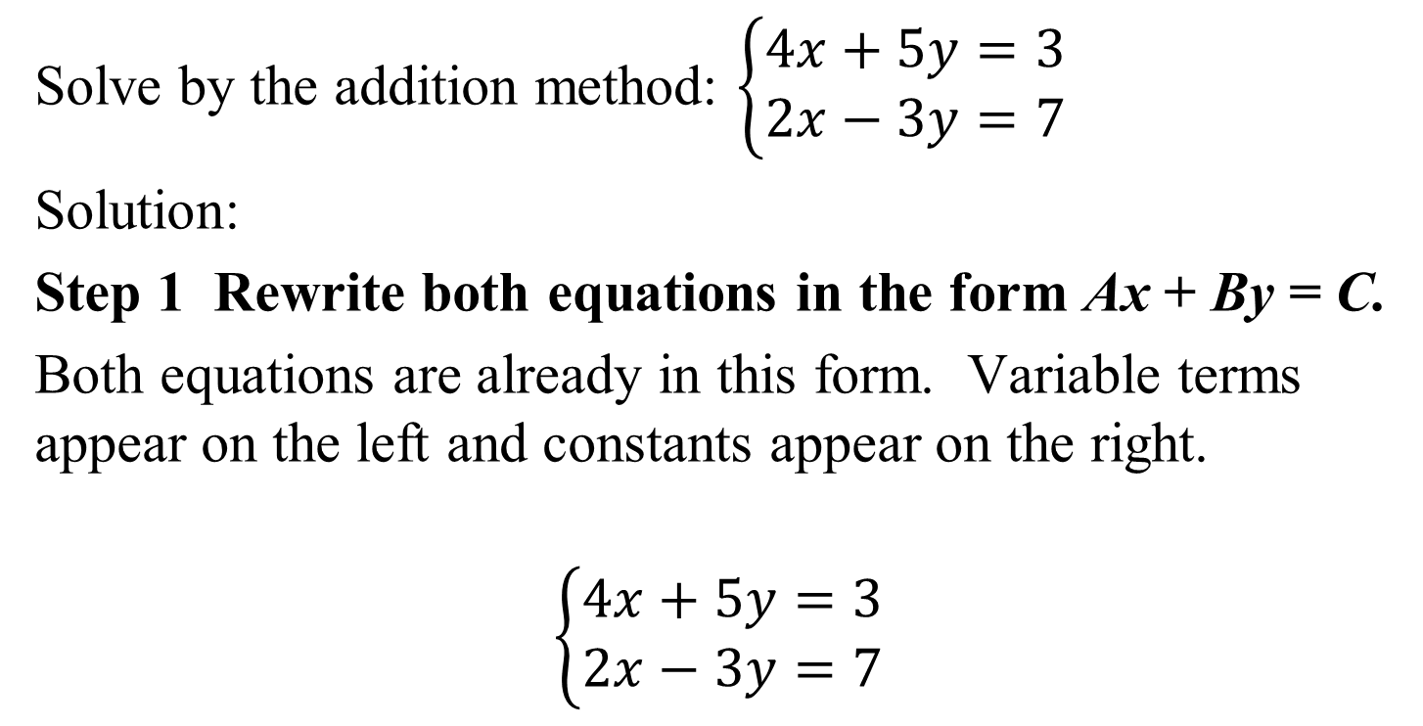
Example 3: Solving a System by the Addition Method
Solve by the addition method: $\left\{\begin{aligned}4x+5y=3 \\ 2x−3y=7\end{aligned}\right.$
Solution:
Step 1 Rewrite both equations in the form Ax + By = C.
Both equations are already in this form. Variable terms appear on the left and constants appear on the right.
$$\left\{\begin{aligned}4x+5y=3 \\ 2x−3y=7\end{aligned}\right.$$

Slide 13
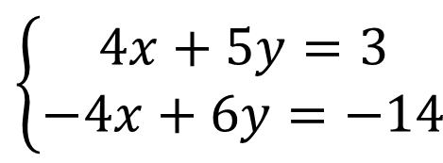
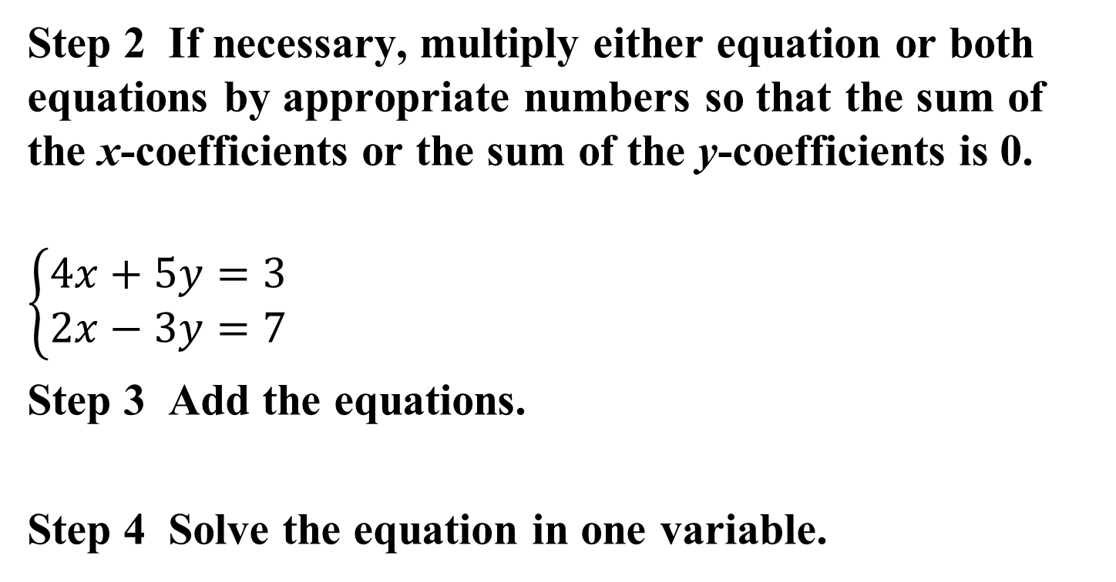



Example 3: Solving a System by the Addition Method
(continued)
Step 2 If necessary, multiply either equation or both equations by appropriate numbers so that the sum of the x-coefficients or the sum of the y-coefficients is 0.
$$\left\{\begin{aligned}4x+5y=3 \\ 2x−3y=7\end{aligned}\right.$$
Step 3 Add the equations.
Step 4 Solve the equation in one variable.
No Change
$$\left\{\begin{aligned}4x+5y=3 \\ −4x+6y=−14\end{aligned}\right.$$
Multiply by –2.
$$11y=−11$$
$$\frac{11y}{11}=\frac{−11}{11}$$
$$y=−1$$

Slide 14
Example 3: Solving a System by the Addition Method
(continued)
Step 5 Back-substitute and find the value for the other variable. Use either one of the given equations.
4x + 5y = 3
4x + 5(–1) = 3
4x – 5 = 3
4x = 8
x = 2
The proposed solution is (2, –1). If you check the proposed solution in both equations they will check.
The solution set is {(2, –1)}.

Slide 15
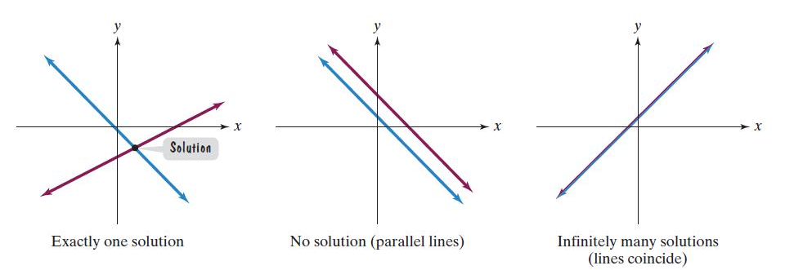
The Number of Solutions to a System of Two Linear Equations
Number of Solutions | What This Means Graphically
Exactly one ordered-pair solution | The two lines intersect at one point.
No solution | The two lines are parallel.
Infinitely many solutions | The two lines are identical.

Slide 16
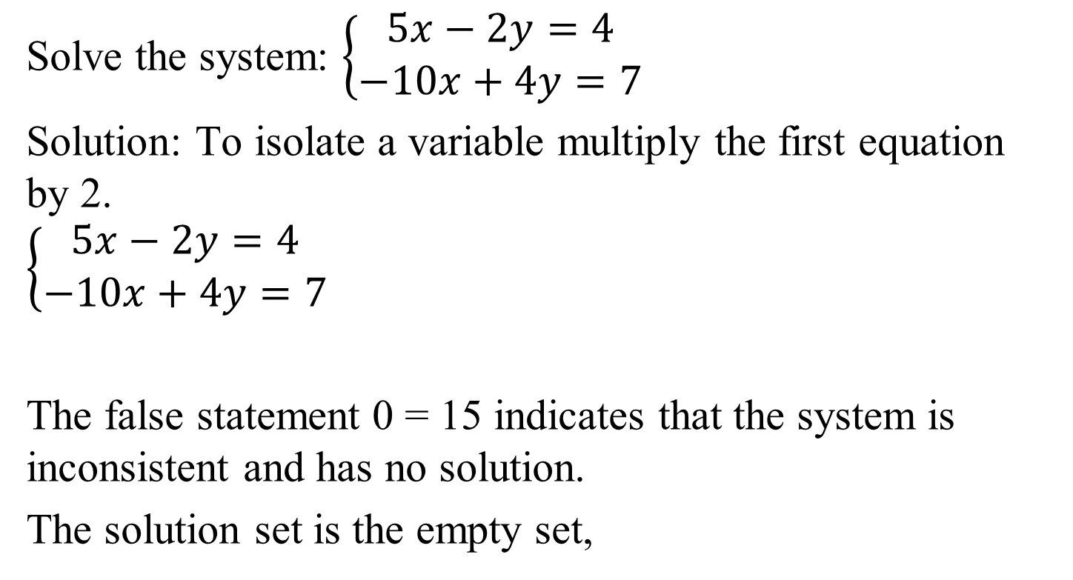


Example 5: A System with No Solution
Solve the system: $\left\{\begin{aligned}5x−2y=4 \\ −10x+4y=7\end{aligned}\right.$
Solution: To isolate a variable multiply the first equation
by 2.
$$\left\{\begin{aligned}5x−2y=4 \\ −10x+4y=7\end{aligned}\right.$$
The false statement 0 = 15 indicates that the system is inconsistent and has no solution.
The solution set is the empty set,
Multiply by 2.
$$\left\{\begin{aligned}10x−4y=8 \\ −10x+4y=7\end{aligned}\right.$$
No Change
$$0=15$$

Slide 17
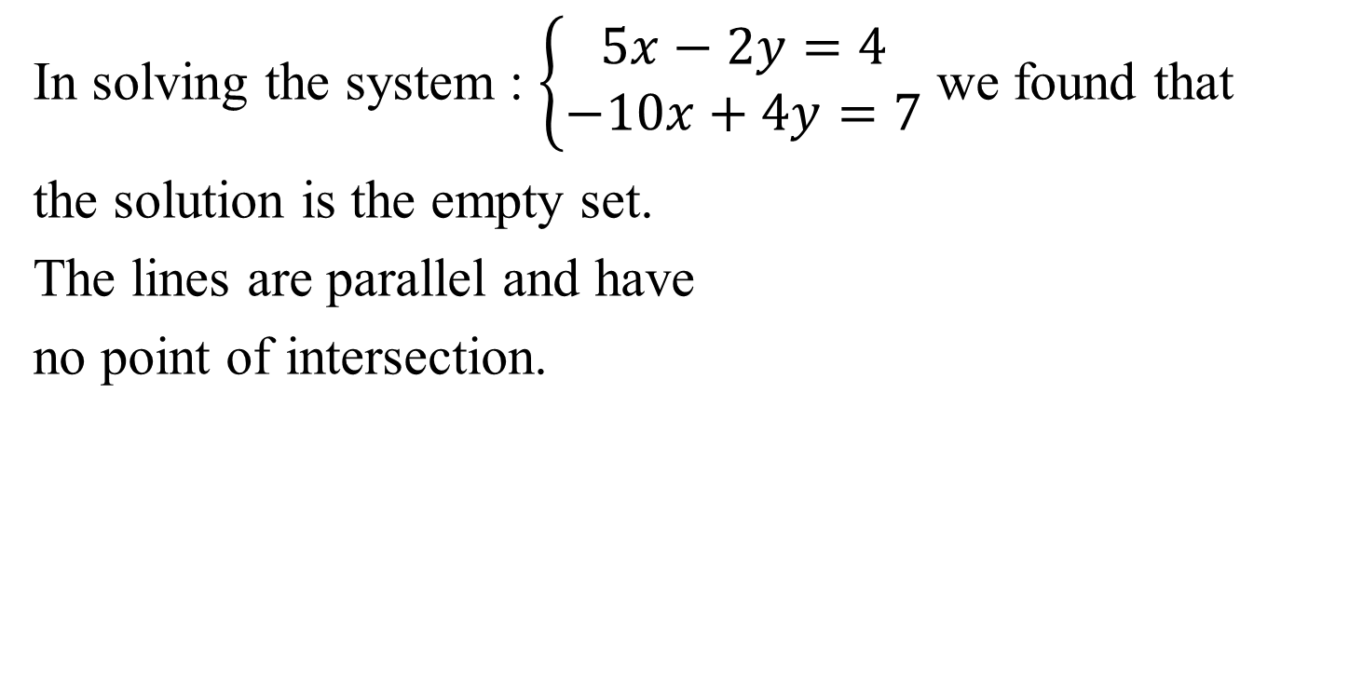
Example 5: A System with No Solution (continued)
In solving the system : $\left\{\begin{aligned}5x−2y=4 \\ −10x+4y=7\end{aligned}\right.$ we found that
the solution is the empty set.
The lines are parallel and have
no point of intersection.

Slide 18
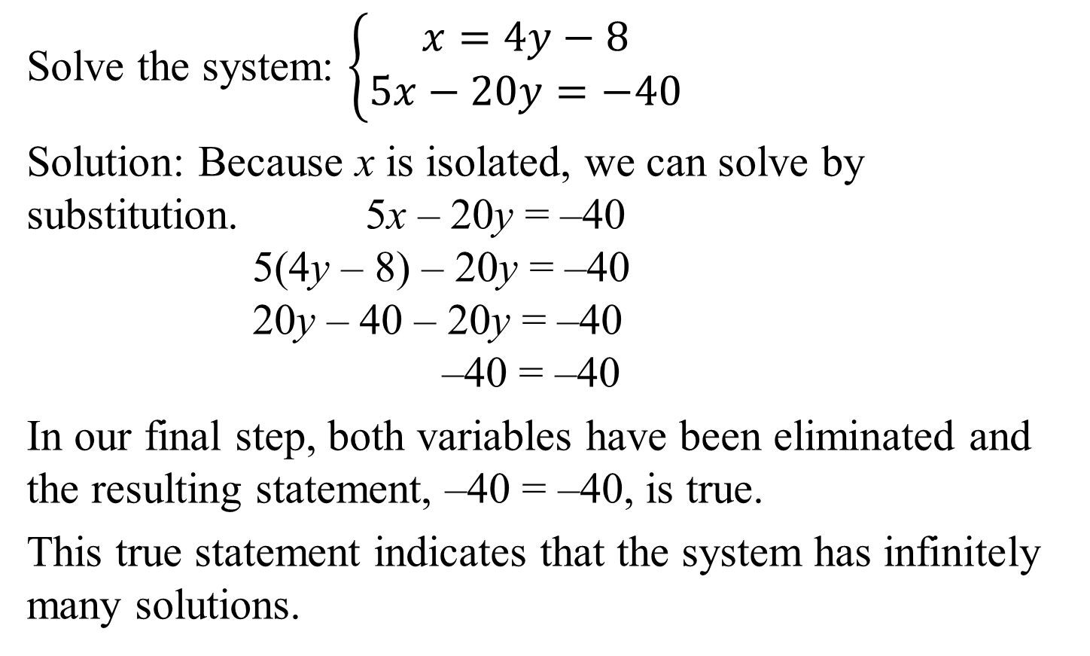
Example 6: A System with Infinitely Many Solutions
Solve the system: $\left\{\begin{aligned}x=4y−8 \\ 5x−20y=−40\end{aligned}\right.$
Solution: Because x is isolated, we can solve by substitution. 5x – 20y = –40
5(4y – 8) – 20y = –40
20y – 40 – 20y = –40
–40 = –40
In our final step, both variables have been eliminated and the resulting statement, –40 = –40, is true.
This true statement indicates that the system has infinitely many solutions.

Slide 19
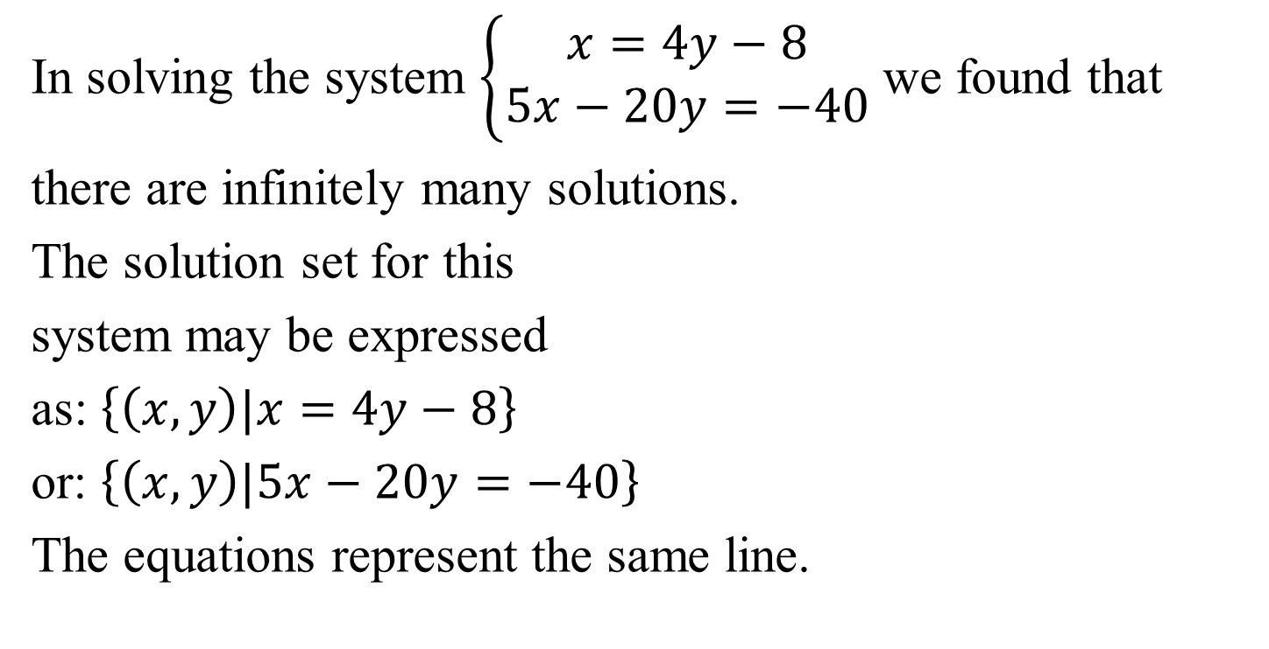
Example 6: A System with Infinitely Many Solutions
(continued)
In solving the system $\left\{\begin{aligned}x=4y−8 \\ 5x−20y=−40\end{aligned}\right.$ we found that
there are infinitely many solutions.
The solution set for this
system may be expressed
as: $\left\{\left(x,y\right)|x=4y−8\right\}$
or: $\left\{\left(x,y\right)|5x−20y=−40\right\}$
The equations represent the same line.

Slide 20
Revenue and Cost Functions
A company produces and sells x units of a product.
Revenue Function
R(x) = (price per unit sold)x
Cost Function
C(x) = fixed cost + (cost per unit produced)x
The point of intersection of the graphs of the revenue and cost functions is called the break-even point.

Slide 21
Example 7: Finding a Break-Even Point
A company that manufactures running shoes has a fixed cost of $300,000. Additionally, it costs $30 to produce each pair of shoes. They are sold at $80 per pair.
a. Write the cost function, C, of producing x pairs of running shoes.
C(x) = 300,000 + 30x
Write the revenue function, R, from the sale of x pairs of running shoes.
R(x) = 80x

Slide 22
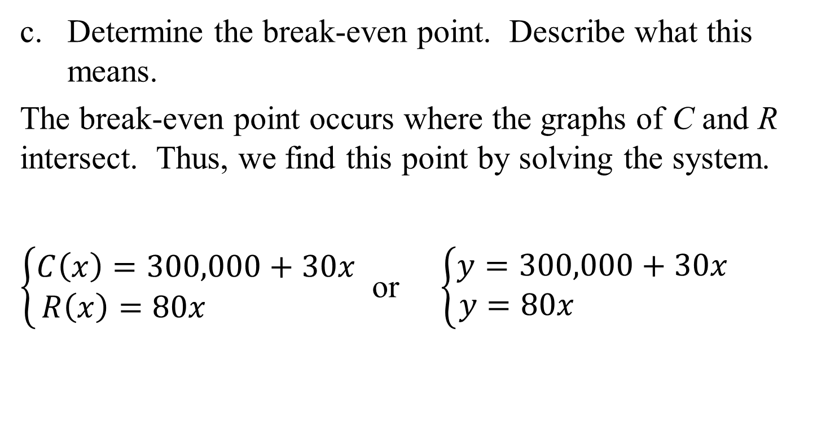
Example 7: Finding a Break-Even Point (continued)
Determine the break-even point. Describe what this means.
The break-even point occurs where the graphs of C and R intersect. Thus, we find this point by solving the system.
$\left\{\begin{aligned}C\left(x\right)=300,000+30x \\ R\left(x\right)=80x \end{aligned}\right.$ or $\left\{\begin{aligned}y=300,000+30x \\ y=80x \end{aligned}\right.$

Slide 23
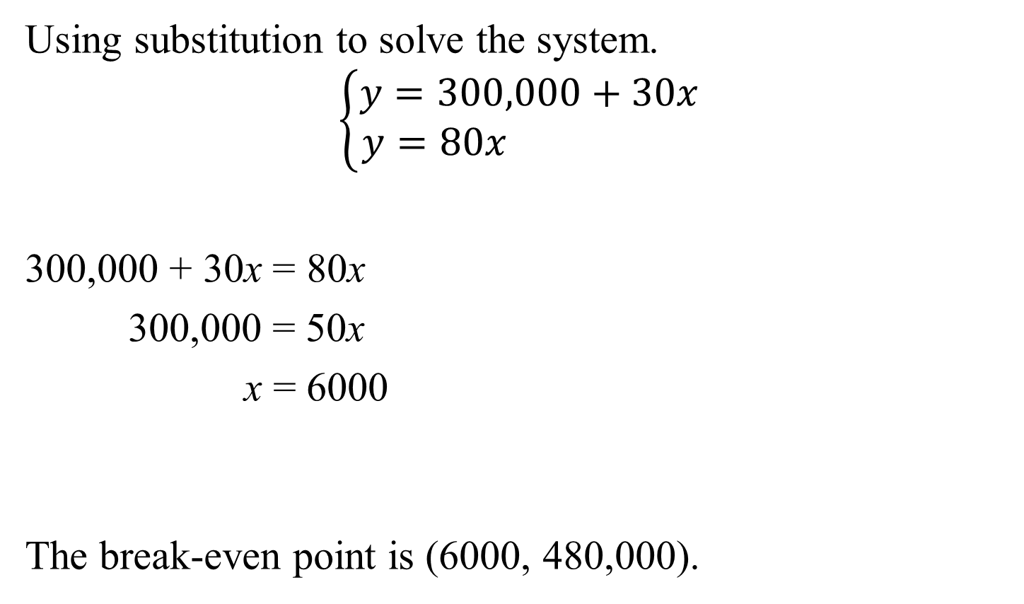
Example 7: Finding a Break-Even Point (continued)
Using substitution to solve the system.
$$\left\{\begin{aligned}y=300,000+30x \\ y=80x \end{aligned}\right.$$
300,000 + 30x = 80x
300,000 = 50x
x = 6000
The break-even point is (6000, 480,000).
y = 80x
y = 80(6000)
y = 480,000

Slide 24
Example 7: Finding a Break-Even Point (continued)
The break-even point is (6000, 480,000). Describe what this means.
This means that the company will break even if it produces and sells 6000 pairs of running shoes.
At this level, the money coming in is equal to the money going out: $480,000.

