Slide 1

Chapter P
Prerequisites: Fundamental Concepts of Algebra
P.6 Rational Expressions

Slide 2
Objectives
Specify numbers that must be excluded from the domain of a rational expression.
Simplify rational expressions.
Multiply rational expressions.
Divide rational expressions.
Add and subtract rational expressions.
Simplify complex rational expressions.
Simplify fractional expressions that occur in calculus.
Rationalize numerators.

Slide 3
Rational Expressions
A rational expression is the quotient of two polynomials. The set of real numbers for which an algebraic expression is defined is the domain of the expression. Because rational expressions indicate division and division by zero is undefined, we must exclude numbers from a rational expression’s domain that make the denominator zero.

Slide 4
Example 1c: Excluding Numbers from the Domain
Find all the numbers that must be excluded from the domain of the rational expression: $\frac{7x}{x^{2}−5x−14}$.
Solution: To determine the numbers that must be excluded from the domain, examine the denominator.
$$x^{2}−5x−14=(x−7)(x+2)$$
We set each factor equal to zero to find the excluded values. x – 7 = 0 or x + 2 = 0
x = 7 x = –2
$$\frac{7x}{x^{2}−5x−14}, x≠7,x≠−2$$

Slide 5
Simplifying Rational Expressions
A rational expression is simplified if its numerator and denominator have no common factors other than 1 or –1. The following procedure can be used to simplify rational expressions:
1. Factor the numerator and the denominator completely.
2. Divide both the numerator and the denominator by any common factors.

Slide 6
Example 2b: Simplifying Rational Expressions
Simplify: $\frac{x^{2}−1}{x^{2}+2x+1}$.
Solution: Factor the numerator and the denominator:
$$\frac{x^{2}−1}{x^{2}+2x+1}=\frac{(x+1)(x−1)}{(x+1)(x+1)}$$
Check for excluded values. x ≠ –1.
$$\frac{x^{2}−1}{x^{2}+2x+1}=\frac{(x+1)(x−1)}{(x+1)(x+1)}$$
$$=\frac{x−1}{x+1},x≠−1$$

Slide 7
Multiplying Rational Expressions
1. Factor all numerators and denominators completely.
2. Divide numerators and denominators by common factors.
3. Multiply the remaining factors in the numerators and multiply the remaining factors in the denominators.

Slide 8
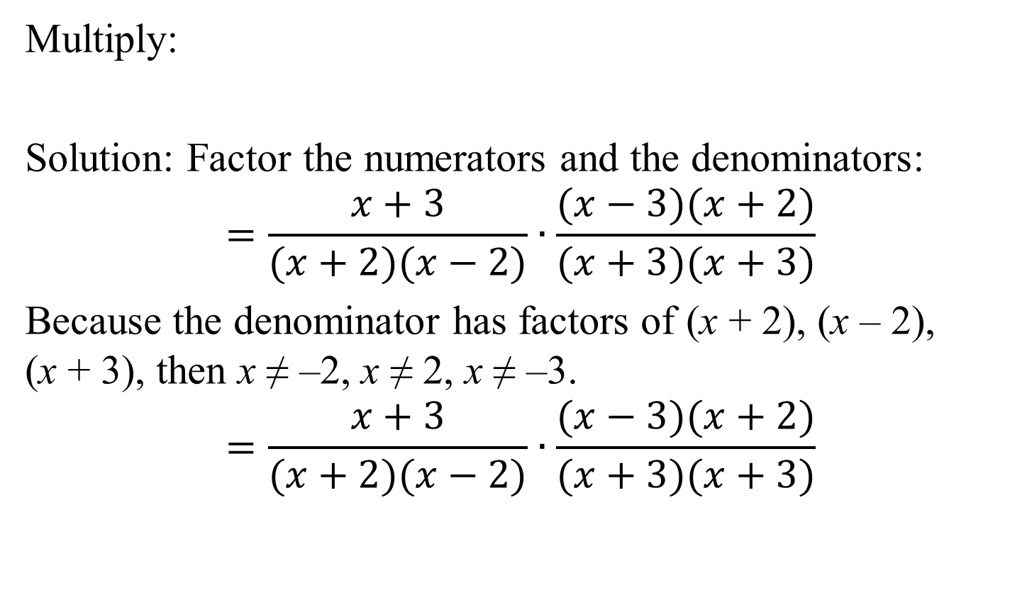
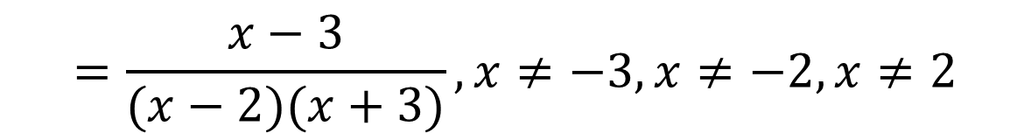
Example 3: Multiplying Rational Expressions
$$\frac{x+3}{x^{2}−4}·\frac{x^{2}−x−6}{x^{2}+6x+9}$$
Multiply:
Solution: Factor the numerators and the denominators:
$$=\frac{x+3}{(x+2)(x−2)}∙\frac{(x−3)(x+2)}{(x+3)(x+3)}$$
Because the denominator has factors of (x + 2), (x – 2),
(x + 3), then x ≠ –2, x ≠ 2, x ≠ –3.
$$=\frac{x+3}{(x+2)(x−2)}∙\frac{(x−3)(x+2)}{(x+3)(x+3)}$$
$$=\frac{x−3}{(x−2)(x+3)},x≠−3,x≠−2,x≠2$$

Slide 9
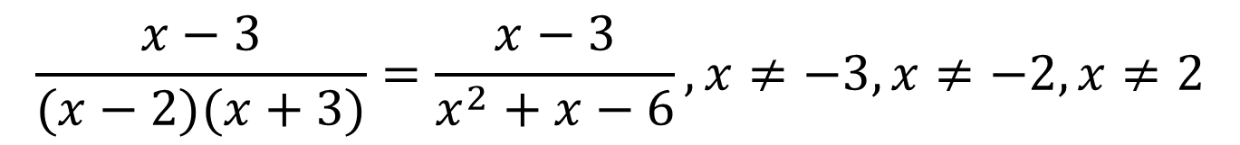
Example 3: Multiplying Rational Expressions (continued)
Multiply the remaining factors in the numerators and denominators.
$$\frac{x−3}{(x−2)(x+3)}=\frac{x−3}{x^{2}+x−6}, x≠−3,x≠−2,x≠2$$

Slide 10
Dividing Rational Expressions
The quotient of two rational expressions is the product of the first expression and the multiplicative inverse, or reciprocal, of the second expression. The reciprocal is found by interchanging the numerator and the denominator. Thus, we find the quotient of two rational expressions by inverting the divisor and multiplying.

Slide 11
Example 4: Dividing Rational Expressions
$$\frac{x^{2}−2x+1}{x^{3}+x}÷\frac{x^{2}+x−2}{3x^{2}+3}$$
Divide:
Solution: Invert the divisor and multiply.
Factor as many numerators and denominators as possible.
$$\frac{x^{2}−2x+1}{x^{3}+x}·\frac{3x^{2}+3}{x^{2}+x−2}=\frac{(x−1)(x−1)}{x(x^{2}+1)}∙\frac{3(x^{2}+1)}{(x+2)(x−1)}$$
Because the denominator is
x(x² + 1)(x + 2)(x – 1);
$$\frac{x^{2}−2x+1}{x^{3}+x}÷\frac{x^{2}+x−2}{3x^{2}+3}=\frac{x^{2}−2x+1}{x^{3}+x}·\frac{3x^{2}+3}{x^{2}+x−2}$$
$$x≠0,x≠−2,x≠1$$

Slide 12
Example 4: Dividing Rational Expressions (continued)
Divide numerators and denominators by common factors.
$$\frac{(x−1)(x−1)}{x(x^{2}+1)}∙\frac{3(x^{2}+1)}{(x+2)(x−1)}$$
$$=\frac{3(x−1)}{x(x+2)}$$
Multiply the remaining factors in the numerator and in the denominator.
$$=\frac{3x−3}{x^{2}+2x},x≠0,x≠−2,x≠1$$

Slide 13
Adding and Subtracting Rational Expressions with the Same Denominator
To add or subtract rational expressions with the same denominator:
1. Add or subtract the numerators.
2. Place this result over the common denominator.
3. Simplify, if possible.
Reminder: Check for excluded values.

Slide 14
Example 5: Subtracting Rational Expressions with the Same Denominator
Subtract: $\frac{x}{x+1}−\frac{3x+2}{x+1}$.
Solution: Check for excluded values: $x+1=0, x≠−1.$
$$\frac{x}{x+1}−\frac{3x+2}{x+1}=\frac{x−(3x+2)}{x+1}$$
$$=\frac{x−3x−2}{x+1}$$
$$=\frac{−2x−2}{x+1}$$
$$=\frac{−2(x+1)}{x+1}$$
$$=−2, x≠−1$$

Slide 15
Finding the Least Common Denominator (LCD)
1. Factor each denominator completely.
2. List the factors of the first denominator.
3. Add to the list in step 2 any factors of the second denominator that do not appear in the list.
4. Form the product of the factors from the list in step 3. This product is the least common denominator.

Slide 16
Adding and Subtracting Rational Expressions That Have Different Denominators
1. Find the LCD of the rational expressions.
2. Rewrite each rational expression as an equivalent expression whose denominator is the LCD. To do so, multiply the numerator and the denominator of each rational expression by any factor(s) needed to convert the denominator into the LCD.
3. Add or subtract numerators, placing the resulting expression over the LCD.
4. If possible, simplify the resulting rational expression.

Slide 17
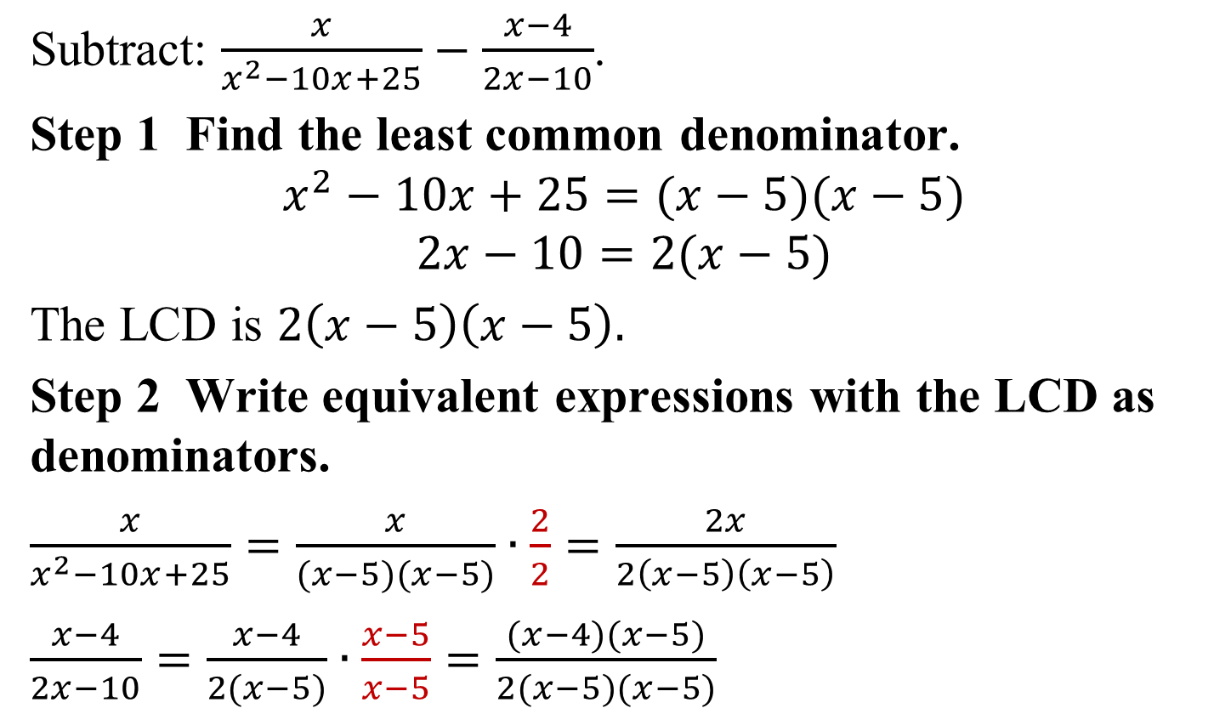
Example 10: Subtracting Rational Expressions with Different Denominators
Subtract: $\frac{x}{x^{2}−10x+25}−\frac{x−4}{2x−10}$.
Step 1 Find the least common denominator.
$$x^{2}−10x+25=(x−5)(x−5)$$
$$2x−10=2(x−5)$$
The LCD is $2\left(x−5\right)\left(x−5\right).$
Step 2 Write equivalent expressions with the LCD as denominators.
$\frac{x}{x^{2}−10x+25}=\frac{x}{(x−5)(x−5)}∙\frac{2}{2}=\frac{2x}{2\left(x−5\right)\left(x−5\right)}$
$\frac{x−4}{2x−10}=\frac{x−4}{2(x−5)}∙\frac{x−5}{x−5}=\frac{(x−4)(x−5)}{2(x−5)(x−5)}$

Slide 18
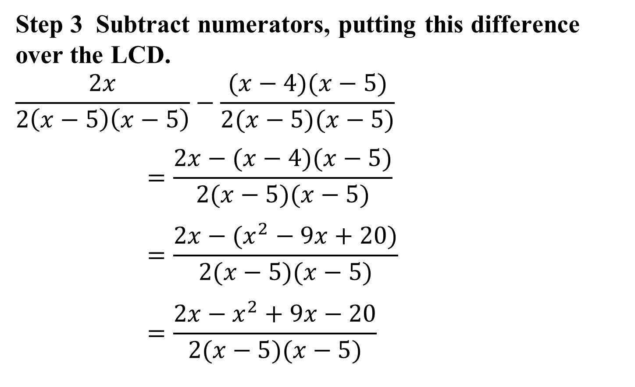
Example 10: Subtracting Rational Expressions with Different Denominators (continued)
Step 3 Subtract numerators, putting this difference over the LCD.
$$\frac{2x}{2\left(x−5\right)\left(x−5\right)}−\frac{(x−4)(x−5)}{2(x−5)(x−5)}$$
$$=\frac{2x−(x−4)(x−5)}{2(x−5)(x−5)}$$
$$=\frac{2x−(x^{2}−9x+20)}{2(x−5)(x−5)}$$
$$=\frac{2x−x^{2}+9x−20}{2(x−5)(x−5)}$$
$$=\frac{−x^{2}+11x−20}{2(x−5)(x−5)}$$

Slide 19
Example 10: Subtracting Rational Expressions with Different Denominators (continued)
Step 4 If necessary, simplify.
$$\frac{−x^{2}+11x−20}{2(x−5)(x−5)}$$
Because the numerator is prime, no further simplification is possible.
$$\frac{x}{x^{2}−10x+25}−\frac{x−4}{2x−10}=\frac{−x^{2}+11x−20}{2\left(x−5\right)\left(x−5\right)},x≠5$$

Slide 20
Complex Rational Expressions
Complex rational expressions, also called complex fractions, have numerators or denominators containing one or more rational expressions. A complex fraction must be simplified so that neither the numerator nor the denominator contains any rational expressions.

Slide 21
Example 12: Simplifying a Complex Rational Expression
Simplify: $\frac{\frac{1}{x+7}−\frac{1}{x}}{7}$.
Solution: We will use the method of multiplying the numerator and the denominator by the least common denominator for all rational expressions. The least common denominator for all rational expressions is
x(x + 7).
$\left(\frac{\frac{1}{x+7}−\frac{1}{x}}{7}\right)∙\frac{x(x+7)}{x(x+7)}$
= $\frac{x\left(x+7\right)\left(\frac{1}{x+7}\right)−x\left(x+7\right)\left(\frac{1}{x}\right)}{x(x+7)∙7}$
$=\frac{x−(x+7)}{7x(x+7)}$

Slide 22
Example 12: Simplifying a Complex Rational Expression (continued)
We continue the process of simplifying.
$$\frac{x−(x+7)}{7x(x+7)}$$
$$=\frac{x−x−7}{7x(x+7)}$$
$$=\frac{−7}{7x(x+7)}$$
$$=\frac{−1}{x(x+7)},x≠0, x≠−7$$

Slide 23
Fractional Expressions in Calculus
Fractional expressions containing radicals occur frequently in calculus. These expressions can often be simplified using the procedure for simplifying complex rational expressions.

Slide 24




Example 13: Simplifying a Fractional Expression Containing Radicals
Simplify: $\frac{\sqrt{x}+\frac{1}{\sqrt{x}}}{x}$.
$$\frac{\sqrt{x}+\frac{1}{\sqrt{x}}}{x}∙\frac{\sqrt{x}}{\sqrt{x}}$$
$$=\frac{\sqrt{x}\sqrt{x}+\frac{1}{\sqrt{x}}\sqrt{x}}{x\sqrt{x}}$$
$$=\frac{x+1}{x∙x^{\frac{1}{2}}}$$
$$=\frac{x+1}{x^{\frac{3}{2}}}$$

Slide 25
Rationalizing the Numerator
To rationalize a numerator, multiply by 1 to eliminate the radicals in the numerator. Multiply the numerator and the denominator by the conjugate of the numerator.

Slide 26

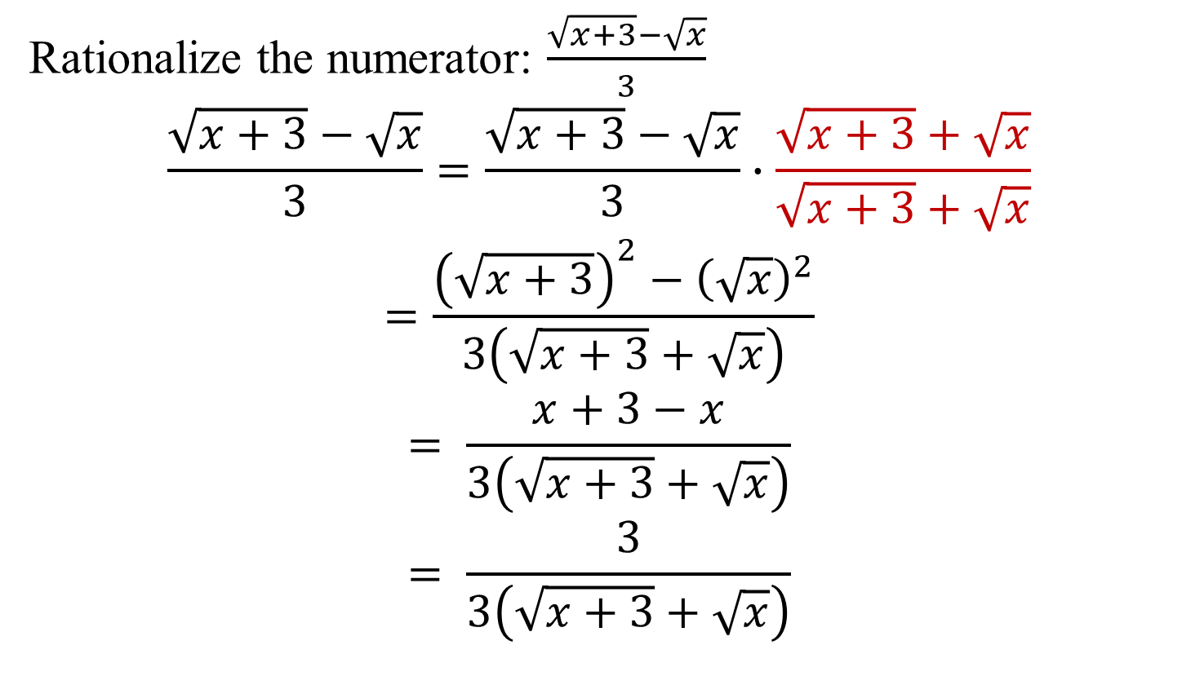
Example 14: Rationalizing a Numerator
Rationalize the numerator: $\frac{\sqrt{x+3}−\sqrt{x}}{3}$
$$\frac{\sqrt{x+3}−\sqrt{x}}{3}=\frac{\sqrt{x+3}−\sqrt{x}}{3}∙\frac{\sqrt{x+3}+\sqrt{x}}{\sqrt{x+3}+\sqrt{x}}$$
$$=\frac{{\left(\sqrt{x+3}\right)}^{2}−{\left(\sqrt{x}\right)}^{2}}{3\left(\sqrt{x+3}+\sqrt{x}\right)}$$
$$= \frac{x+3−x}{3\left(\sqrt{x+3}+\sqrt{x}\right)}$$
$$= \frac{3}{3\left(\sqrt{x+3}+\sqrt{x}\right)}$$
$$= \frac{1}{\sqrt{x+3}+\sqrt{x}}$$

