Slide 1

Chapter P
Prerequisites: Fundamental Concepts of Algebra
P.5 Factoring Polynomials

Slide 2
Objectives
Factor out the greatest common factor of a polynomial.
Factor by grouping.
Factor trinomials.
Factor the difference of squares.
Factor perfect square trinomials.
Factor the sum or difference of two cubes.
Use a general strategy for factoring polynomials.
Factor algebraic expressions containing fractional and negative exponents.

Slide 3
Factoring Polynomials
Factoring a polynomial expressed as the sum of monomials means finding an equivalent expression that is a product. The goal in factoring a polynomial is to use one or more factoring techniques until each of the polynomial’s factors, except possibly for a monomial factor, is prime or irreducible. In this situation, the polynomial is said to be factored completely.

Slide 4
Greatest Common Factor
The greatest common factor, abbreviated GCF, is an expression of the highest degree that divides each term of the polynomial.

Slide 5
Example 1: Factoring Out the Greatest Common Factor
Factor:
a. $10x^{3}−4x^{2}$
b. $2x\left(x−7\right)+3(x−7)$
$$=2x^{2}\left(5x\right)−2x^{2}(2)$$
$$=2x^{2}\left(5x−2\right)$$
$$=(x−7)(2x+3)$$

Slide 6
Factoring by Grouping
Some polynomials have only a greatest common factor of 1. However, by a suitable grouping of the terms, it still may be possible to factor. This process is called factoring by grouping.

Slide 7
Example 2: Factoring by Grouping
Factor:
$$x^{3}+5x^{2}−2x−10$$
$$=\left(x^{3}+5x^{2}\right)+\left(−2x−10\right)$$
$$=x^{2}\left(x+5\right)+\left(−2\right)\left(x+5\right)$$
$$=(x+5)(x^{2}−2)$$

Slide 8
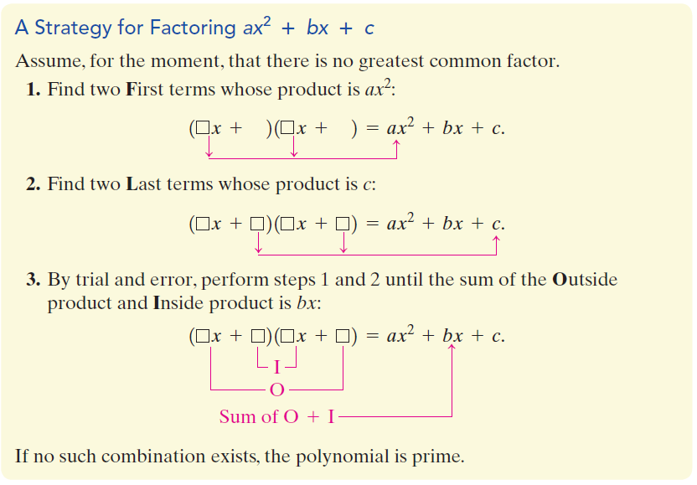
Factoring Trinomials of the Form $ax^{2}+bx+c$

Slide 9
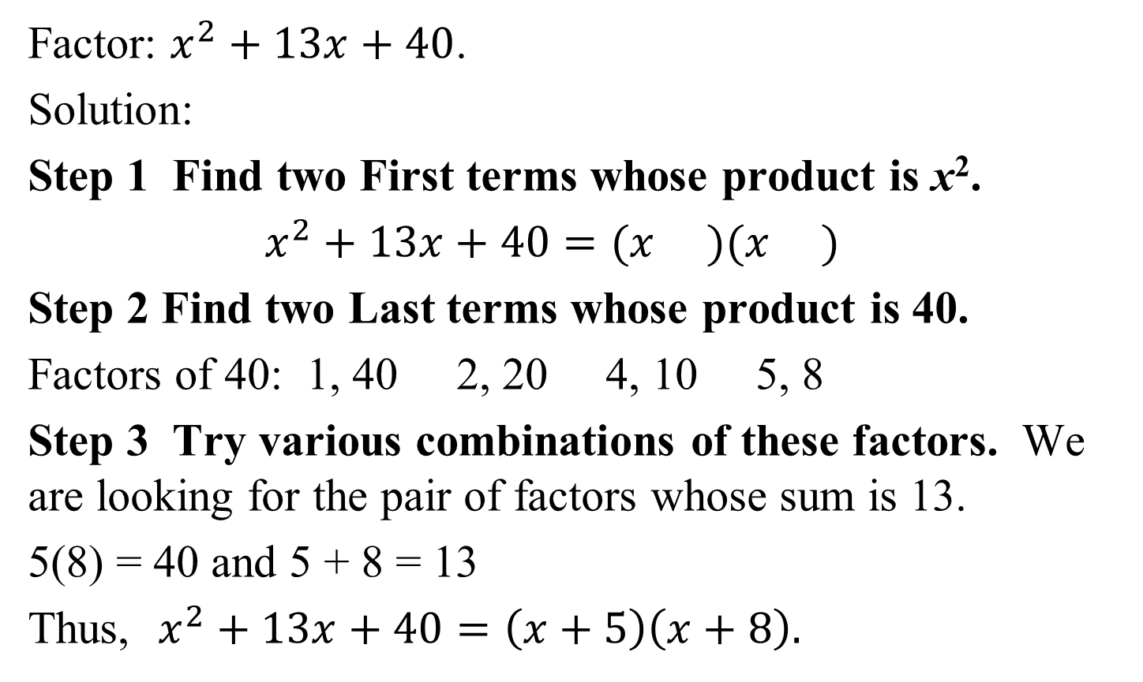
Example 3: Factoring a Trinomial Whose Leading Coefficient is 1
Factor: $x^{2}+13x+40$.
Solution:
Step 1 Find two First terms whose product is x².
$x^{2}+13x+40=(x )(x )$
Step 2 Find two Last terms whose product is 40.
Factors of 40: 1, 40 2, 20 4, 10 5, 8
Step 3 Try various combinations of these factors. We are looking for the pair of factors whose sum is 13.
5(8) = 40 and 5 + 8 = 13
Thus, $x^{2}+13x+40=\left(x+5\right)\left(x+8\right).$

Slide 10
The Difference of Two Squares
If A and B are real numbers, variables, or algebraic expressions, then
$$A^{2}−B^{2}=(A+B)(A−B)$$
In words: The difference of the squares of two terms factors as the product of a sum and a difference of those terms.

Slide 11
Example 7b: Factoring the Difference of Two Squares
Factor: $36x^{2}−25$.
Solution:
$$36x^{2}−25={\left(6x\right)}^{2}−{\left(5\right)}^{2}$$
$$=(6x+5)(6x−5)$$

Slide 12
Factoring Perfect Square Trinomials
Let A and B be real numbers, variables, or algebraic expressions.
$A^{2}+2AB+B^{2}=$ ${\left(A+B\right)}^{2}$
$$A^{2}−2AB+B^{2}={\left(A−B\right)}^{2}$$
same sign
same sign

Slide 13
Example 9b: Factoring Perfect Square Trinomials
Factor:$16x^{2}−56x+49$.
Solution: We suspect that $16x^{2}−56x+49$ is a perfect square trinomial because 16x² = (4x)² and 49 = (7)². The middle term can be expressed as twice the product of
4x and 7.
$$16x^{2}−56x+49= {\left(4x\right)}^{2}−2∙4x∙7+7^{2}$$
$={(4x−7)}^{2}$

Slide 14
Factoring the Sum or Difference of Two Cubes
1. Factoring the Sum of Two Cubes
$$A^{3}+B^{3}=(A+B)(A^{2}−AB+B^{2})$$
2. Factoring the Difference of Two Cubes
$$A^{3}−B^{3}=(A−B)(A^{2}+AB+B^{2})$$

Slide 15
Example 10b: Factoring Sums and Differences of Two Cubes
Factor: $125x^{3}−8$.
Solution: We will use the formula for factoring the difference of two cubes:
$A^{3}−B^{3}=(A−B)(A^{2}+AB+B^{2})$
$125x^{3}−8= {\left(5x\right)}^{3}−{\left(2\right)}^{3}$
$=\left(5x−2\right)\left[{\left(5x\right)}^{2}+\left(5x\right)\left(2\right)+2^{2}\right]$
$=(5x−2)(25x^{2}+10x+4)$

Slide 16
A Strategy for Factoring Polynomials
1. If there is a common factor, factor out the GCF.
2. Determine the number of terms in the polynomial and try factoring as follows:
a. If there are two terms, can the binomial be
factored by using one of the following special
forms?
Difference of Two Squares $A^{2}−B^{2}=(A+B)(A−B)$
Sum of Two Cubes $A^{3}+B^{3}=(A+B)(A^{2}−AB+B^{2})$
Difference of Two Cubes
$$A^{3}−B^{3}=(A−B)(A^{2}+AB+B^{2})$$

Slide 17
A Strategy for Factoring Polynomials (continued)
b. If there are three terms, is the trinomial a perfect square trinomial? If so, factor by using one of the following special forms:
$A^{2}+2AB+B^{2}=$ ${\left(A+B\right)}^{2}$
$A^{2}−2AB+B^{2}={\left(A−B\right)}^{2}$
If the trinomial is not a perfect square trinomial, try factoring by trial and error.
c. If there are four or more terms, try factoring by grouping.
3. Check to see if any factors with more than one term in the factored polynomial can be factored further. If so, factor completely.

Slide 18
Example 11: Factoring a Polynomial
Factor: $3x^{3}−30x^{2}+75x$
Solution: Step 1 If there is a common factor, factor out the GCF.
Because 3x is common to all terms, we factor it out.
$$3x^{3}−30x^{2}+75x=3x(x^{2}−10x+25)$$
Step 2 Determine the number of terms and factor accordingly.
The factor $(x^{2}−10x+25)$ has three terms and is a perfect square trinomial. We factor using
$$A^{2}−2AB+B^{2}={\left(A−B\right)}^{2}$$

Slide 19
Example 11: Factoring a Polynomial (continued)
$3x^{3}−30x^{2}+75x=3x(x^{2}−10x+25)$
$=3x(x^{2}−2∙x∙5+5^{2})$
$=3x{\left(x−5\right)}^{2}$
Step 3 Check to see if factors can be factored further.
In this case, they cannot, so we have factored completely.

Slide 20
Factoring Algebraic Expressions Containing Fractional and Negative Exponents
Although expressions containing fractional and negative exponents are not polynomials, they can be simplified using factoring techniques.

Slide 21
Example 13: Factoring Involving Fractional and Negative Exponents
Factor and simplify: $x{\left(x−1\right)}^{− \frac{1}{2}}+$ ${\left(x−1\right)}^{\frac{1}{2}}$.
Solution:
The greatest common factor of $x{\left(x−1\right)}^{−\frac{ 1}{2}}+$ ${\left(x−1\right)}^{\frac{1}{2}}$ is
(x – 1) with the smaller exponent in the two terms.
Thus, the greatest common factor is ${\left(x−1\right)}^{− \frac{1}{2}}$.

Slide 22
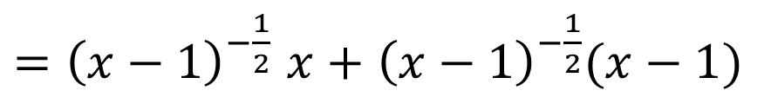



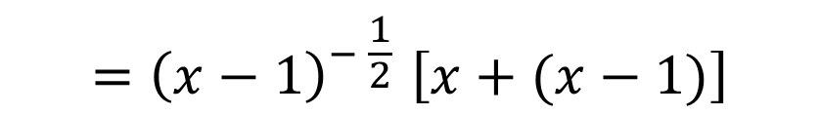
Example 13: Factoring Involving Fractional and Negative Exponents (continued)
$x{\left(x−1\right)}^{−\frac{1}{2}}+$ ${\left(x−1\right)}^{\frac{1}{2}}$
${=\left(x−1\right)}^{−\frac{1}{2}}x+$ ${\left(x−1\right)}^{−\frac{1}{2}}(x−1)$
$${=\left(x−1\right)}^{− \frac{1}{2}}\left[x+(x−1)\right]$$
$${=\left(x−1\right)}^{− \frac{1}{2}}(2x−1)$$
$$=\frac{2x−1}{{\left(x−1\right)}^{\frac{1}{2}}}$$

