Slide 1

Chapter P
Prerequisites: Fundamental Concepts of Algebra
P.4 Polynomials

Slide 2
Objectives
Understand the vocabulary of polynomials.
Add and subtract polynomials.
Multiply polynomials.
Use FOIL in polynomial multiplication.
Use special products in polynomial multiplication.
Perform operations with polynomials in several variables.

Slide 3
Polynomials
When a polynomial is in standard form, the terms are written in the order of descending powers of the variable.
A polynomial is simplified when it contains no grouping symbols and no like terms.
A simplified polynomial that has exactly one term is called a monomial. A binomial is a simplified polynomial that has two terms. A trinomial is a simplified polynomial with three terms. Simplified polynomials with four or more terms have no special names.
The degree of a polynomial is the greatest degree of all the terms of the polynomial.

Slide 4
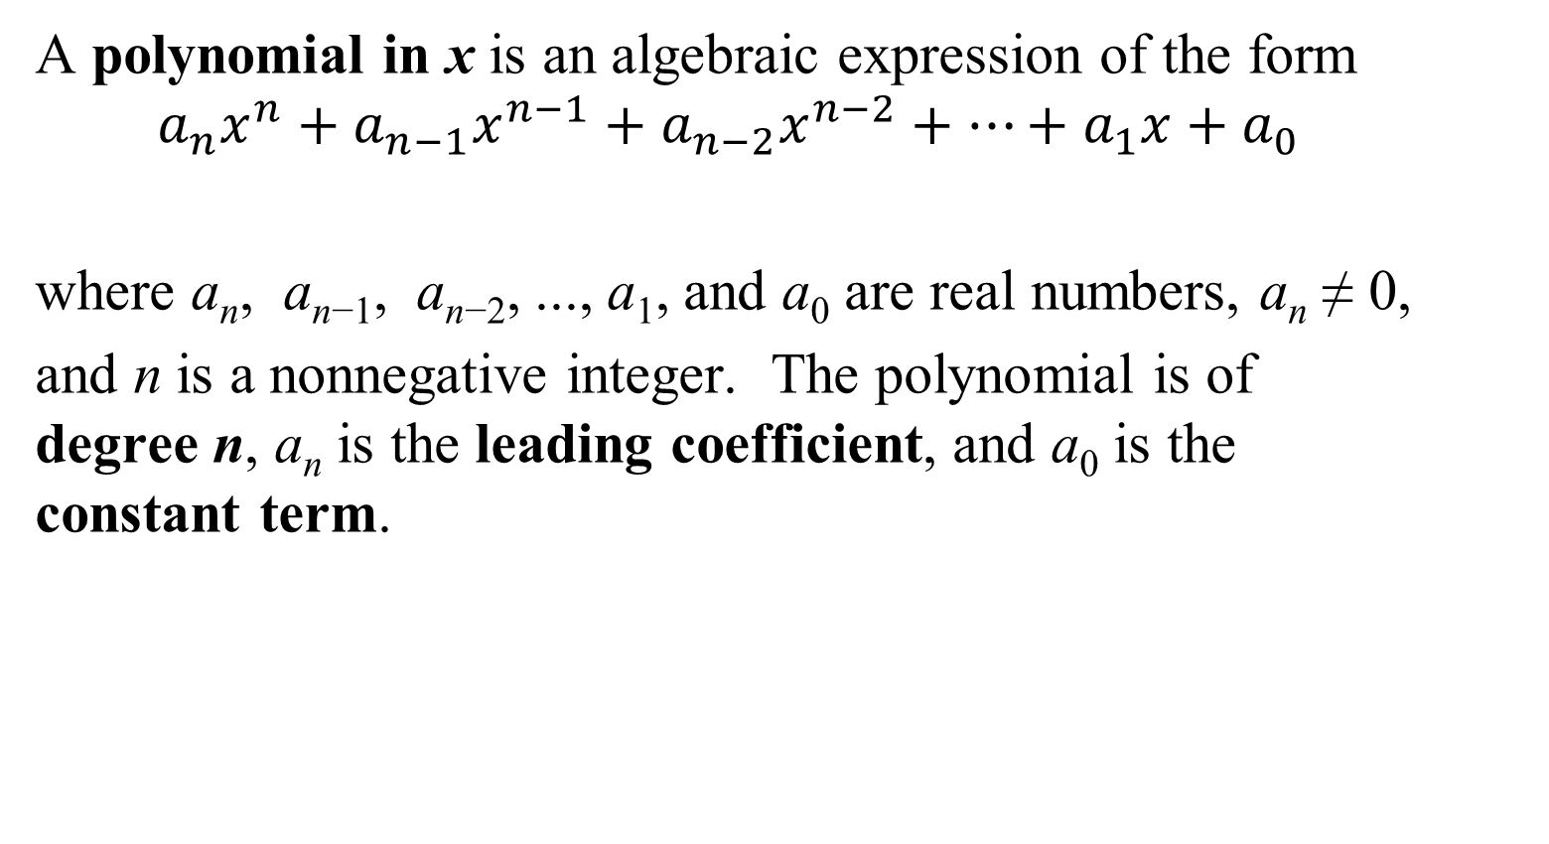
Definition of a Polynomial in x
A polynomial in x is an algebraic expression of the form
$$a_{n}x^{n}+a_{n−1}x^{n−1}+a_{n−2}x^{n−2}+…+a_{1}x+a_{0}$$
where a_{n}, a_{n−1}, a_{n−2}, ..., a₁, and a₀ are real numbers, a_{n} ≠ 0,
and n is a nonnegative integer. The polynomial is of degree n, a_{n} is the leading coefficient, and a₀ is the constant term.

Slide 5
Adding and Subtracting Polynomials
Polynomials are added and subtracted by combining like terms.
Like terms are terms that have exactly the same variable factors.

Slide 6
Example 1a: Adding and Subtracting Polynomials
Perform the indicated operations and simplify:
$$(−17x^{3}+4x^{2}−11x−5)+(16x^{3}−3x^{2}+3x−15)$$
$$=\left(−17x^{3}+16x^{3}\right)+\left(4x^{2}−3x^{2}\right)+\left(−11x+3x\right)+\left(−5−15\right)$$
$$=−x^{3}+x^{2}−8x−20$$

Slide 7
Multiplying Polynomials
The product of two monomials is obtained by using properties of exponents.
We use the distributive property to multiply a monomial and a polynomial that is not a monomial.
Multiplying Polynomials When Neither Is a Monomial
Multiply each term of one polynomial by each term of the other polynomial. Then combine like terms.

Slide 8
Example 2: Multiplying a Binomial and a Trinomial
Multiply: $(5x−2)(3x^{2}−5x+4)$
Solution:
$$(5x−2)(3x^{2}−5x+4)$$
$=5x\left(3x^{2}−5x+4\right)−2(3x^{2}−5x+4)$
$=15x^{3}−25x^{2}+20x−6x^{2}+10x−8$
$=15x^{3}−31x^{2}+30x−8$
This problem could also have been solved using a vertical format.

Slide 9
The Product of Two Binomials: FOIL
Any two binomials can be quickly multiplied by using the FOIL method:
F represents the product of the first terms in each binomial.
O represents the product of the outside terms.
I represents the product of the inside terms.
L represents the product of the last, or second, terms in each binomial.

Slide 10
Example 3: Using the FOIL Method
Multiply: $(7x−5)(4x−3)$
Solution:
$(7x−5)(4x−3)$ =
F
O
I
L
$$7x(4x)$$
$$+ 7x(−3)$$
$$−5(4x)$$
$$−5(−3)$$
$$=28x^{2}−21x−20x+15$$
$$=28x^{2}−41x+15$$

Slide 11
Special Products
There are several products that occur so frequently that it’s convenient to memorize the form, or pattern, of these formulas. If A and B represent real numbers, variables, or algebraic expressions, then:
$\left(A+B\right)\left(A−B\right)= A^{2}−B^{2}$ Product of the Sum and
Difference of Two Terms
${\left(A+B\right)}^{2}=A^{2}+2AB+B^{2}$ Squaring a Binomial
$${\left(A−B\right)}^{2}=A^{2}−2AB+B^{2}$$

Slide 12
Polynomials in Several Variables
A polynomial in two variables, x and y, contains the sum of one or more monomials in the form ax^{n}y^{m}.
The constant, a, is the coefficient.
The exponents, n and m, represent whole numbers. The degree of the monomial ax^{n}y^{m} is n + m.
The degree of a polynomial in two variables is the highest degree of all its terms.

Slide 13
Example 4: Multiplying Polynomials in Two Variables
Multiply: $(7x−6y)(3x−y)$
Solution:
$$(7x−6y)(3x−y)$$
F
O
I
L
$$=7x(3x)$$
$$+ 7x(−y)$$
$$−6y(3x)$$
$$−6y(−y)$$
$$=21x^{2}−7xy−18xy+6y^{2}$$
$$=21x^{2}−25xy+6y^{2}$$

