Slide 1

Chapter P
Prerequisites: Fundamental Concepts of Algebra
P.3 Radicals and Rational Exponents

Slide 2
Objectives
Evaluate square roots.
Simplify expressions of the form $\sqrt{a^{2}}.$
Use the product rule to simplify square roots.
Use the quotient rule to simplify square roots.
Add and subtract square roots.
Rationalize denominators.
Evaluate and perform operations with higher roots.
Understand and use rational exponents.

Slide 3
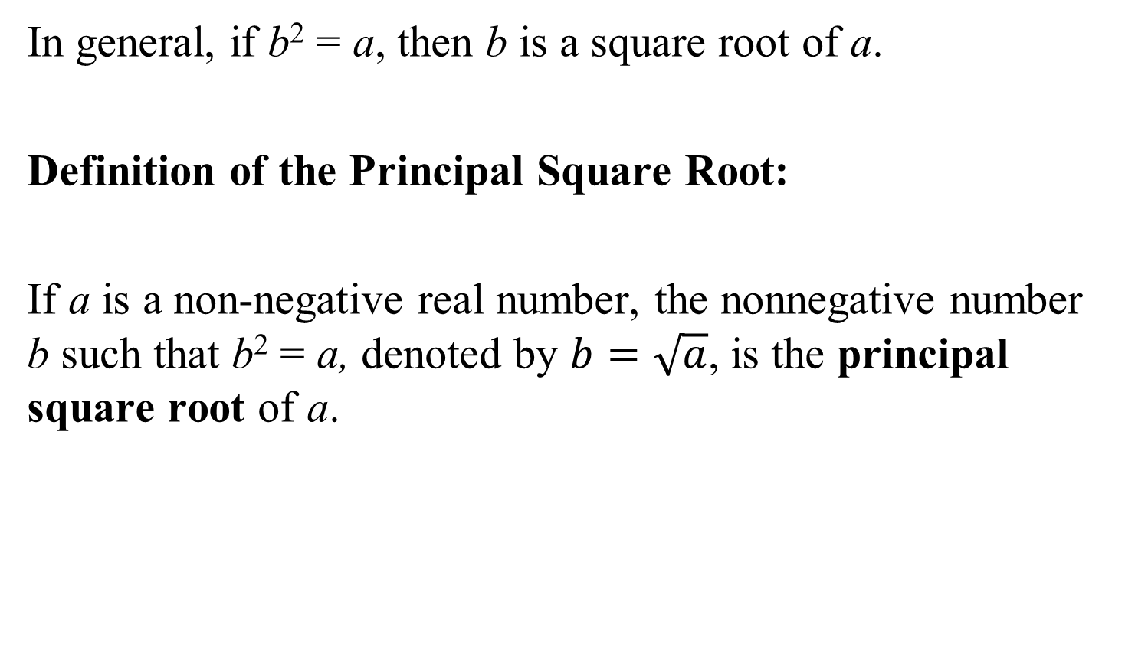
Definition of the Principal Square Root
In general, if b² = a, then b is a square root of a.
Definition of the Principal Square Root:
If a is a non-negative real number, the nonnegative number b such that b² = a, denoted by $b=\sqrt{a}$, is the principal square root of a.

Slide 4
Example 1: Evaluating Square Roots
Evaluate:
a. $\sqrt{81}$
b. $−\sqrt{9}$
c. $\sqrt{36+64}$
= 9
= –3
$$=\sqrt{100}$$
= 10

Slide 5
Simplifying Expressions of the Form$\sqrt{a^{2}}$
Simplifying $\sqrt{a^{2}}$
For any real number a,
$$\sqrt{a^{2}}= \left|a\right|$$
In words, the principal square root of a² is the absolute value of a.

Slide 6
The Product Rule for Square Roots
If a and b represent nonnegative real numbers, then
$\sqrt{ab}=\sqrt{a}∙\sqrt{b}$ and $\sqrt{a}∙\sqrt{b}= \sqrt{ab.}$

Slide 7
Example 2: Using the Product Rule to Simplify Square Roots
Simplify:
a. $\sqrt{75}$
b. $\sqrt{5x}∙\sqrt{10x}$
$$=\sqrt{25·3}$$
$$=\sqrt{25}\sqrt{3}$$
$$=5\sqrt{3}$$
$$=\sqrt{50x^{2}}$$
$$=\sqrt{25x^{2}·2}$$
$$=\sqrt{25}\sqrt{x^{2}}\sqrt{2}$$
$$=5x\sqrt{2}$$

Slide 8
The Quotient Rule for Square Roots
If a and b represent nonnegative real numbers and b ≠ 0, then
$\sqrt{\frac{a}{b}}= \frac{\sqrt{a}}{\sqrt{b}}$ and $\frac{\sqrt{a}}{\sqrt{b}}=\sqrt{\frac{a}{b}}.$

Slide 9
Example 3: Using the Quotient Rule to Simplify Square Roots
Simplify:
a.
b.
$$\sqrt{\frac{25}{16}}$$
$$=\frac{\sqrt{25}}{\sqrt{16}}$$
$$=\frac{5}{4}$$
$$\frac{\sqrt{150x^{3}}}{\sqrt{2x}}$$
$$=\sqrt{\frac{150x^{3}}{2x}}$$
$$=\sqrt{75x^{2}}$$
$$=\sqrt{25}\sqrt{x^{2}}\sqrt{3}$$
$$=5x\sqrt{3}$$

Slide 10
Adding and Subtracting Square Roots
Two or more square roots can be combined using the distributive property provided that they have the same radicand. Such radicals are called like radicals.

Slide 11
Example 4: Adding and Subtracting Like Radicals
Add or subtract as indicated:
a. $8\sqrt{13}+9\sqrt{13}$
b. $\sqrt{17x}−20\sqrt{17x}$
$$\left.= ( 8+9\right)\sqrt{13}$$
$$=17\sqrt{13}$$
$$\left.= ( 1−20\right)\sqrt{17x}$$
$$=−19\sqrt{17x}$$

Slide 12
Rationalizing Denominators
The process of rewriting a radical expression as an equivalent expression in which the denominator no longer contains any radicals is called rationalizing the denominator. If the denominator consists of the square root of a natural number that is not a perfect square, multiply the numerator and the denominator by the smallest number that produces the square root of a perfect square in the denominator.

Slide 13
Rationalizing Denominators (continued)
Radical expressions that involve the sum and difference of the same two terms are called conjugates. Thus,
$\sqrt{a}+\sqrt{b}$ and $\sqrt{a}−\sqrt{b}$ are conjugates. If the denominator contains two terms with one or more square roots, multiply the numerator and denominator by the conjugate of the denominator.

Slide 14
Example 6: Rationalizing Denominators
Rationalize the denominator:
$$\frac{5}{\sqrt{3}}$$
$$=\frac{5}{\sqrt{3}}·\frac{\sqrt{3}}{\sqrt{3}}$$
$$=\frac{5\sqrt{3}}{\sqrt{9}}$$
$$=\frac{5\sqrt{3}}{3}$$

Slide 15
Example 7: Rationalizing Denominators
Rationalize the denominator:
$$\frac{8}{4+\sqrt{5}}$$
$$=\frac{8}{4+\sqrt{5}}·\frac{4−\sqrt{5}}{4−\sqrt{5}}$$
$$=\frac{8\left(4−\sqrt{5}\right)}{4^{2}−{\left(\sqrt{5}\right)}^{2}}$$
$$=\frac{8\left(4−\sqrt{5}\right)}{16−5}$$
$$=\frac{32−8\sqrt{5}}{11}$$

Slide 16
Definition of the Principal nth Root of a Real Number
$\sqrt[n]{a}=b$ means that b^{n} = a.
If n, the index, is even, then a is nonnegative (a ≥ 0) and b is also nonnegative (b ≥ 0). If n is odd, a and b can be any real numbers.
The symbol $\sqrt[n]{}$ is called a radical and the expression under the radical is called the radicand.

Slide 17

Finding nth Roots of Perfect nth Powers
If n is odd,$\sqrt[n]{a^{n}}=a$.
If n is even,$\sqrt[n]{a^{n}}=\left|a\right|$.

Slide 18
The Product and Quotient Rules for nth Roots
For all real numbers a and b, where the indicated roots represent real numbers,
$$\sqrt[n]{ab}=\sqrt[n]{a}·\sqrt[n]{b} and \sqrt[n]{a}·\sqrt[n]{b}=\sqrt[n]{ab}$$
$\sqrt[n]{\frac{a}{b}}=\frac{\sqrt[n]{a}}{\sqrt[n]{b}}, b≠0 and \frac{\sqrt[n]{a}}{\sqrt[n]{b}}=\sqrt[n]{\frac{a}{b}},b≠0$.

Slide 19
Example 8: Simplifying, Multiplying, and Dividing Higher Roots
Simplify:
a. $\sqrt[3]{40}$
b.
$$=\sqrt[3]{8}·\sqrt[3]{5}$$
$$=2\sqrt[3]{5}$$
$$\sqrt[3]{\frac{125}{27}}$$
$$=\frac{\sqrt[3]{125}}{\sqrt[3]{27}}$$
$$=\frac{5}{3}$$

Slide 20
The Definition of $a^{\frac{1}{n}}$
If $\sqrt[n]{a}$ represents a real number, where $n ≥2$ is an integer, then
$$a^{\frac{1}{n}}= \sqrt[n]{a}.$$
Furthermore,
$$a^{−\frac{1}{n}}=\frac{1}{a^{\frac{1}{n}}}=\frac{1}{\sqrt[n]{a}},a≠0.$$

Slide 21
Example 10: Using the Definition of $a^{\frac{1}{n}}$
Simplify:
a. ${25}^{\frac{1}{2}}$
b. $−{81}^{\frac{1}{4}}$
c. ${27}^{− \frac{1}{3}}$
$$=\sqrt{25}$$
$$=5$$
$$=−(\sqrt[4]{81})$$
$$=−3$$
$$=\frac{1}{{27}^{\frac{1}{3}}}=\frac{1}{\sqrt[3]{27}}$$
$$=\frac{1}{3}$$

Slide 22
The Definition of $a^{\frac{m}{n}}$
If $\sqrt[n]{a}$ represents a real number and $\frac{m}{n}$ is a positive number, $n ≥2$, then
Also,
Furthermore, if $a^{−\frac{m}{n}}$ is a nonzero real number, then
$$a^{−\frac{m}{n}}=\frac{1}{a^{\frac{m}{n}}}.$$
$a^{\frac{m}{n}}={\left(\sqrt[n]{a}\right)}^{m}$.
$a^{\frac{m}{n}}=\sqrt[n]{a^{m}}$.

Slide 23
Example 11: Using the definition of $a^{\frac{m}{n}}$
Simplify: ${27}^{\frac{4}{3}}$
$${27}^{\frac{4}{3}}={\left(\sqrt[3]{27}\right)}^{4}$$
$$=3^{4}$$
$$=81$$

Slide 24
Example 12: Simplifying Expressions with Rational Exponents
Simplify using properties of exponents:
$$\left(2x^{\frac{4}{3}}\right)\left(5x^{\frac{8}{3}}\right)$$
$$=2·5·x^{\frac{4}{3}}·x^{\frac{8}{3}}$$
$$=10x^{\frac{4+8}{3}}$$
$$=10x^{\frac{12}{3}}$$
$$=10x^{4}$$

